Slide 2
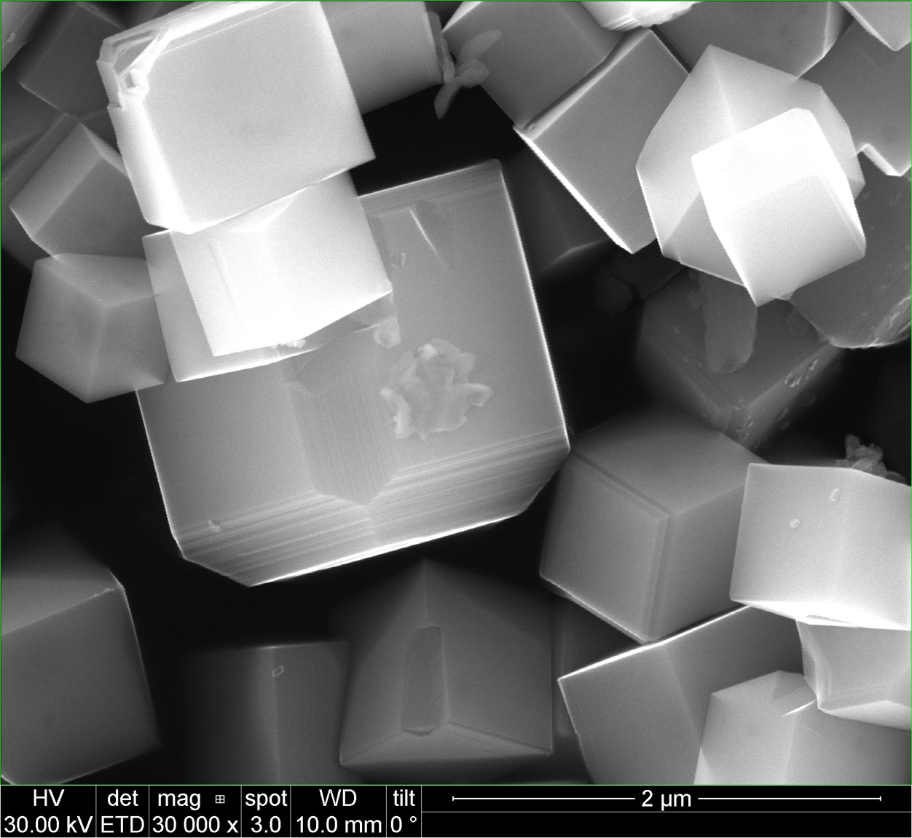
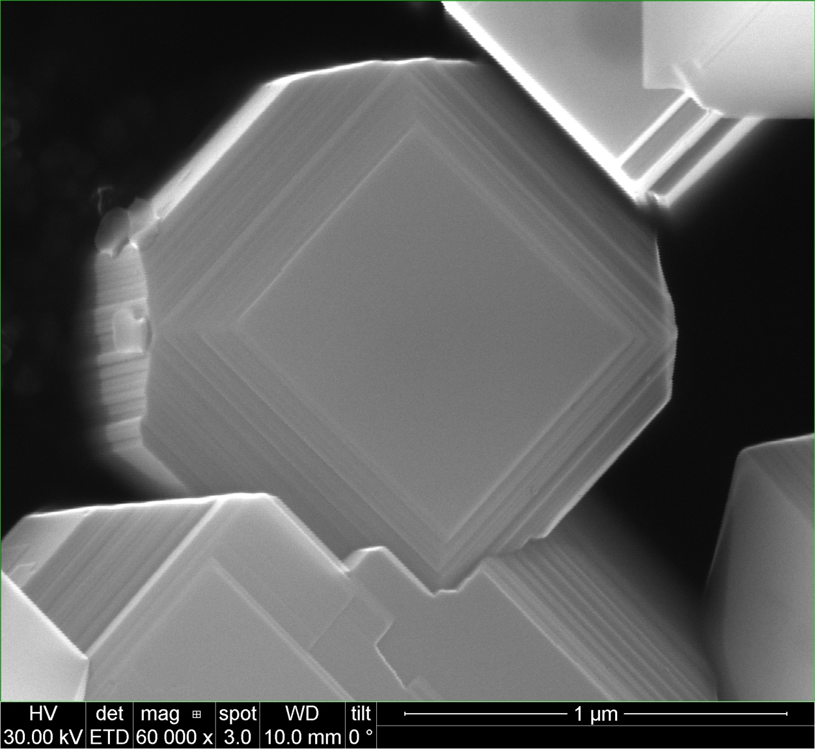
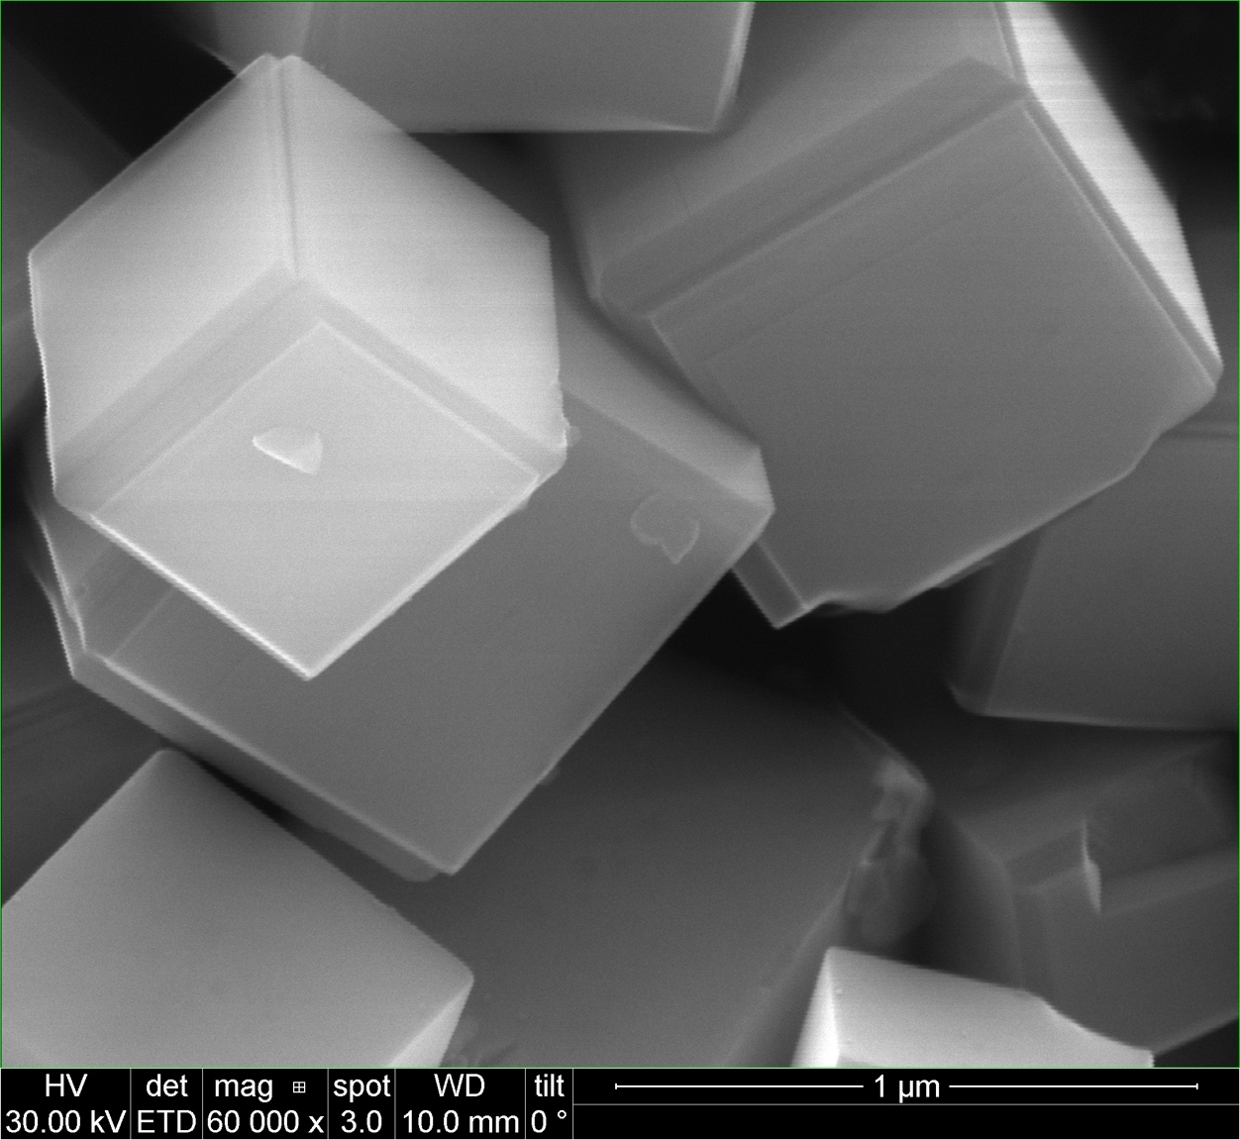
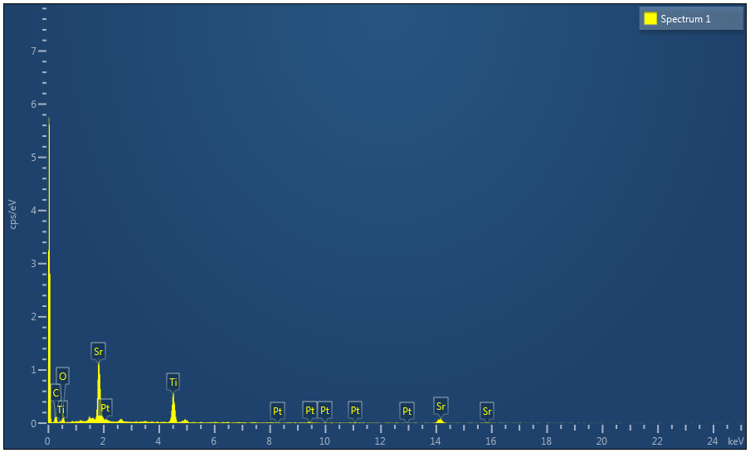
Undoped STO – Flux treat in Pt crucible
Spectrum 1 | Atomic %
O | 45.24
Ti | 24.75
Sr | 29.21
Pt | 0.80
Total | 100.00

Slide 3
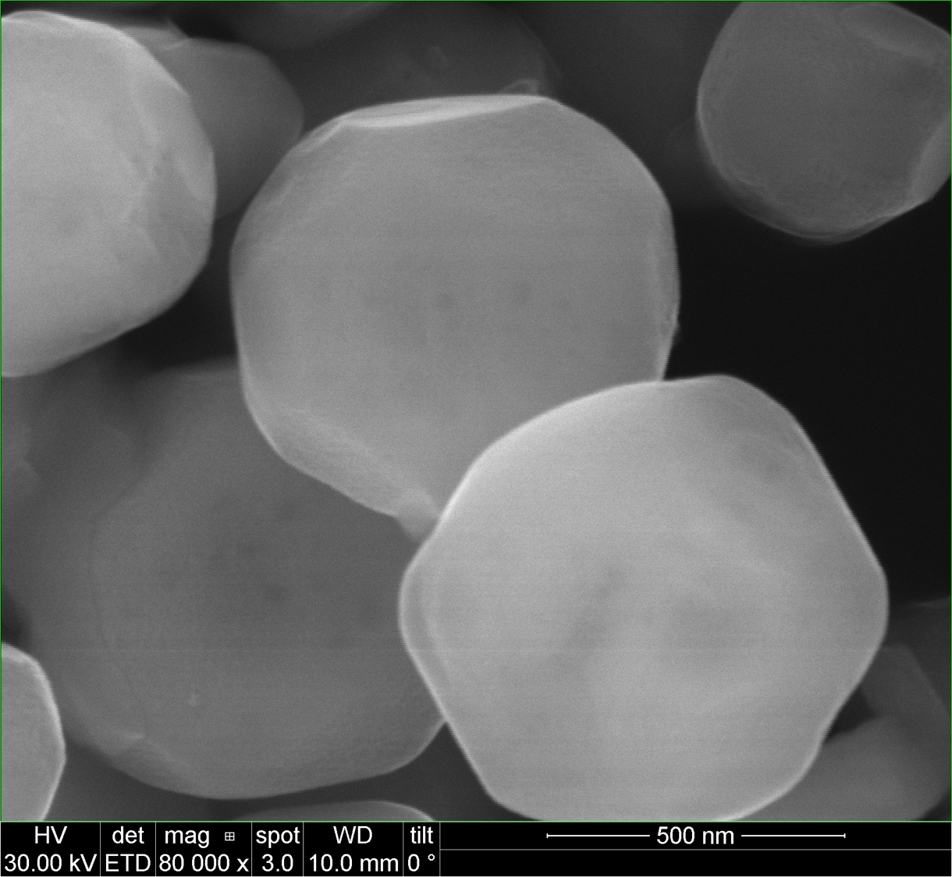
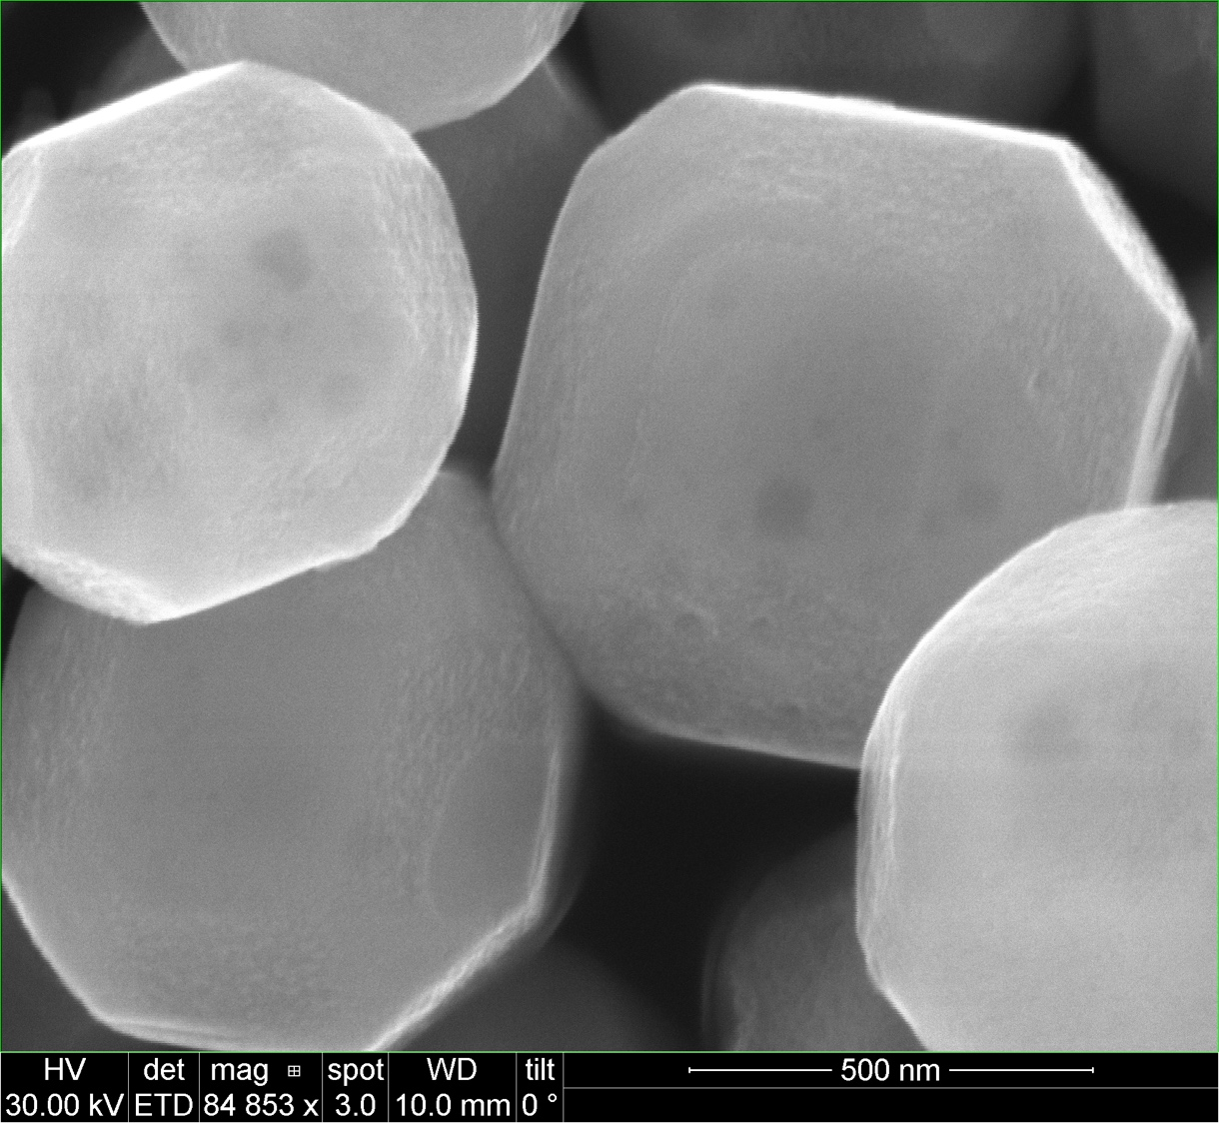
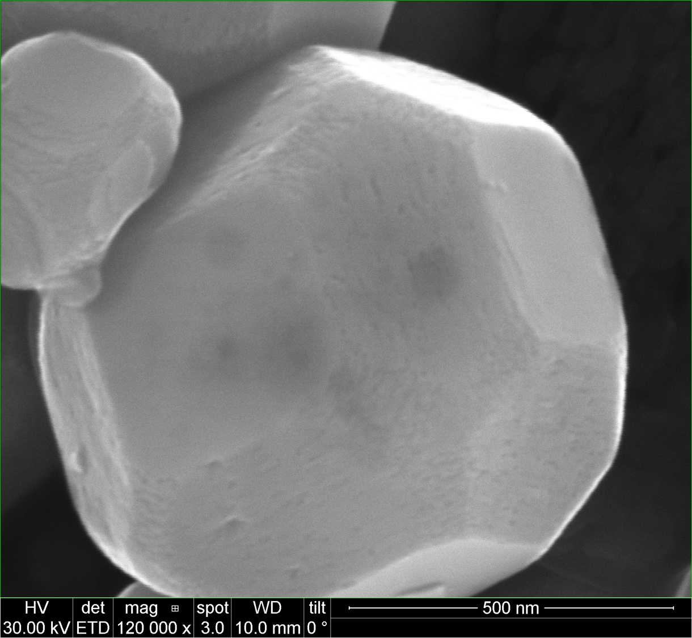
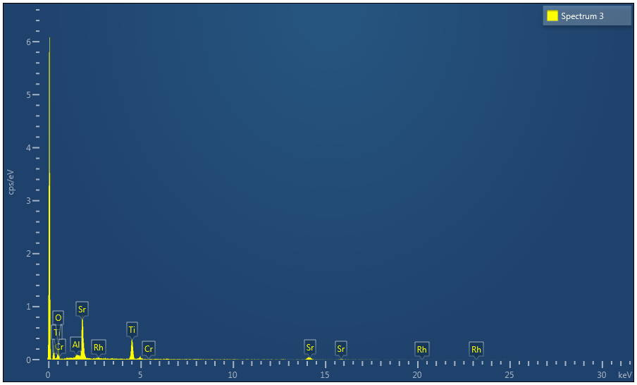
Undoped STO – Flux treat in Al crucible
Spectrum 3 | Atomic %
O | 58.76
Al | 1.86
Ti | 21.04
Cr | 0.00
Sr | 17.65
Rh | 0.69
Total | 100.00

Slide 4
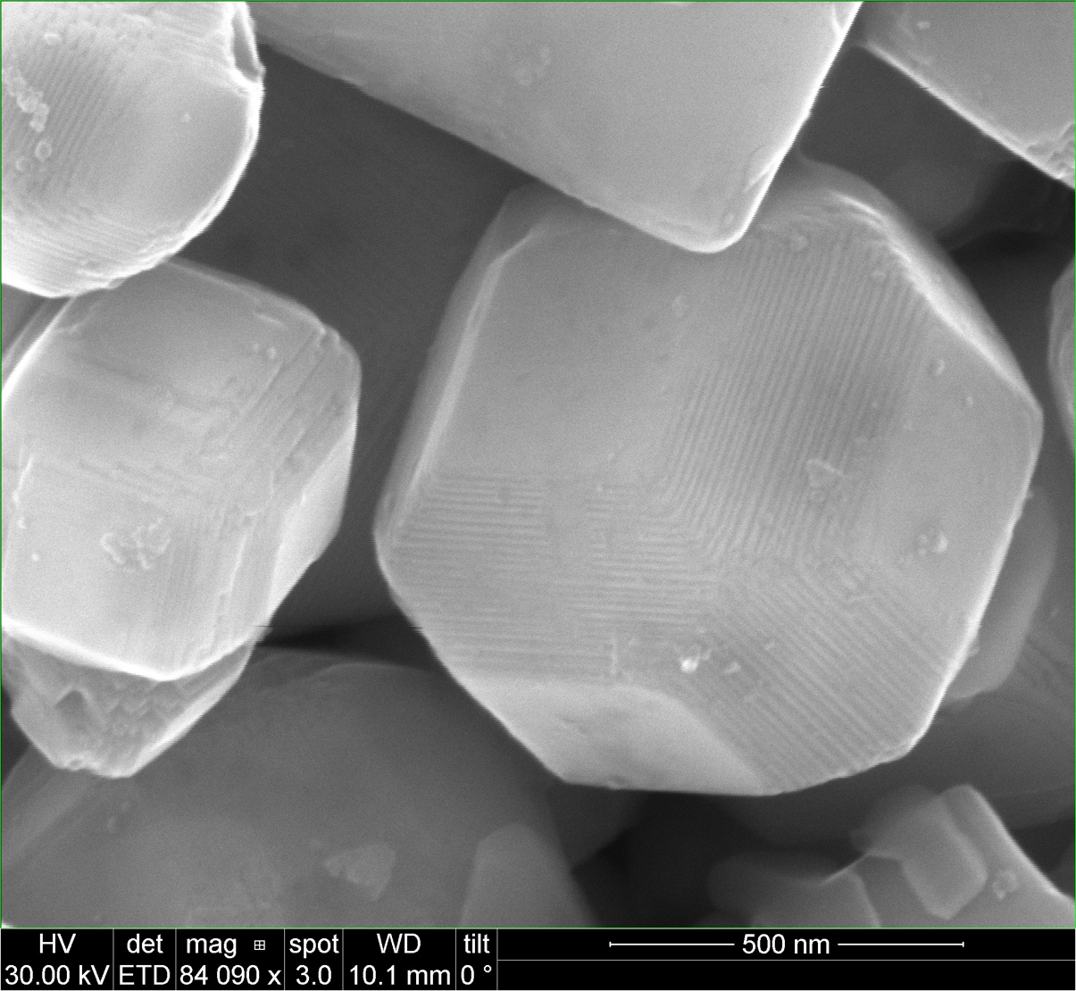
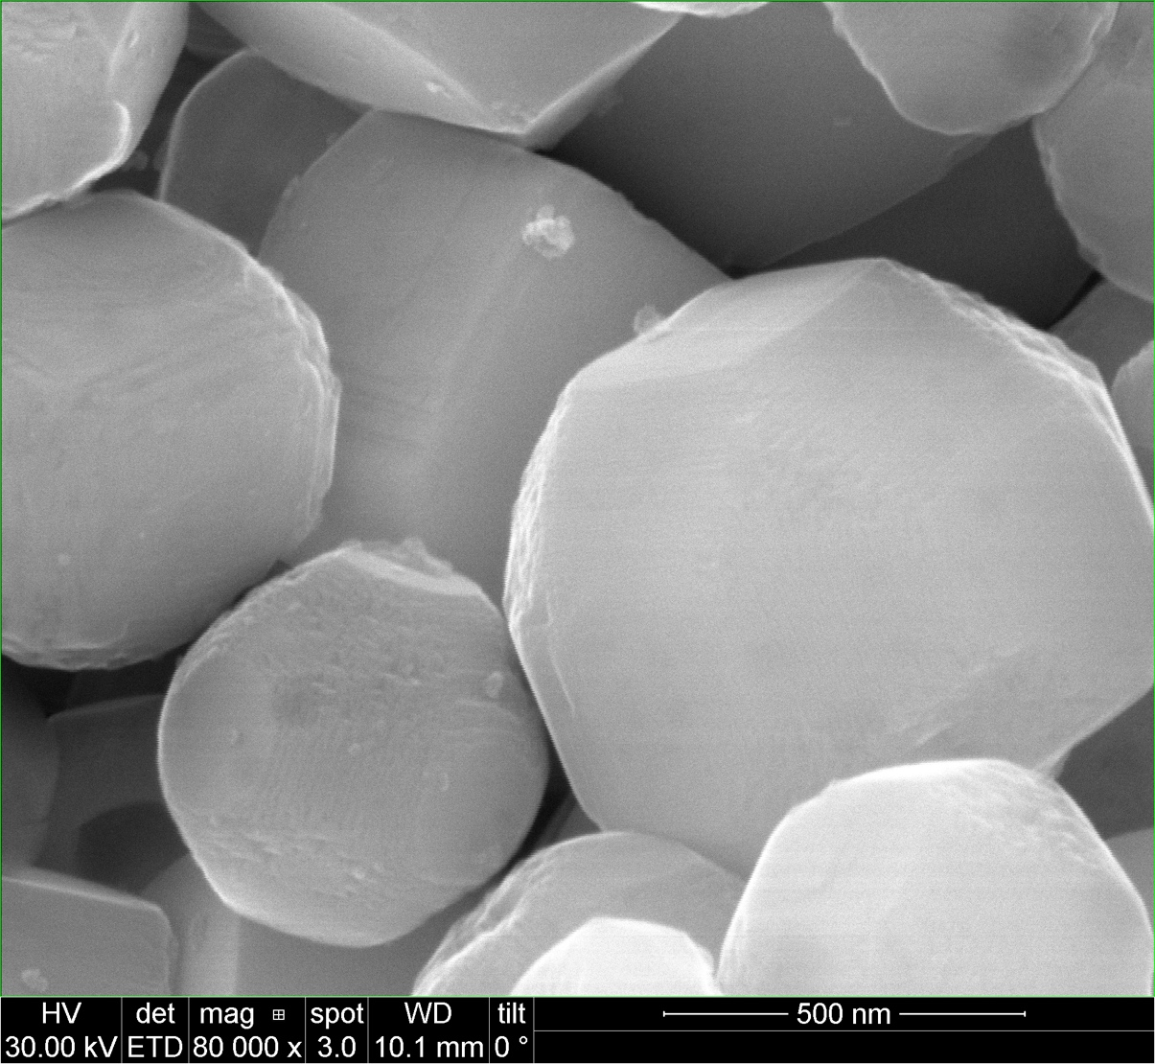
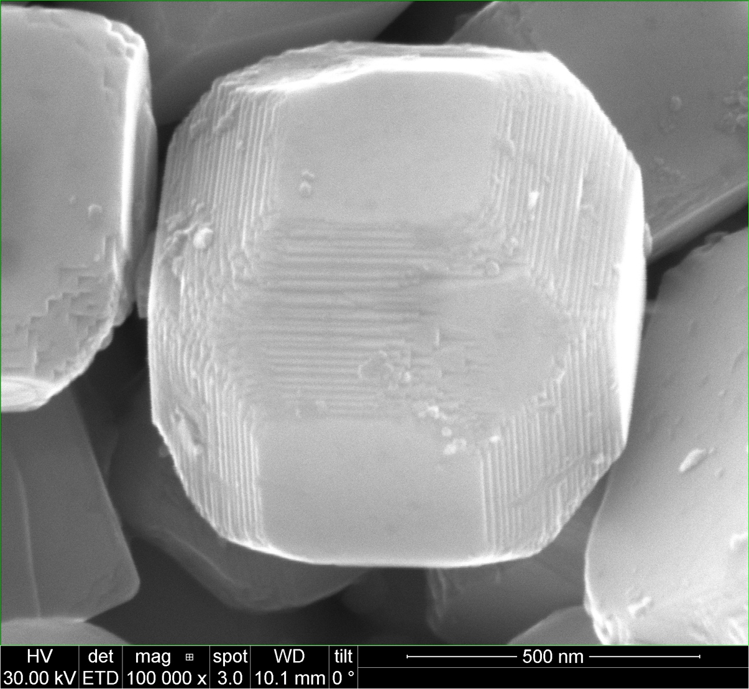
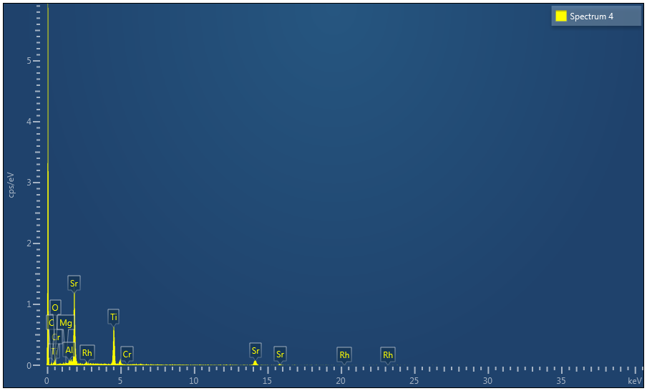
Undoped STO – Flux treat in Mg crucible
Spectrum 4 | Atomic %
O | 45.46
Mg | 0.68
Al | 1.22
Ti | 25.56
Cr | 0.01
Sr | 27.06
Rh | 0.00
Total | 100.00

Slide 5
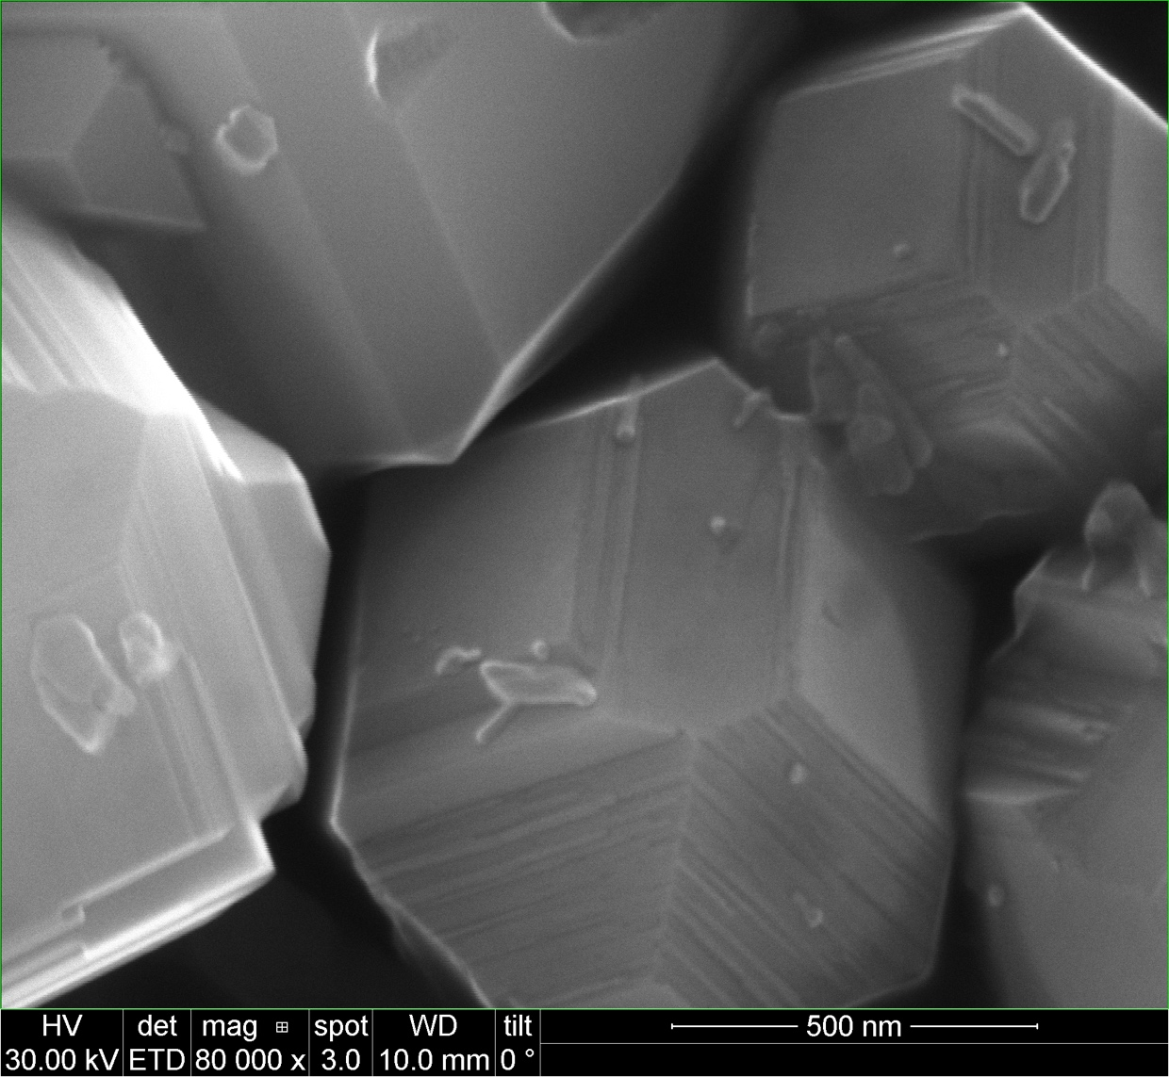
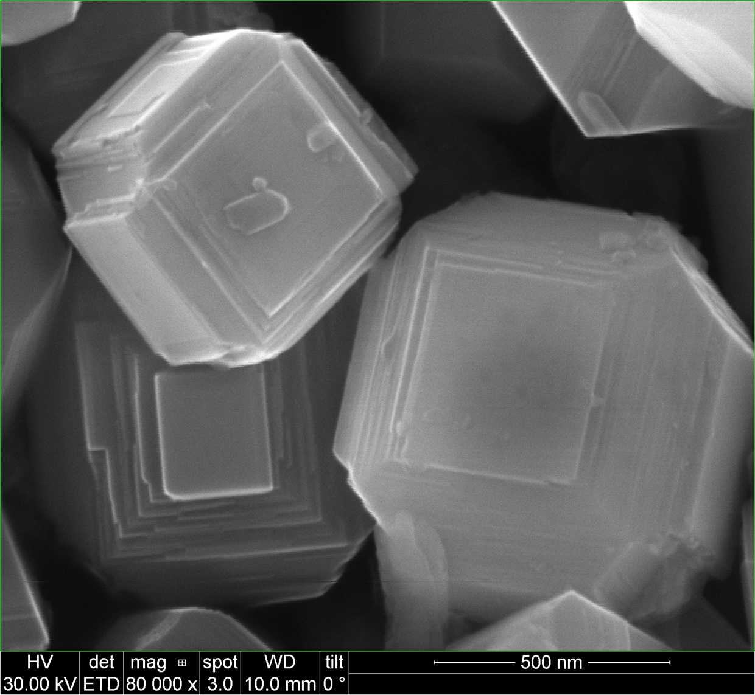
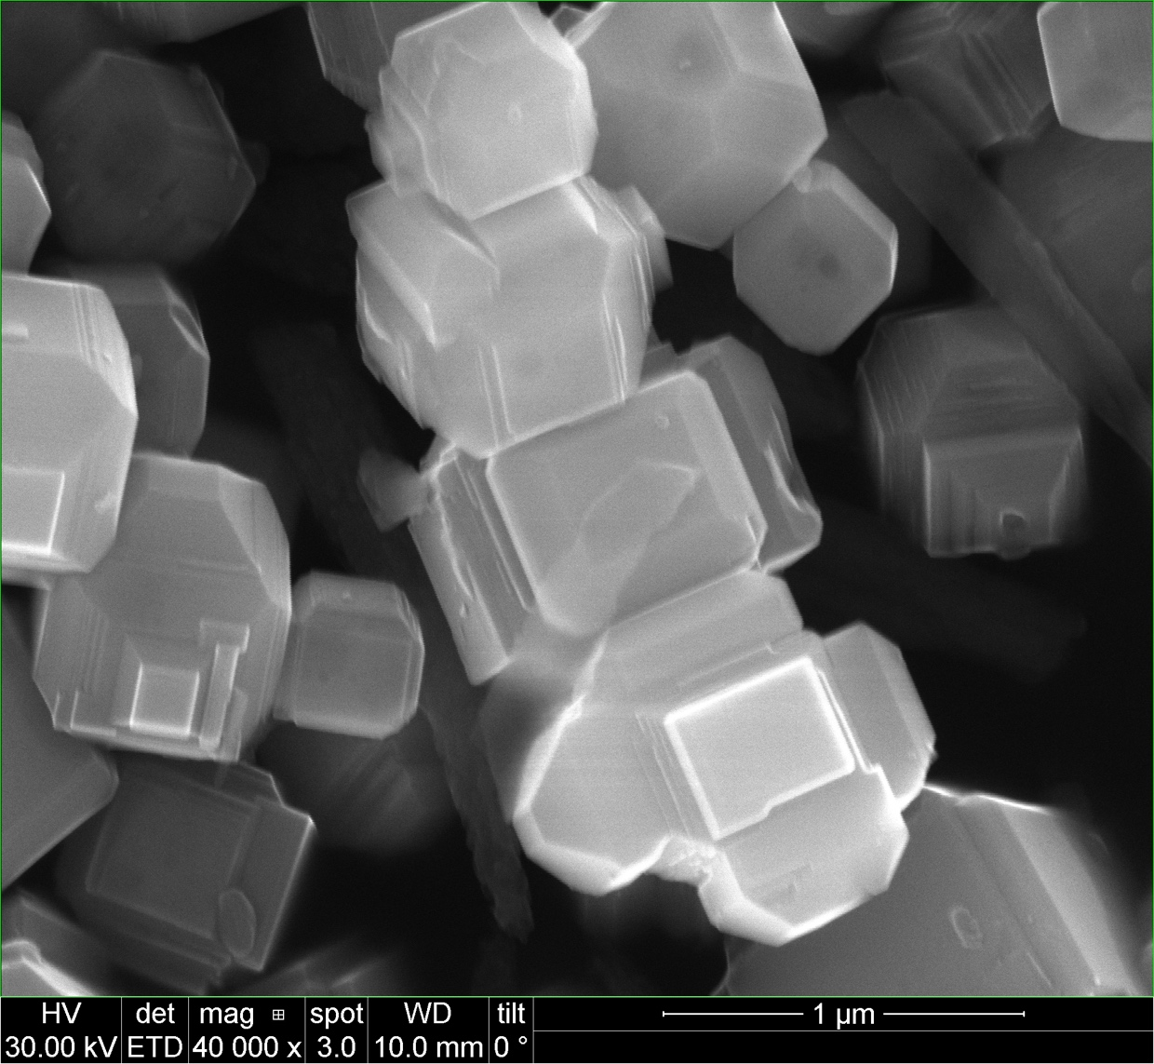

Al1% STO – Flux treat in Pt crucible
Spectrum 5 | Atomic %
O | 60.75
Al | 1.36
Cl | 3.26
Ti | 16.87
Cr | 0.19
Sr | 16.78
Rh | 0.00
Pt | 0.80
Total | 100.00

Slide 6
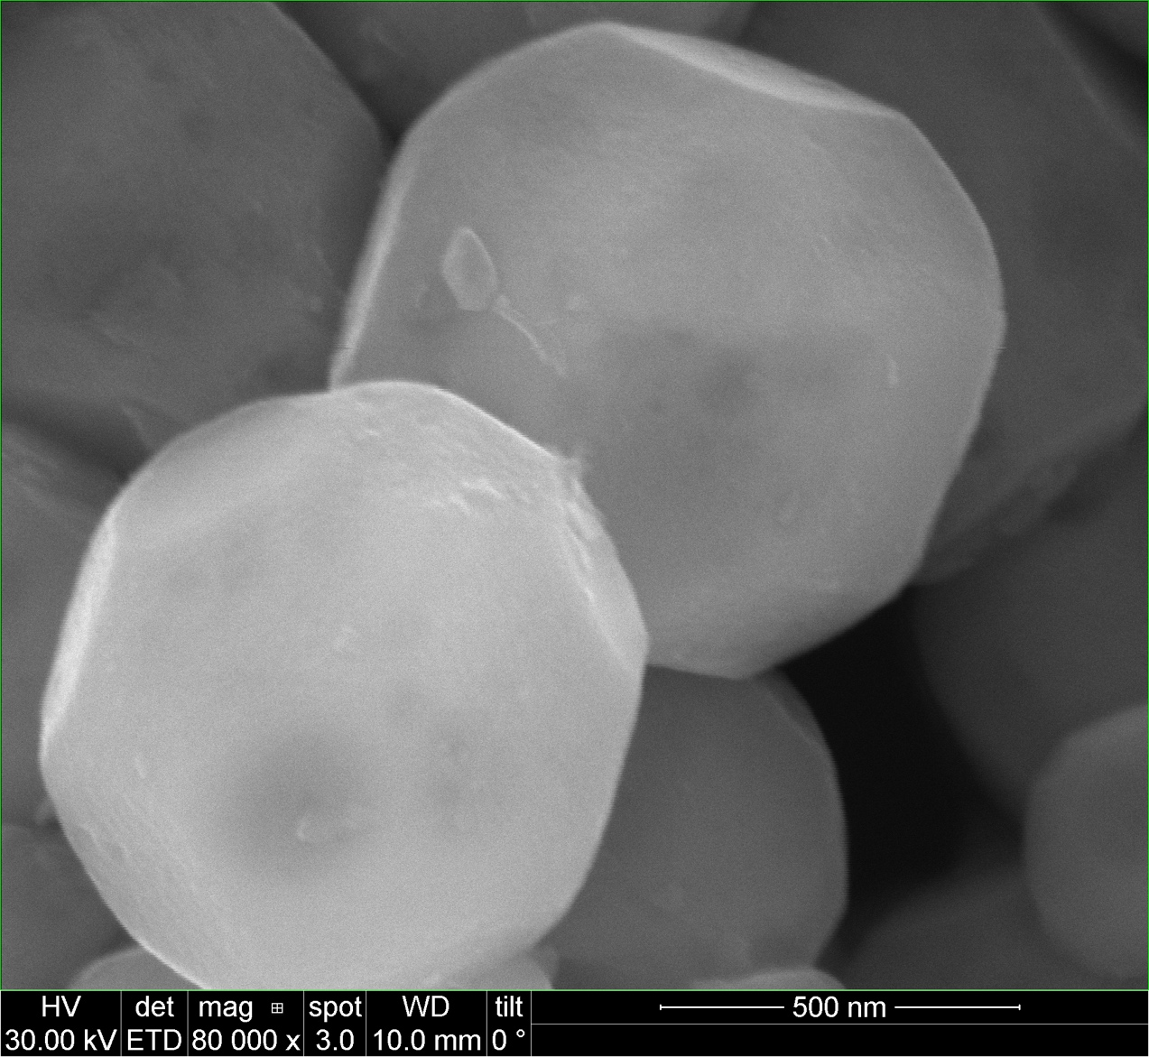
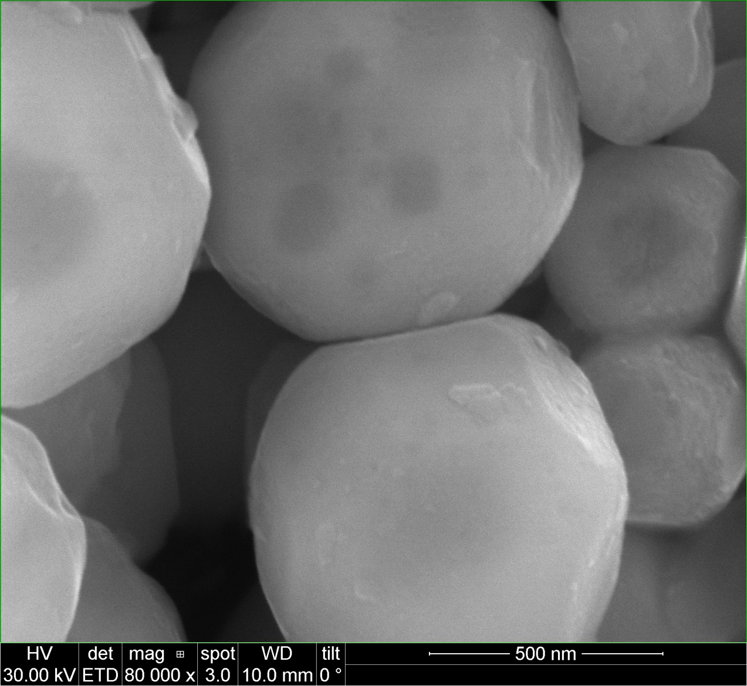
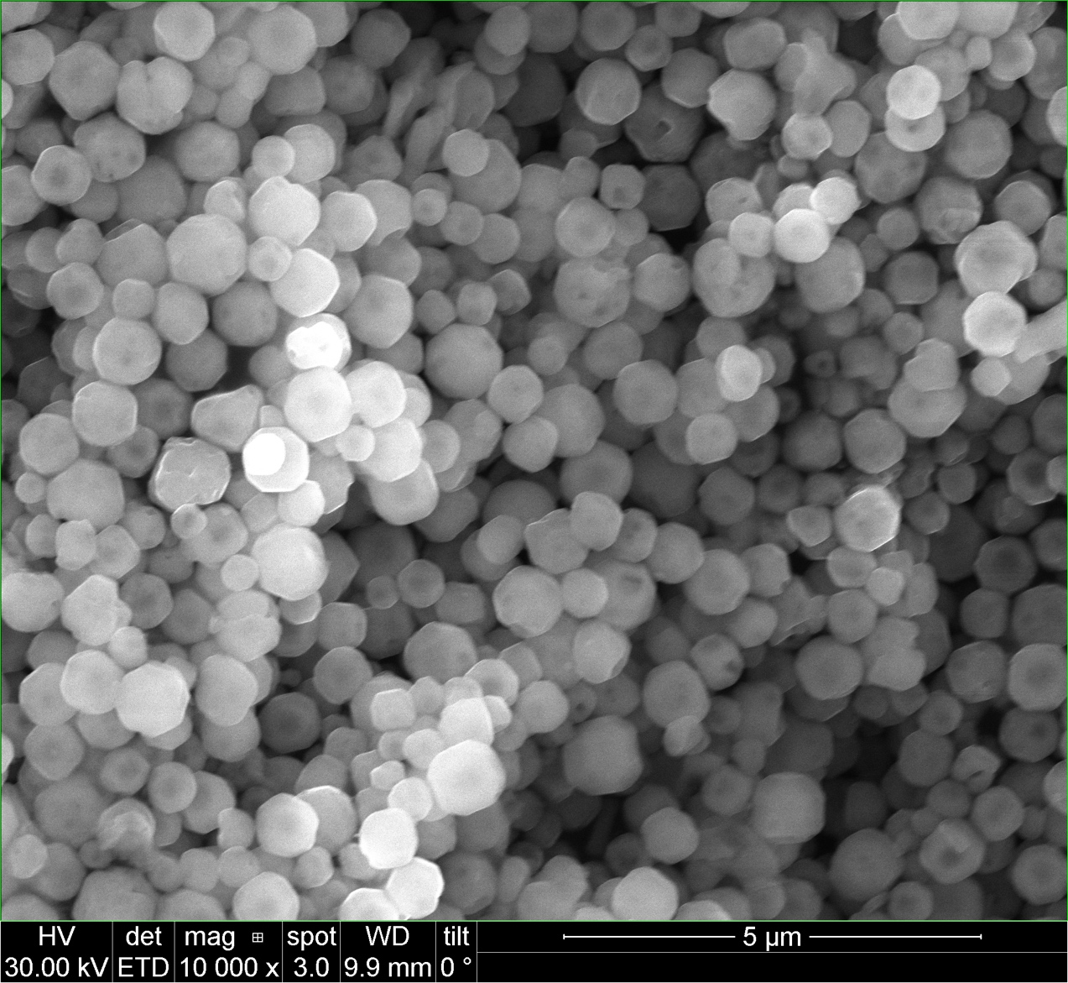
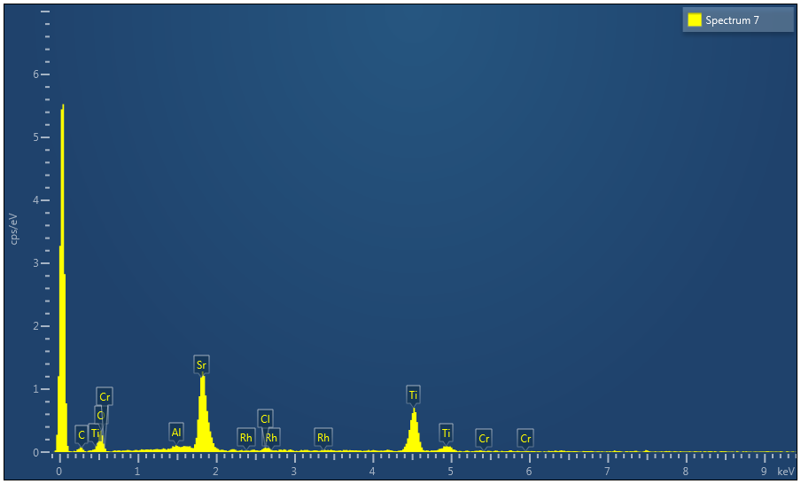
Al1% STO – Flux treat in Al crucible
Spectrum 7 | Atomic %
O | 50.99
Al | 1.35
Cl | 1.61
Ti | 22.86
Cr | 0.09
Sr | 22.86
Rh | 0.24
Total | 100.00

Slide 7
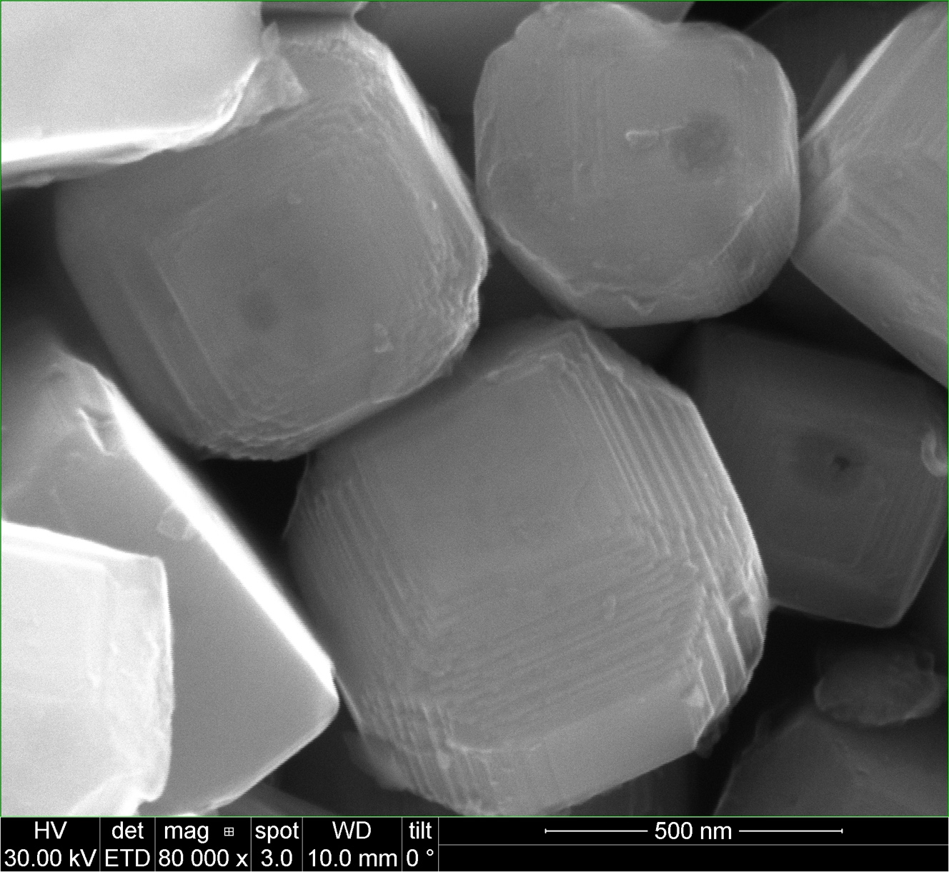
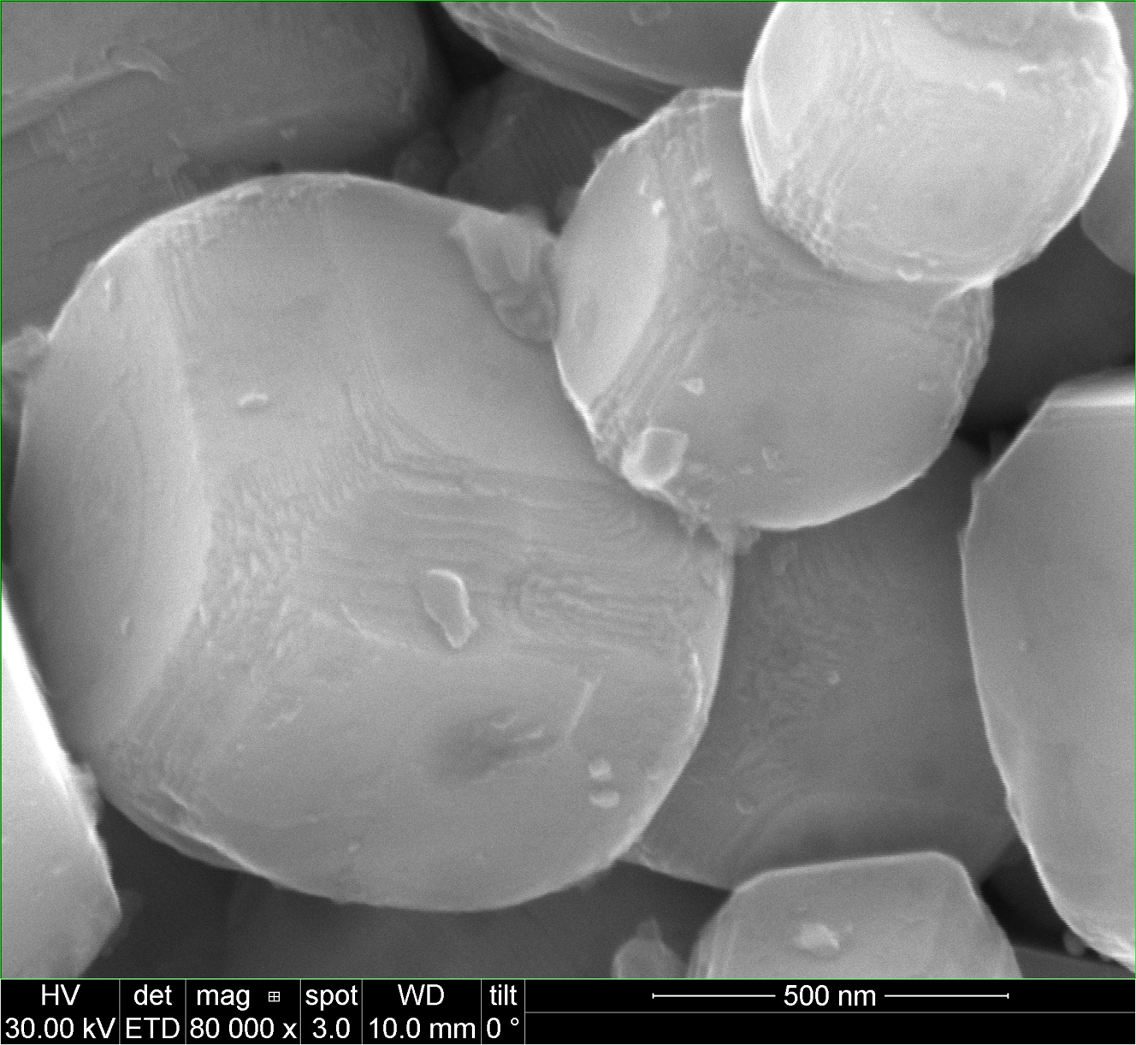
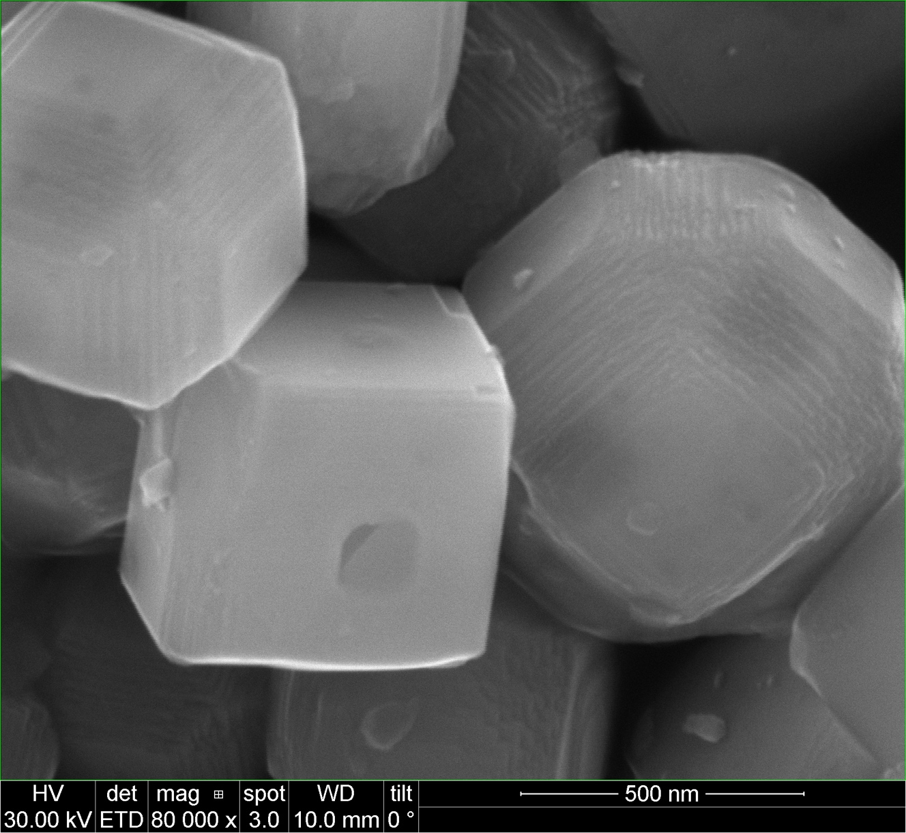
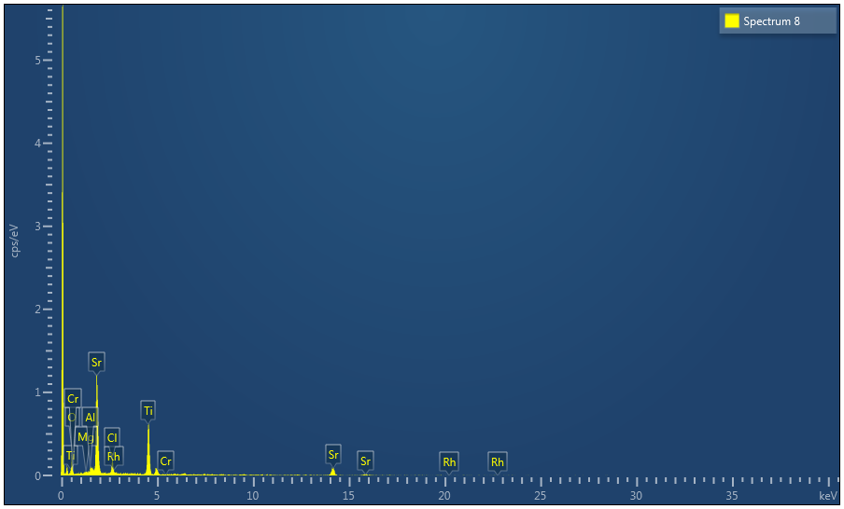
Al1% STO – Flux treat in Mg crucible
Spectrum 8 | Atomic %
O | 41.66
Mg | 0.06
Al | 1.59
Cl | 5.57
Ti | 23.35
Cr | 0.00
Sr | 27.54
Rh | 0.22
Total | 100.00

Slide 8
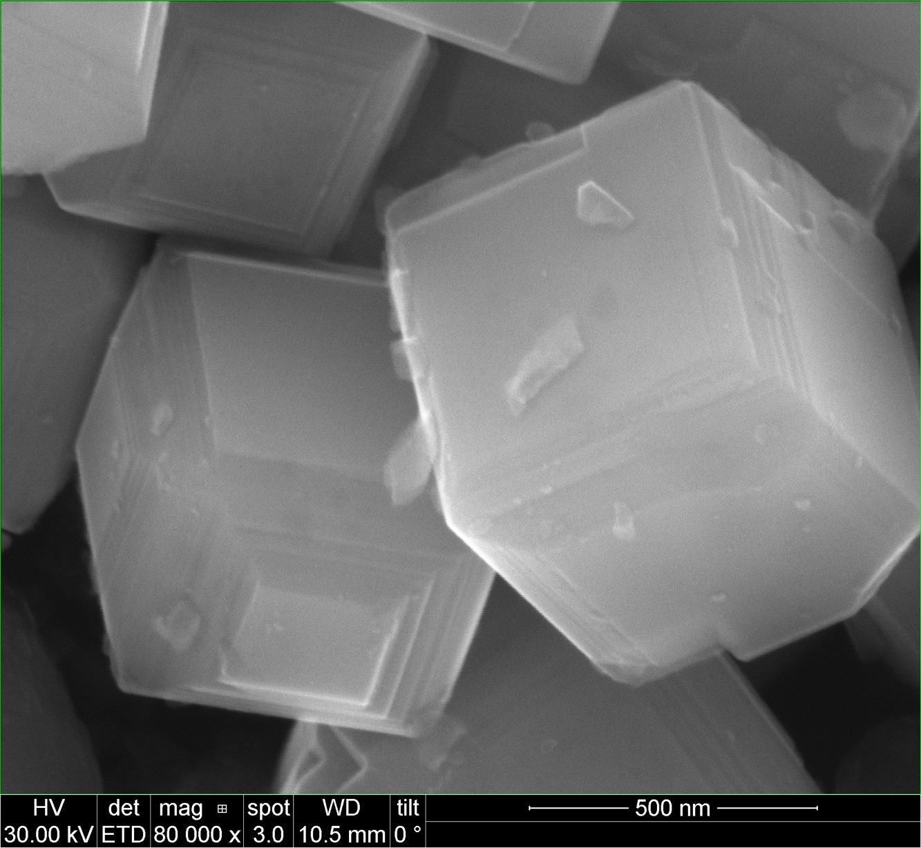
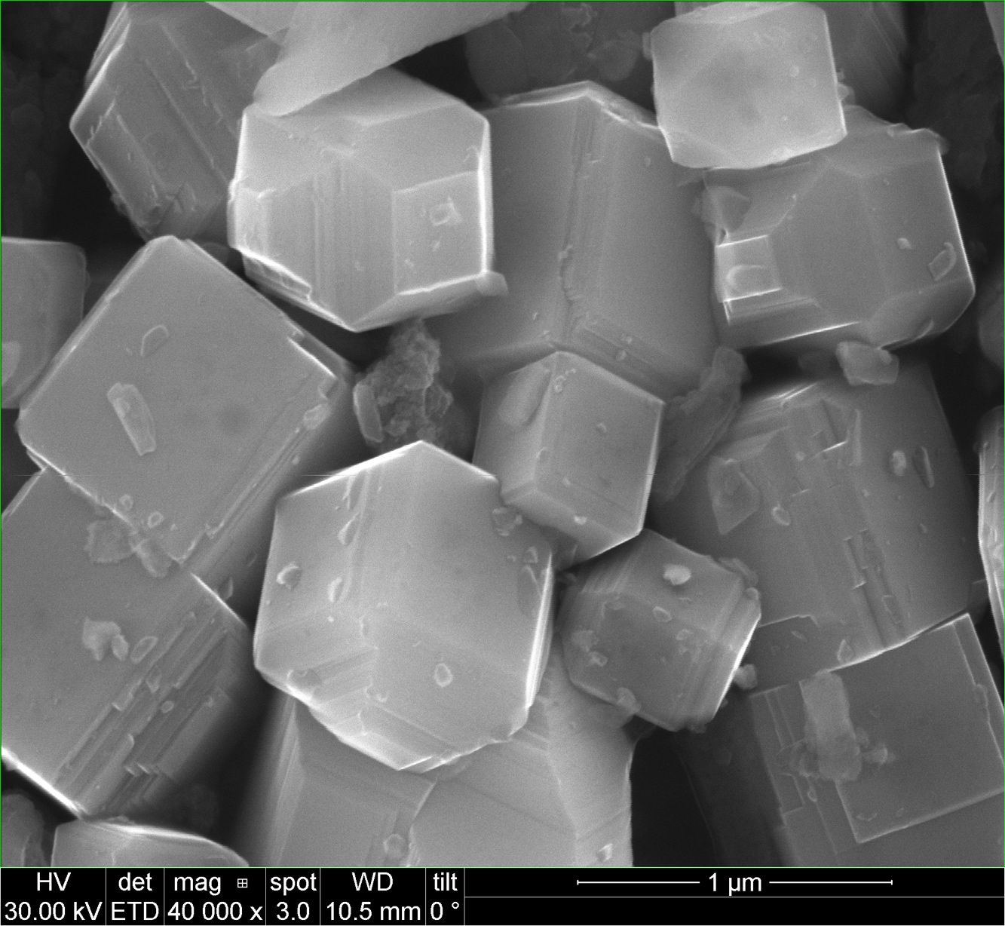
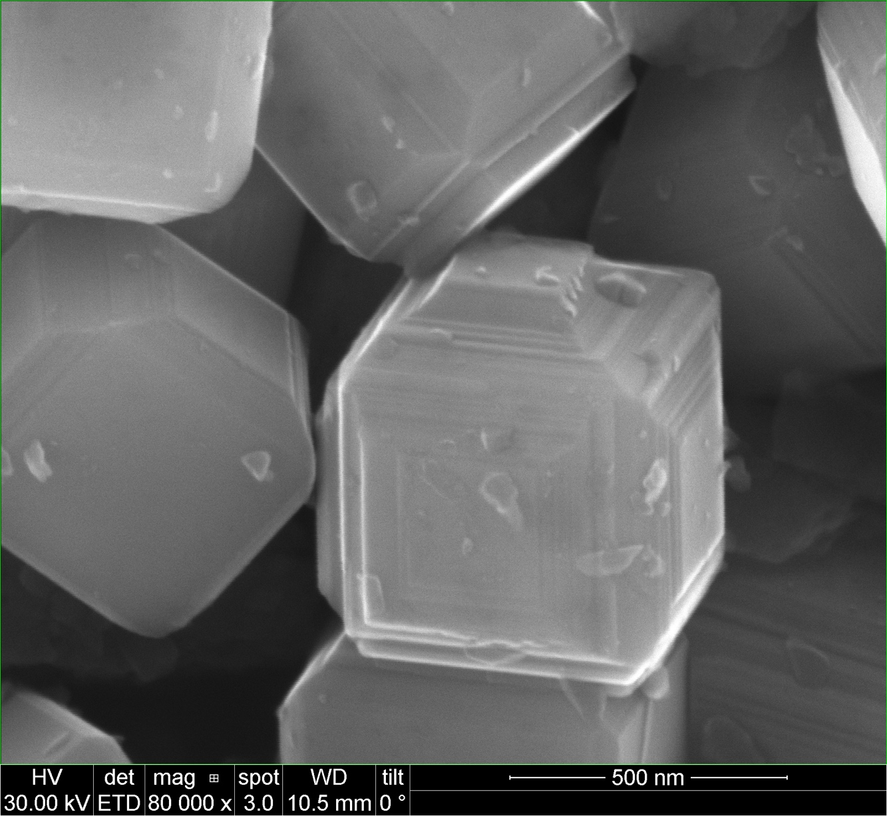
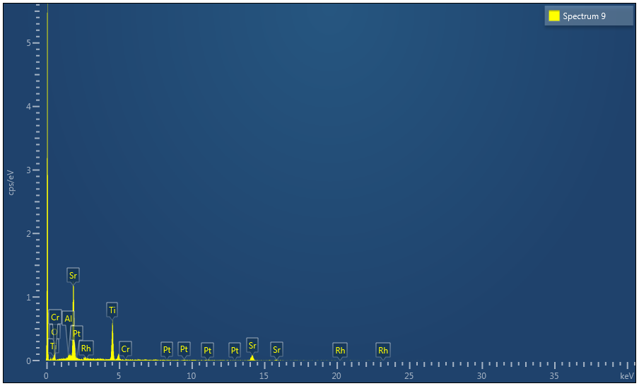
Al2% STO – Flux treat in Pt crucible
Spectrum 9 | Atomic %
O | 48.63
Al | 1.47
Ti | 23.27
Cr | 0.19
Sr | 26.05
Rh | 0.00
Pt | 0.39
Total | 100.00

Slide 9
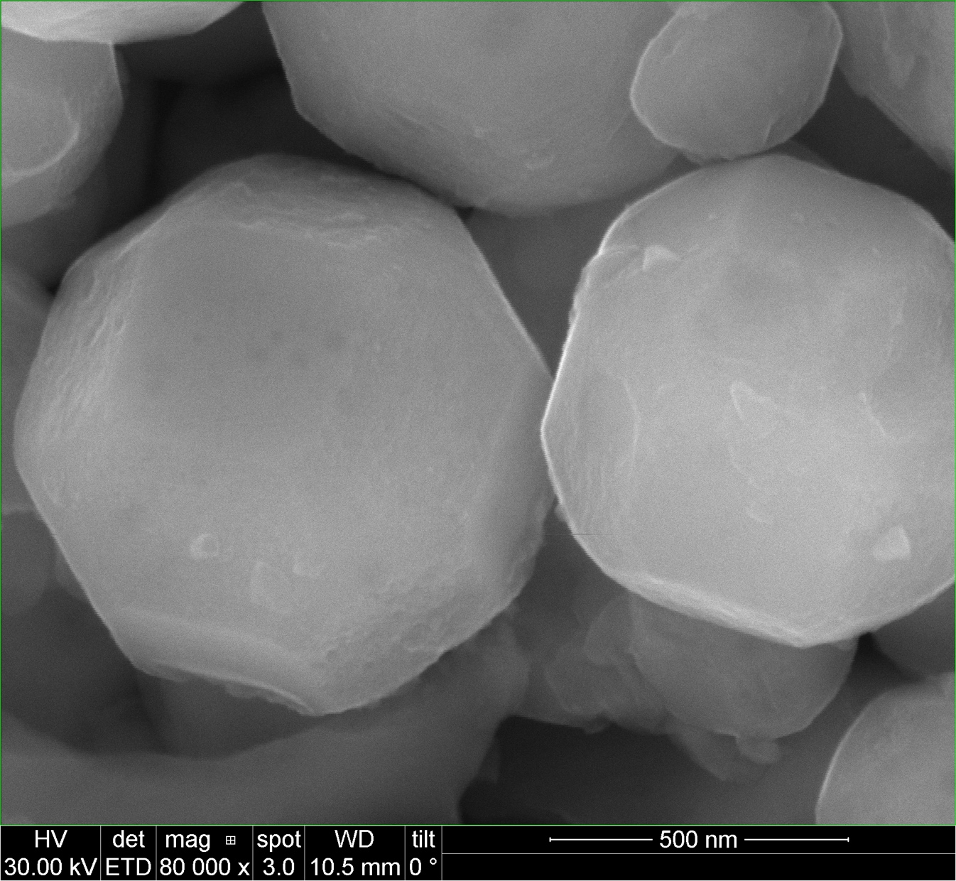
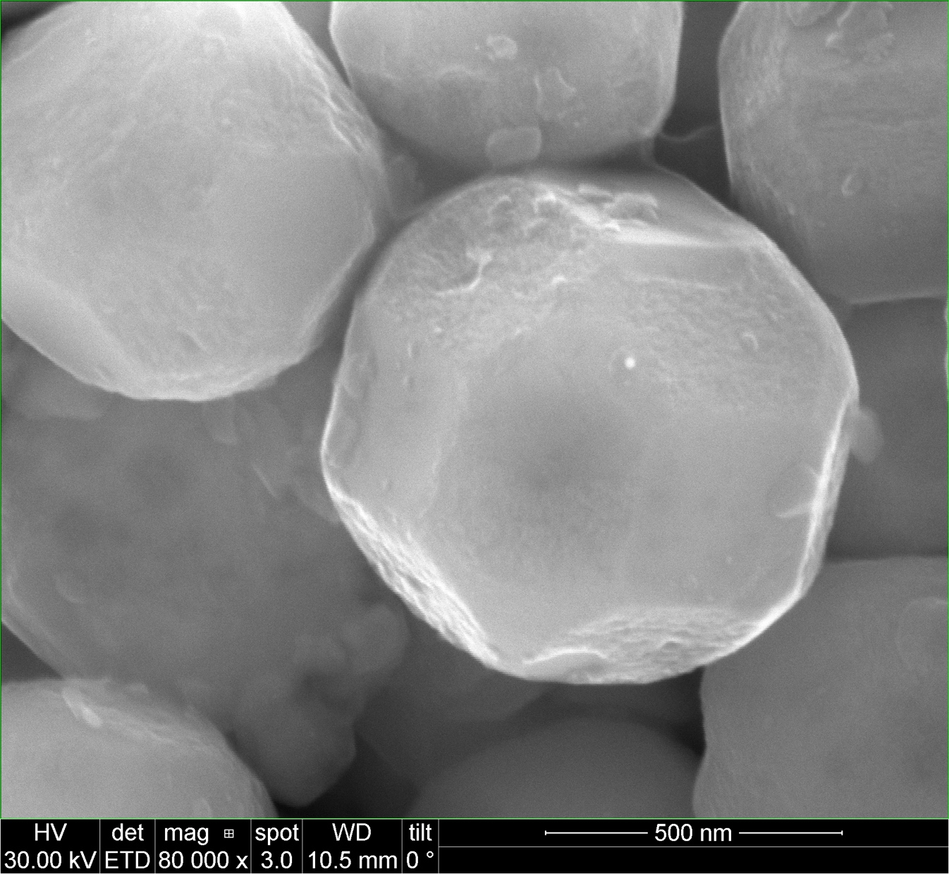
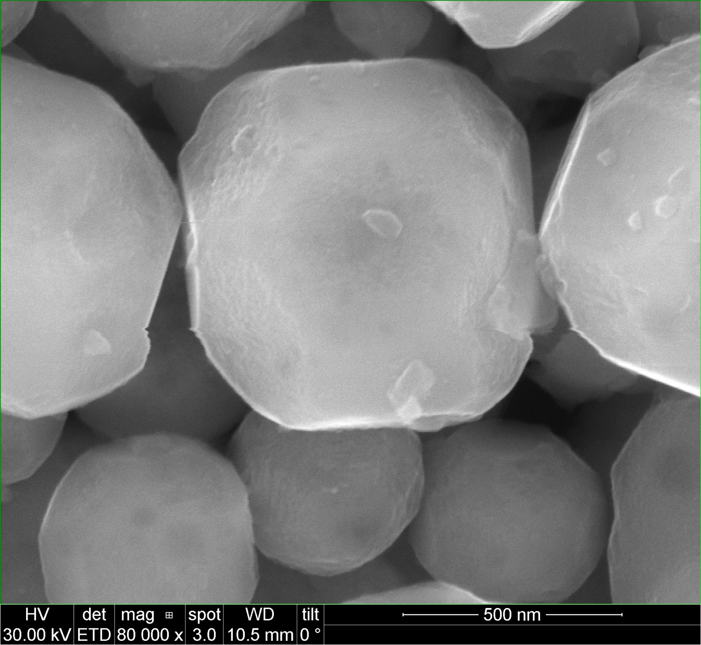

Al2% STO – Flux treat in Al crucible
Spectrum 10 | Atomic %
O | 43.05
Al | 2.10
Cl | 2.25
Ti | 25.94
Cr | 0.00
Sr | 26.66
Rh | 0.00
Total | 100.00

Slide 10
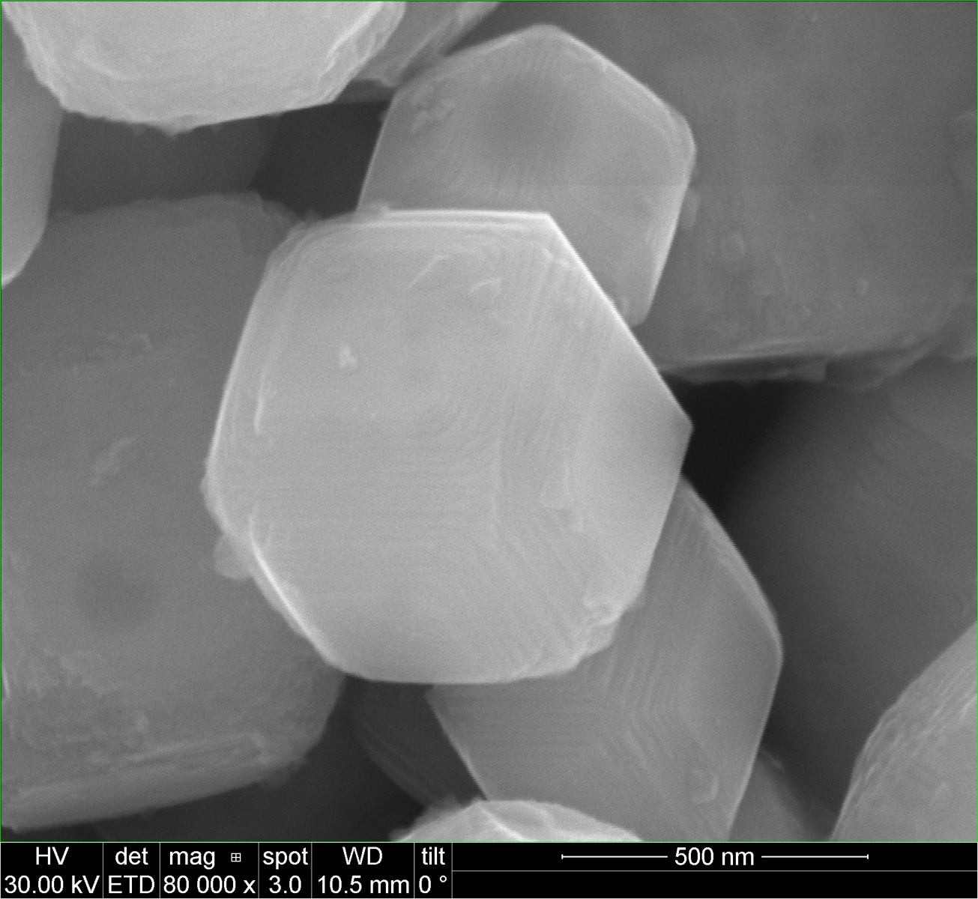
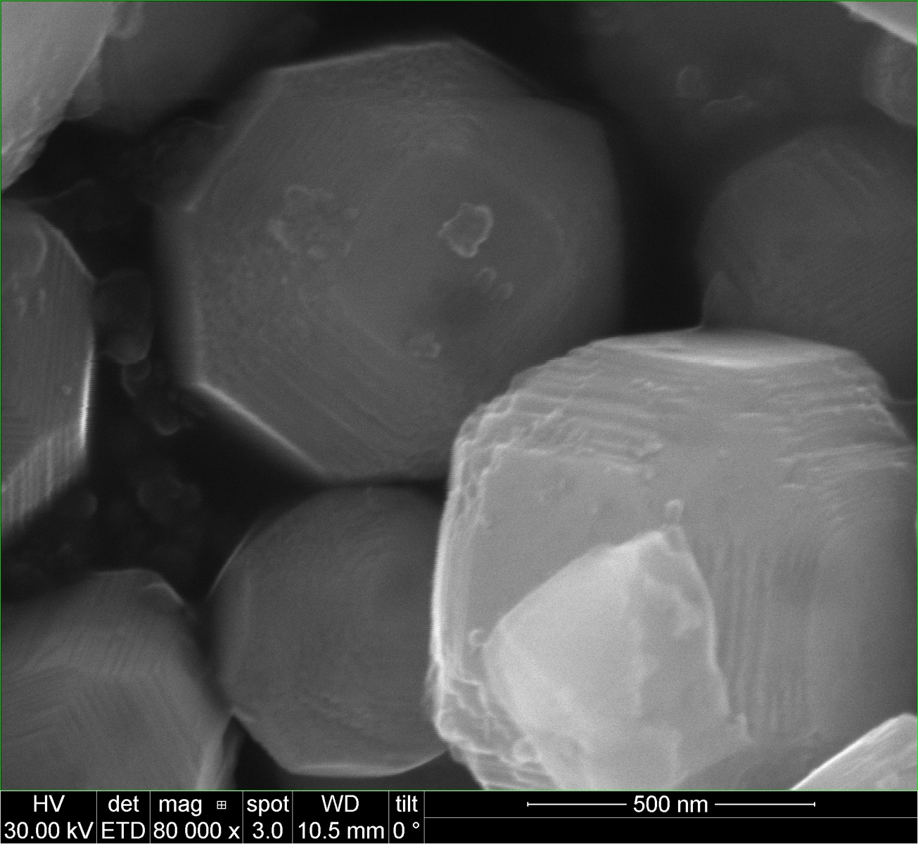
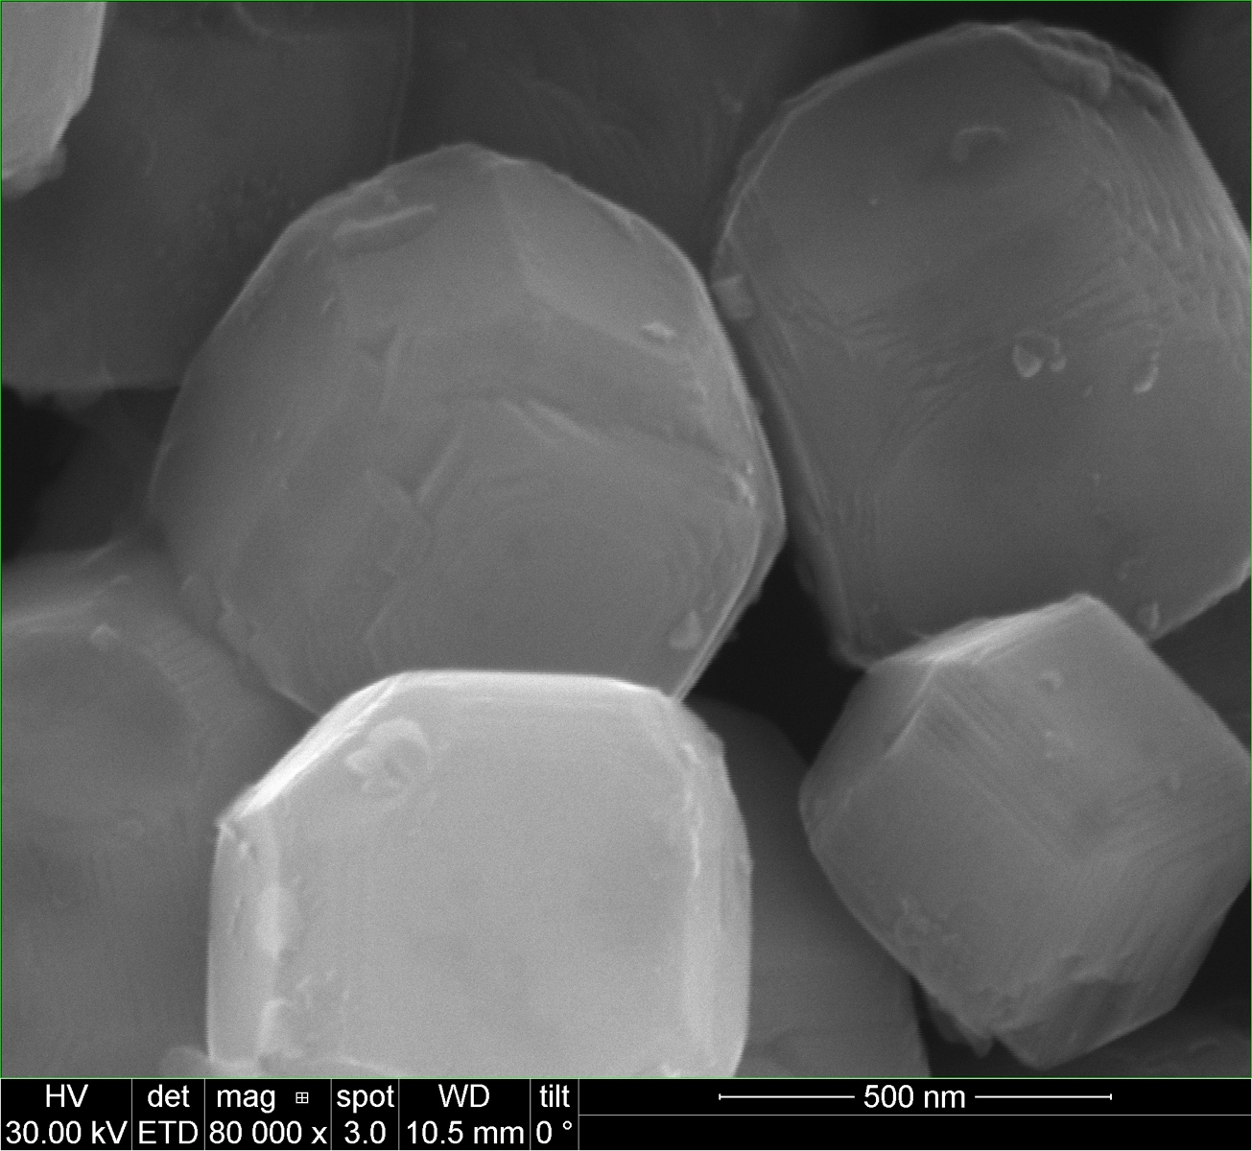
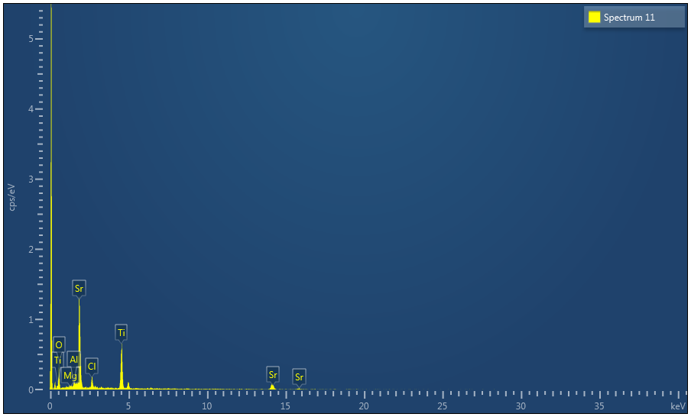
Al2% STO – Flux treat in Mg crucible
Spectrum 11 | Atomic %
O | 54.19
Mg | 0.00
Al | 1.68
Cl | 4.38
Ti | 19.60
Sr | 20.15
Total | 100.00

Slide 11
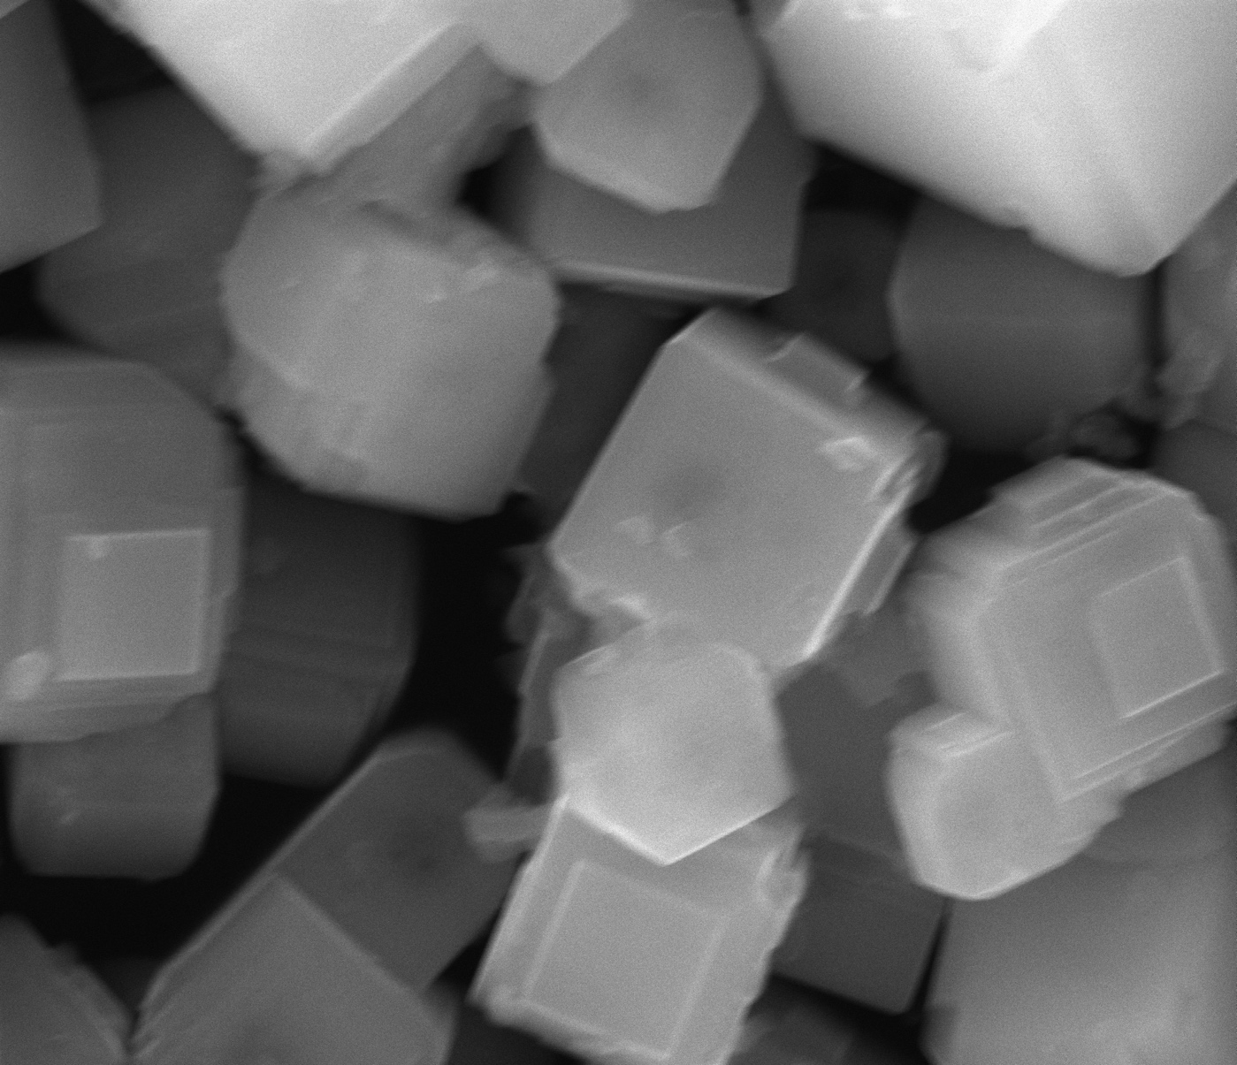
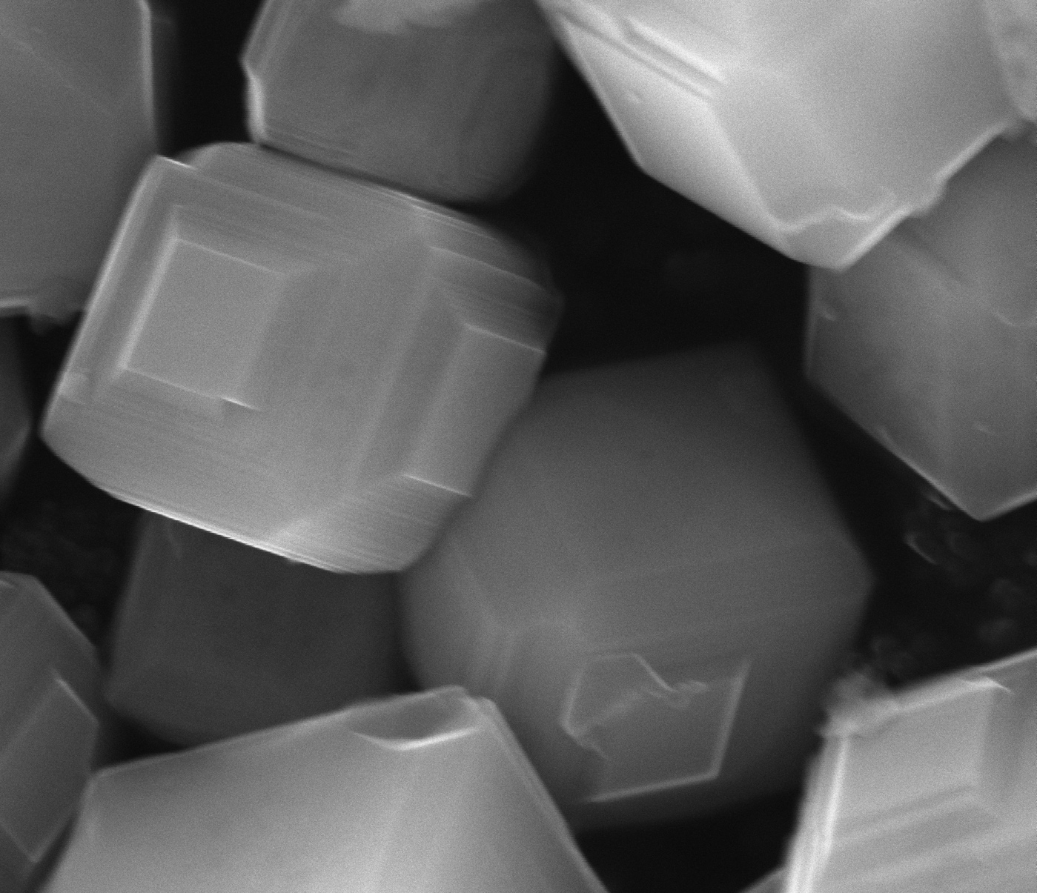
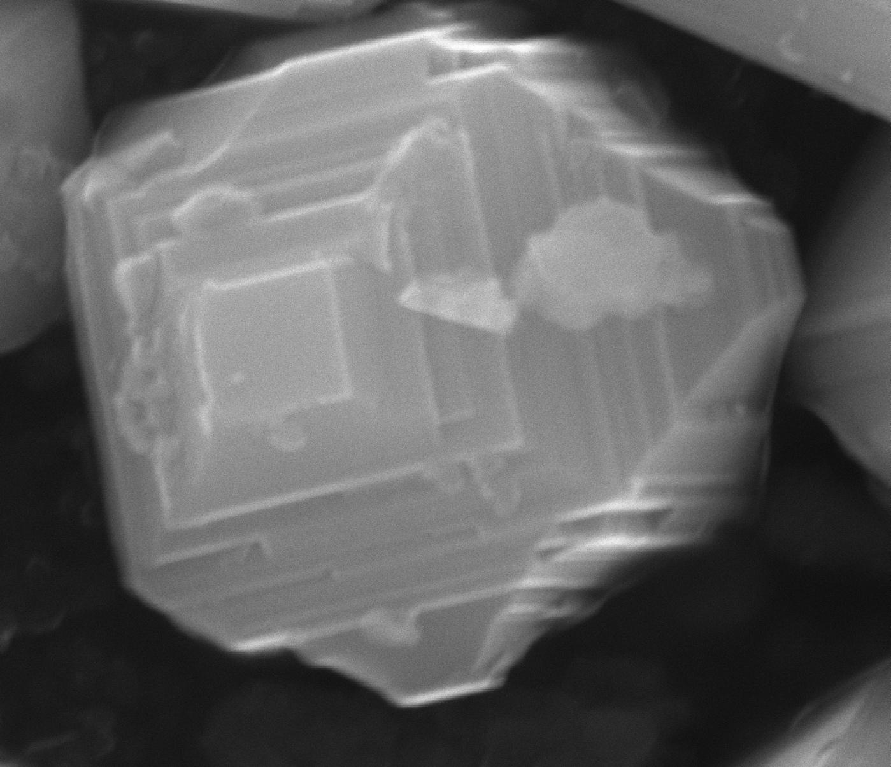
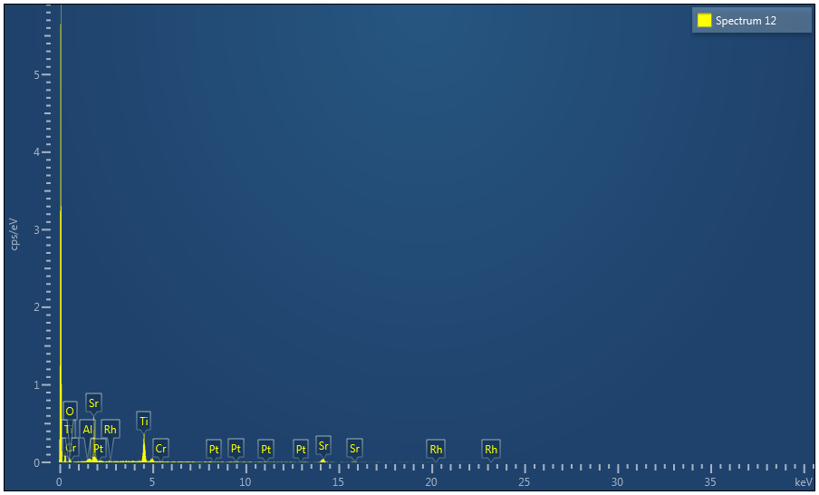
Al3% STO – Flux treat in Pt crucible
Spectrum 12 | Atomic %
O | 34.25
Al | 0.75
Ti | 31.74
Cr | 0.00
Sr | 33.15
Rh | 0.11
Pt | 0.00
Total | 100.00

Slide 12
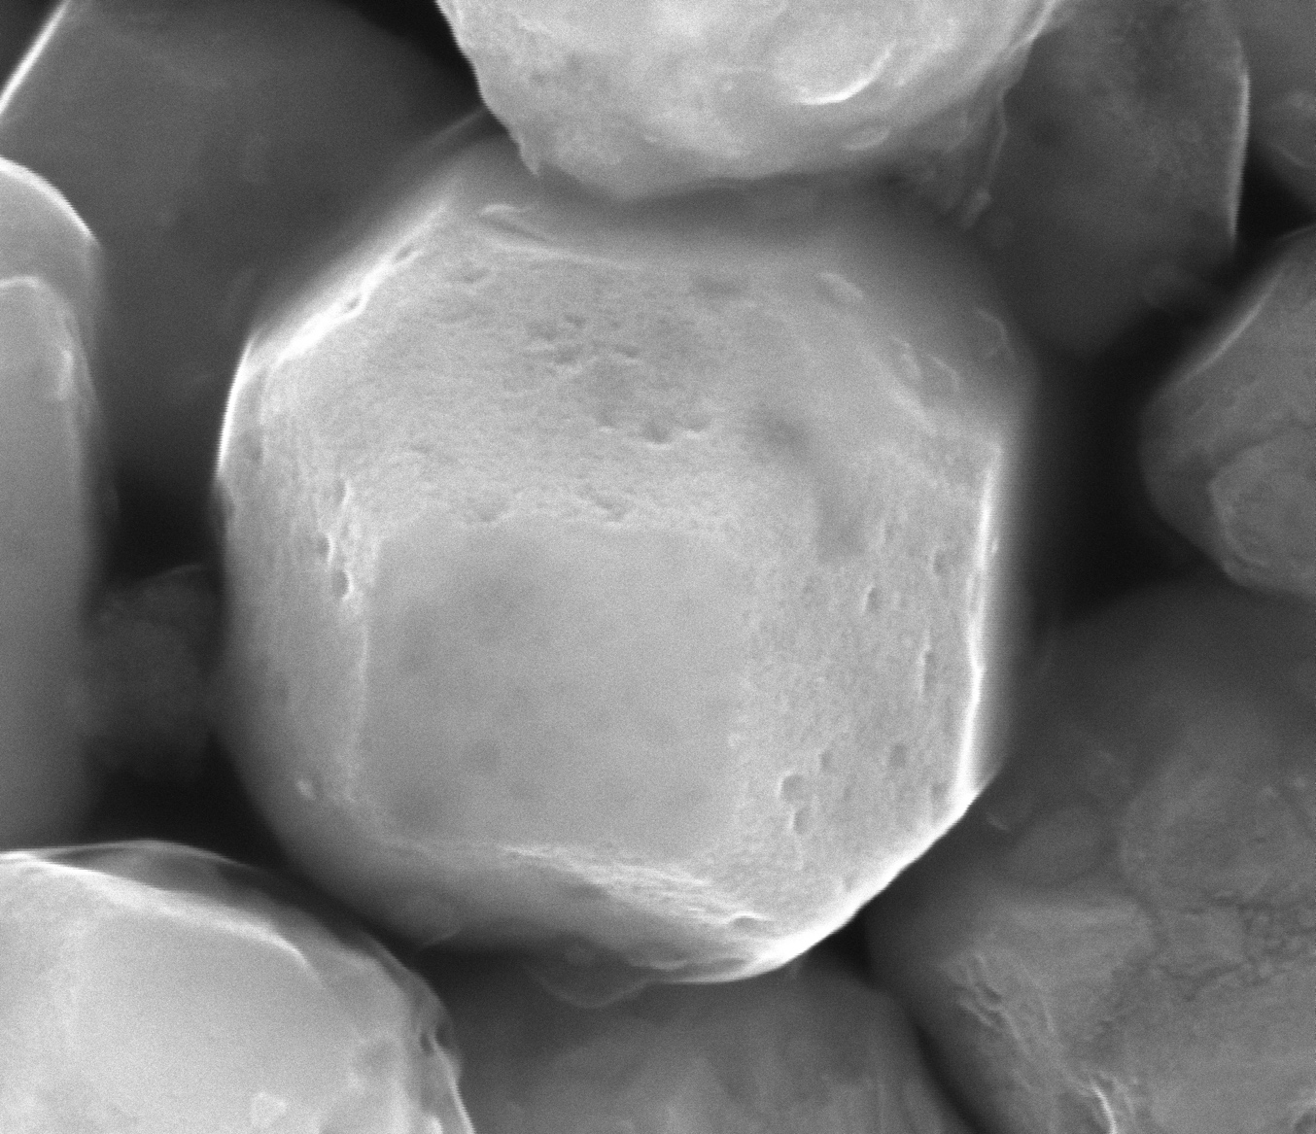
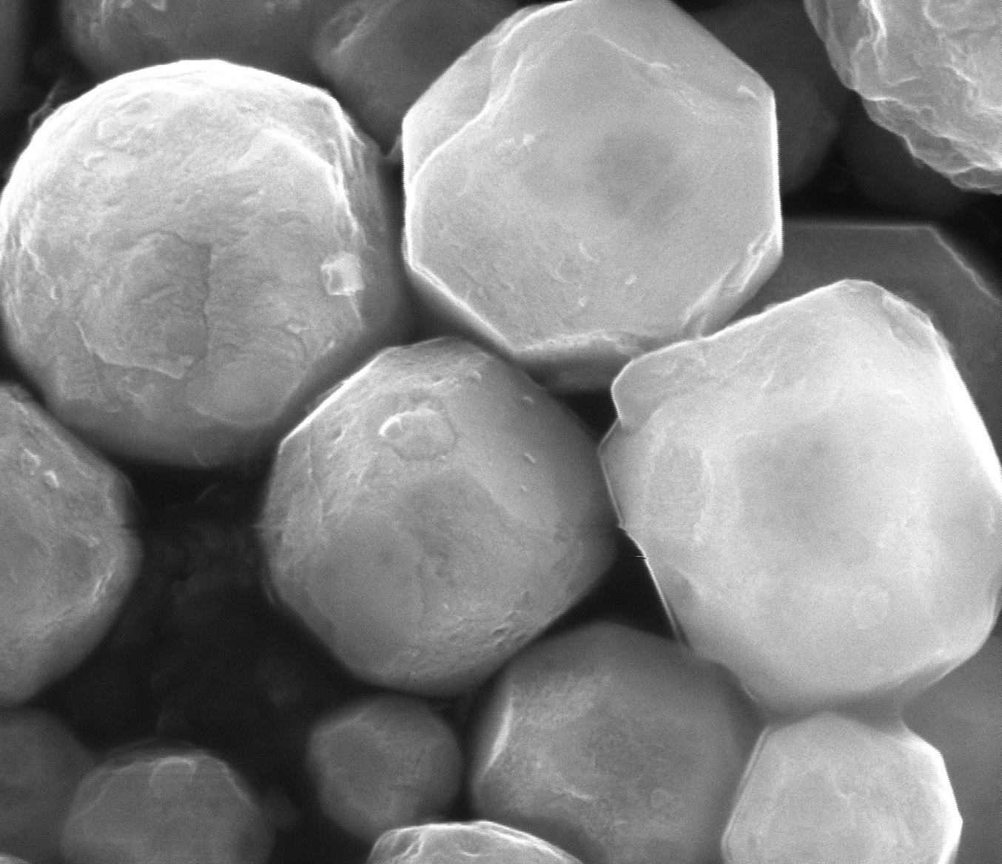
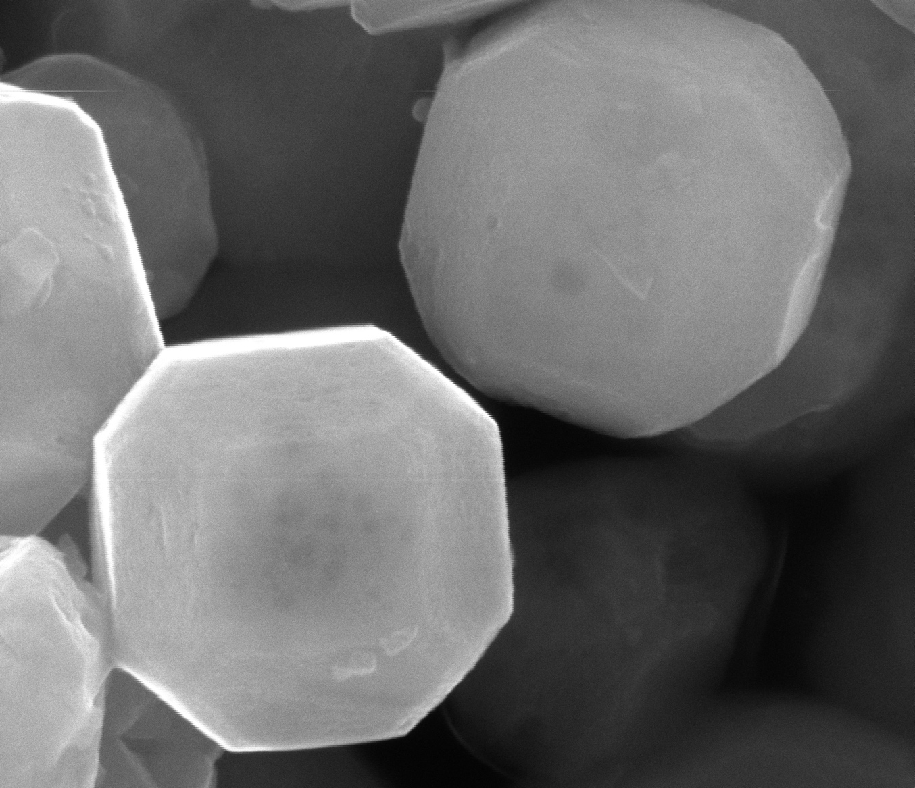

Al3% STO – Flux treat in Al crucible
Spectrum 13 | Atomic %
O | 55.97
Al | 1.36
Ti | 22.91
Cr | 0.13
Sr | 19.63
Rh | 0.00
Total | 100.00

Slide 13
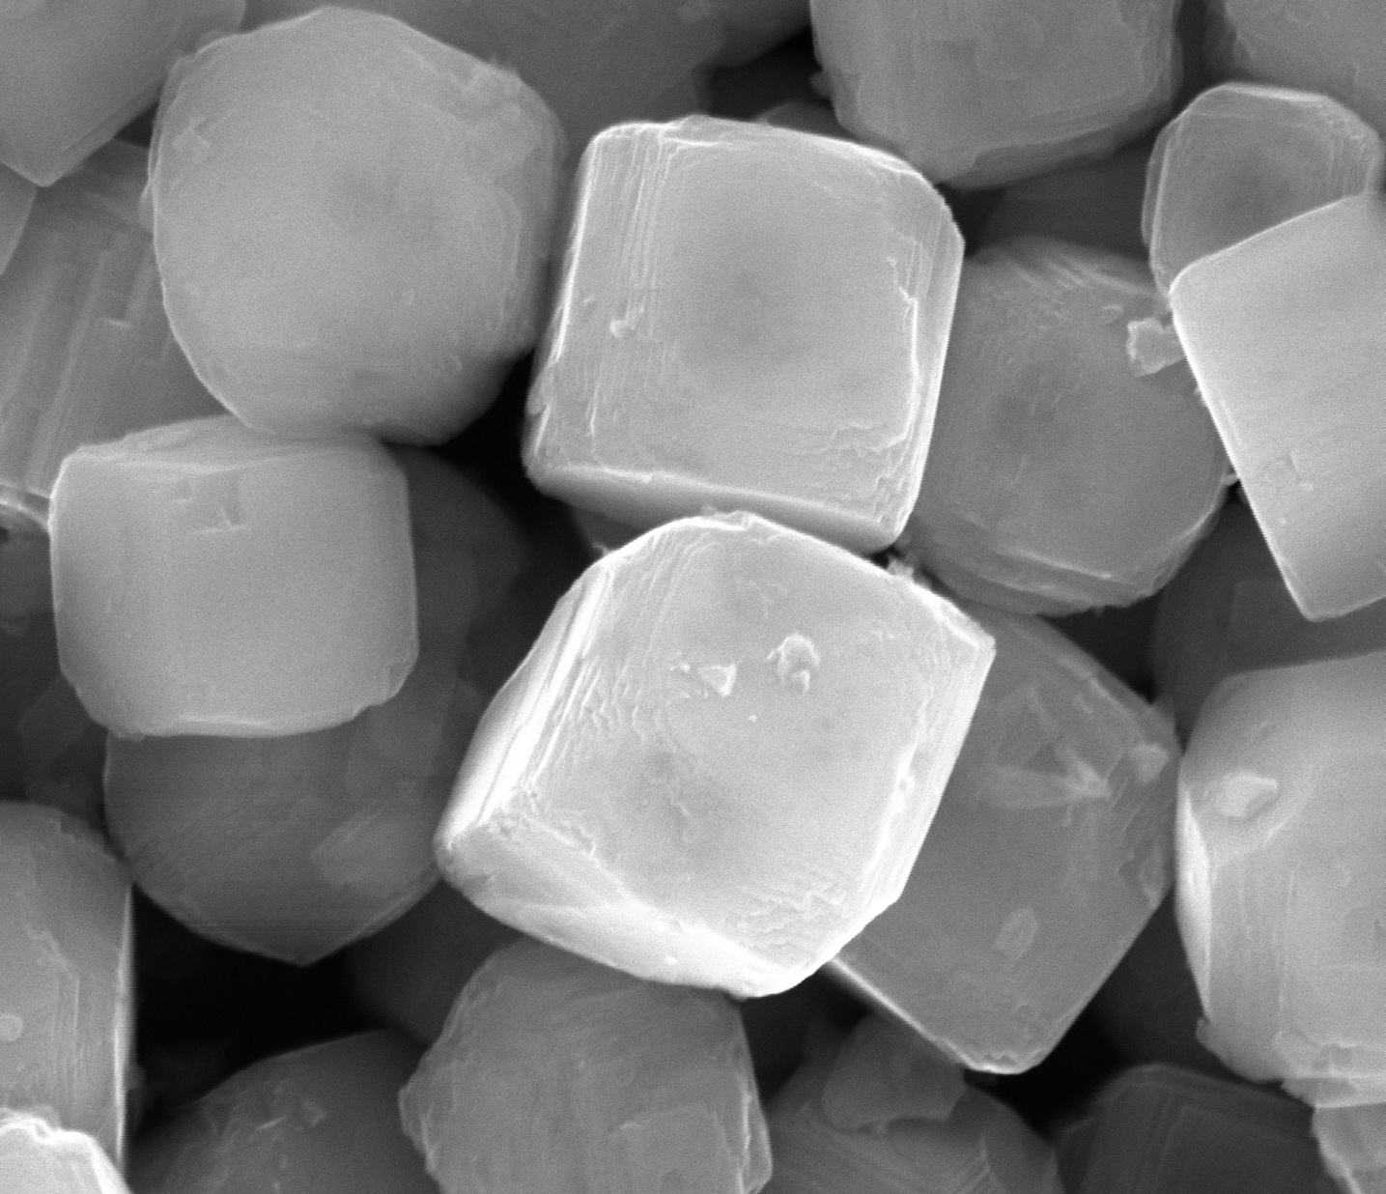
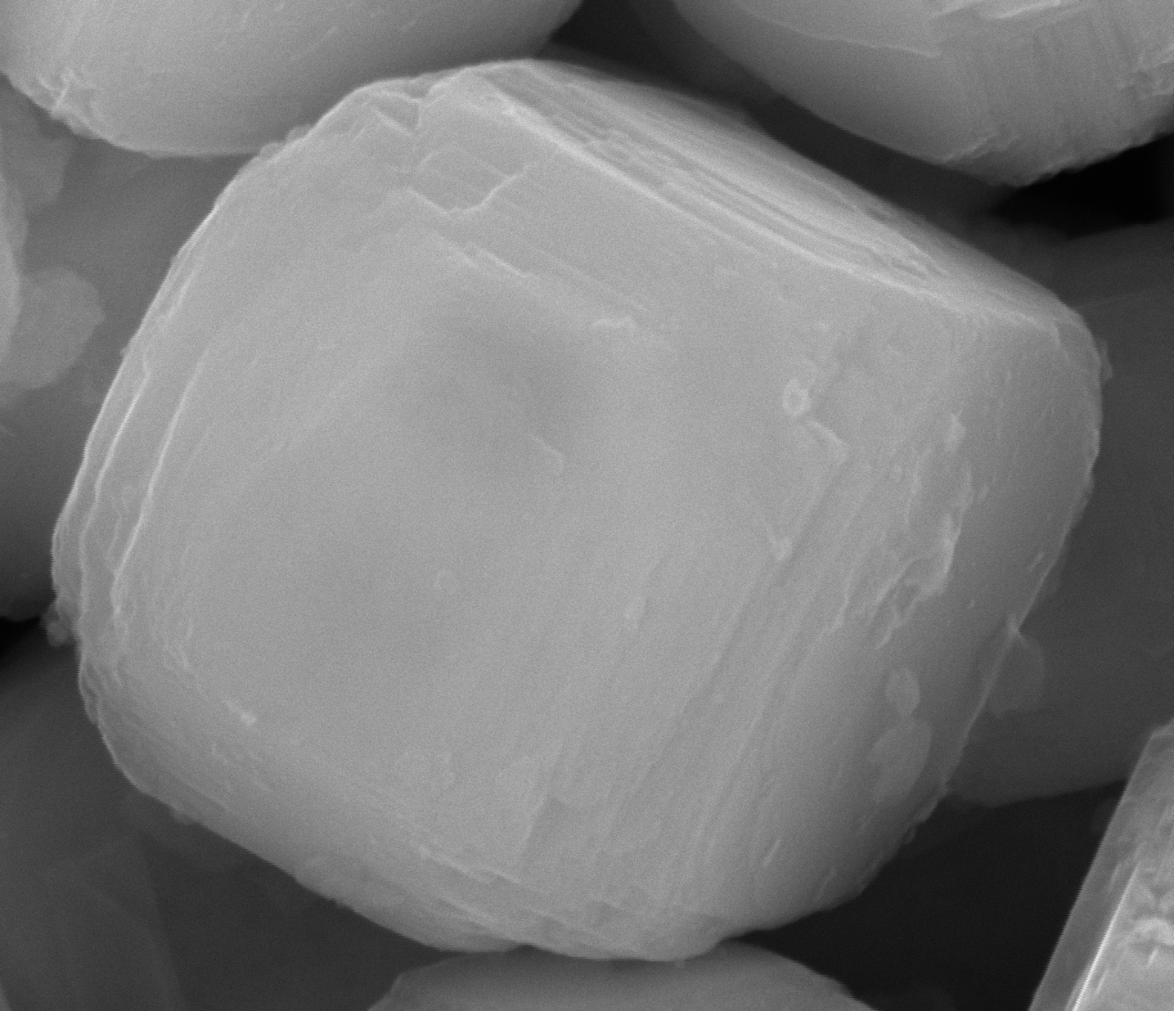
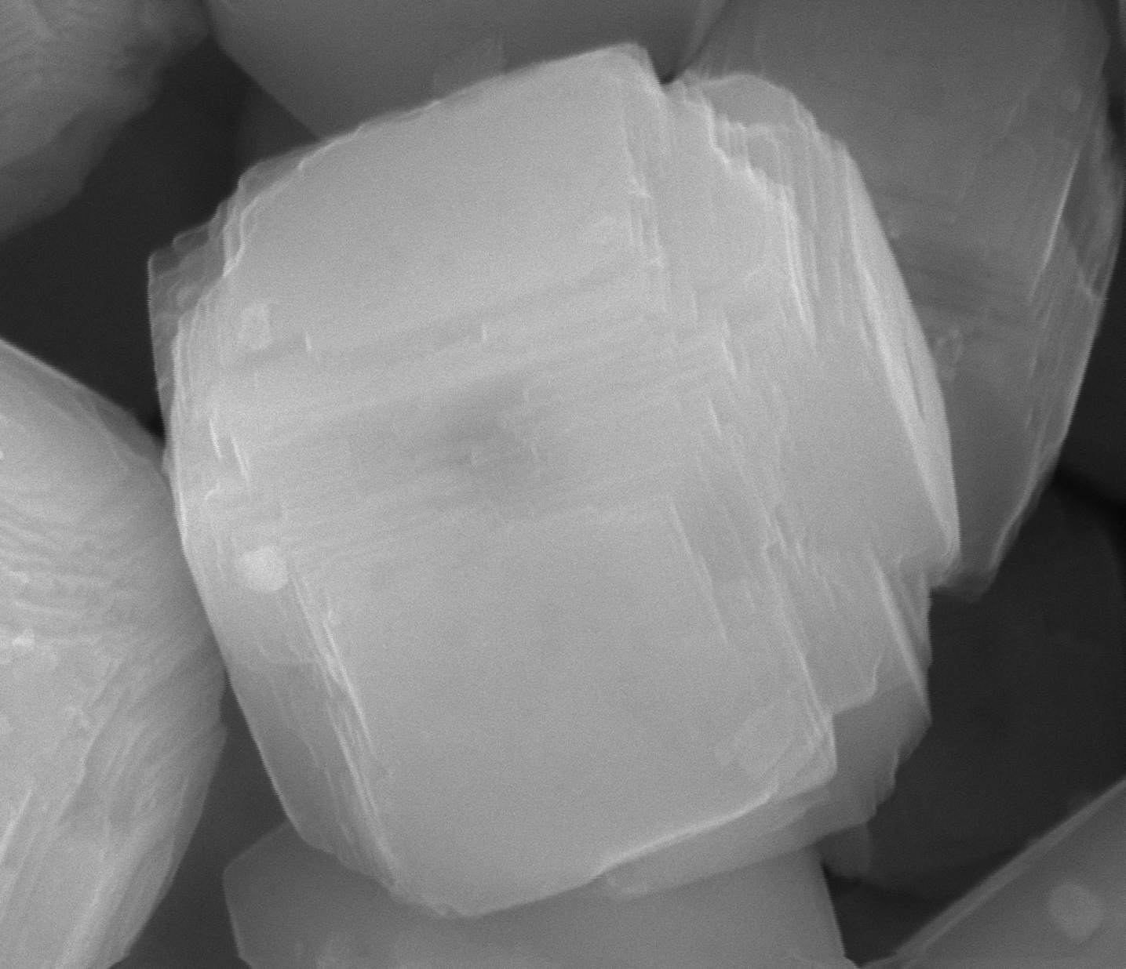
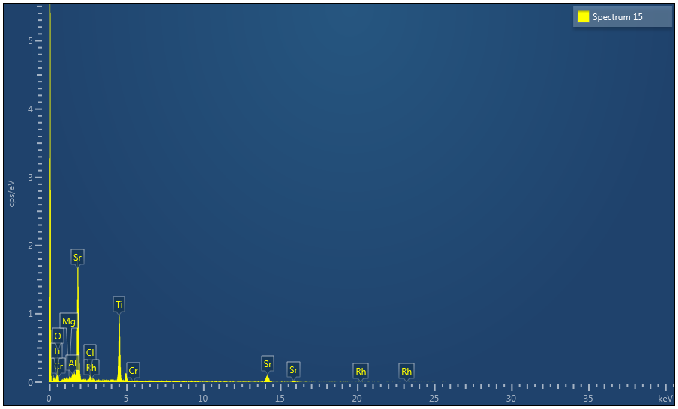
Al3% STO – Flux treat in Mg crucible
Spectrum 15 | Atomic %
O | 50.92
Mg | 0.54
Al | 1.10
Cl | 1.95
Ti | 24.07
Cr | 0.00
Sr | 21.34
Rh | 0.09
Total | 100.00

Slide 14
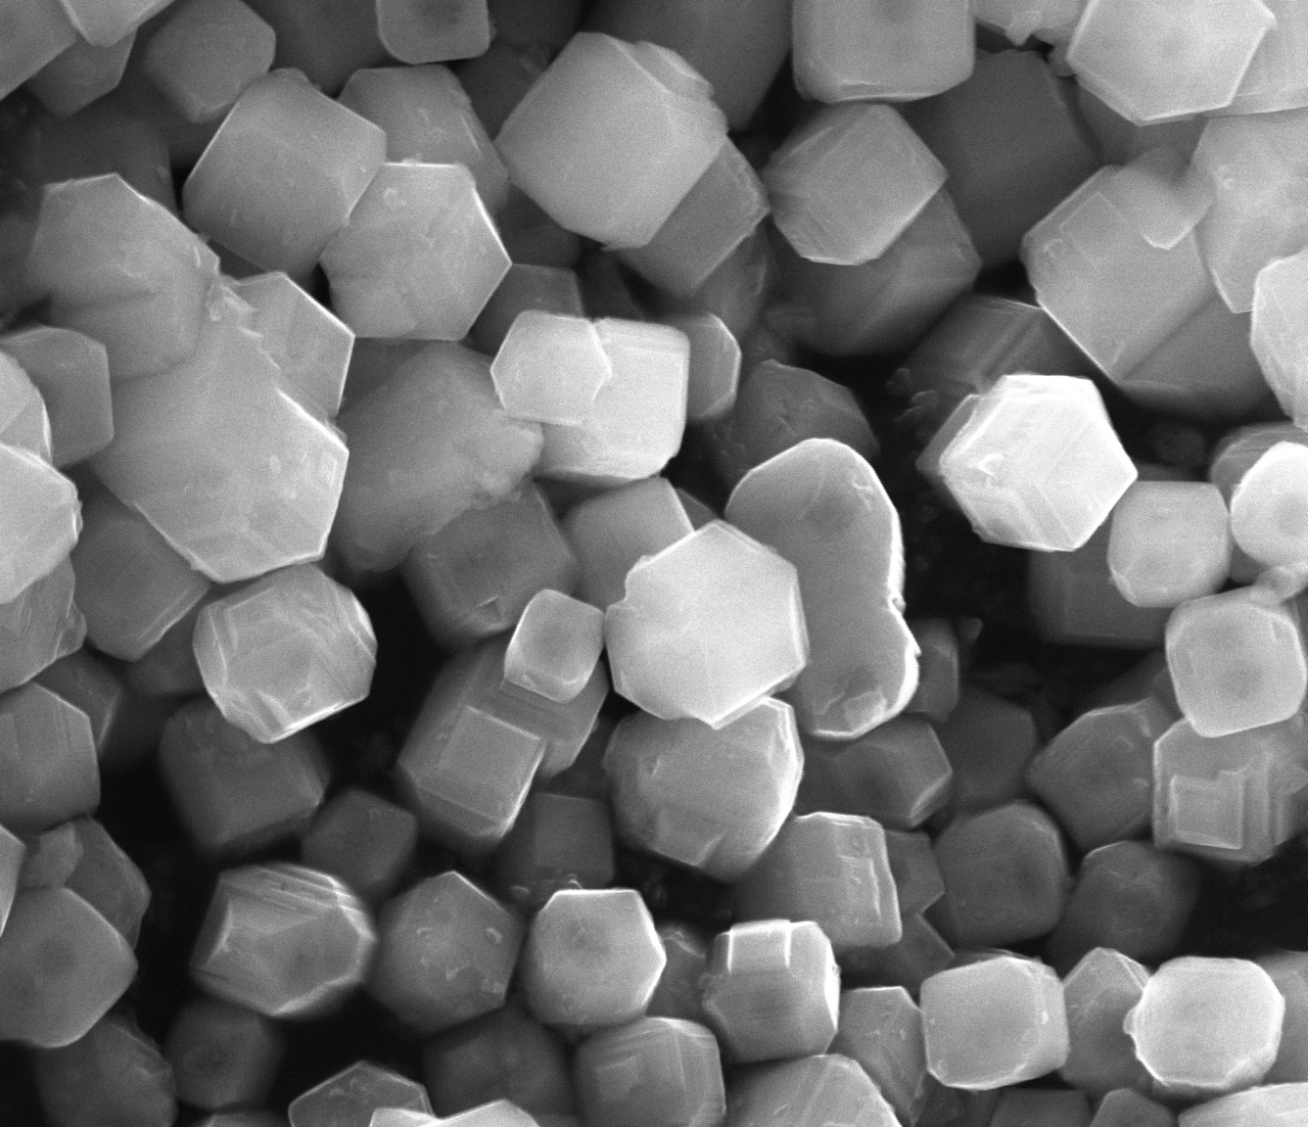
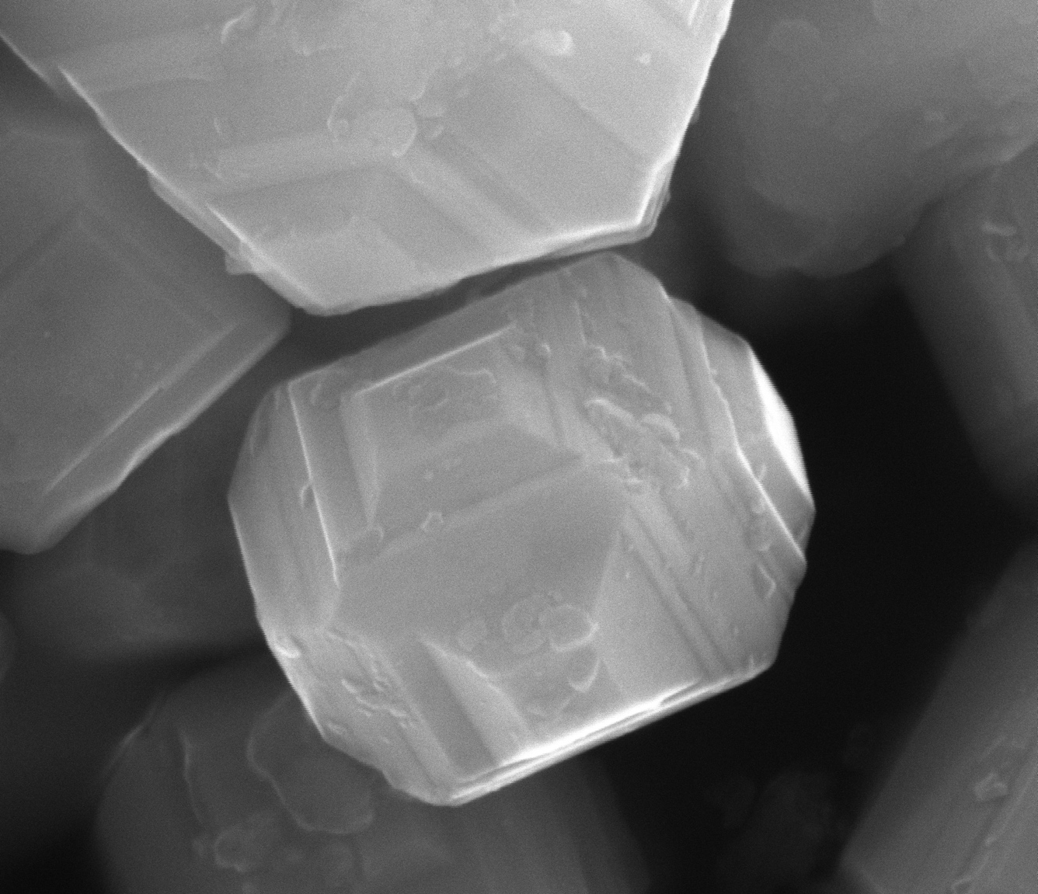
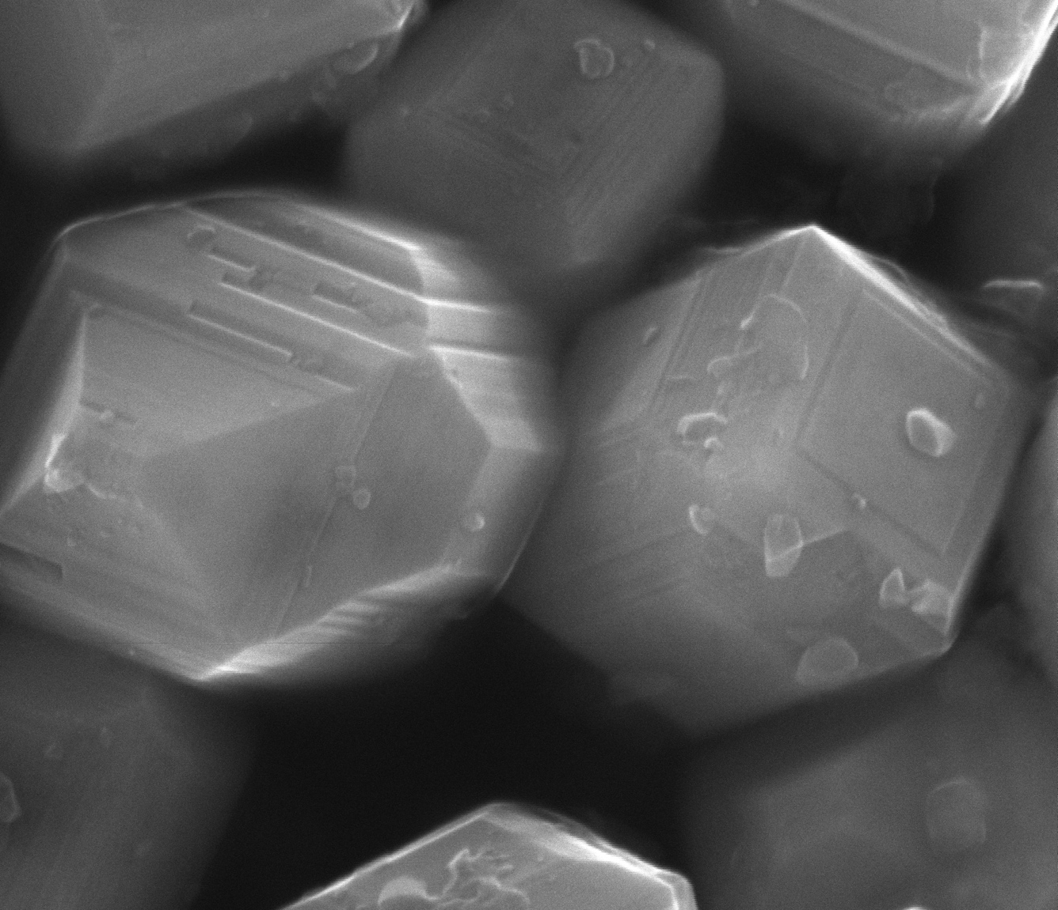
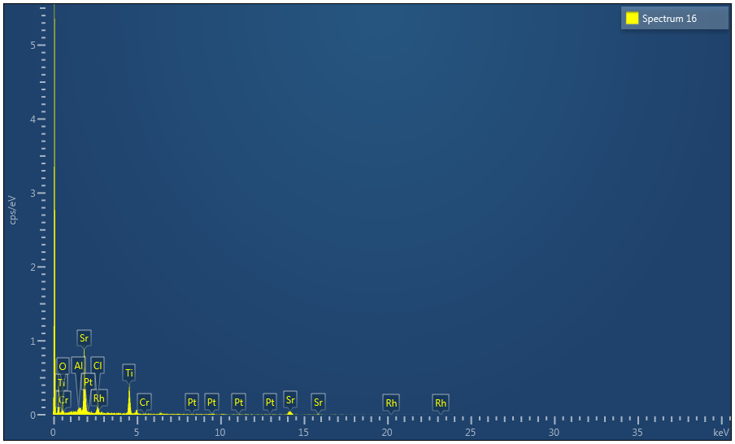
Al5% STO – Flux treat in Pt crucible
Spectrum 16 | Atomic %
O | 63.60
Al | 0.97
Cl | 5.34
Ti | 14.73
Cr | 0.33
Sr | 15.02
Rh | 0.00
Pt | 0.02
Total | 100.00

Slide 15
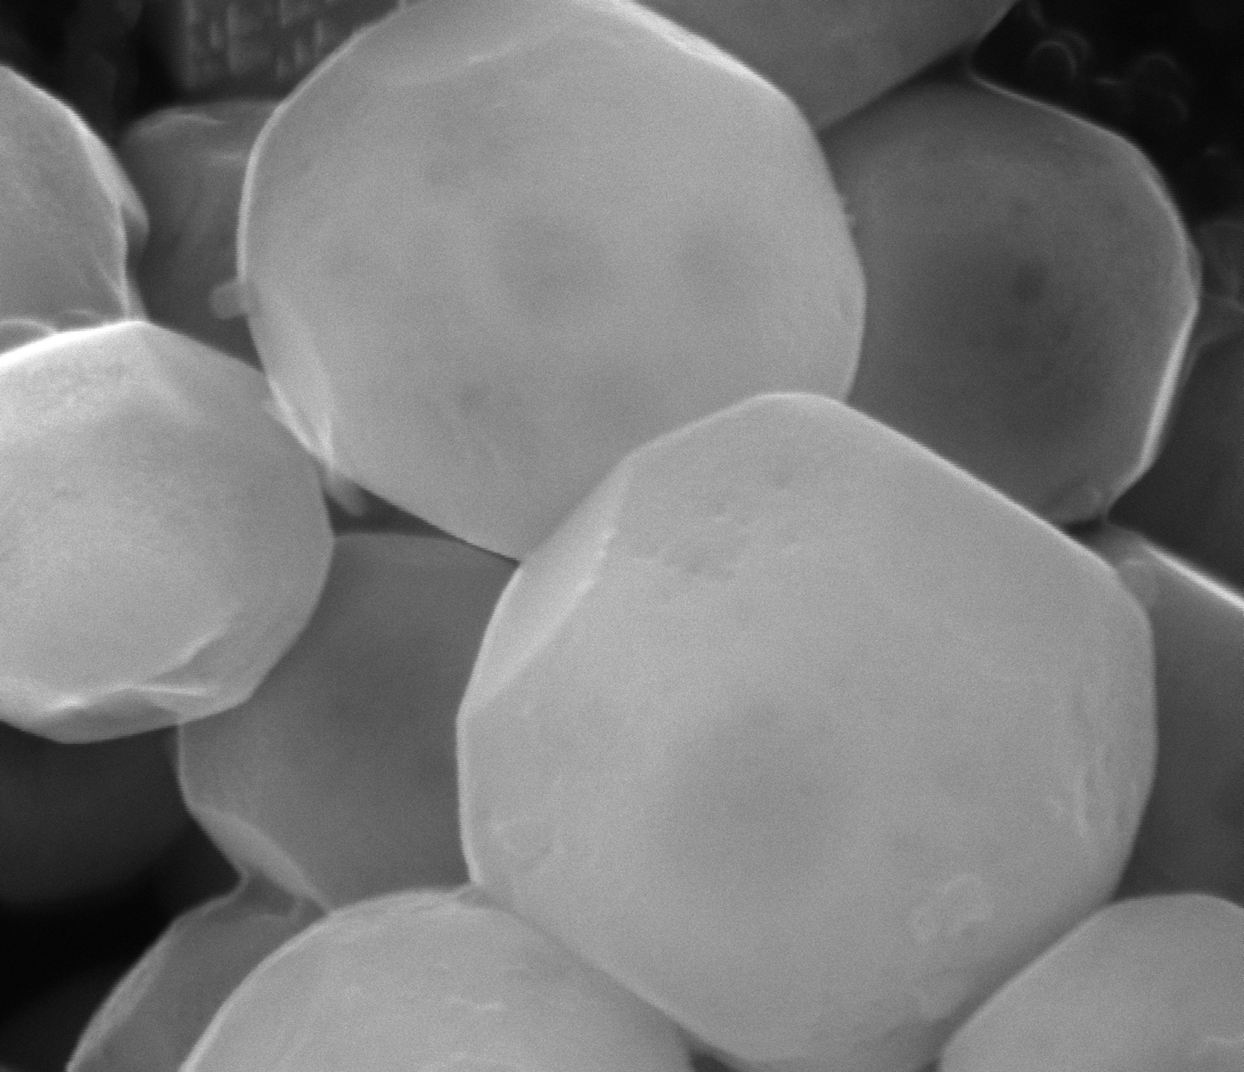



Al5% STO – Flux treat in Al crucible
Spectrum 17 | Atomic %
O | 54.75
Al | 1.25
Cl | 1.39
Ti | 21.43
Cr | 0.07
Sr | 21.10
Rh | 0.00
Total | 100.00

Slide 16




Al5% STO – Flux treat in Mg crucible
Spectrum 18 | Atomic %
O | 41.93
Mg | 0.03
Al | 1.42
Cl | 3.31
Ti | 23.77
Cr | 0.39
Sr | 29.04
Rh | 0.10
Total | 100.00

Slide 17




Al10% STO – Flux treat in Pt crucible
Spectrum 19 | Atomic %
O | 55.59
Al | 1.62
Ti | 19.97
Cr | 0.00
Sr | 22.19
Rh | 0.63
Pt | 0.00
Total | 100.00

Slide 18




Al10% STO – Flux treat in Al crucible
Spectrum 20 | Atomic %
O | 51.65
Al | 2.16
Ti | 23.30
Cr | 0.35
Sr | 22.53
Rh | 0.00
Total | 100.00

Slide 19




Al10% STO – Flux treat in Mg crucible
Spectrum 21 | Atomic %
O | 54.18
Mg | 0.32
Al | 1.46
Cl | 1.48
Ti | 22.15
Cr | 0.00
Sr | 20.40
Rh | 0.02
Total | 100.00

Slide 20




Mg1% STO – Flux treat in Pt crucible
Spectrum 22 | Atomic %
O | 42.48
Mg | 0.00
Ti | 24.76
Cr | 0.48
Sr | 31.85
Rh | 0.43
Pt | 0.00
Total | 100.00

Slide 21




Mg1% STO – Flux treat in Al crucible
Spectrum 23 | Atomic %
O | 62.10
Mg | 0.36
Al | 0.81
Cl | 1.03
Ti | 19.06
Cr | 0.00
Sr | 16.64
Rh | 0.00
Total | 100.00

Slide 22




Mg1% STO – Flux treat in Mg crucible
Spectrum 24 | Atomic %
O | 57.29
Mg | 0.96
Cl | 3.13
Ti | 18.21
Cr | 0.17
Sr | 19.91
Rh | 0.33
Total | 100.00

Slide 23




Mg2% STO – Flux treat in Pt crucible
Spectrum 25 | Wt% | Wt% Sigma
O | 26.19 | 2.14
Mg | 0.20 | 0.30
Ti | 25.55 | 1.54
Cr | 0.57 | 0.35
Sr | 46.55 | 2.77
Rh | 0.00 | 0.91
Pt | 0.95 | 1.38
Total | 100.00

Slide 24




Mg2% STO – Flux treat in Al crucible
Spectrum 26 | Atomic %
O | 58.77
Mg | 0.29
Al | 1.35
Si | 0.00
Cl | 0.96
Ti | 19.25
Cr | 0.07
Sr | 19.31
Rh | 0.00
Total | 100.00

Slide 25




Mg2% STO – Flux treat in Mg crucible
Spectrum 27 | Atomic %
O | 49.90
Mg | 2.03
Si | 0.26
Cl | 2.09
Ti | 21.20
Cr | 0.34
Sr | 23.89
Rh | 0.30
Total | 100.00

Slide 26



Mg3% STO – Flux treat in Pt crucible
Spectrum 25 | Wt% | Wt% Sigma
O | 26.19 | 2.14
Mg | 0.20 | 0.30
Ti | 25.55 | 1.54
Cr | 0.57 | 0.35
Sr | 46.55 | 2.77
Rh | 0.00 | 0.91
Pt | 0.95 | 1.38
Total | 100.00

Slide 27




Mg3% STO – Flux treat in Al crucible
Spectrum 29 | Atomic %
O | 56.26
Mg | 0.53
Al | 1.59
Cl | 2.32
Ti | 19.97
Cr | 0.09
Sr | 19.24
Rh | 0.00
Total | 100.00

Slide 28




Mg3% STO – Flux treat in Mg crucible
Spectrum 30 | Atomic %
O | 53.29
Mg | 0.91
Ti | 20.84
Cr | 0.00
Sr | 24.96
Rh | 0.00
Total | 100.00

Slide 29




Mg5% STO – Flux treat in Pt crucible
Spectrum 31 | Atomic %
O | 54.77
Mg | 0.59
Ti | 22.25
Cr | 0.11
Sr | 22.07
Rh | 0.00
Pt | 0.21
Total | 100.00

Slide 30




Mg5% STO – Flux treat in Al crucible
Spectrum 32 | Atomic %
O | 50.18
Mg | 1.05
Al | 1.54
Cl | 2.40
Ti | 18.65
Cr | 0.07
Sr | 25.99
Rh | 0.11
Total | 100.00

Slide 31




Mg5% STO – Flux treat in Mg crucible
Spectrum 33 | Atomic %
O | 52.20
Mg | 0.77
Cl | 1.87
Ti | 21.28
Cr | 0.00
Sr | 23.53
Rh | 0.36
Total | 100.00

Slide 32




Mg10% STO – Flux treat in Pt crucible
Spectrum 34 | Atomic %
O | 52.48
Mg | 1.02
Cl | 1.07
Ti | 22.52
Cr | 0.00
Sr | 22.40
Rh | 0.00
Pt | 0.51
Total | 100.00

Slide 33




Mg10% STO – Flux treat in Al crucible
Spectrum 35 | Atomic %
O | 52.37
Mg | 0.82
Al | 0.91
Cl | 1.73
Ti | 21.88
Cr | 0.41
Sr | 21.60
Rh | 0.30
Total | 100.00

Slide 34




Mg10% STO – Flux treat in Mg crucible
Spectrum 36 | Atomic %
O | 50.52
Mg | 2.20
Cl | 2.08
Ti | 22.15
Cr | 0.00
Sr | 24.92
Rh | 0.12
Total | 100.00

Slide 35




Ga1% STO – Flux treat in Pt crucible
Spectrum 37 | Atomic %
O | 51.67
Ti | 25.01
Cr | 0.00
Ga | 0.07
Sr | 22.56
Rh | 0.00
Pt | 0.68
Total | 100.00

Slide 36




Ga1% STO – Flux treat in Al crucible
Spectrum 38 | Atomic %
O | 48.85
Al | 1.01
Cl | 3.08
Ti | 22.07
Cr | 0.14
Ga | 0.00
Sr | 24.61
Rh | 0.24
Total | 100.00

Slide 37




Ga1% STO – Flux treat in Mg crucible
Spectrum 39 | Atomic %
O | 57.80
Mg | 0.31
Ti | 20.80
Cr | 0.00
Ga | 0.00
Sr | 21.09
Rh | 0.00
Total | 100.00

Slide 38




Ga2% STO – Flux treat in Pt crucible
Spectrum 40 | Atomic %
O | 39.96
Ti | 30.22
Cr | 0.33
Ga | 0.16
Sr | 27.75
Rh | 0.65
Pt | 0.92
Total | 100.00

Slide 39




Ga2% STO – Flux treat in Al crucible
Spectrum 41 | Atomic %
O | 45.45
Al | 1.17
Si | 0.69
Cl | 1.34
Ti | 24.67
Cr | 0.03
Ga | 0.01
Sr | 26.50
Rh | 0.14
Total | 100.00

Slide 40




Ga2% STO – Flux treat in Mg crucible
Spectrum 42 | Atomic %
O | 52.86
Mg | 0.70
Cl | 1.64
Ti | 23.09
Cr | 0.00
Ga | 0.01
Sr | 21.71
Rh | 0.00
Total | 100.00

Slide 41




Ga3% STO – Flux treat in Pt crucible
Spectrum 43 | Atomic %
O | 48.53
Cl | 4.27
Ti | 20.11
Cr | 0.00
Ga | 0.18
Sr | 26.64
Rh | 0.16
Pt | 0.11
Total | 100.00

Slide 42




Ga3% STO – Flux treat in Al crucible
Spectrum 44 | Atomic %
O | 54.65
Al | 0.91
Cl | 1.19
Ti | 21.07
Cr | 0.00
Ga | 0.18
Sr | 21.94
Rh | 0.06
Total | 100.00

Slide 43




Ga3% STO – Flux treat in Mg crucible
Spectrum 45 | Atomic %
O | 53.86
Mg | 0.40
Ti | 21.21
Cr | 0.00
Ga | 0.47
Sr | 24.03
Rh | 0.03
Total | 100.00

Slide 44



Ga5% STO – Flux treat in Pt crucible
Spectrum 43 | Atomic %
O | 48.53
Cl | 4.27
Ti | 20.11
Cr | 0.00
Ga | 0.18
Sr | 26.64
Rh | 0.16
Pt | 0.11
Total | 100.00

Slide 45




Ga5% STO – Flux treat in Al crucible
Spectrum 47 | Atomic %
O | 56.00
Al | 1.41
Cl | 1.51
Ti | 18.52
Cr | 0.08
Ga | 0.00
Sr | 21.95
Rh | 0.54
Total | 100.00

Slide 46




Ga5% STO – Flux treat in Mg crucible
Spectrum 48 | Atomic %
O | 48.35
Mg | 0.56
Cl | 4.23
Ti | 22.12
Cr | 0.22
Ga | 0.14
Sr | 24.21
Rh | 0.17
Total | 100.00

Slide 47




Ga10% STO – Flux treat in Pt crucible
Spectrum 49 | Atomic %
O | 55.89
Ti | 21.69
Cr | 0.10
Ga | 0.00
Sr | 21.71
Rh | 0.00
Pt | 0.61
Total | 100.00

Slide 48




Ga10% STO – Flux treat in al crucible
Spectrum 50 | Atomic %
O | 57.11
Al | 1.81
Ti | 23.58
Cr | 0.00
Ga | 0.00
Sr | 17.50
Rh | 0.00
Total | 100.00

Slide 49




Ga10% STO – Flux treat in Mg crucible
Spectrum 51 | Atomic %
O | 58.22
Mg | 0.48
Cl | 2.05
Ti | 19.03
Cr | 0.01
Ga | 0.00
Sr | 20.22
Rh | 0.00
Total | 100.00

