Slide 1
Weekly Meeting
8/12/2021
Mingyi Zhang

Slide 2
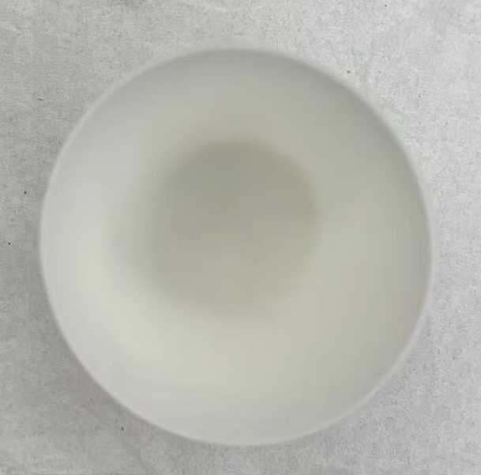
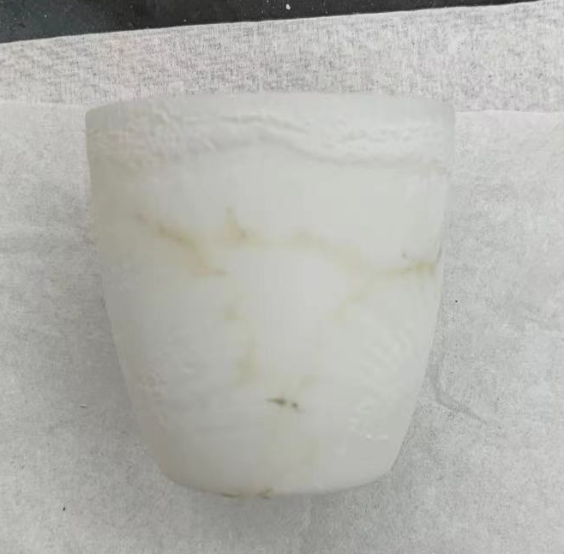
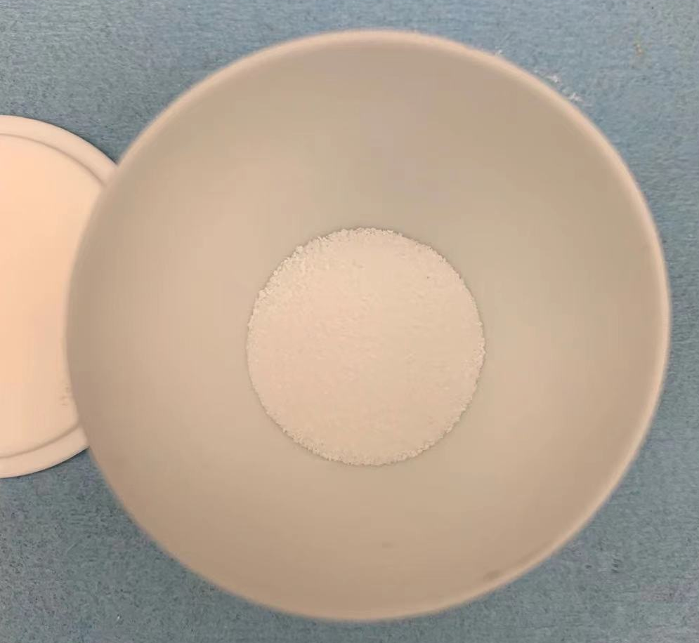
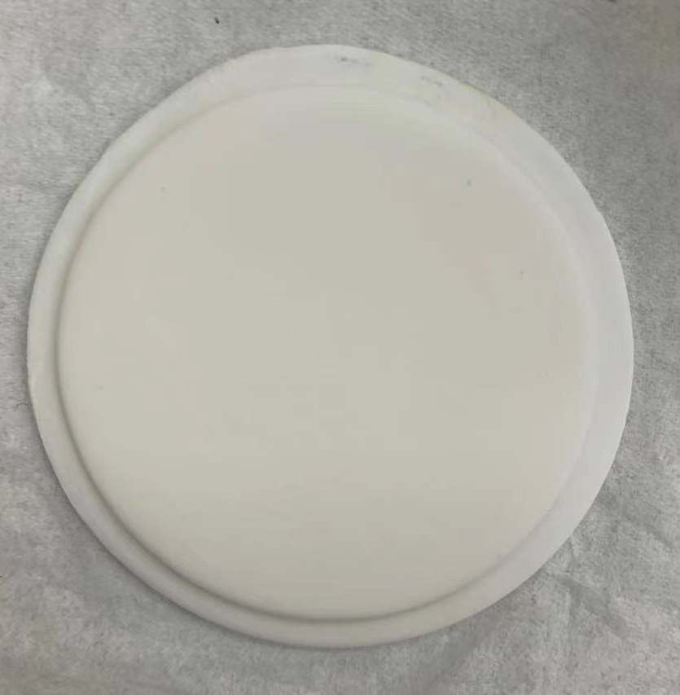
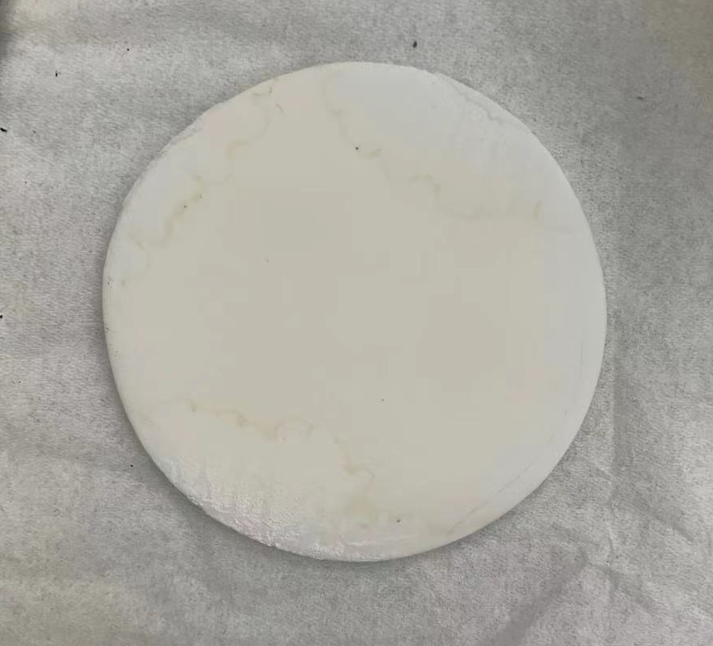
1100 C
10h
It is clean inside but a lot of stuff outside.
2g SrCl₂

Slide 3
SrCl₂
In Al crucible
No longer SrCl₂
Sr(OH)2
SrO
SrCO3

Slide 4
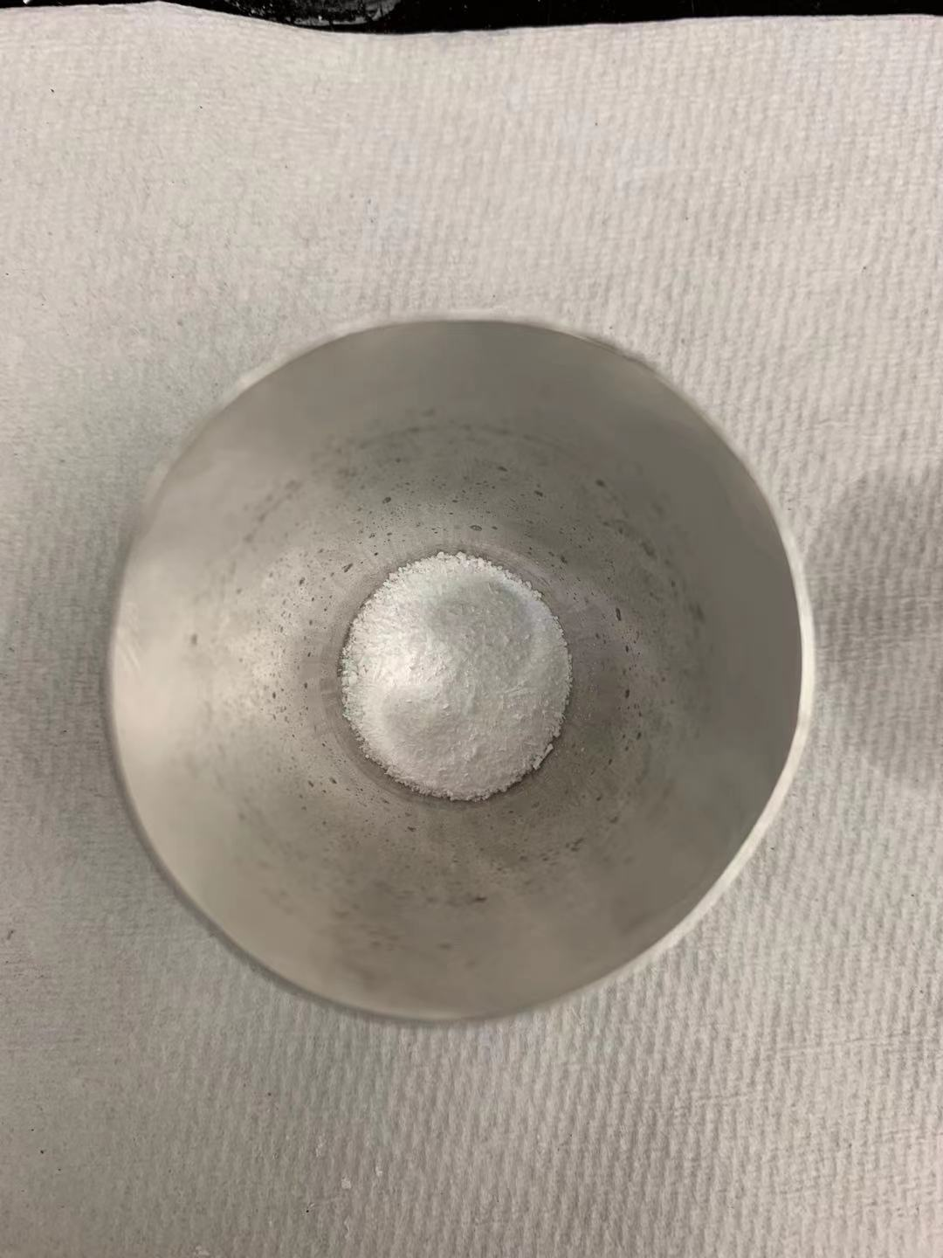
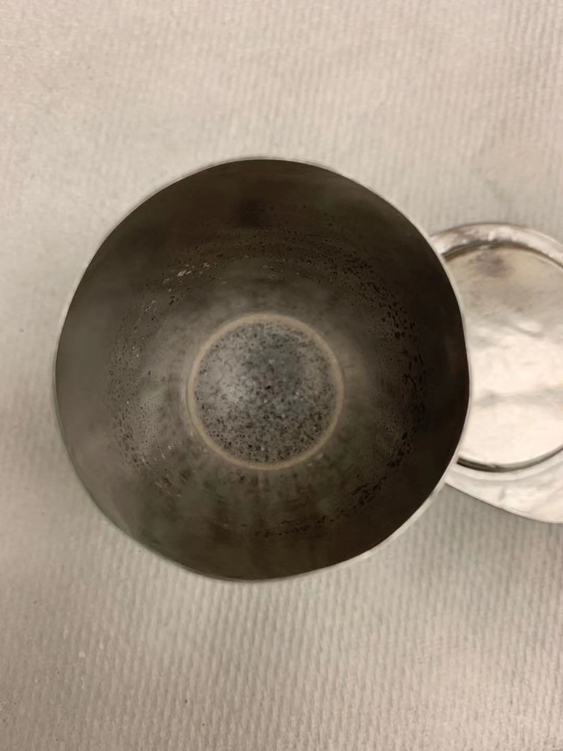
1100 C
10h
1g SrCl₂

Slide 5
SrCl₂
Mostly SrCl₂
and some Sr(OH)₂?
Sr(OH)₂
SrO
SrCO₃

Slide 6
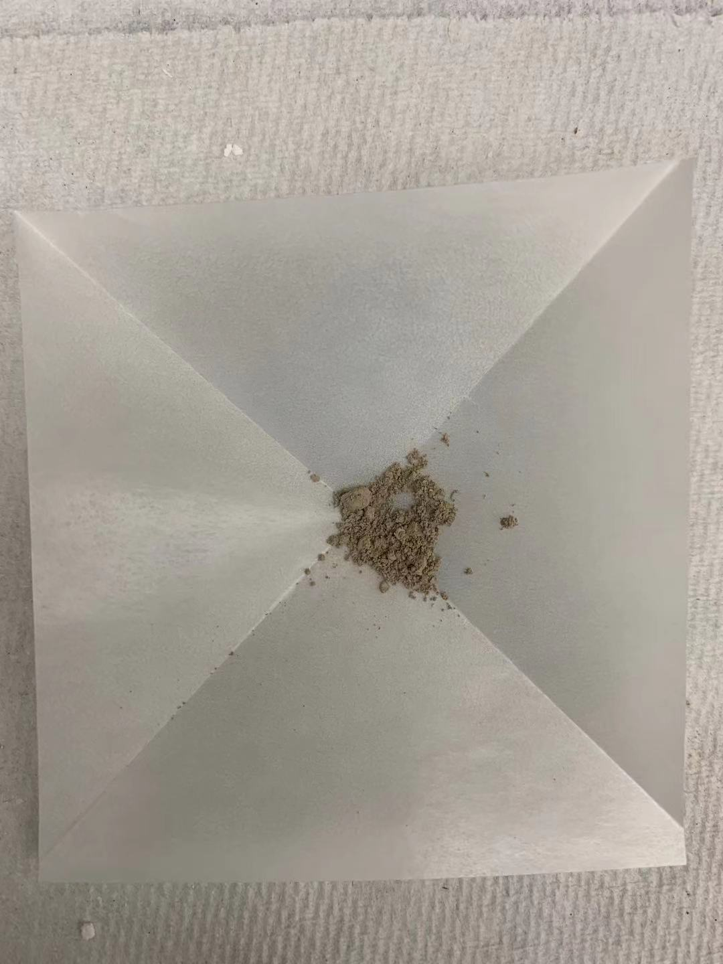
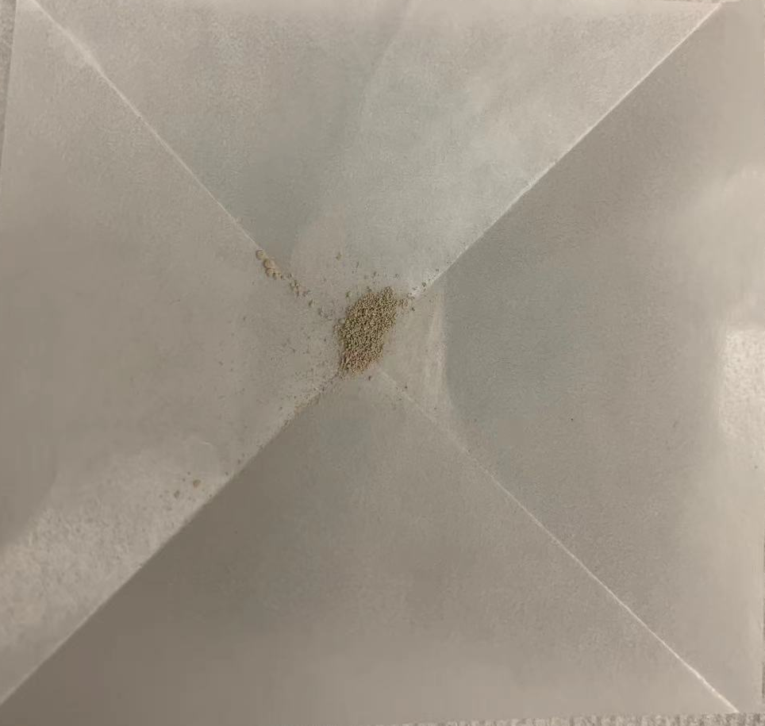
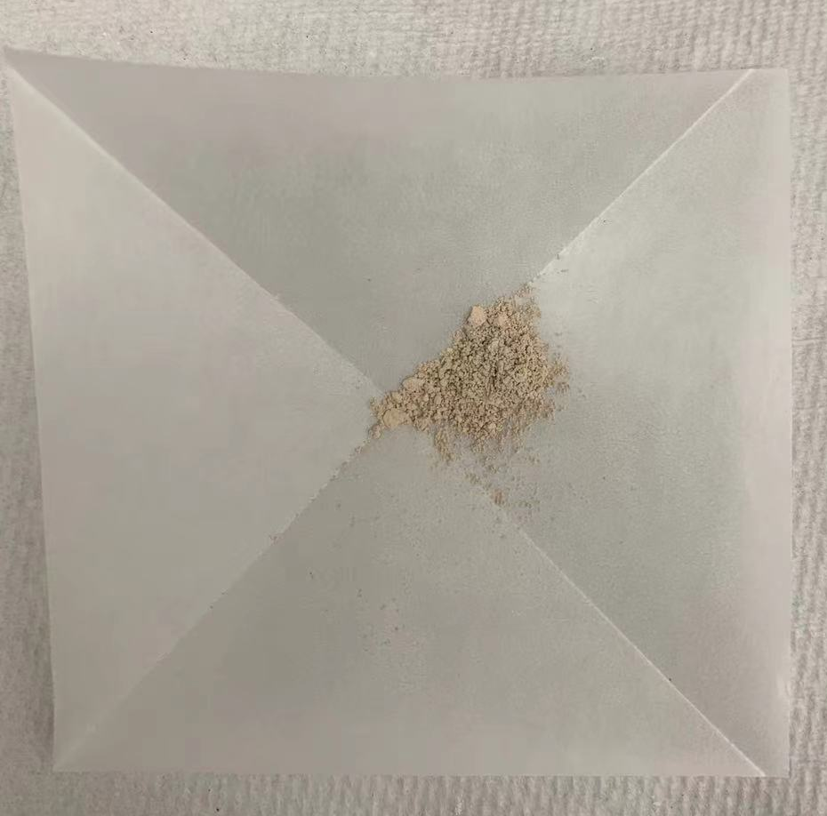
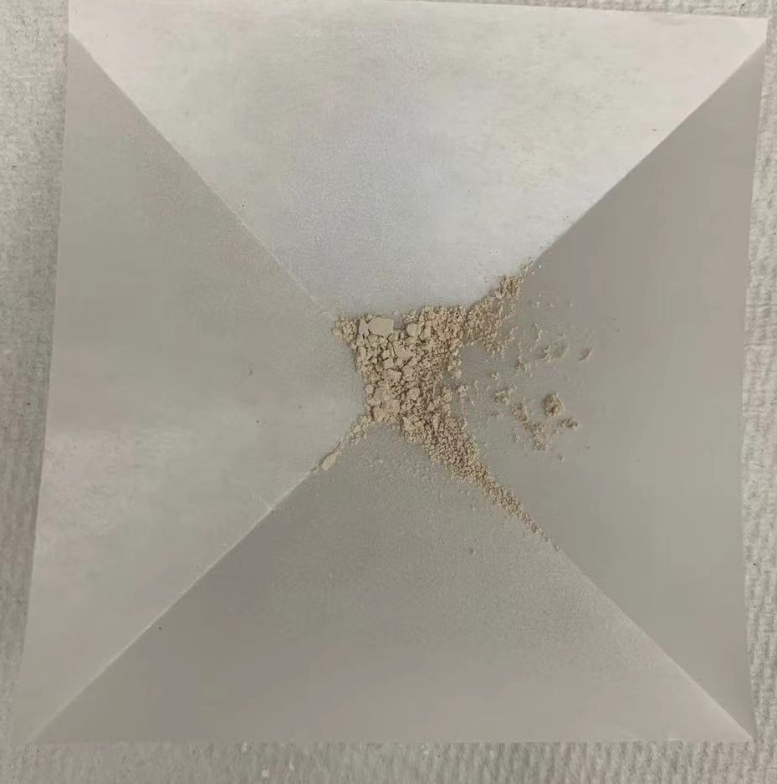
10h
5h
Treated in flux
for different time
in Pt crucible
1% Al
2h
1h

Slide 7
10 h
5 h
2 h
1 h

Slide 8
Heated in flux for 5h in Pt crucible
Steps?

Slide 9
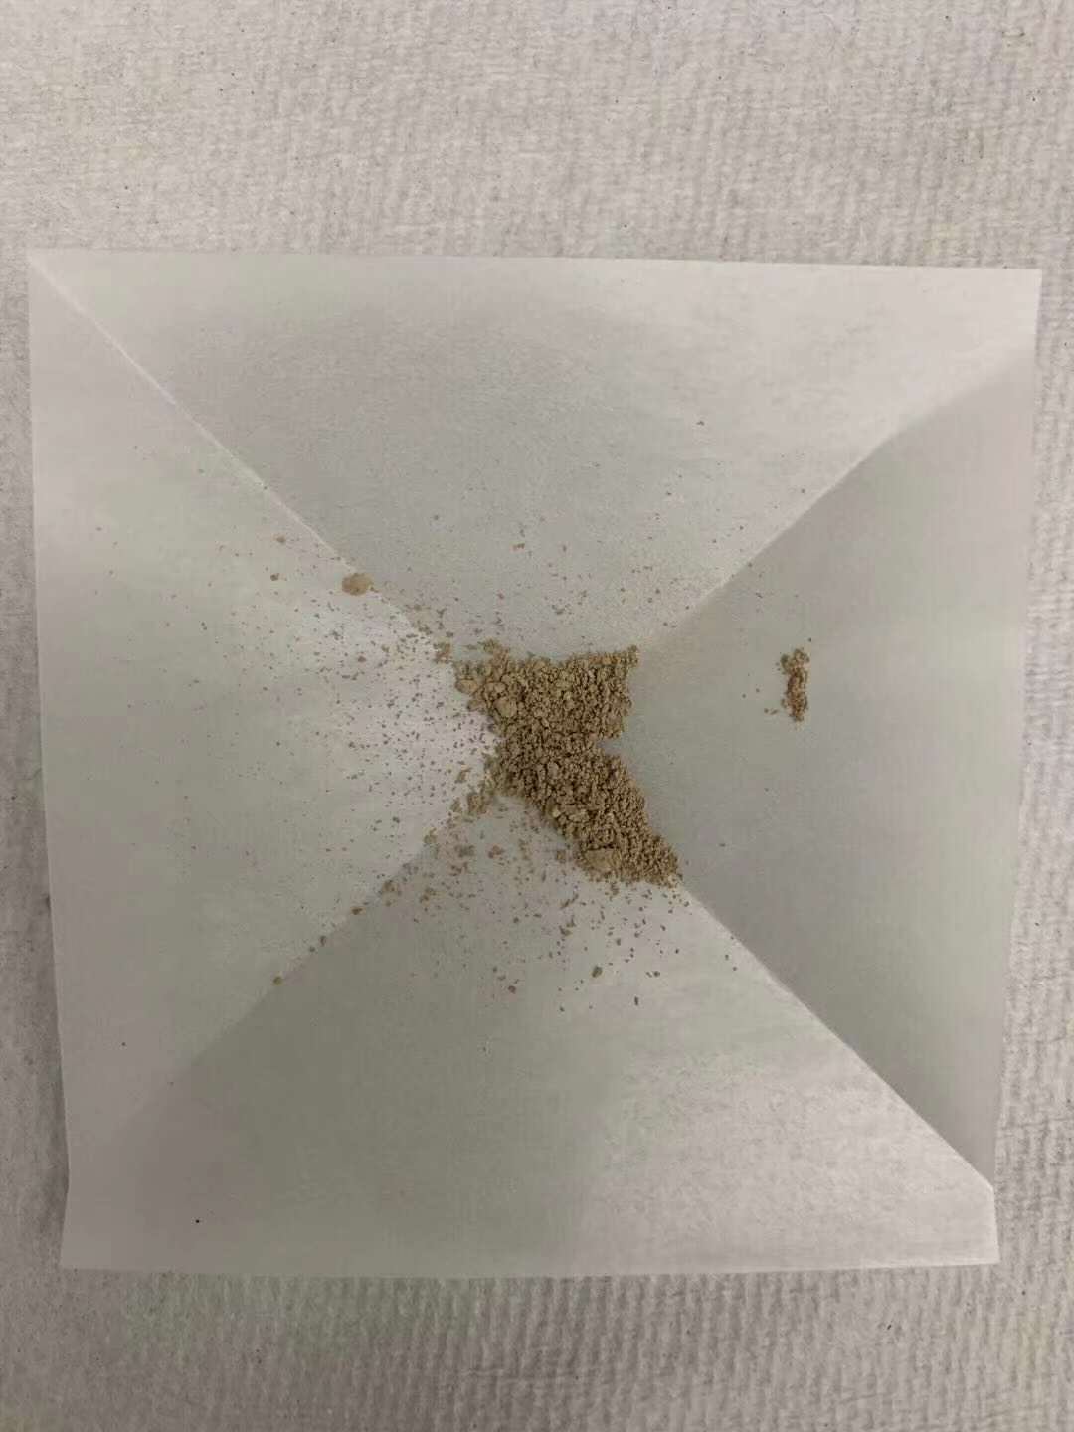
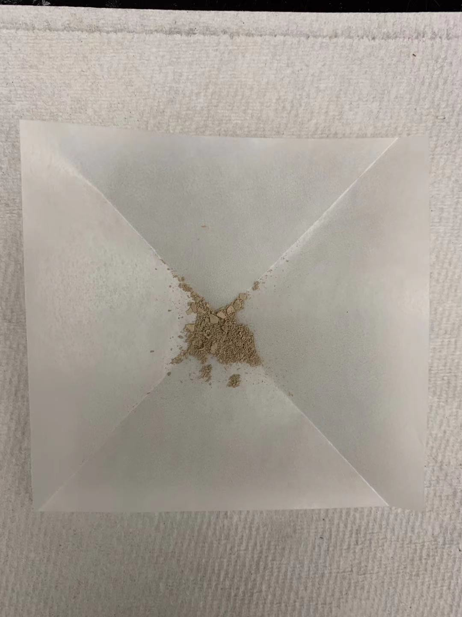
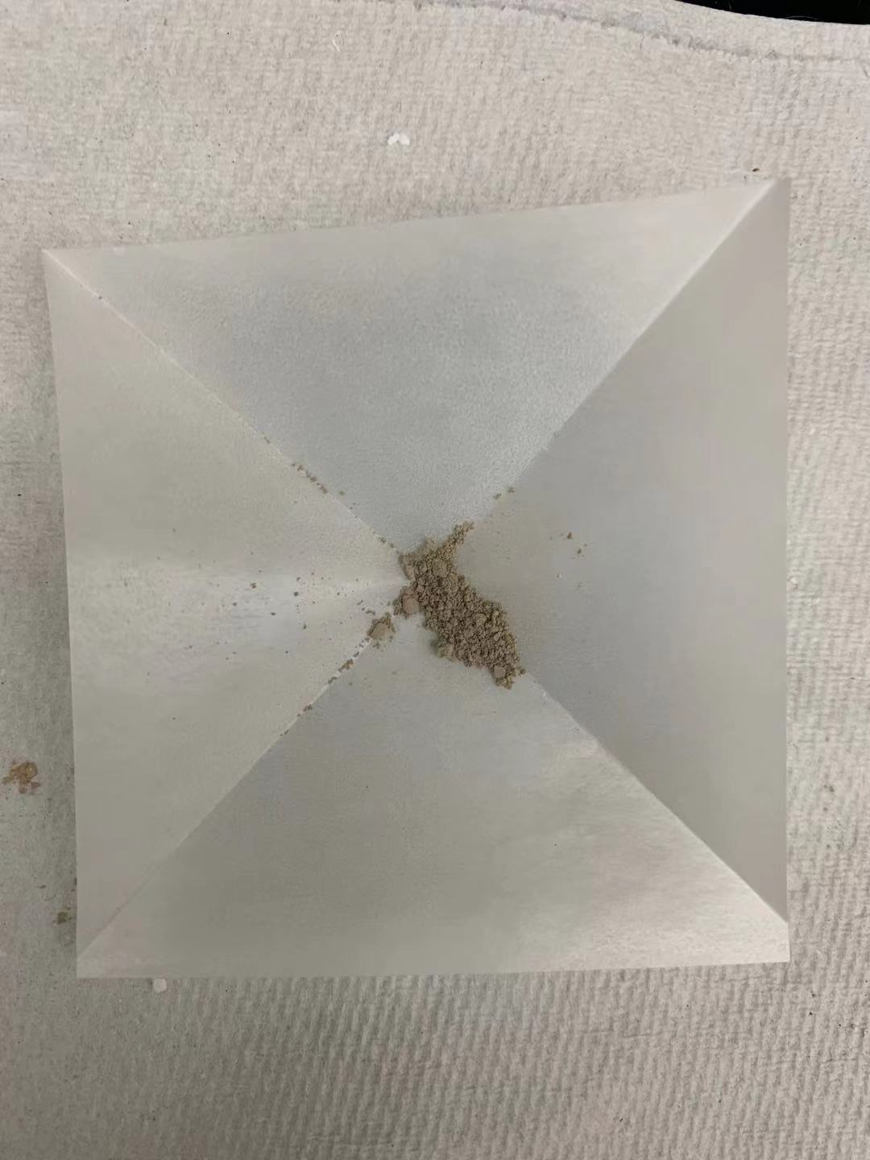
Flux treated for 10h
Flux treated for 10h
Annealed in O₂ overnight
400C
Color did not
change obviously after O2 anneal
Flux treated for 5h
Flux treated for 5h
These two samples are
from a different batch in
another furnace

Slide 10
1% Al doped during hydrothermal synthesis
Not annealed in O₂
Annealed in O₂
Treated in flux for
methanol
pH 3
pH 7
pH 12
methanol
pH 3
pH 7
pH 12
10 h
5 h
2 h
These two samples are from a different batch in another furnace.
1 h

