Slide 1
Weekly Meeting
11/22/2019
Mingyi Zhang

Slide 2
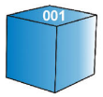
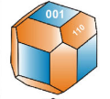
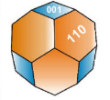
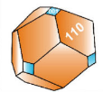

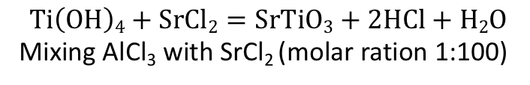
Al : STO
Method 1:
Method 2:
$$TiCl4+H2O =TiOCl2∙2HCl$$
Heating undoped facet particles in Al flux
STO : Al₂O₃ : SrCl₂ = 1 : 0.02 : 10
Heat at 1100C, 10h
$$TiOCl2∙2HCl+LiOH=Ti\left(OH\right)4+4Li+ +4Cl− +H2O$$
$$Ti\left(OH\right)4+SrCl2=SrTiO3+2HCl+H2O$$
Mixing AlCl₃ with SrCl₂ (molar ration 1:100)
Shape A
Shape B
Shape C
Shape D

Slide 3
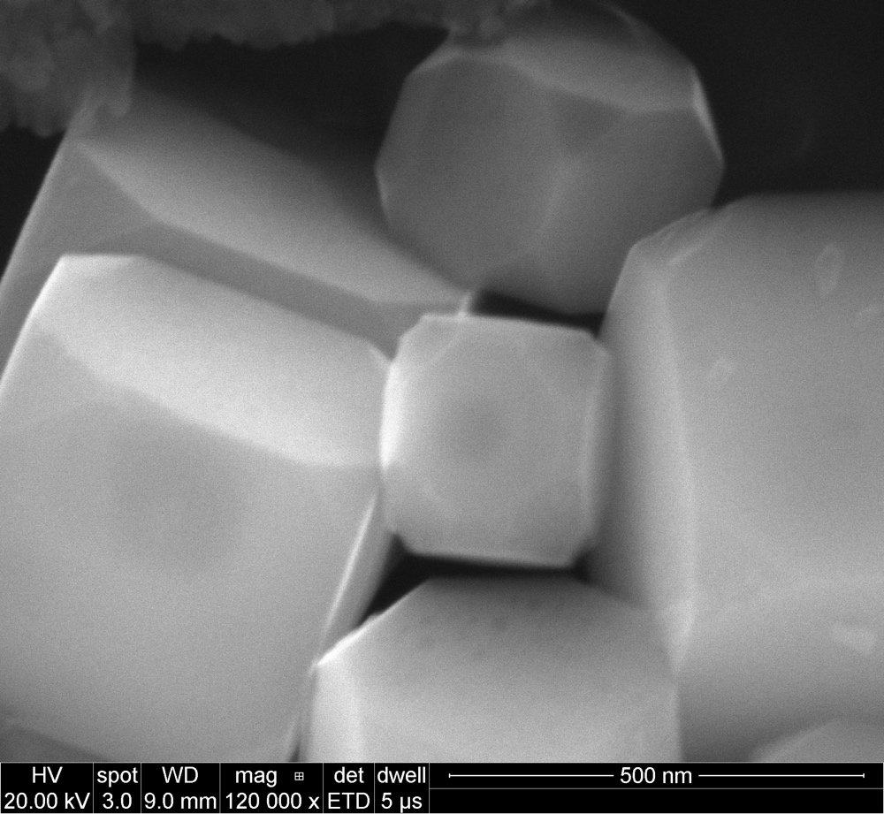
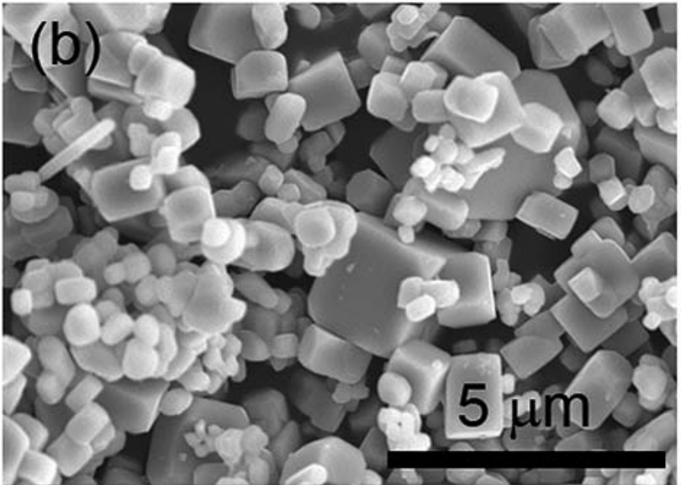
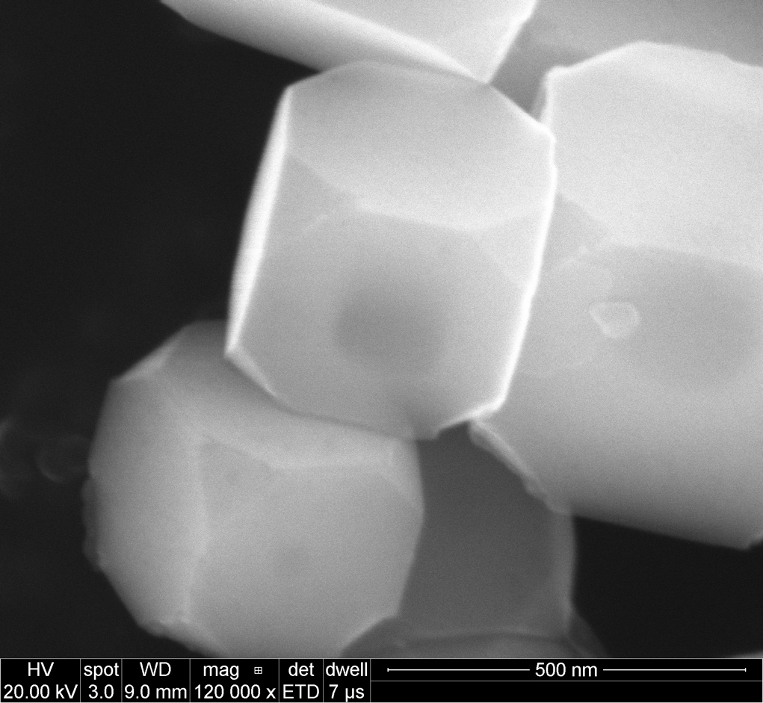
Shape A after treatment in Al flux (method 2)
From Domen’s paper.

Slide 4
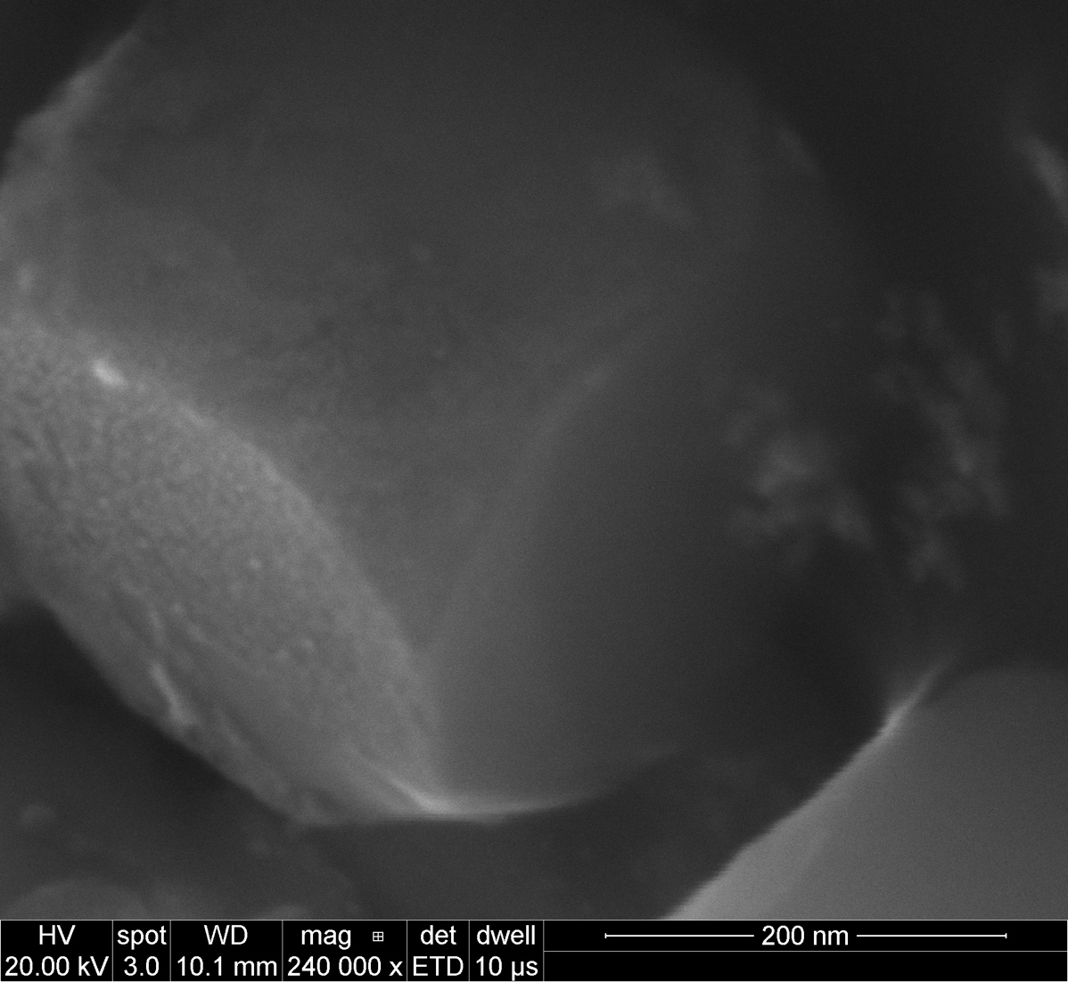
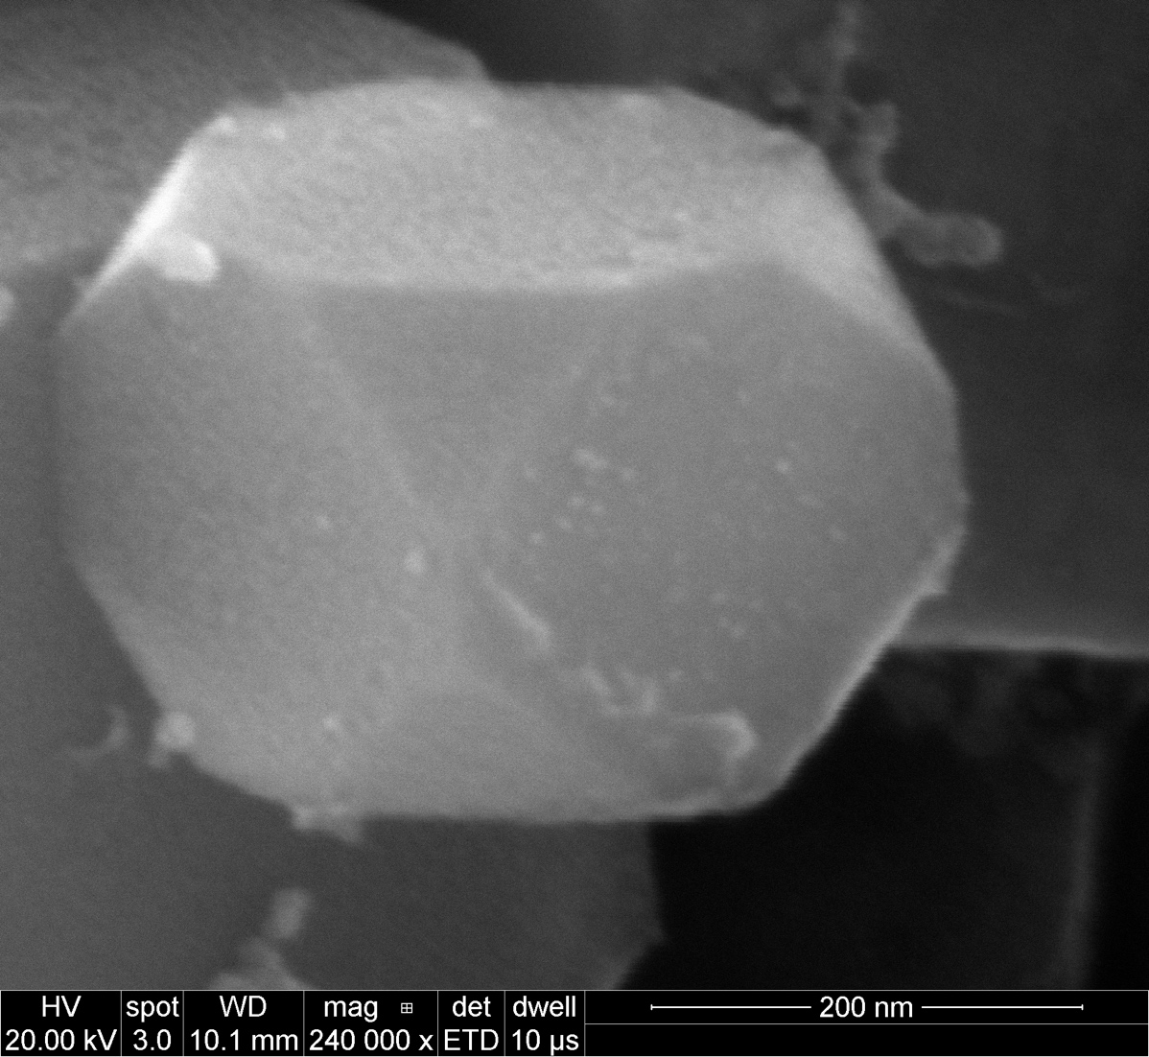
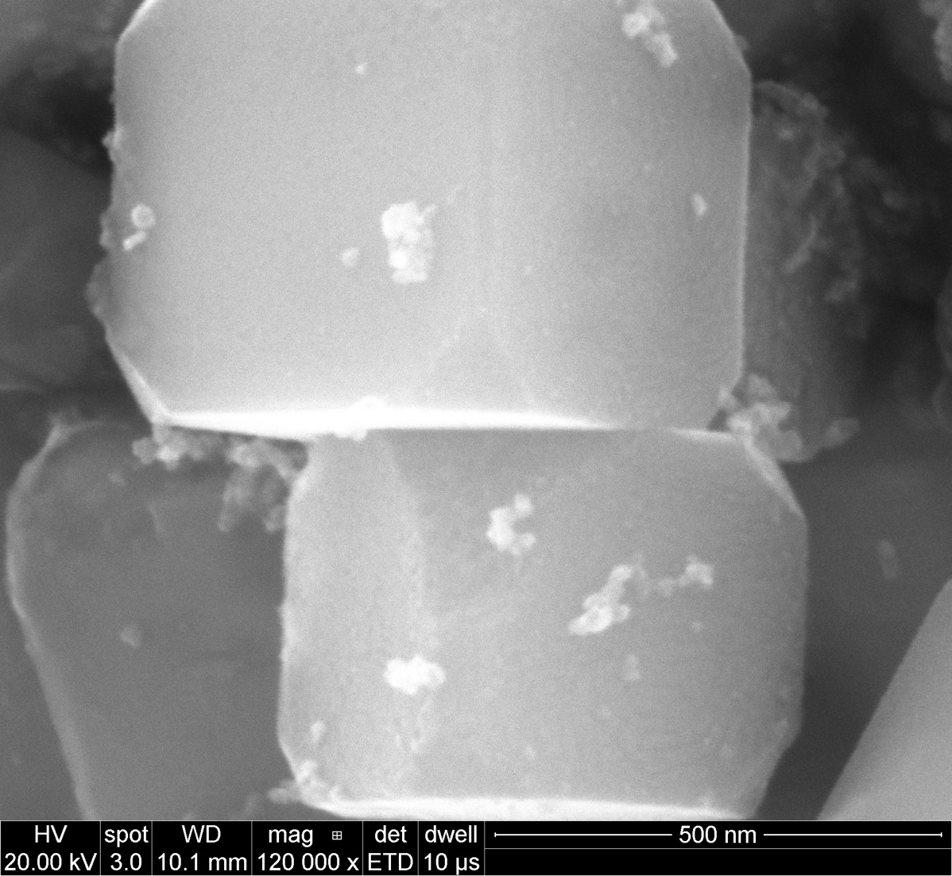
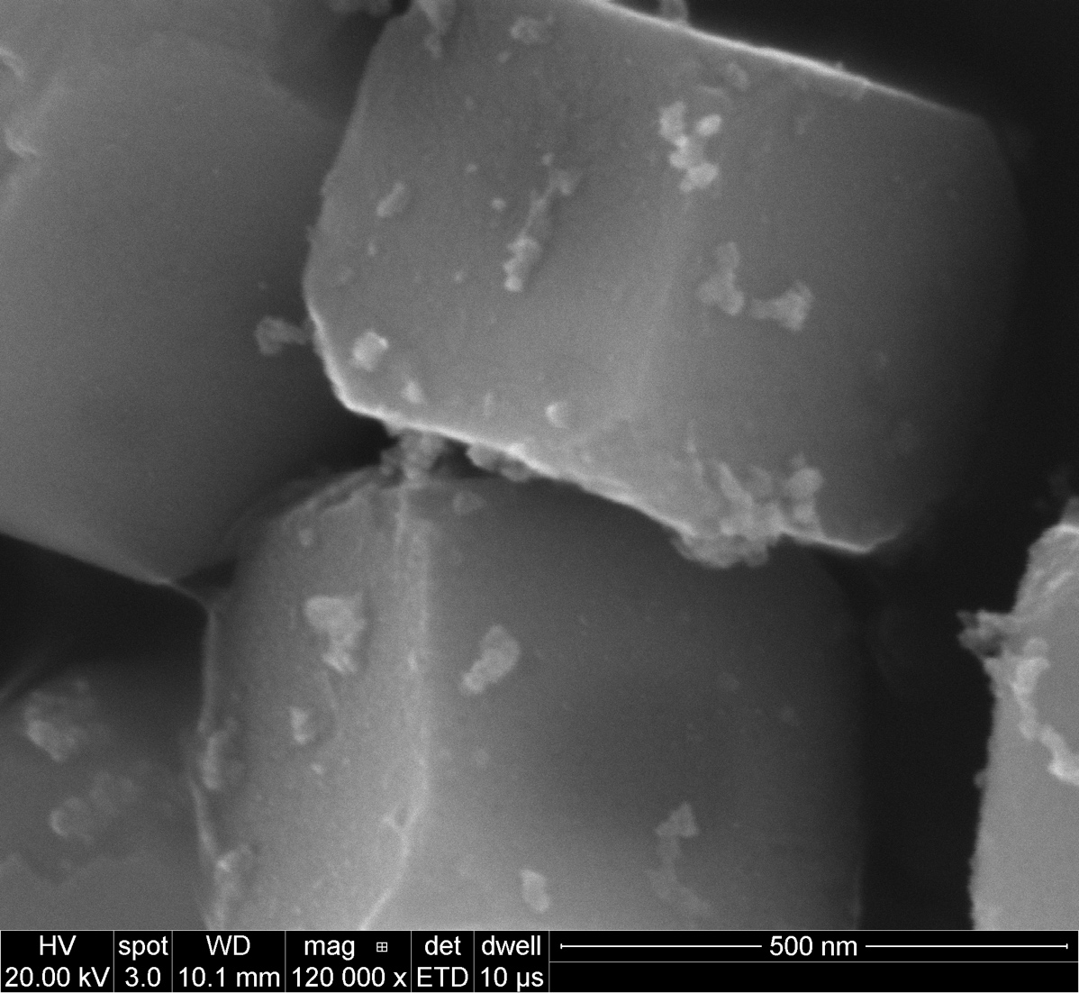
After Pt deposition

Slide 5
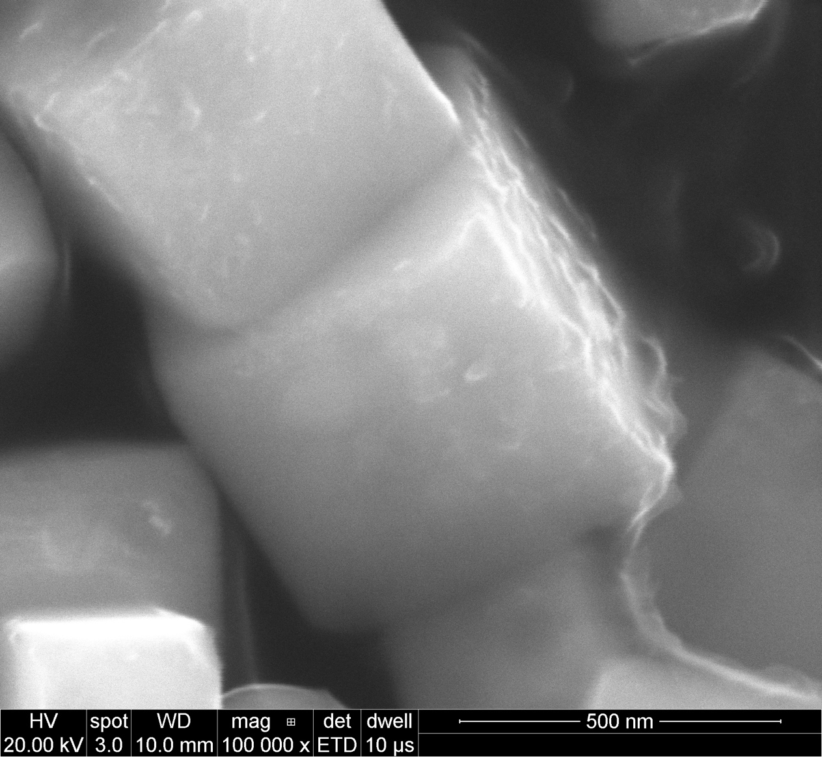
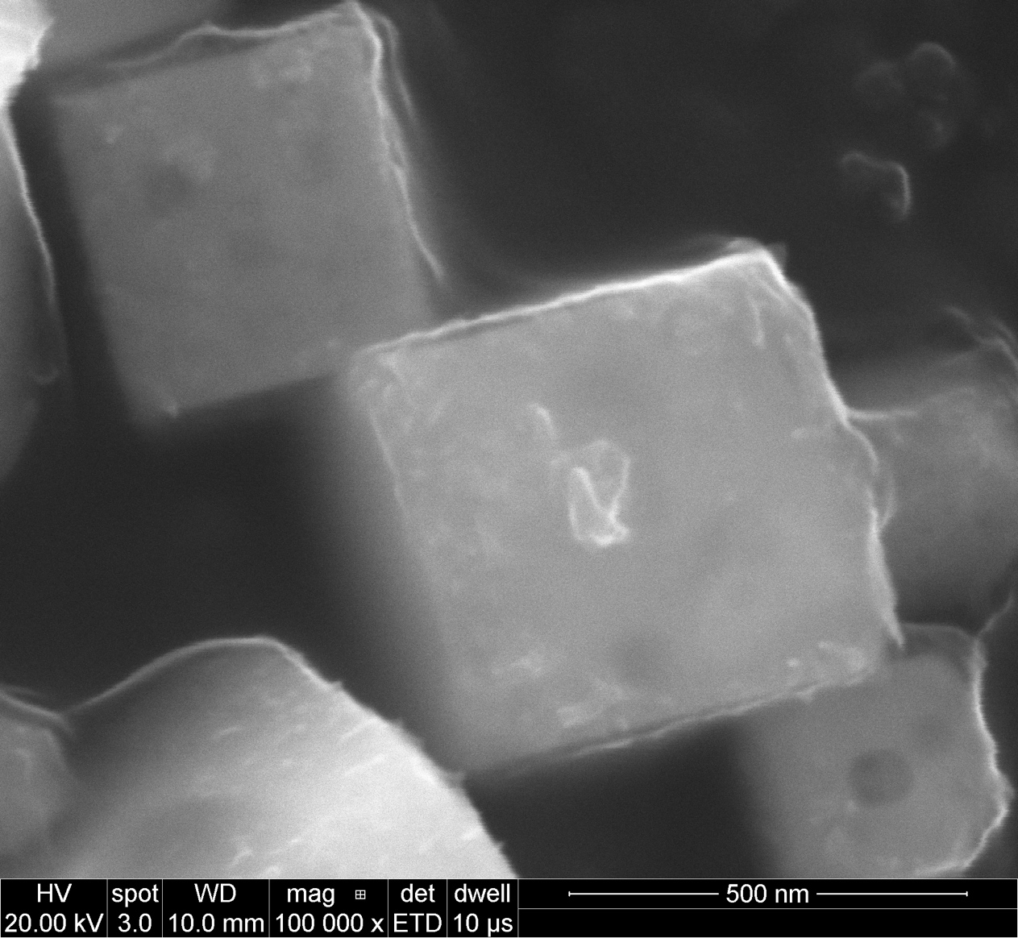
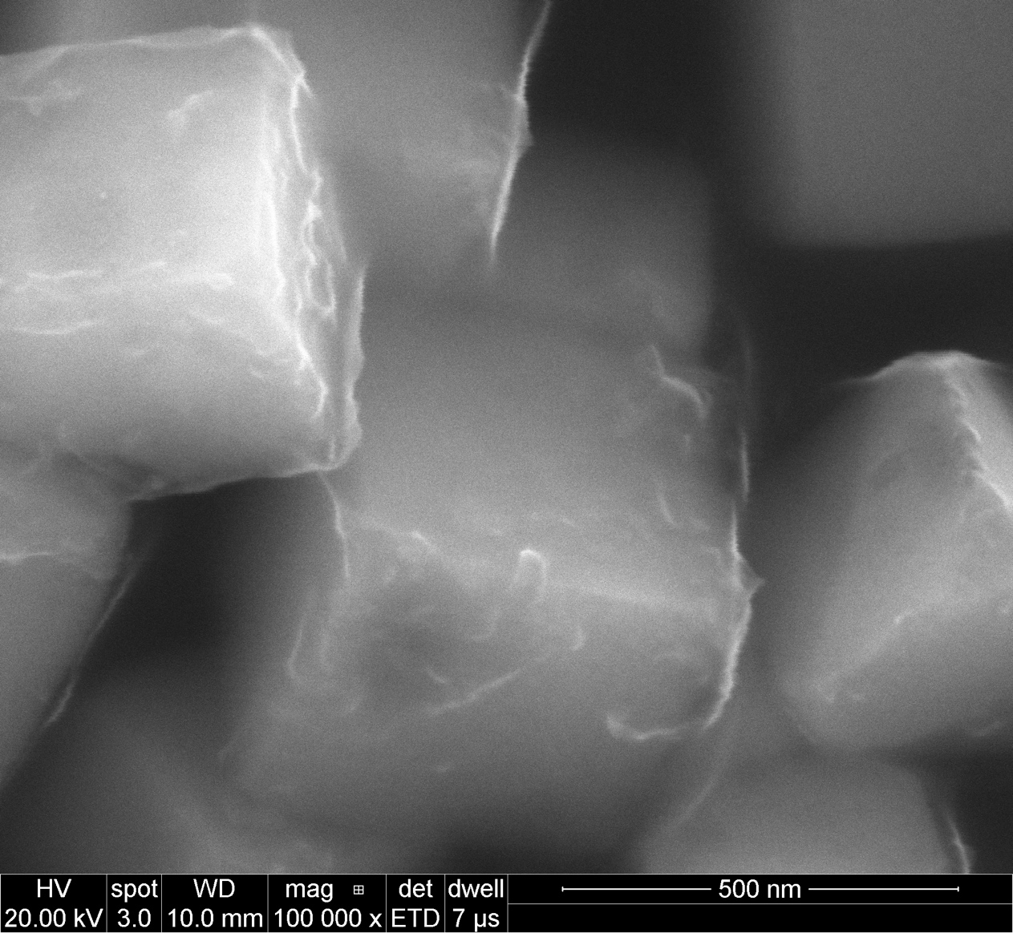
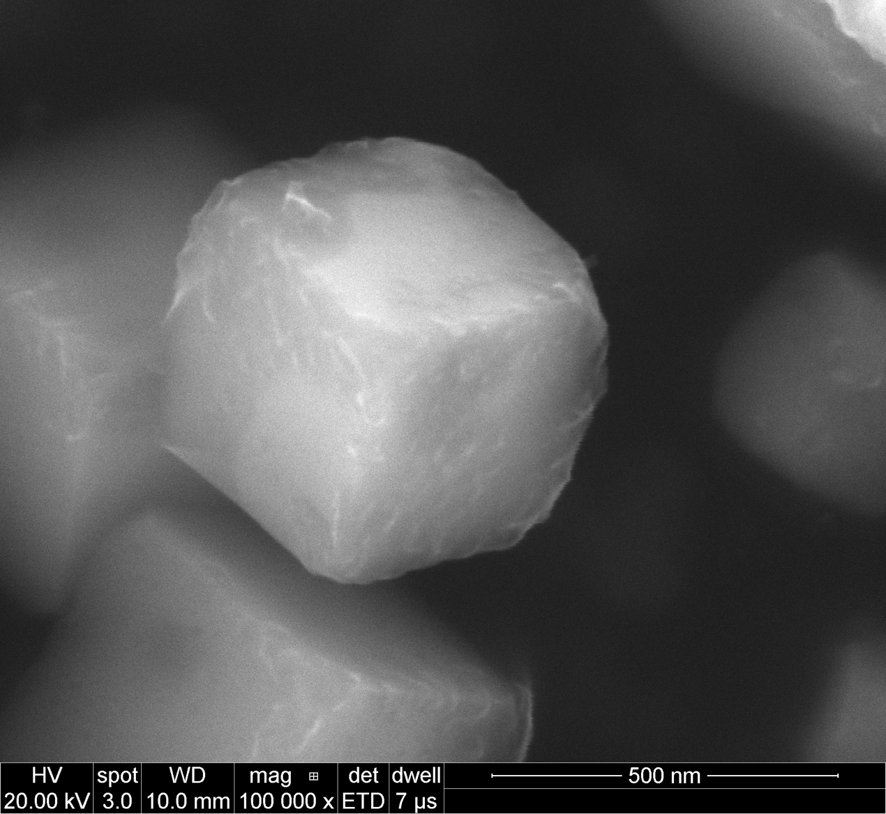
After Mn deposition

Slide 6
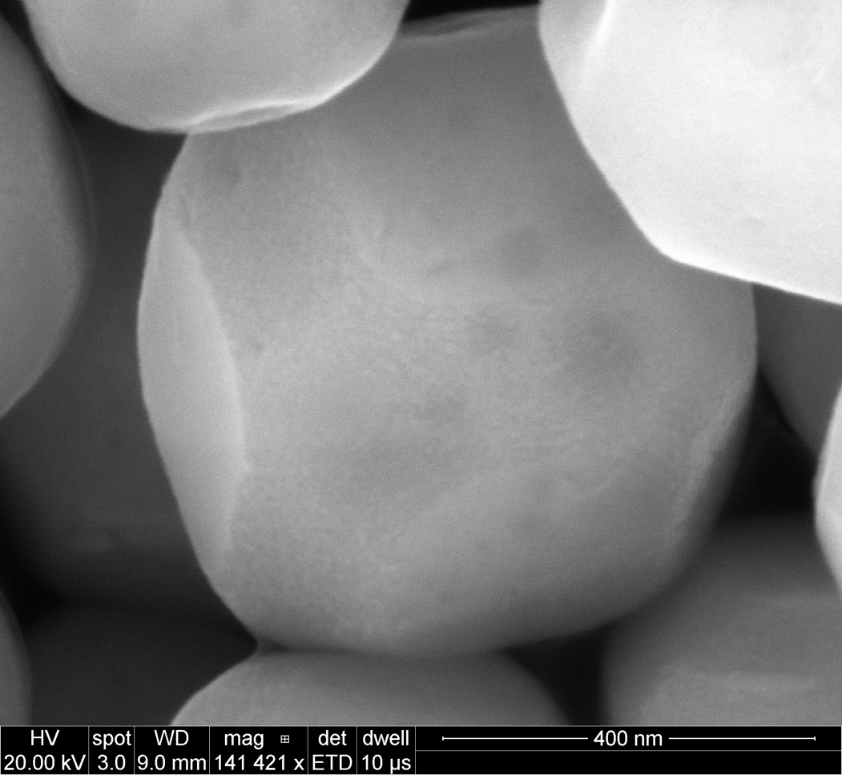
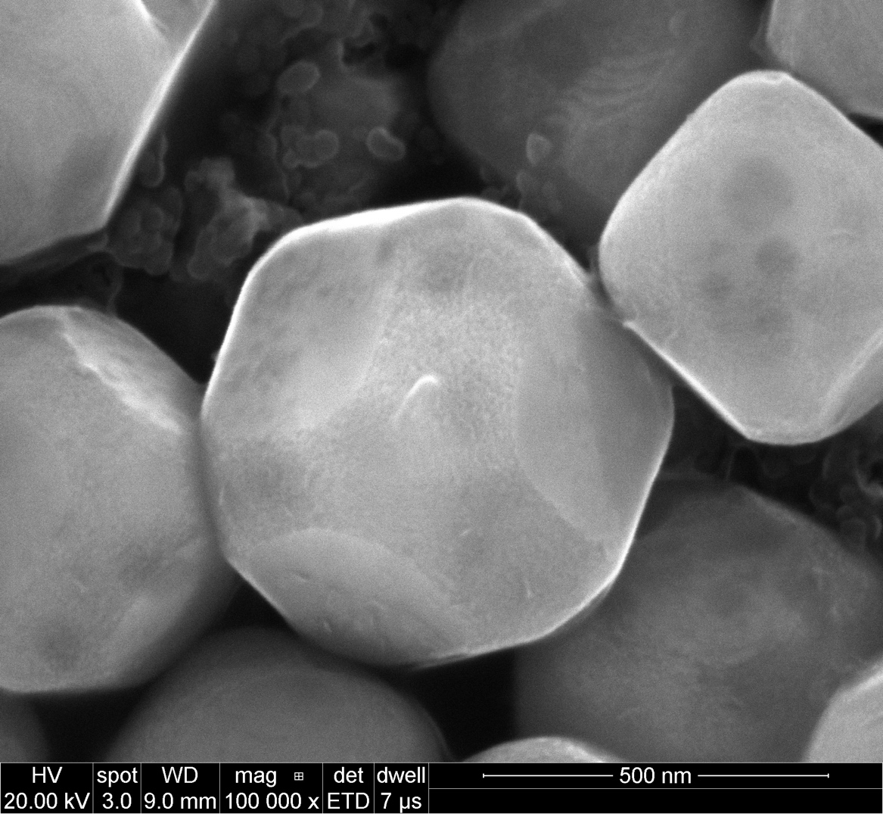
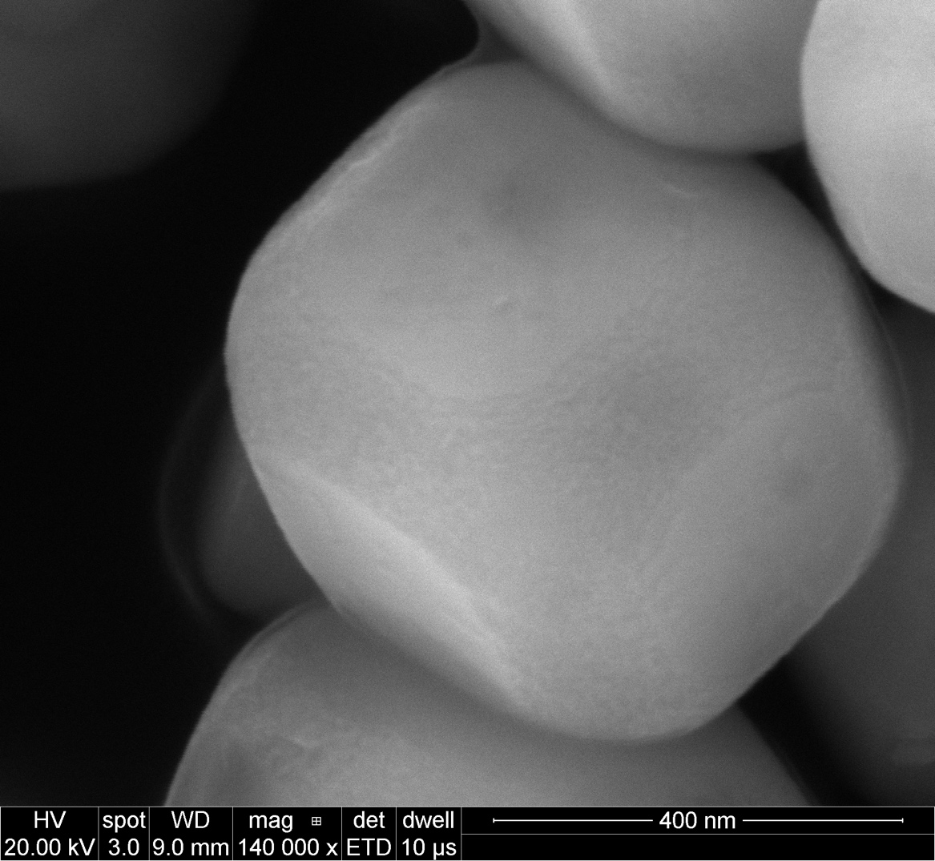
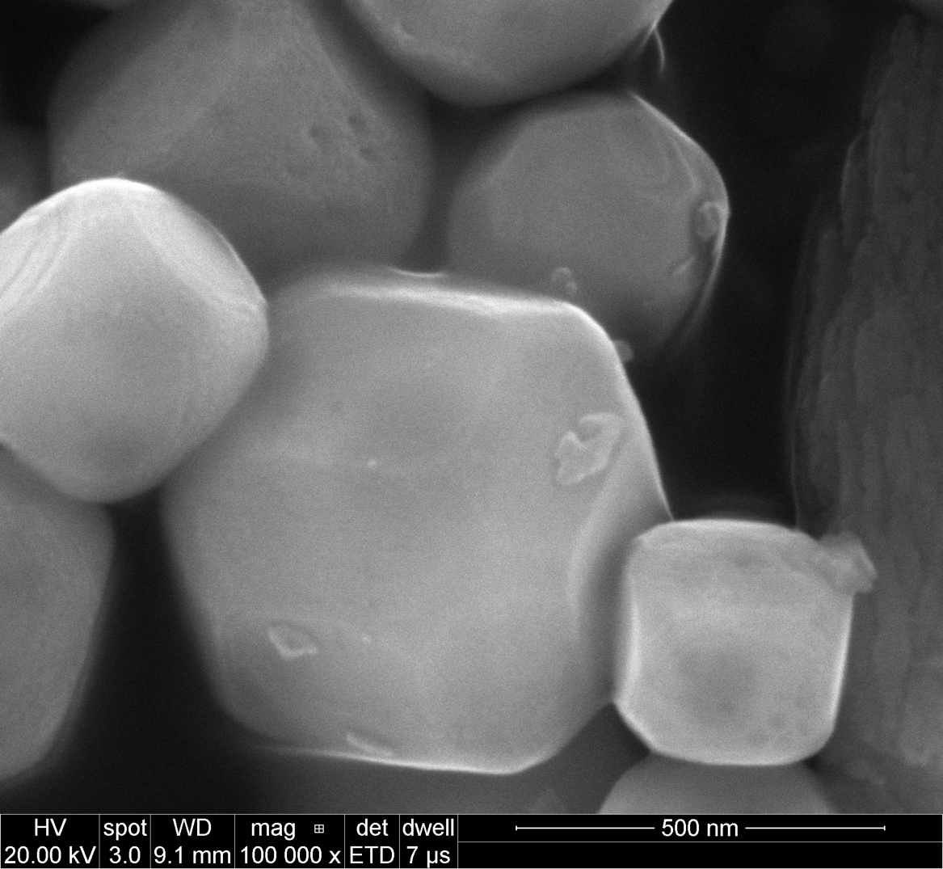
Shape B after treatment in Al flux (method 2)

Slide 7
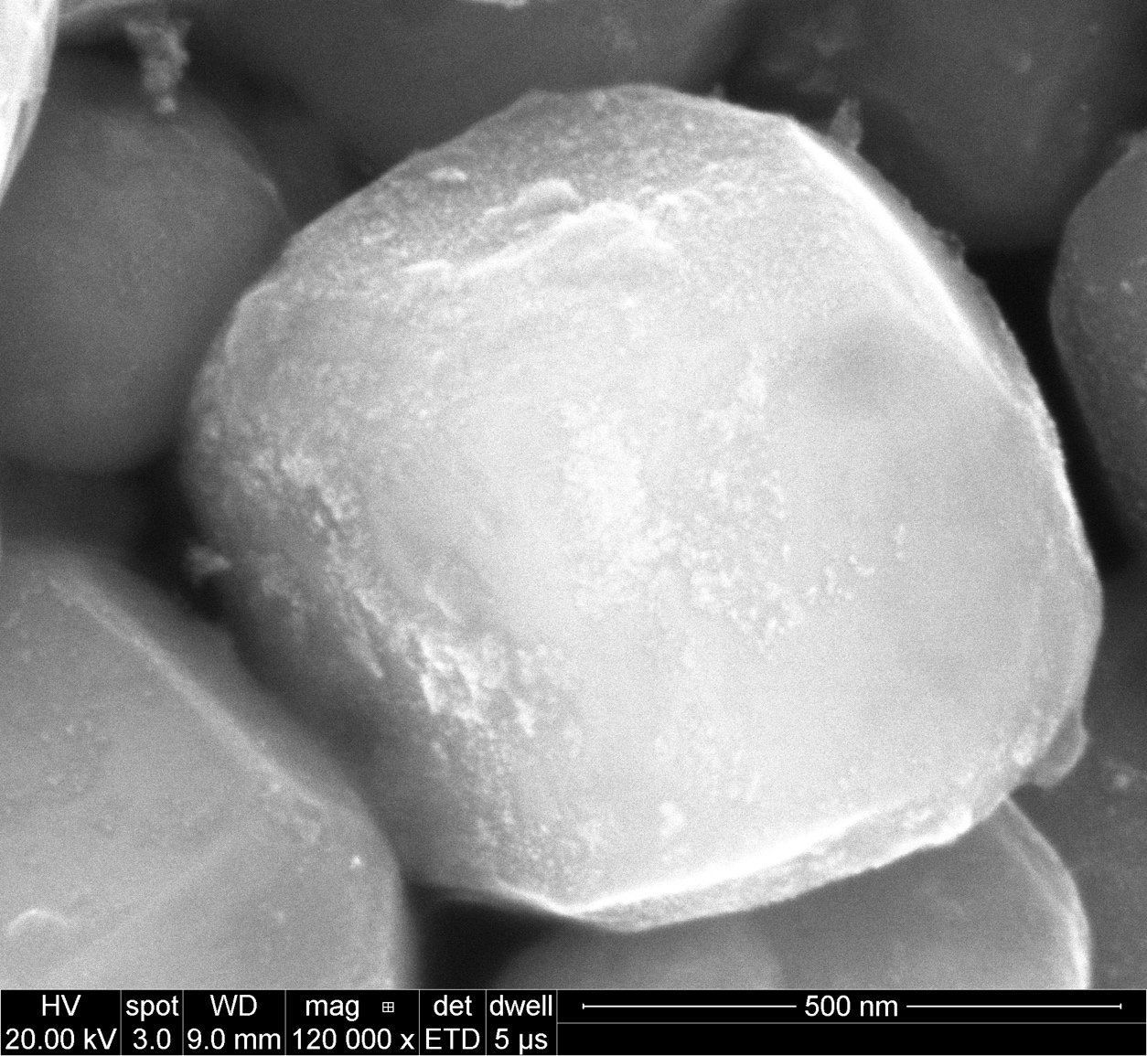
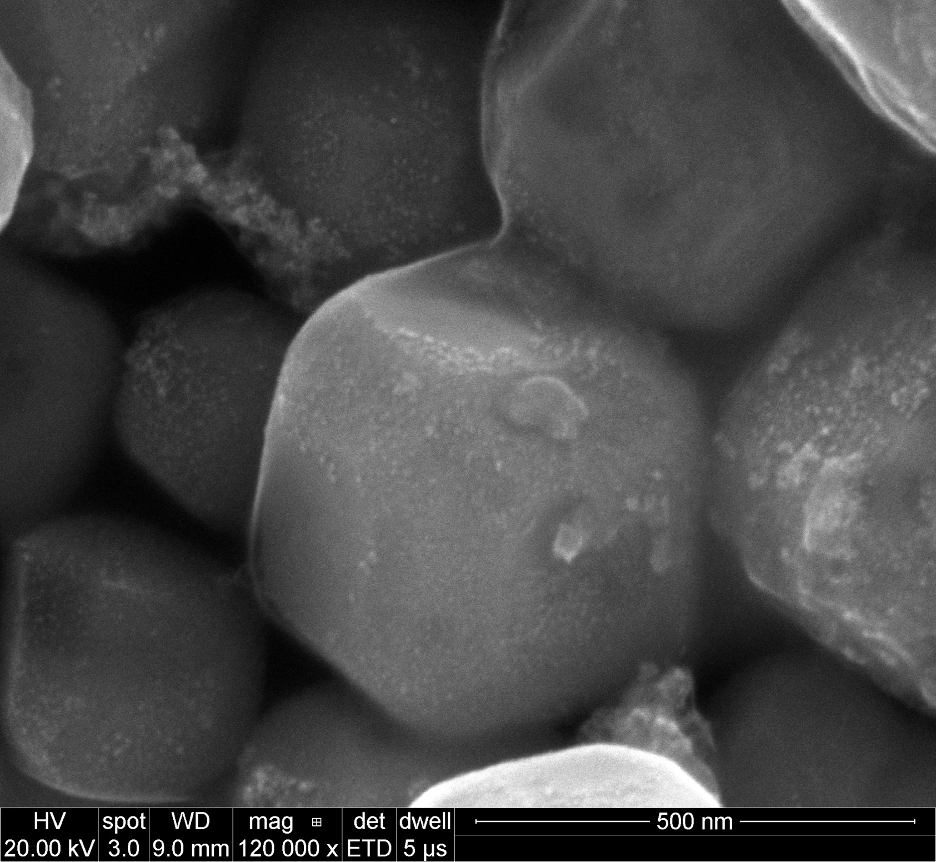
Shape B after treatment in Al flux (method 2)
Photo deposition of Pt

Slide 8
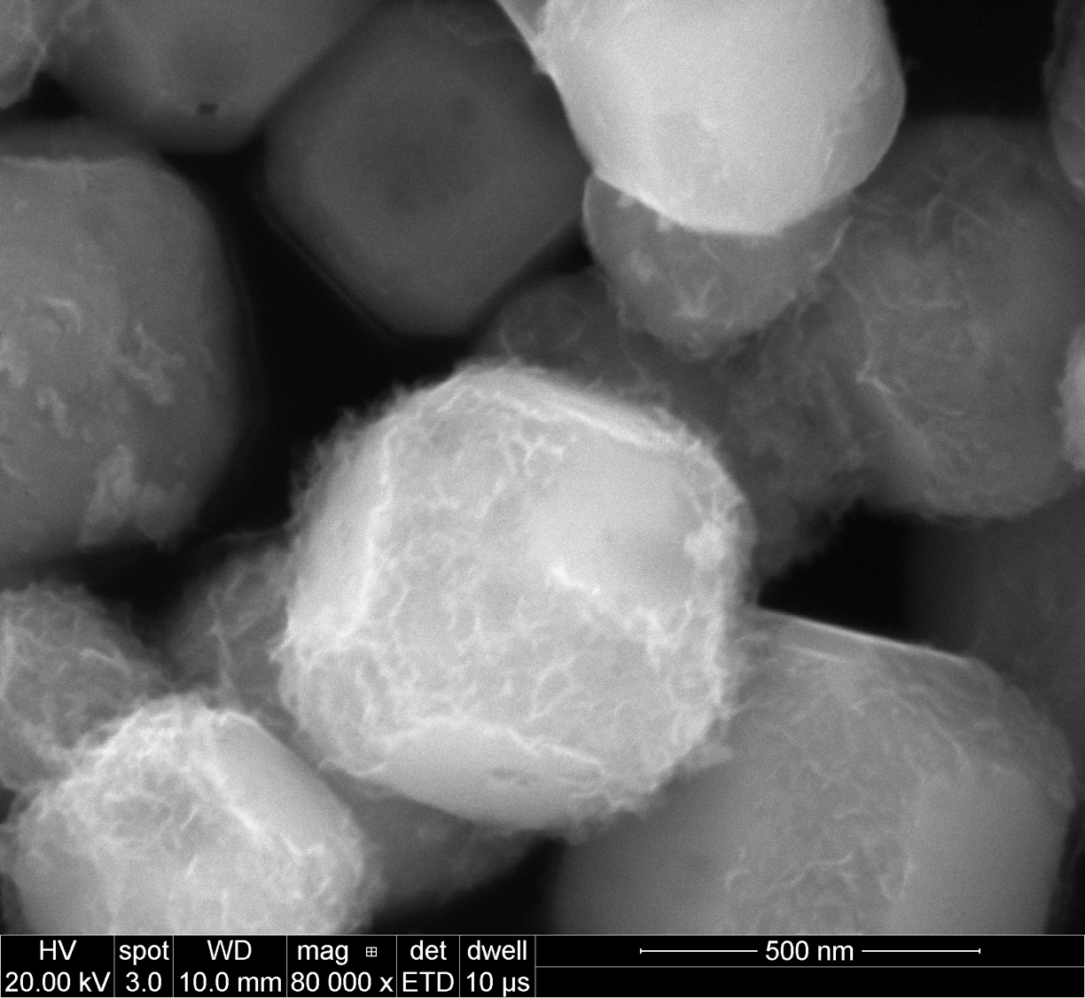
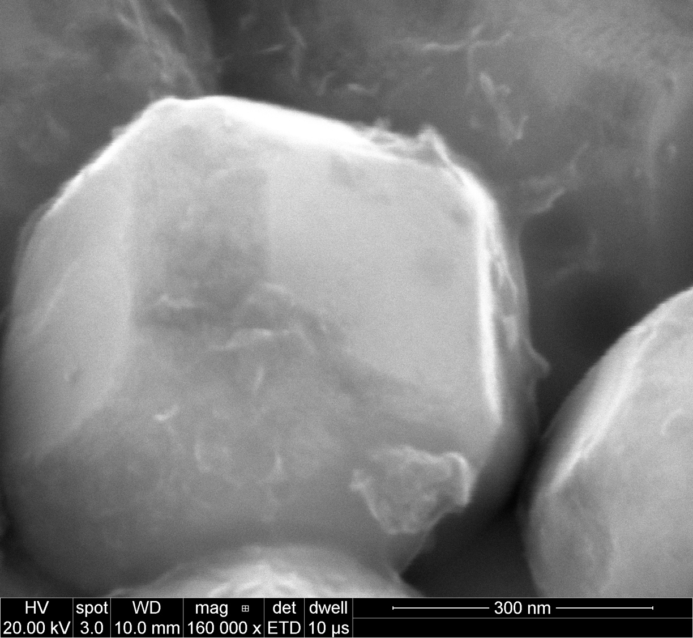
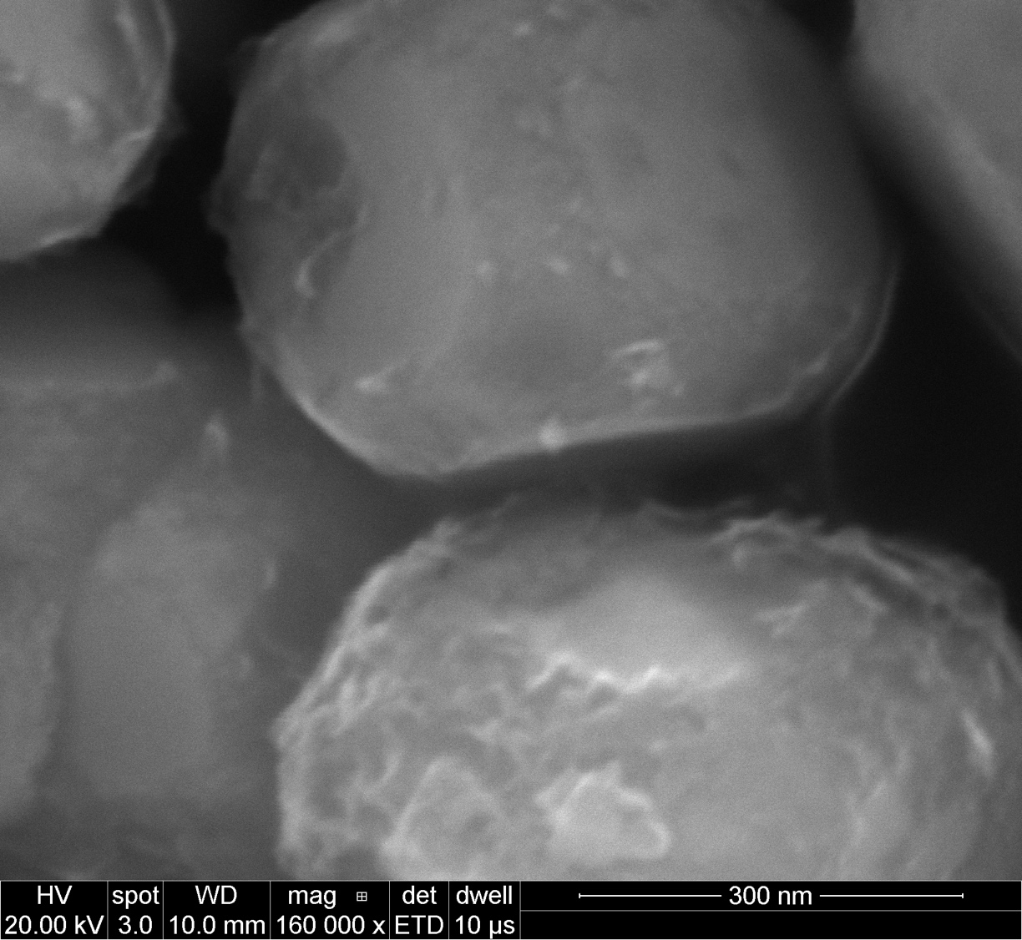
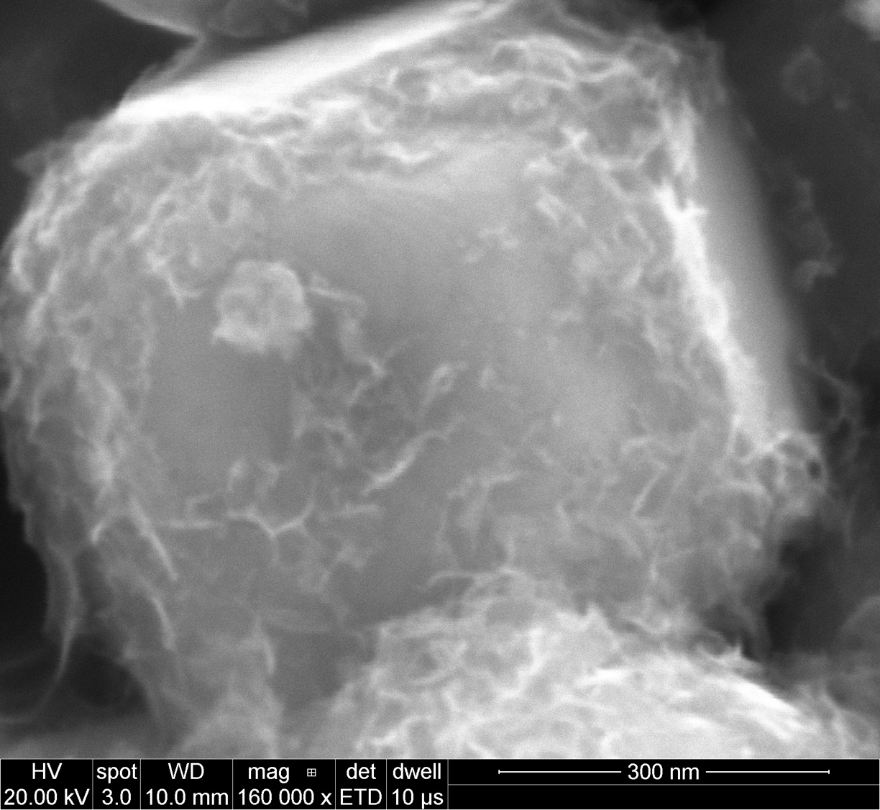
Shape B after treatment in Al flux (method 2)
Photo deposition of Mn

Slide 9
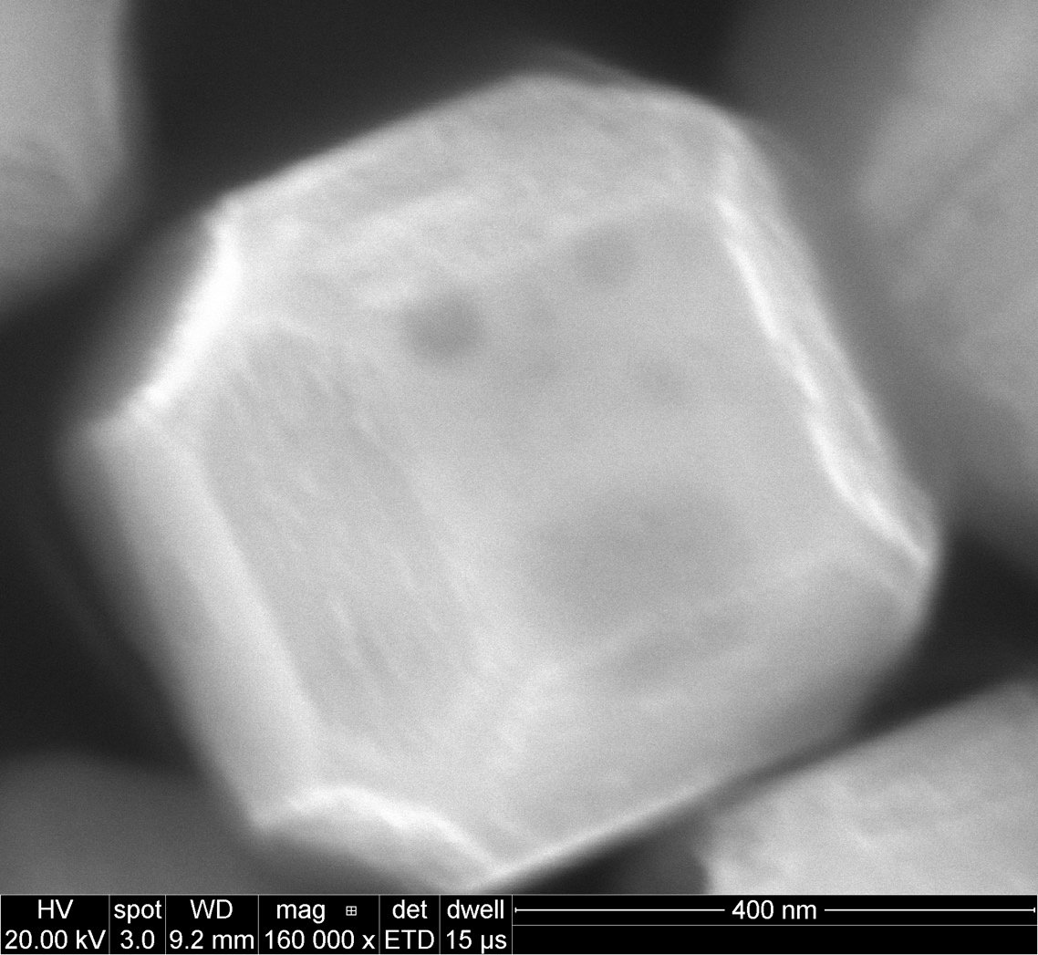
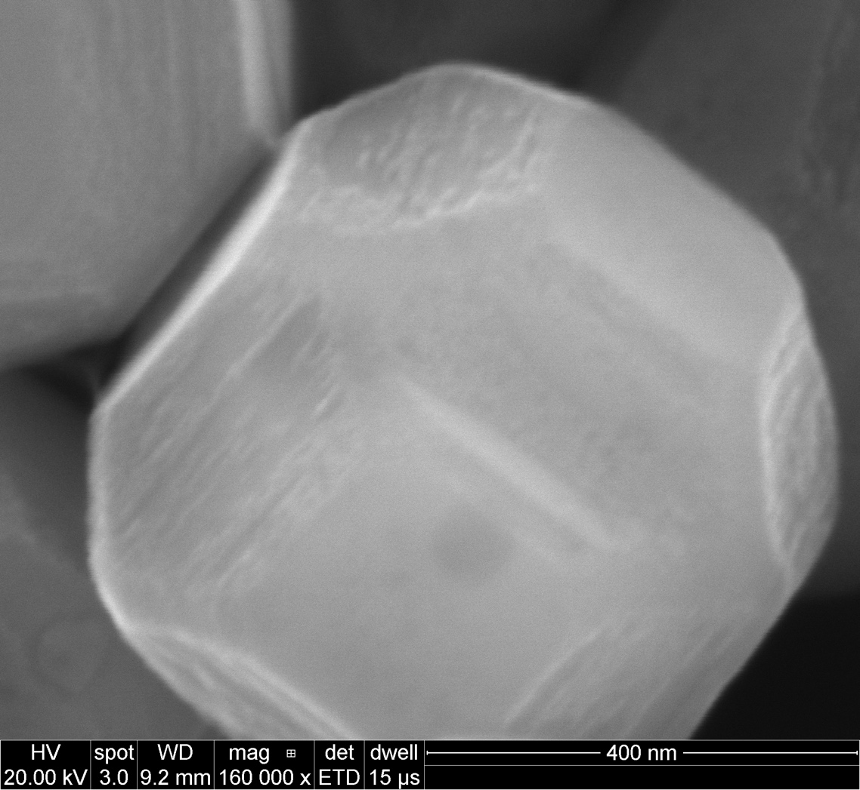
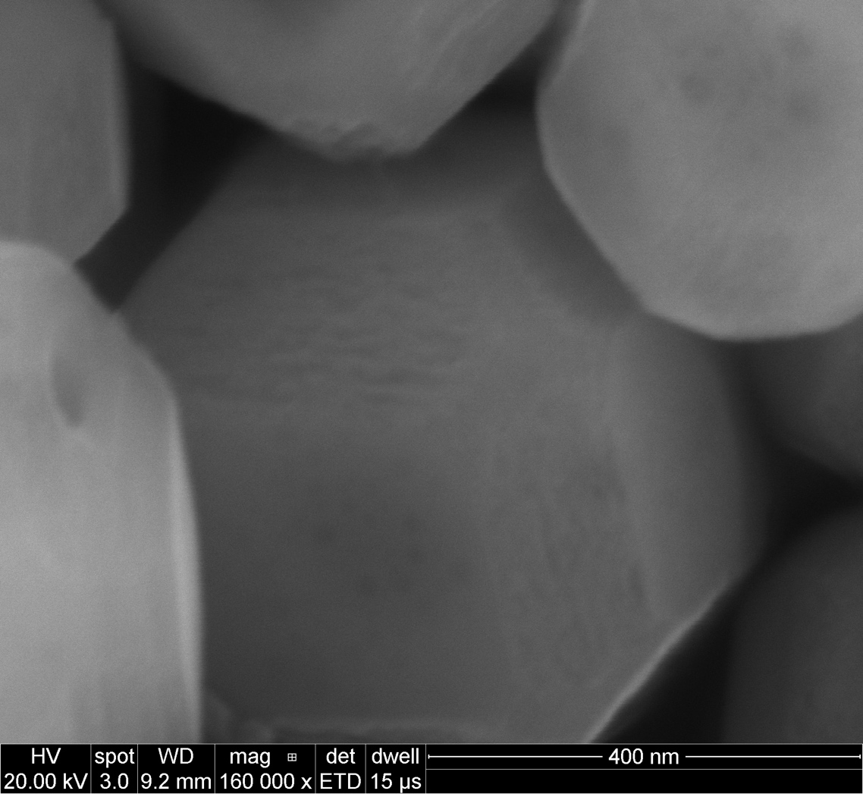
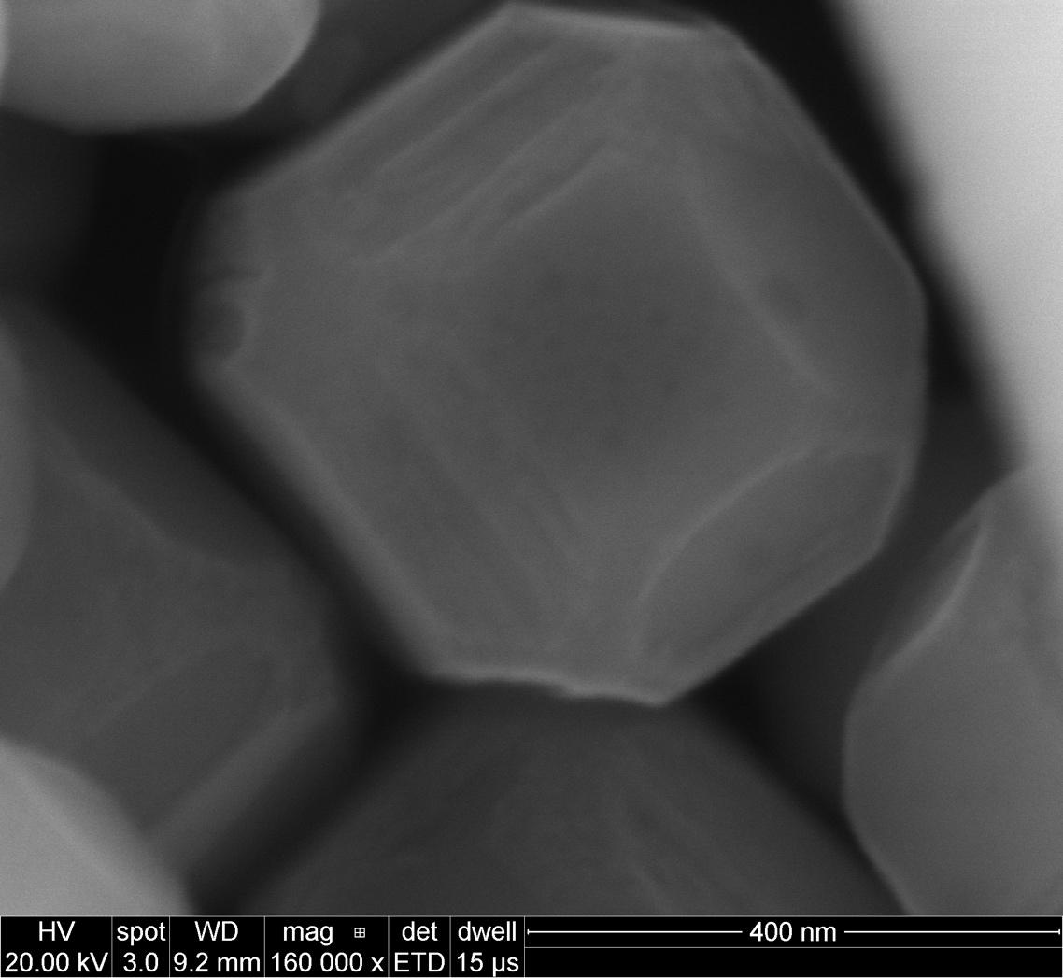
Shape C after treatment in Al flux (method 2)

Slide 10
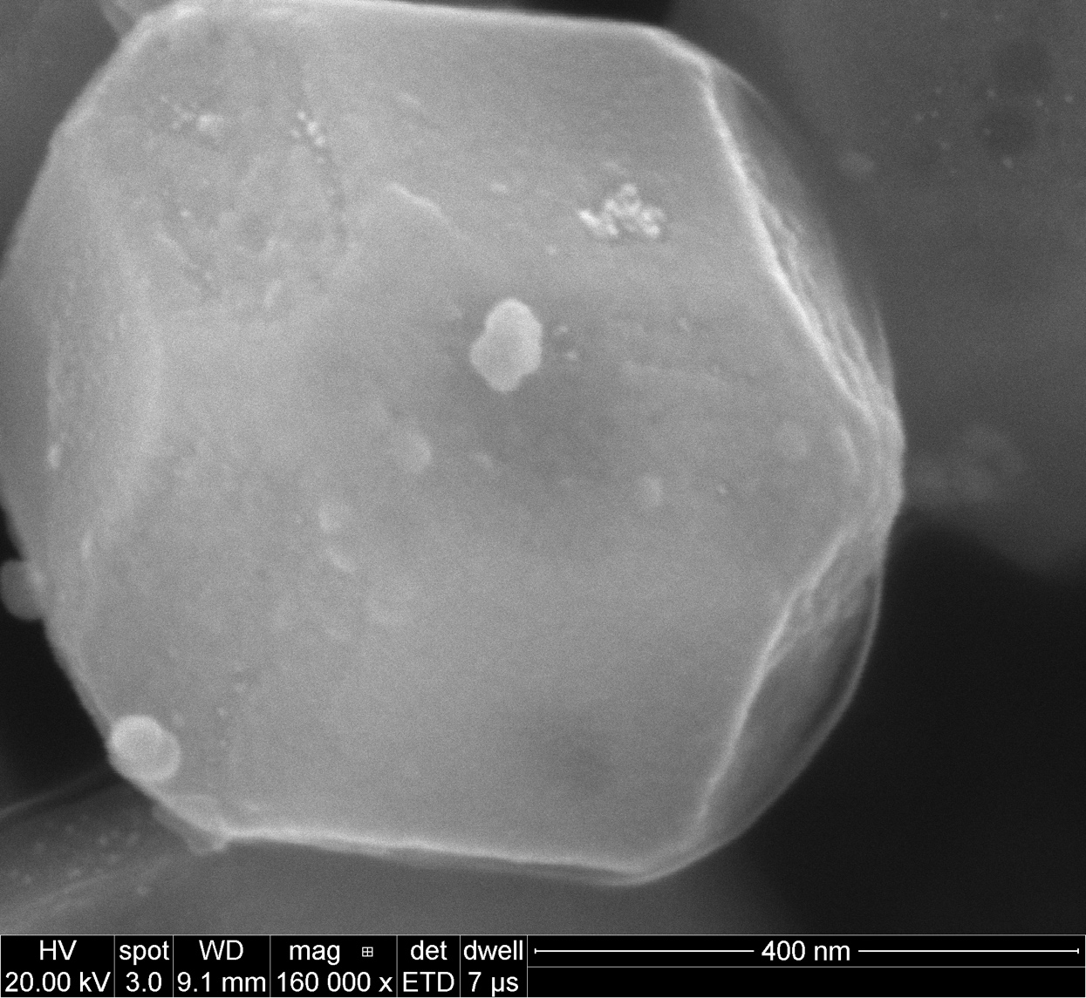
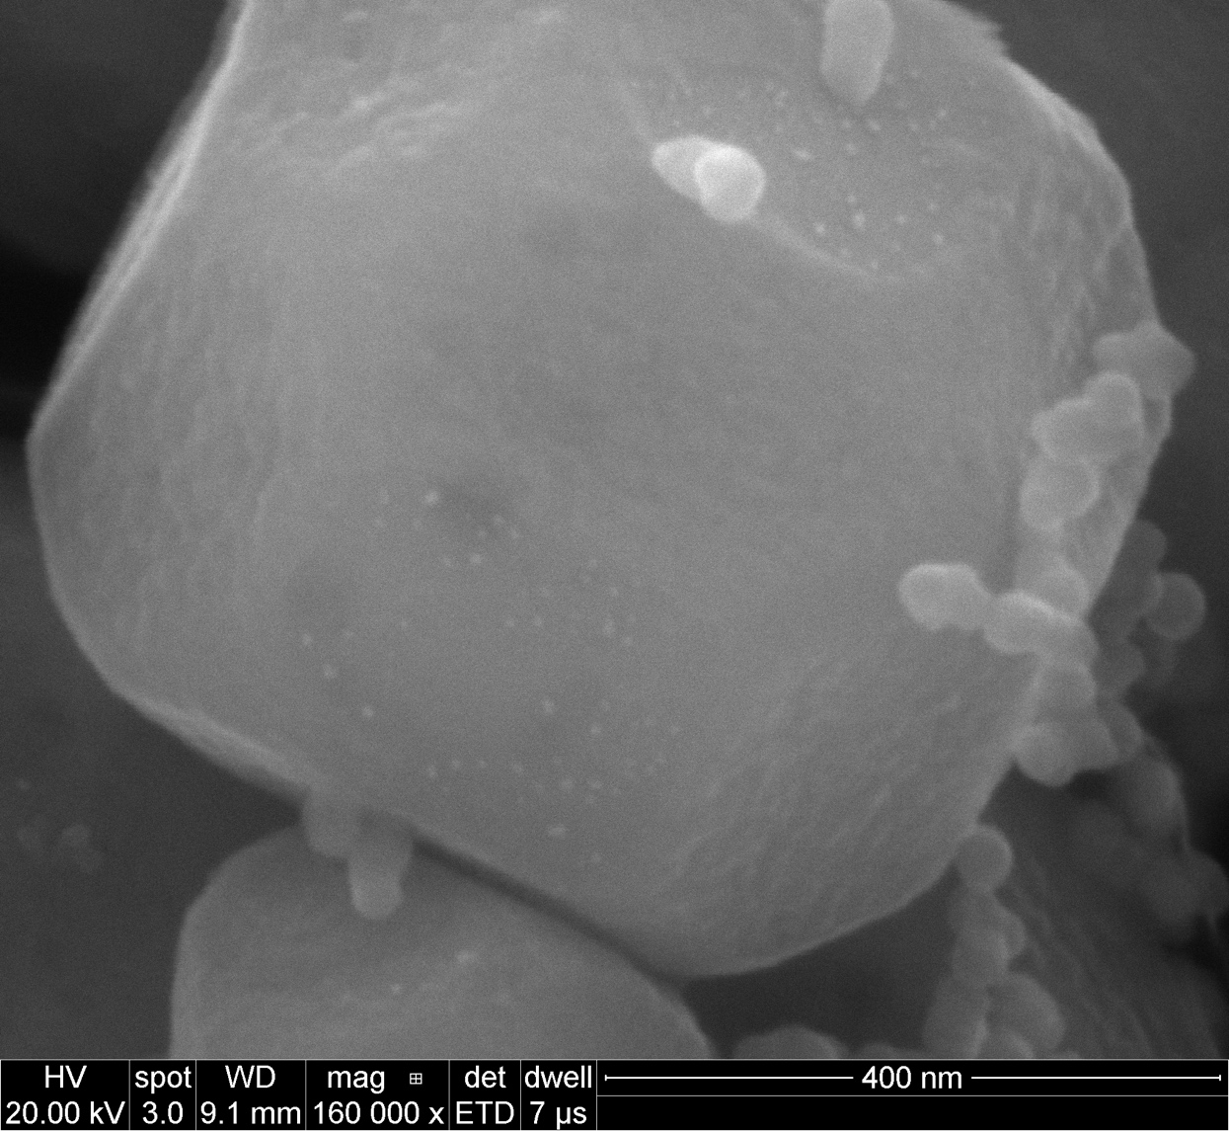
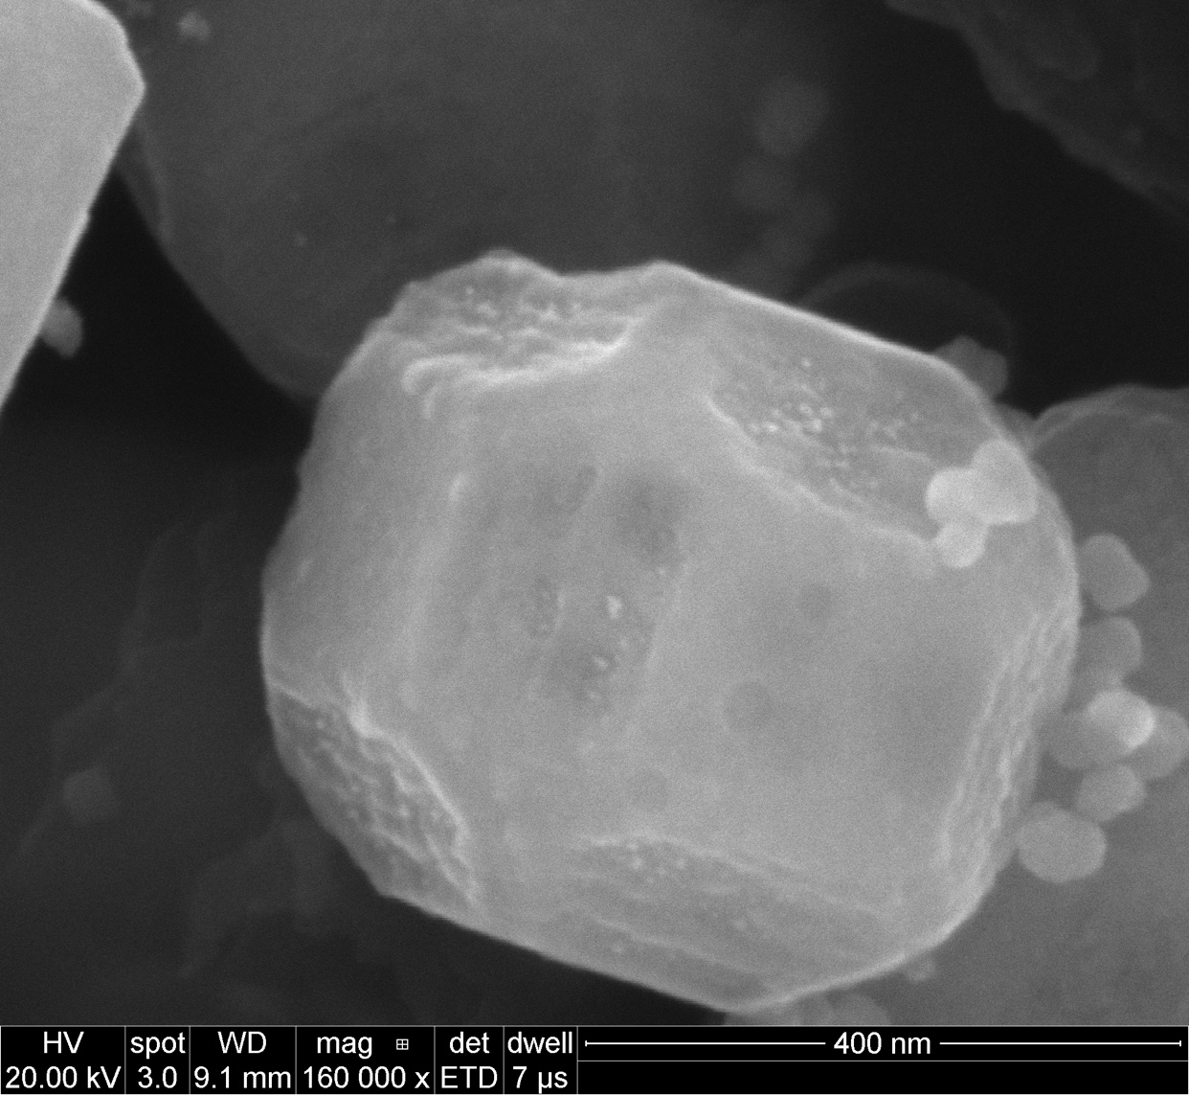
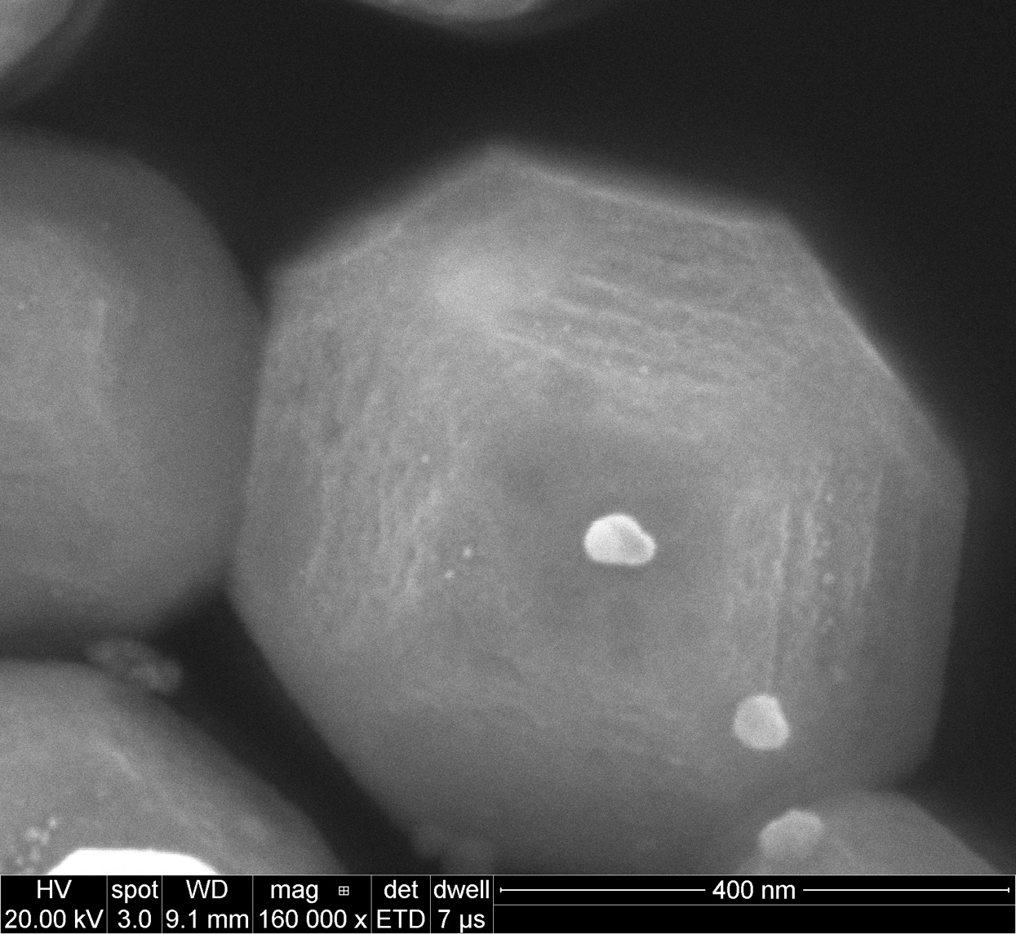
After Pt deposition

Slide 11
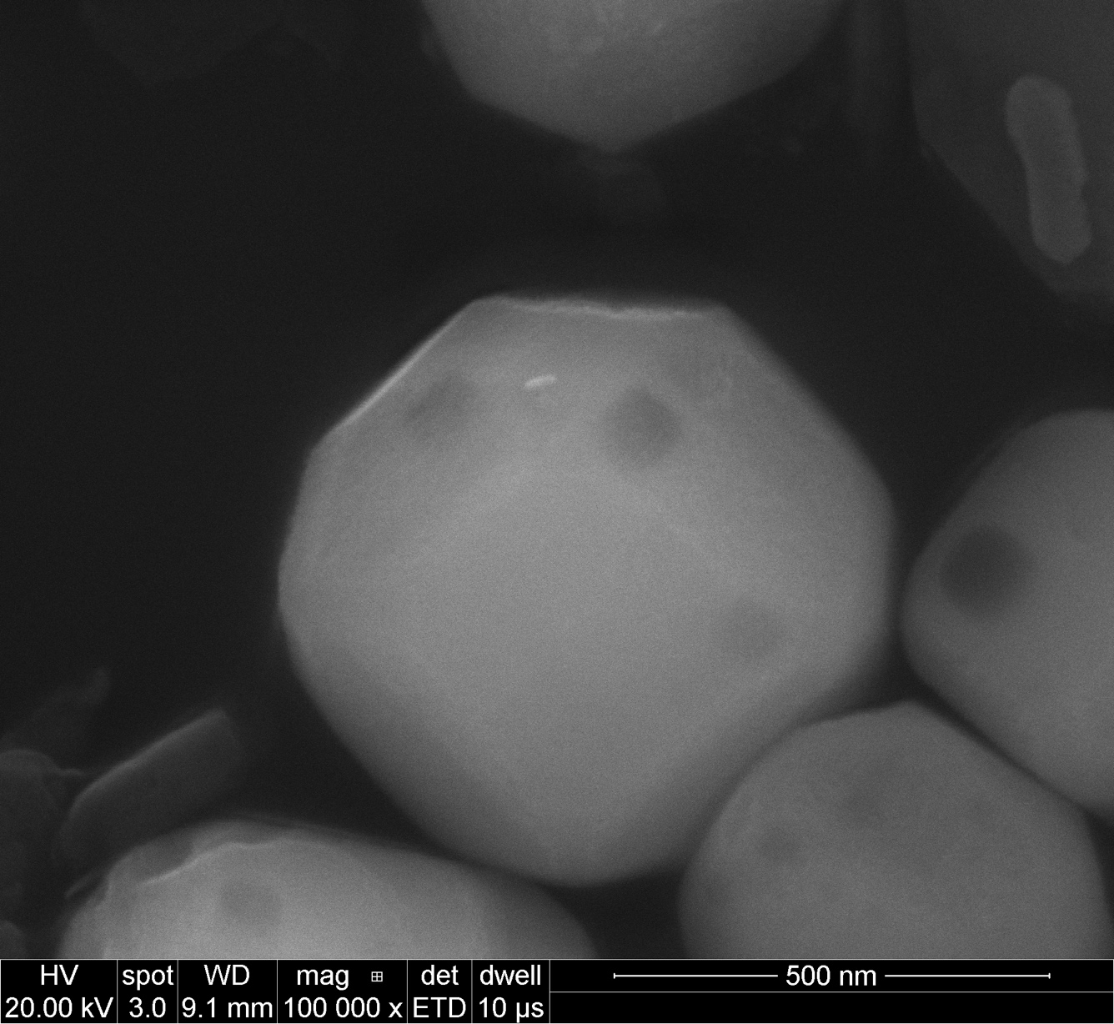
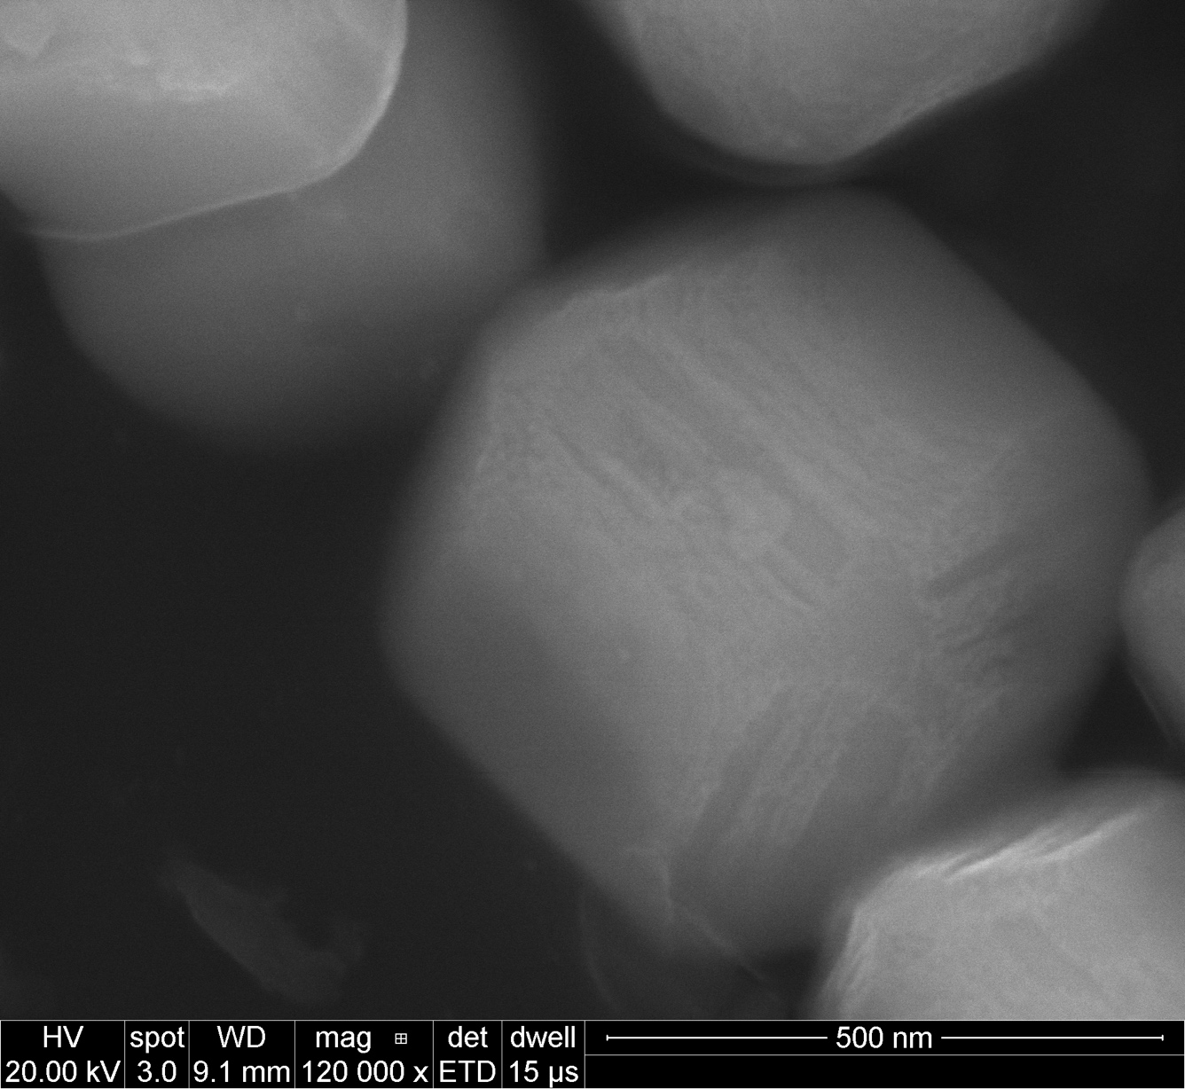
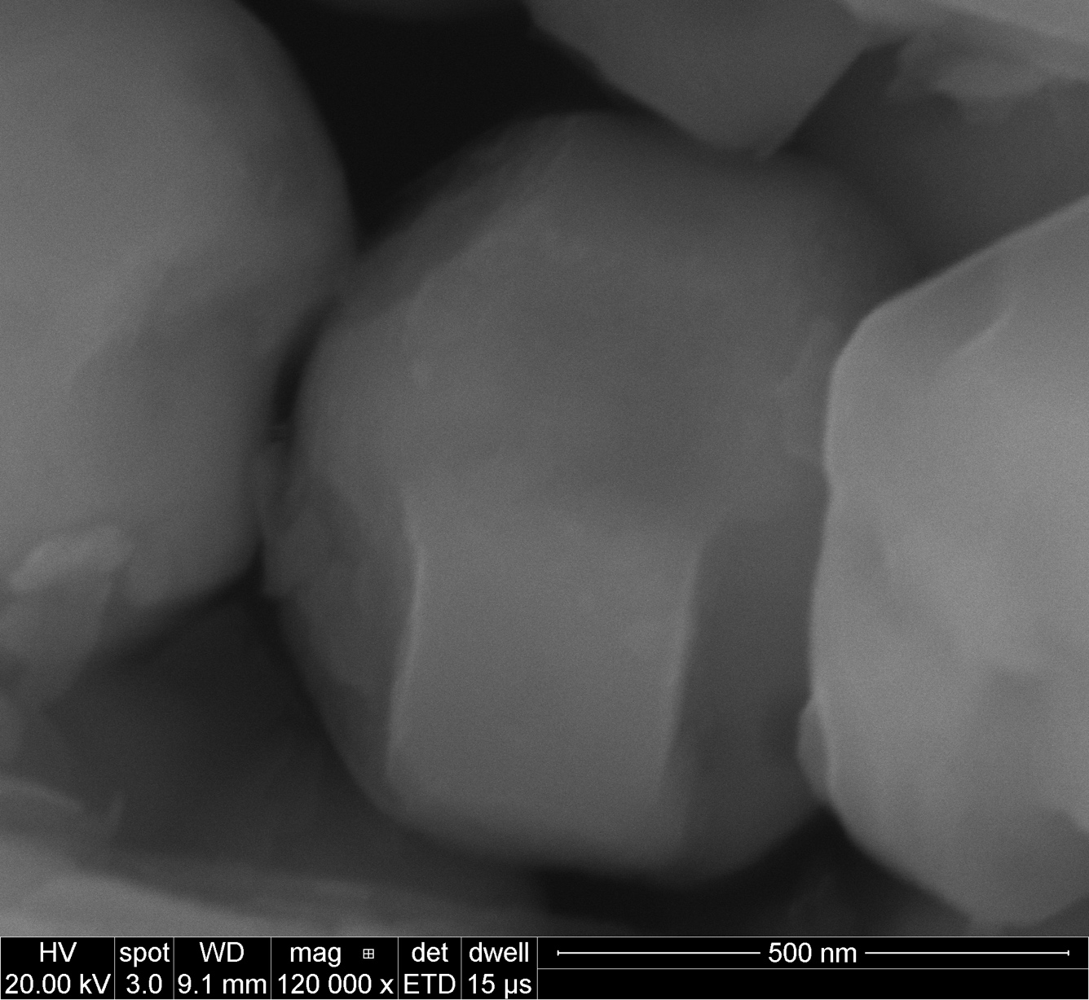
Shape D after treatment in Al flux (method 2)

Slide 12
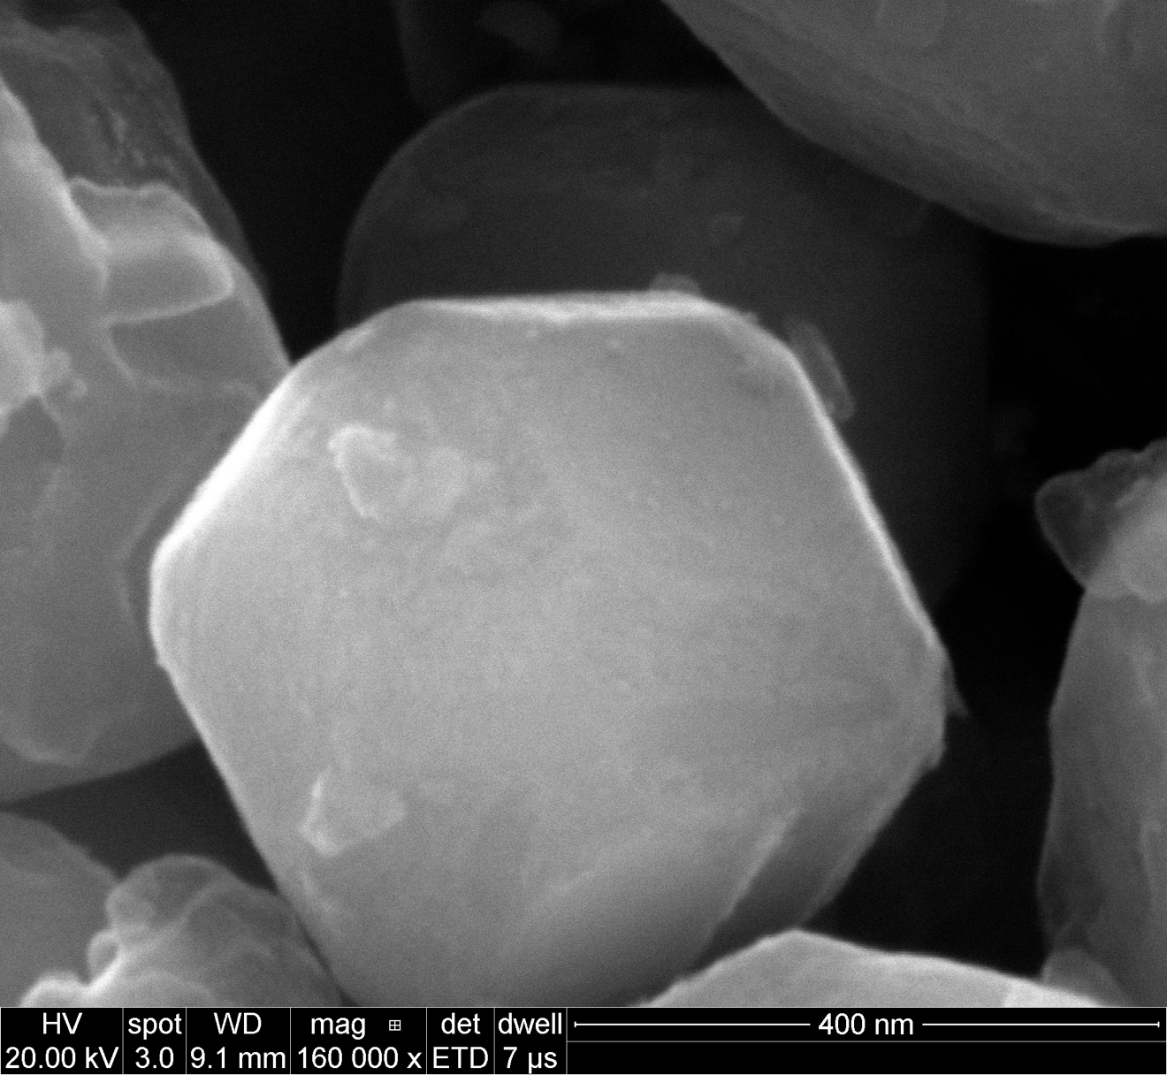
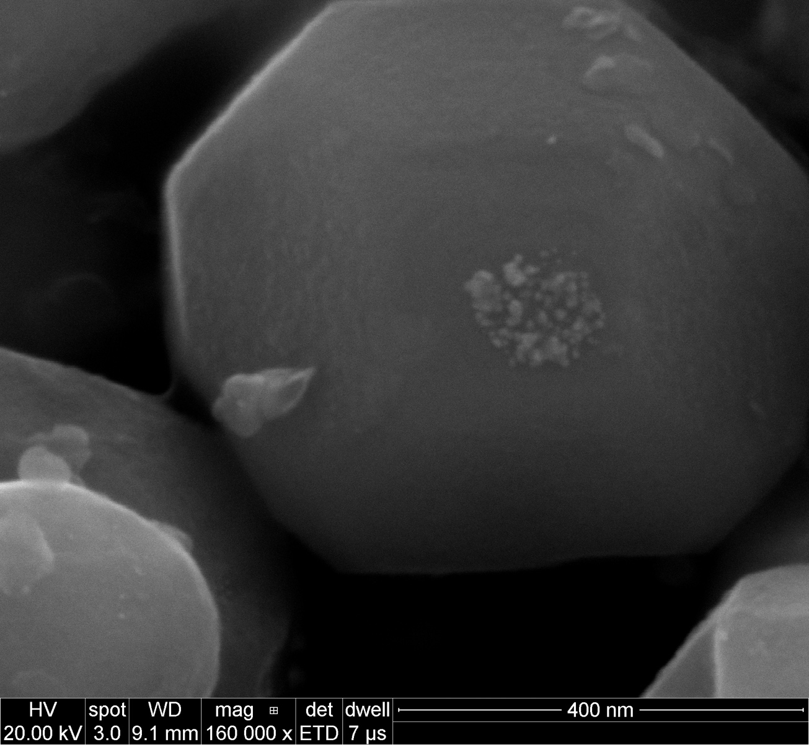
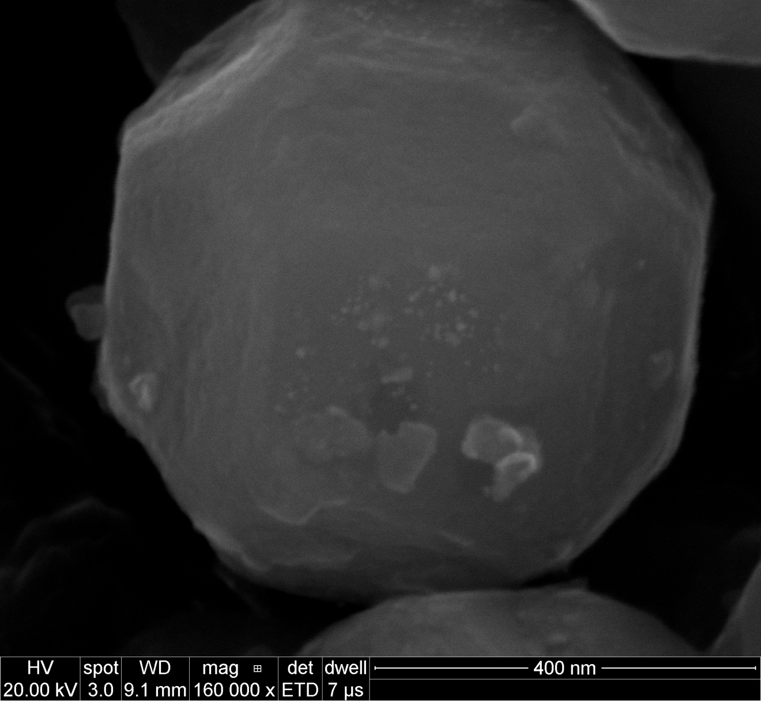
After Pt deposition

Slide 13
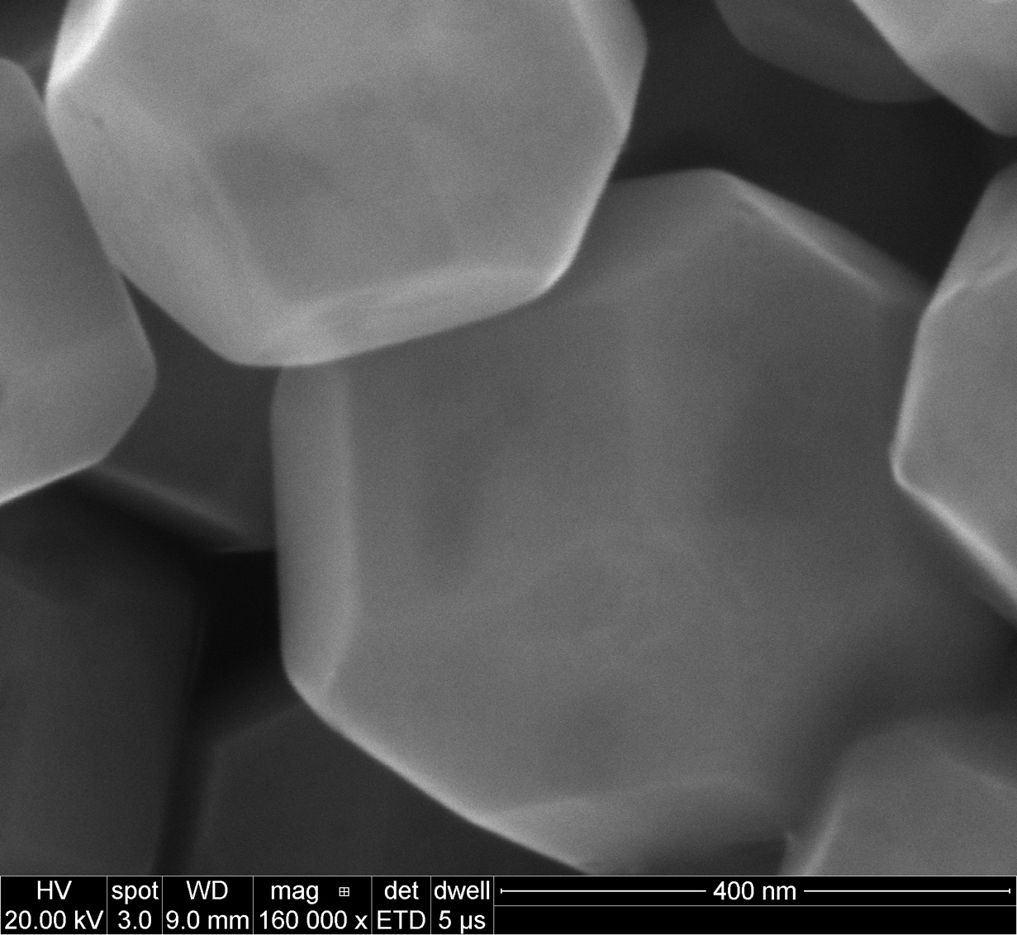
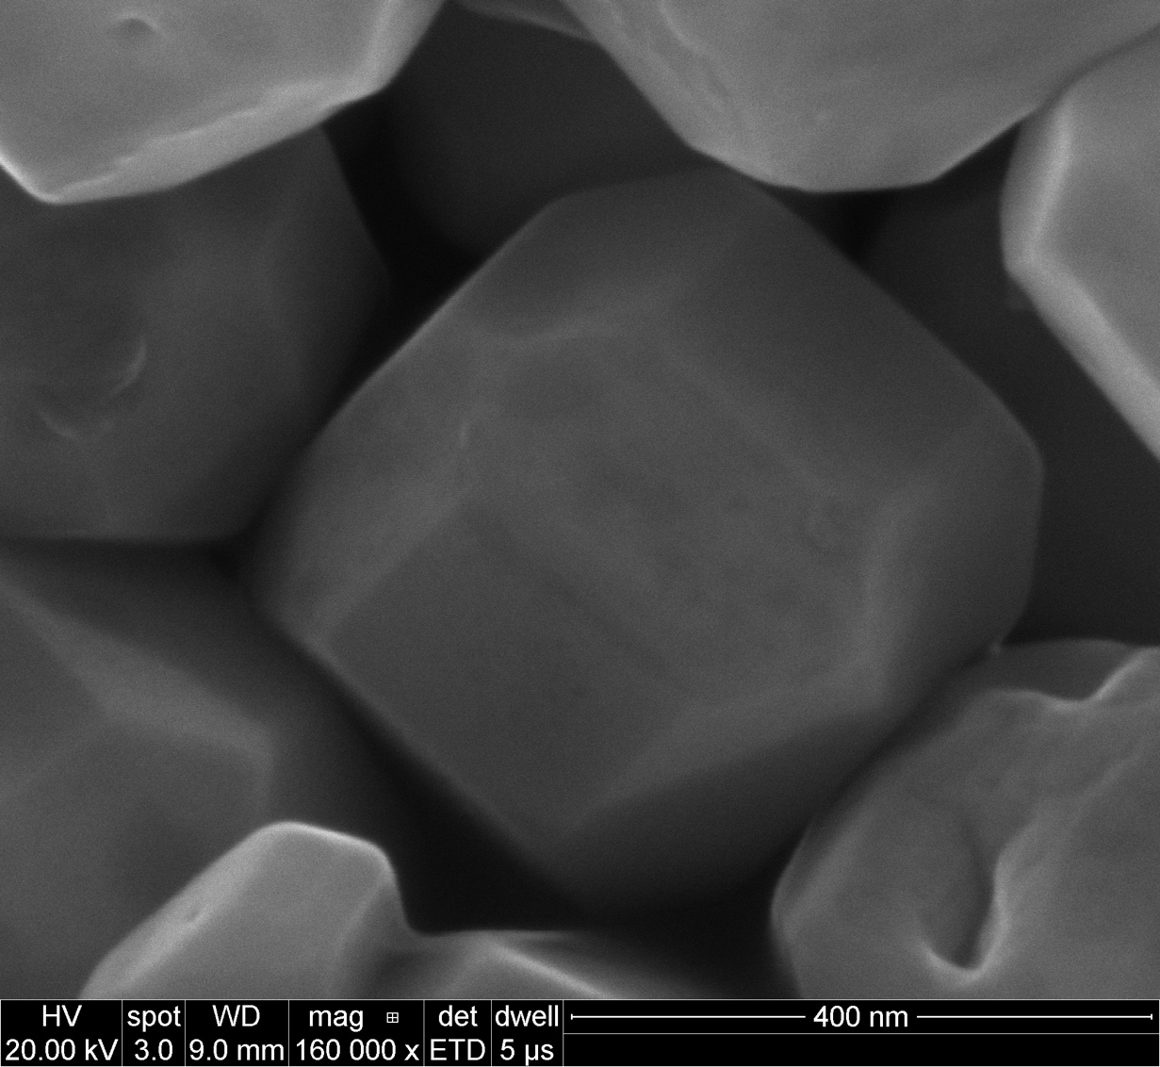
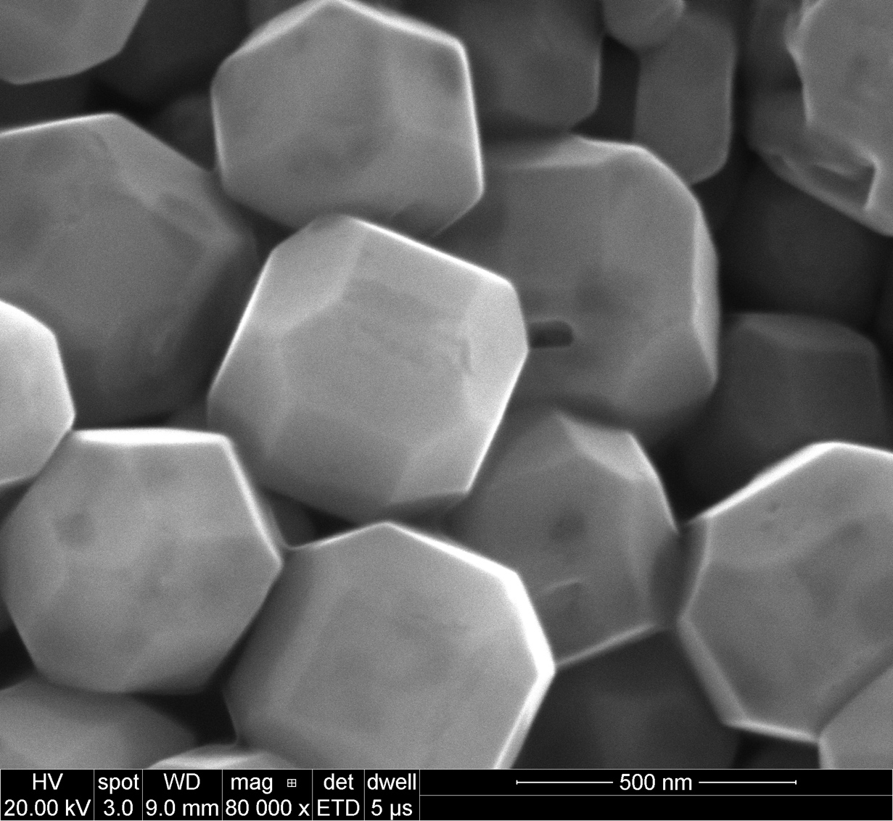
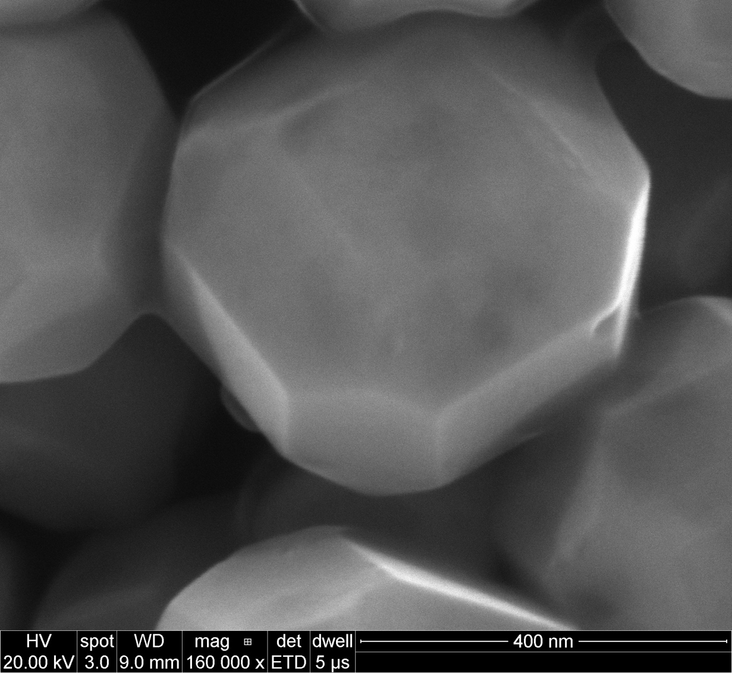
Shape C prepared with mothed 1

Slide 14
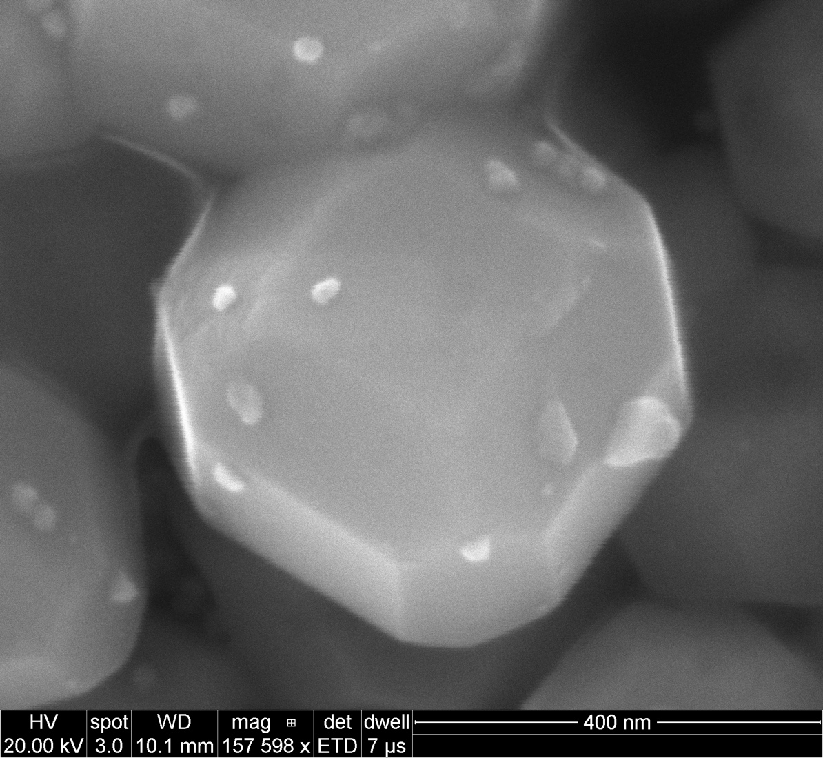
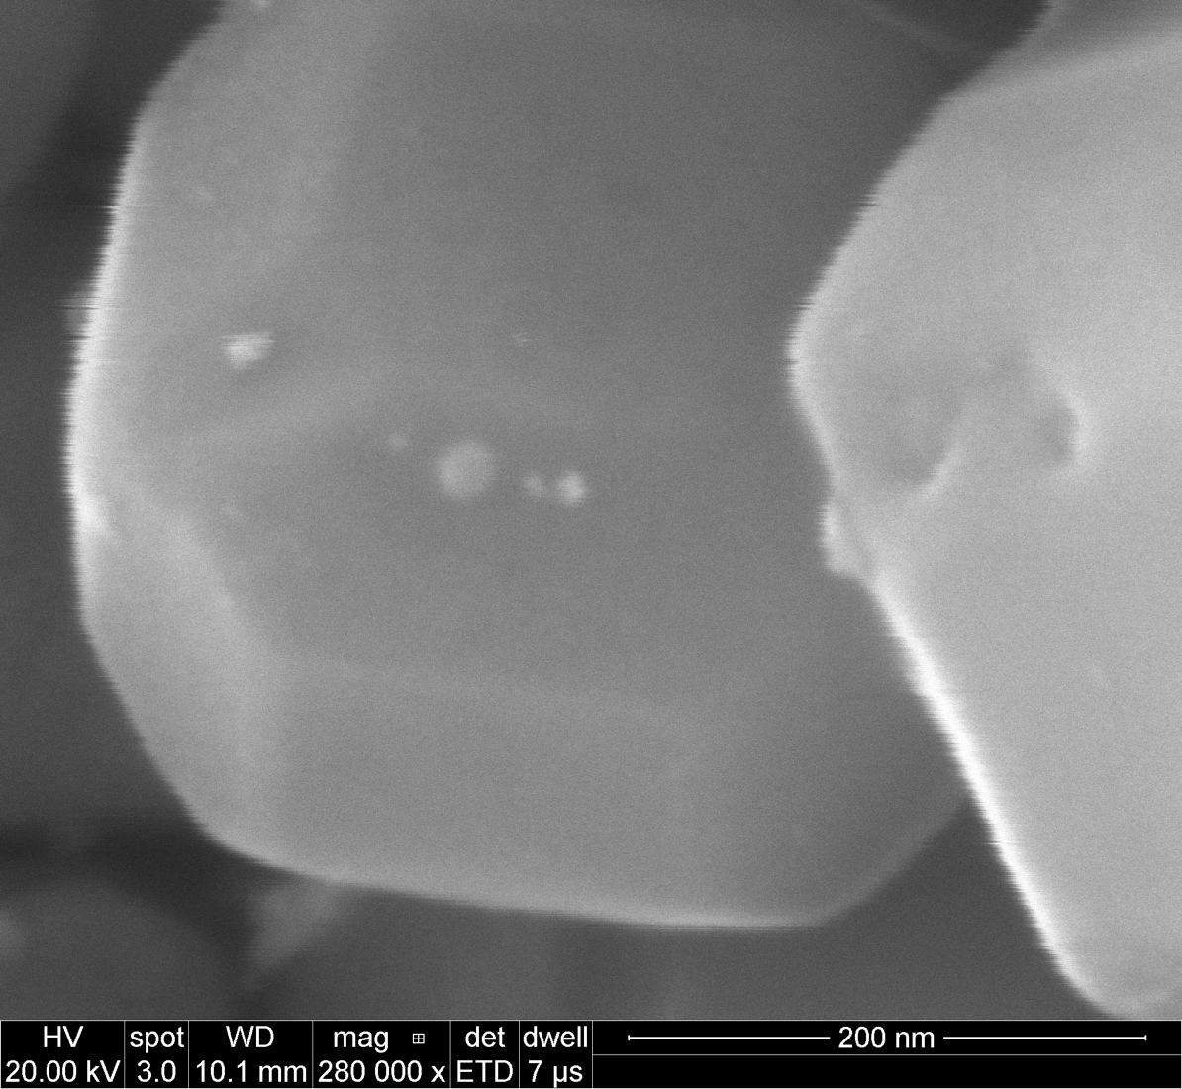
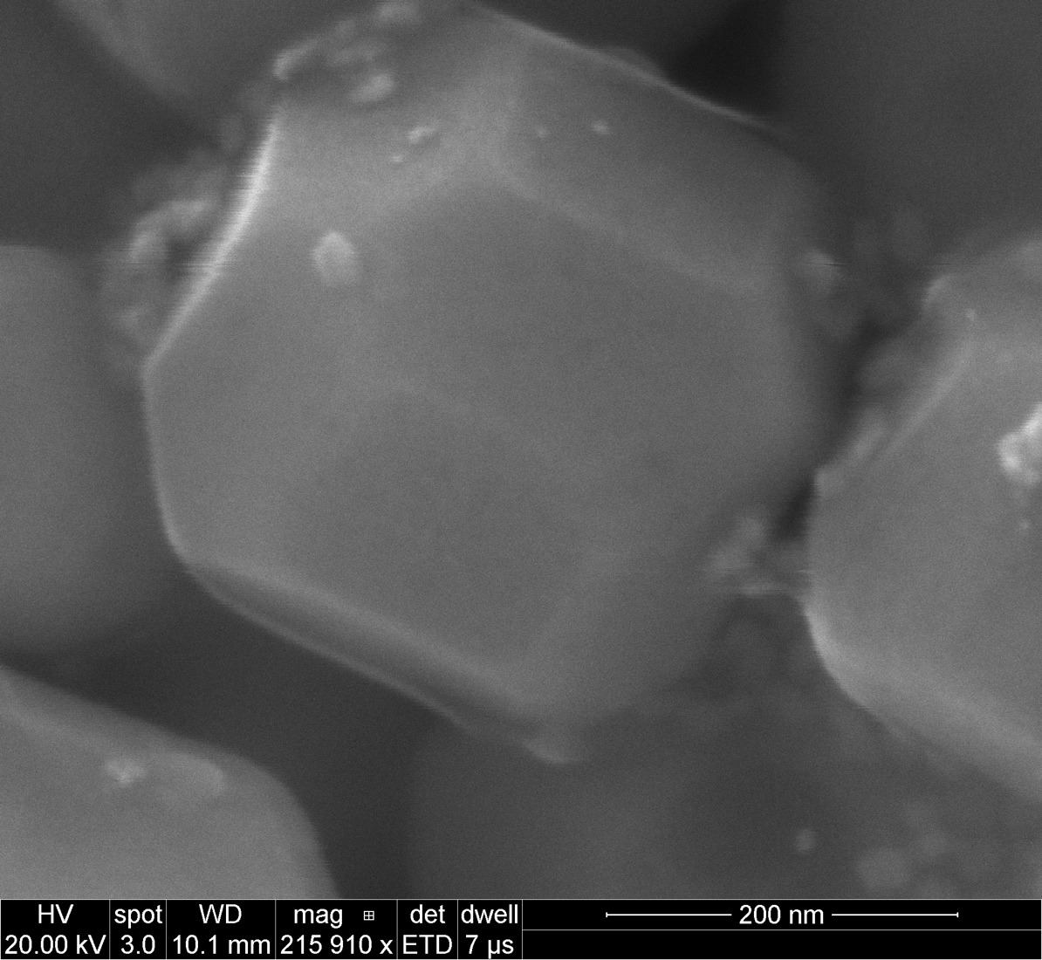
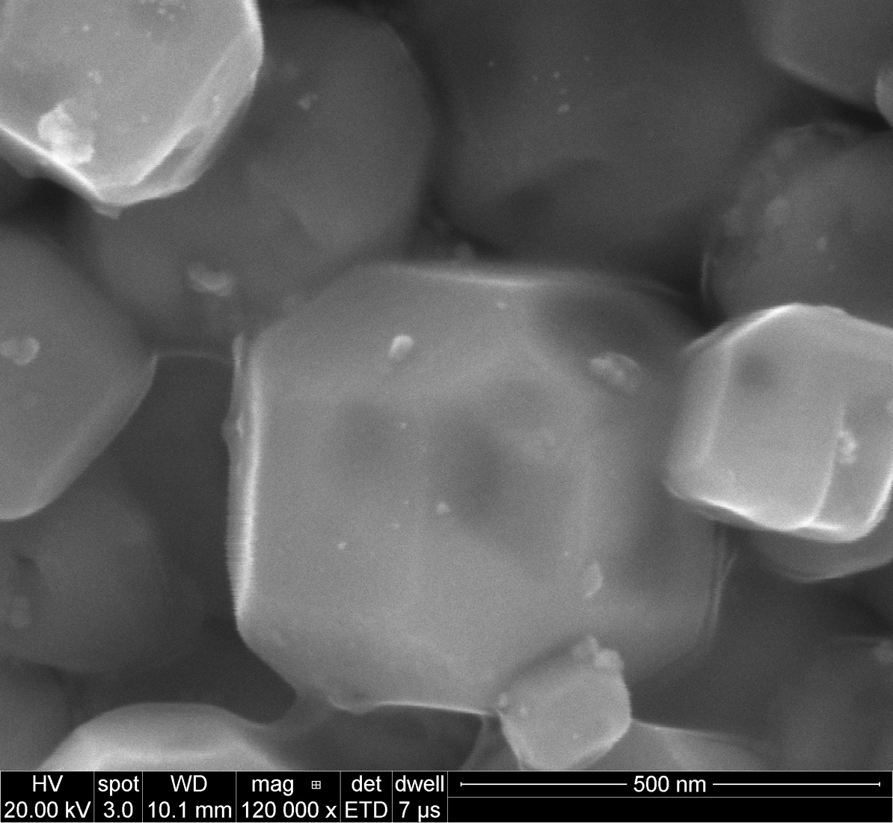
Shape C prepared with mothed 1
Photo deposition of Pt

Slide 15
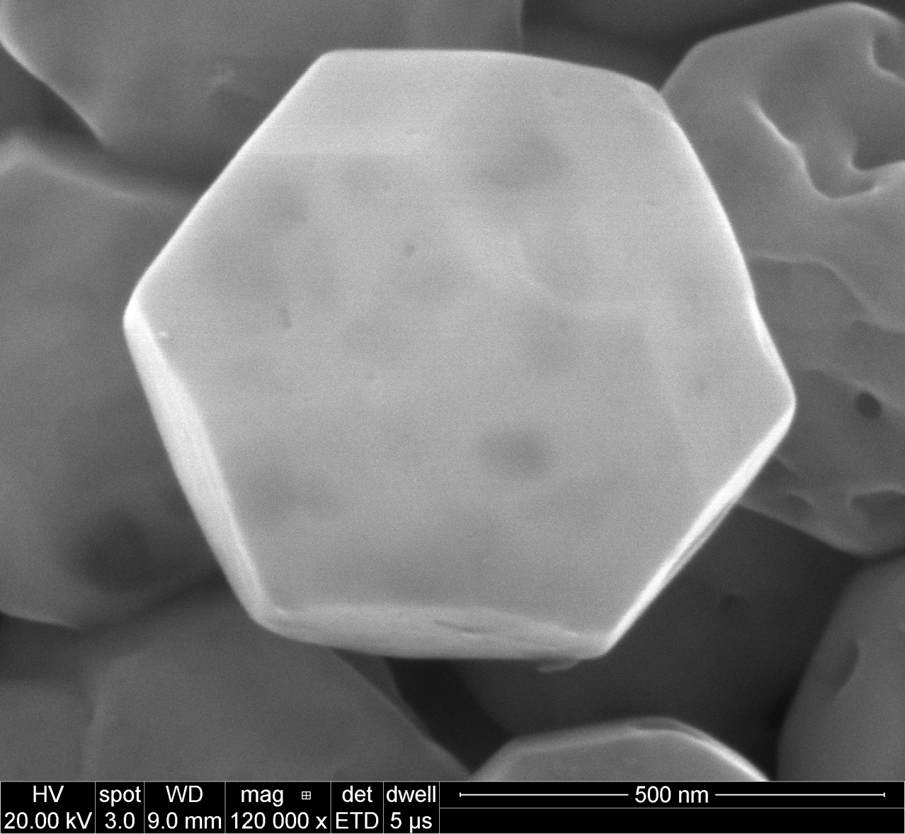
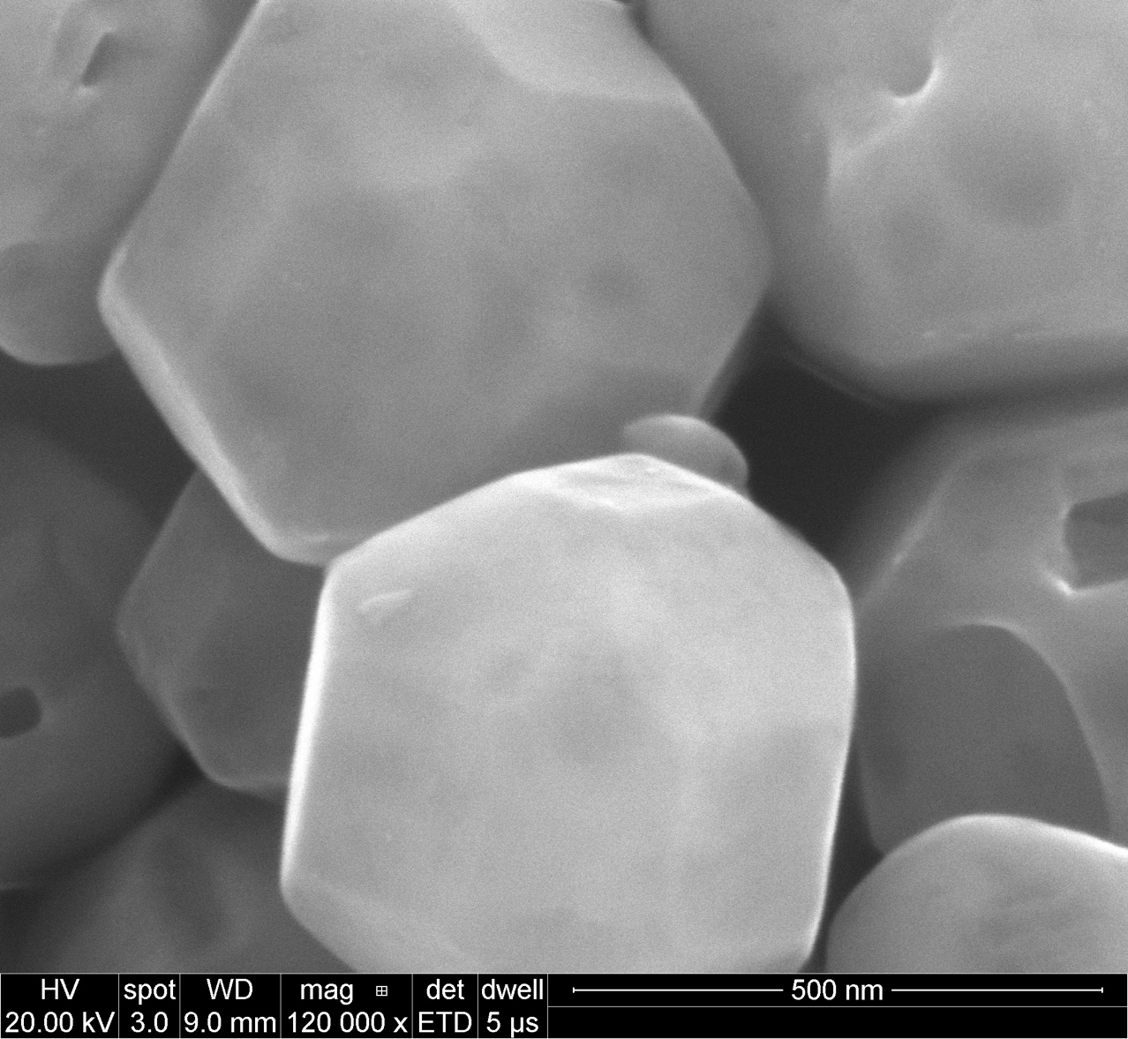

Shape D prepared with mothed 1

Slide 16




Shape D prepared with mothed 1
Photo deposition of Pt

Slide 17
Hg lamp in our lab: a broad spectrum from 300nm to 800nm,
there is a sharp peak at 240 nm before the intensity goes to zero.
UV LED in photoreactor: 380nm ±15nm (365nm – 395nm)
380nm corresponds to 3.25eV
Indirect Band gap of STO: 3.25eV
Direct band gap: 3.75eV (330nm)
Is this LED enough to excite STO?

