Slide 1
Weekly Meeting
9/11/2020
Mingyi Zhang

Slide 2
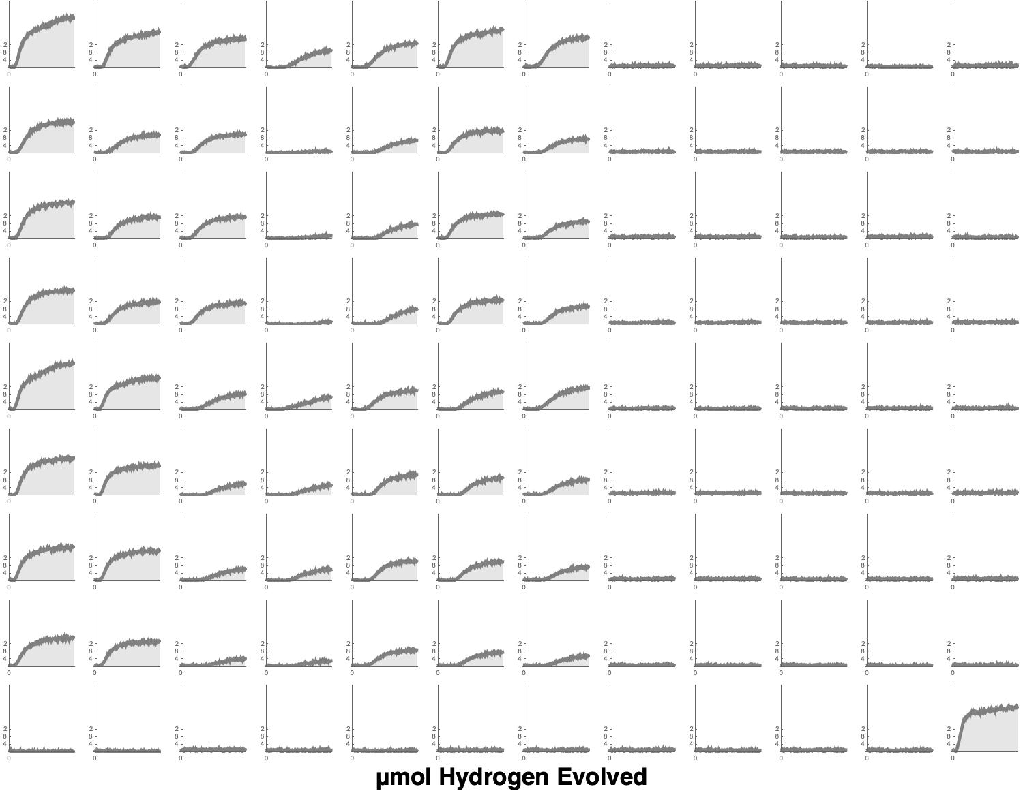
All coated with
0.1wt% Rh and Cr (metal)
Batch 1
Batch 2
Batch 3
Batch 4
Batch 5
Batch 6
Batch 7
Methanol
pH 7
Al 1%
pH 7
pH 7
Methanol
pH 7
Al 2%
pH 7
pH 7

Slide 3
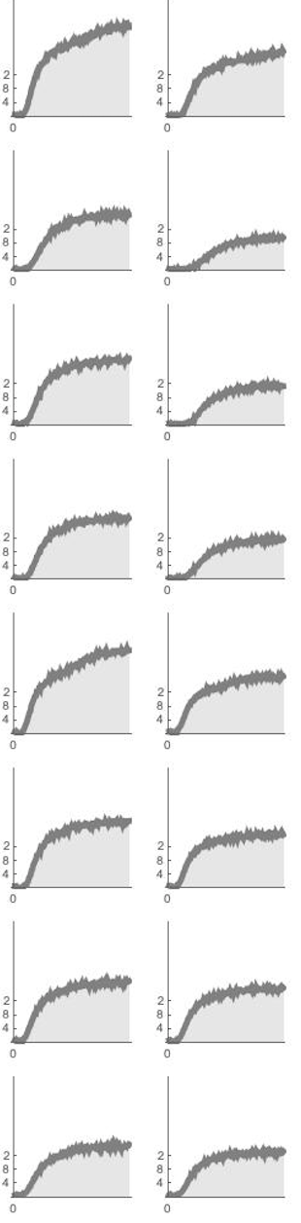
50mg powder + 0.5 ml solution
Batch 1
Batch 2
stirring
Methanol
pH 7
Al 1%
pH 7
pH 7
Methanol
pH 7
Heat Stage
Al 2%
pH 7
pH 7

Slide 4
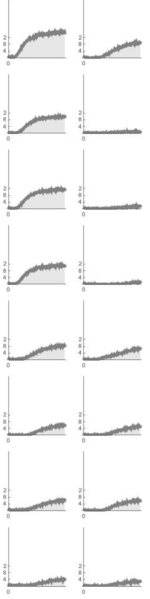
50mg powder + 0.5 ml solution + 1.5ml DI water
Batch 3
Batch 4
stirring
Methanol
pH 7
Al 1%
pH 7
pH 7
Methanol
pH 7
Al 2%
Heat Stage
pH 7
pH 7

Slide 5
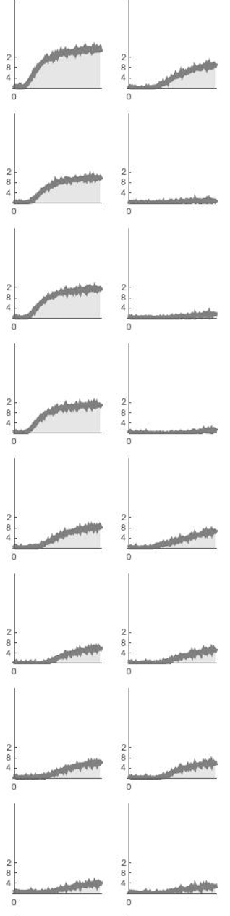
50mg powder + 0.5 ml solution (no water bath)
Batch 5
Batch 6
Methanol
stirring
pH 7
Al 1%
pH 7
pH 7
(~110 C)
Methanol
Heat Stage
pH 7
Al 2%
pH 7
pH 7

Slide 6
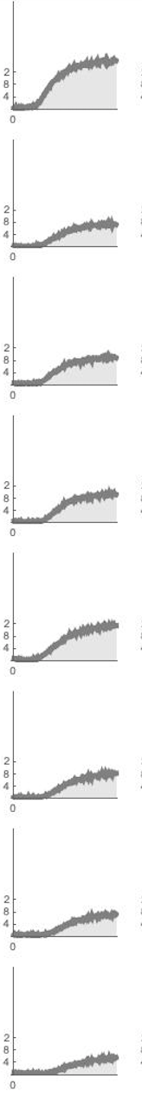
50mg powder + 0.5 ml solution (no stirring)
Batch 7
Methanol
pH 7
Al 1%
pH 7
pH 7
Methanol
pH 7
Al 2%
Heat Stage
pH 7
pH 7

Slide 7
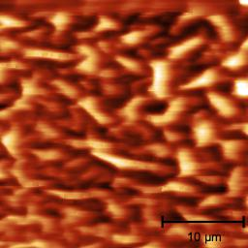
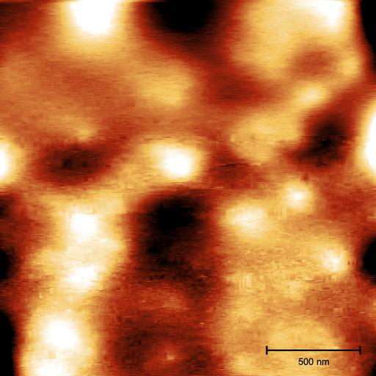
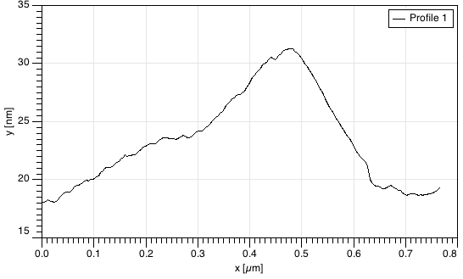
Dark to bright: 100nm
Dark to bright: 13nm
Evaporate a drop of Rh/Cr solution on a fresh
STO (100) single crystal
Then heat it at 350C for 1h.

Slide 8
Based on my experiments in the past two months
Cocatalysts should be heated in a clean crucible (no Sr)
After Al salt treatment, water the powder more times to remove all SrCl2.
During the evaporation, weigh fewer samples every time and try to make it more uniform.
For a run with all pH data, it needs about 150mg STO powder. I could split the cocatalysts coating
process in 3 times (each for 50mg).

