Slide 1
Weekly Meeting
Mingyi Zhang
3/8/2019

Slide 2
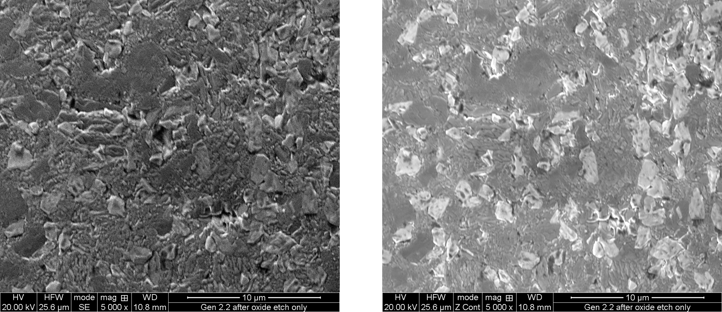
La₂Ti₂O₇

Slide 3
Before sintering
After sintering

Slide 4
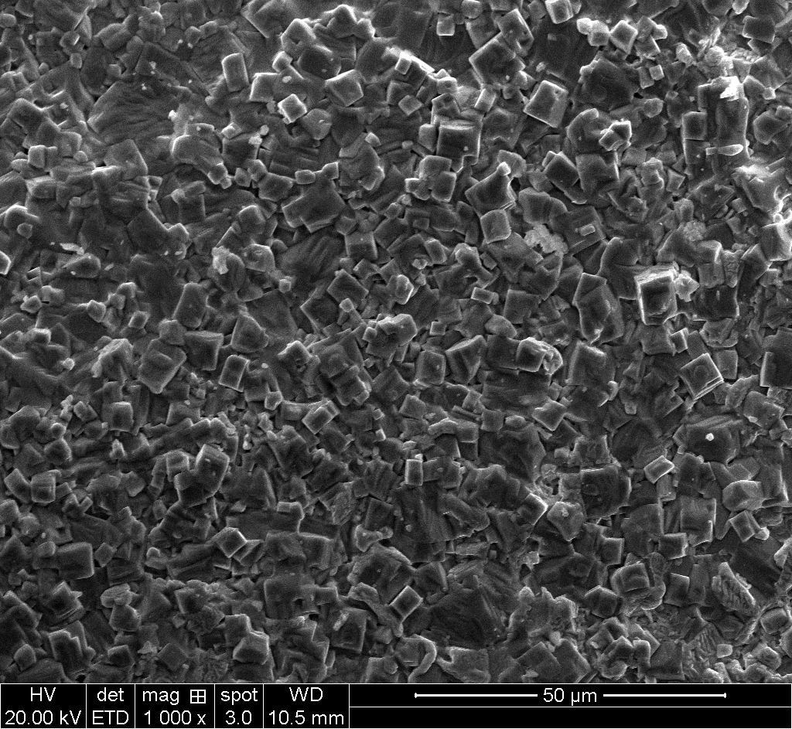
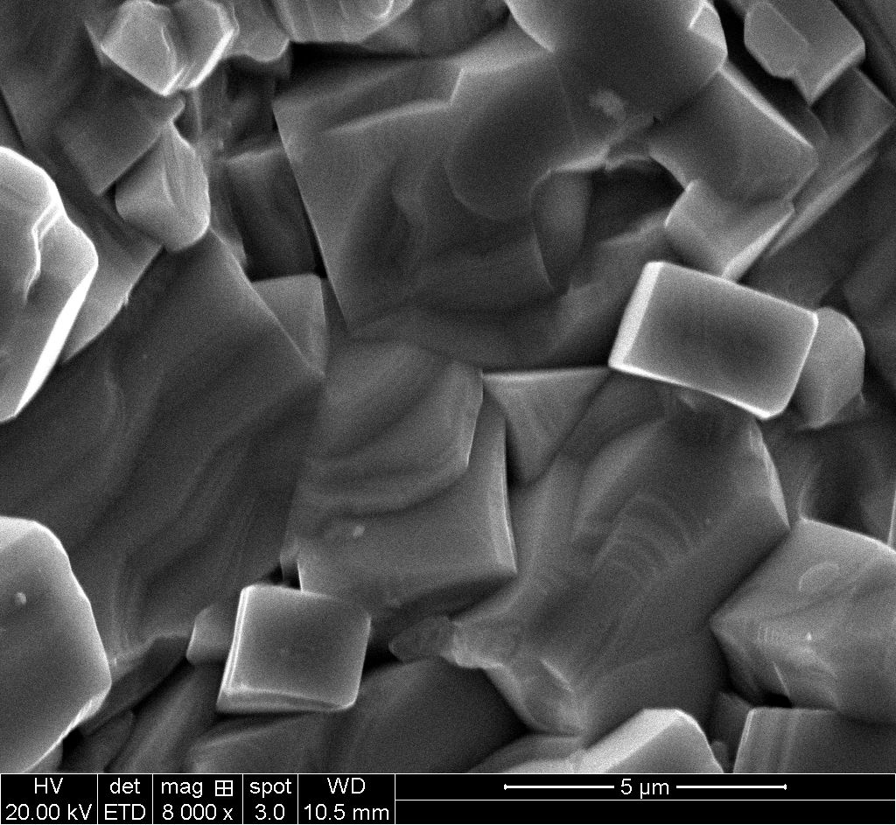

Slide 5
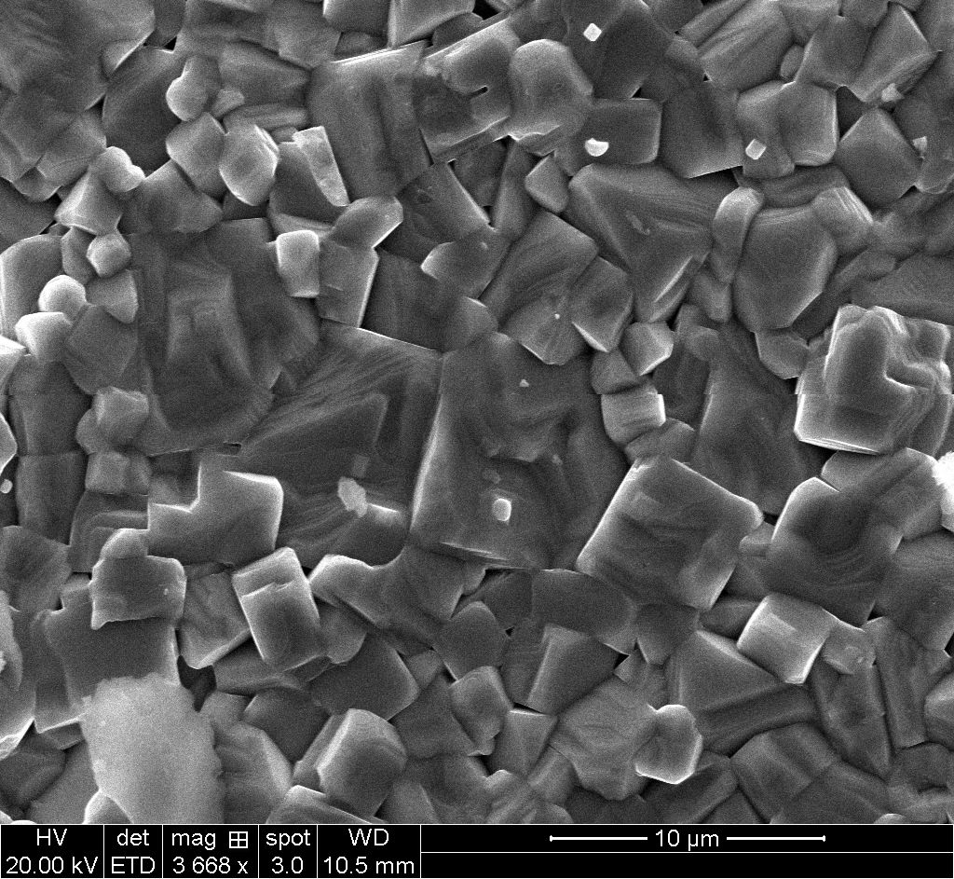

Slide 6
After polishing and annealing at 1100C

Slide 9
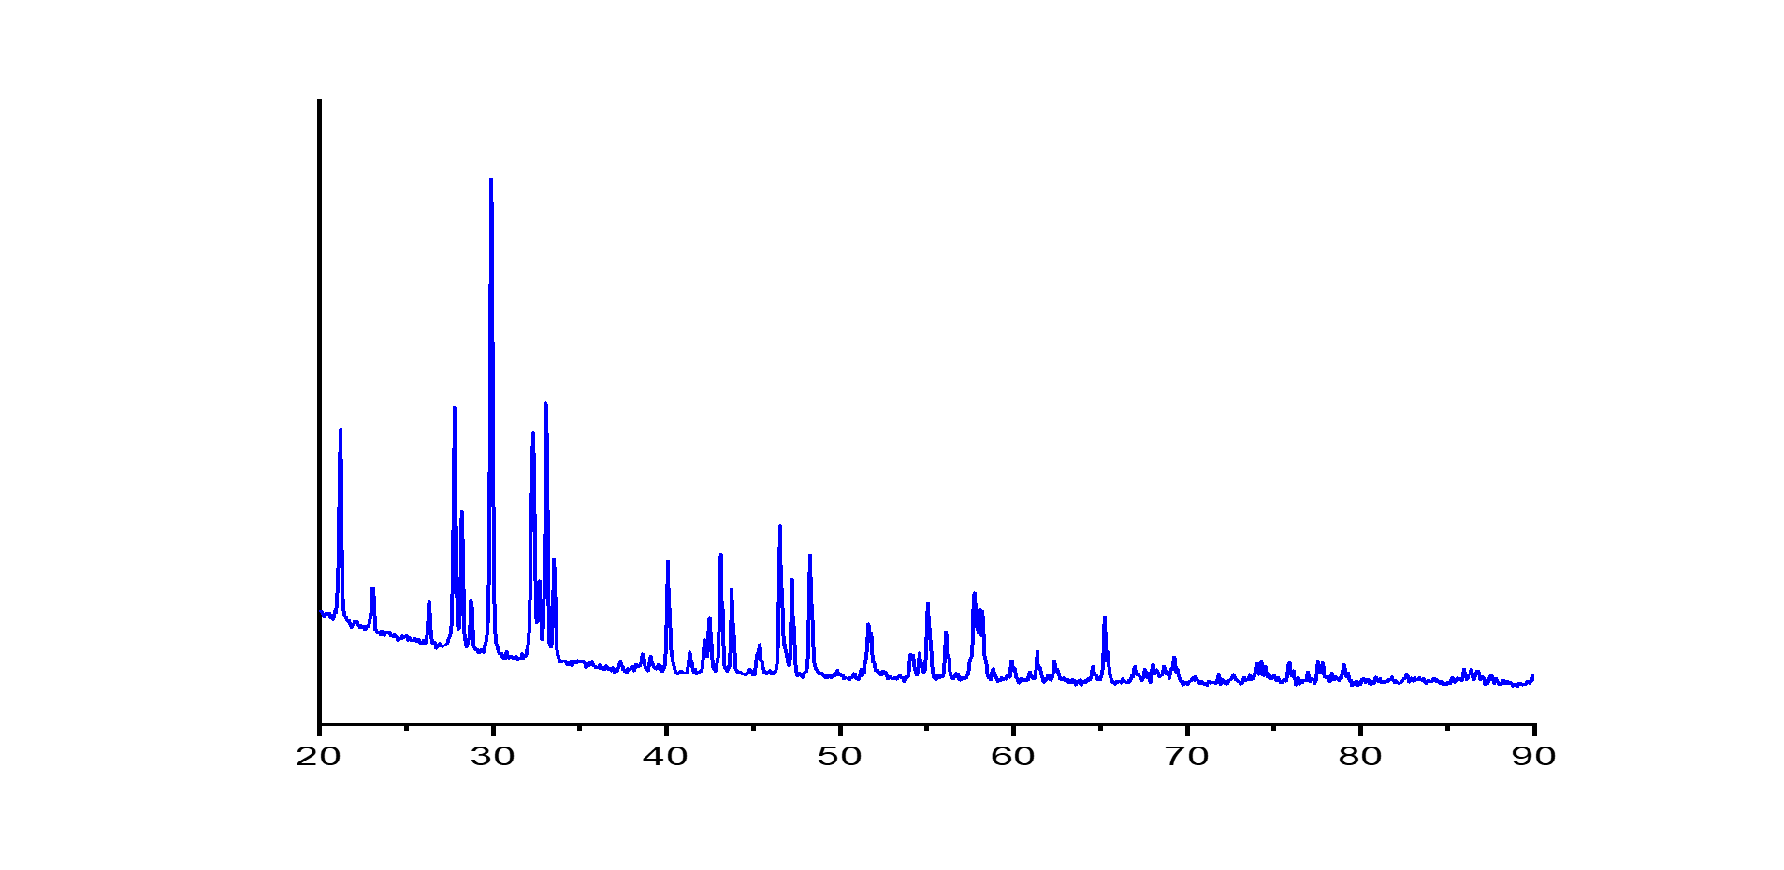
Before sintering
After
sintering

