Slide 1
Weekly Meeting
Mingyi Zhang
3/29/2019

Slide 2
La₂Ti₂O₇

Slide 3
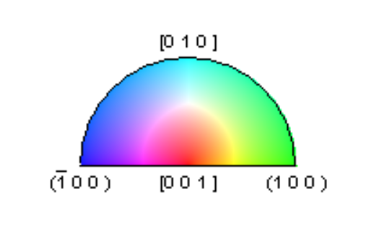
The ferroelectric polarization is along b-axis.
There is a phase transition from monoclinic to orthorhombic at 1053K.
Indexed with structure of Pr2Ti2O7, in low vacuum.

Slide 4
Grains close to (010)

Slide 5
Grains close to (001)

