Slide 1
Weekly Meeting
2/10/2022
Mingyi Zhang

Slide 2

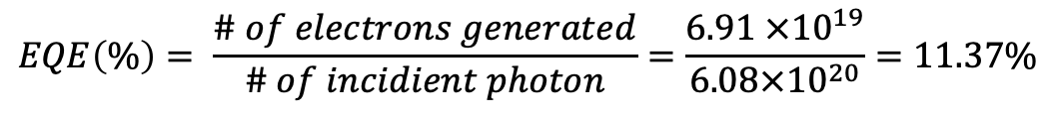
20 mg powder in 20 ml water.
Run in Ar.
Light intensity 6 mW/cm²
need to measure it again
$W=6\frac{mW}{cm^{2}}×{(\frac{2.5}{2})}^{2}×3.14=$29.4 mW
2.5 cm
$$E of photon \left(380 nm\right)=3.26 eV=5.22 × {10}^{−19}J$$
$\# of photon in 3h= \frac{0.0294 W ×3∗3600 }{5.22× {10}^{−19}J}=6.08×{10}^{20}$ photons
57.3339 umol H₂
$$\# of e=57.3339 × 2 × {10}^{−6}×6.026×{10}^{23}=6.91 ×{10}^{19}$$
57.3339 umol
At 380 nm
$$EQE\left(\%\right)= \frac{\# of electrons generated}{\# of incidient photon}=\frac{6.91 ×{10}^{19}}{6.08×{10}^{20}}=11.37\%$$
1.5607 umol
Will repeat this under 365 nm, 370 nm, 400 nm
I’m afraid the STO result is odd, but BTO makes sense to me.
Unfortunately, they can’t quantify O₂ because they didn’t calibrate the GC for O₂.

Slide 3
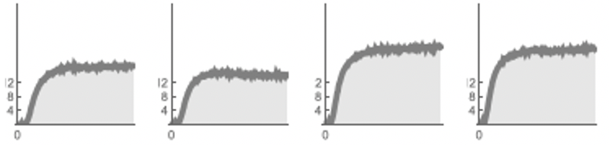
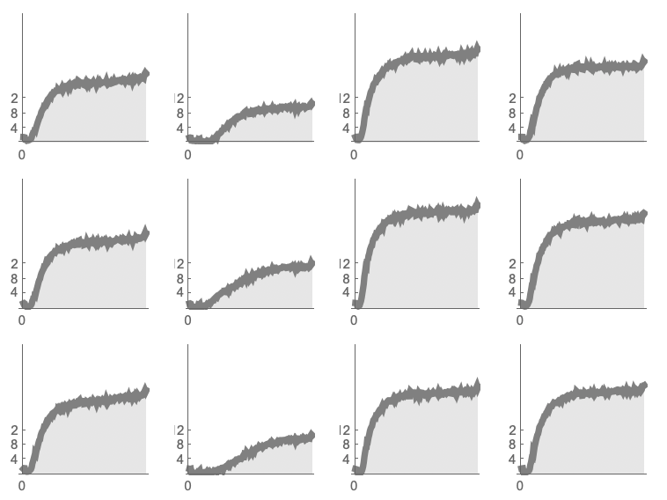
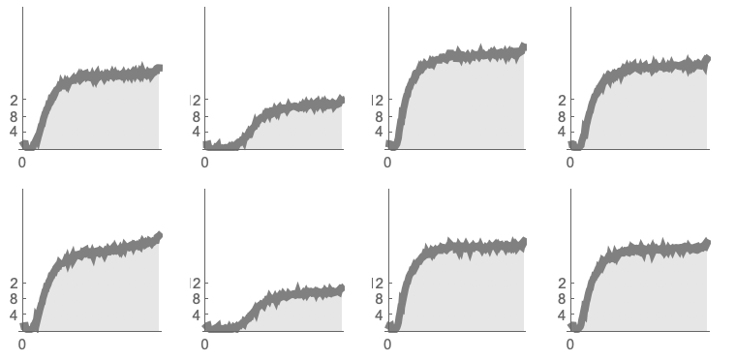
380 nm
16 h
BTO + Al₂O₃ +SrCl₂ in Al crucible
methanol
pH 2
pH 7
pH 12
methanol
pH 2
pH 7
pH 12
0% Al
1% Al
2% Al
3% Al
4% Al
5% Al
10 mg in 0.4 ml solution
As the amount of Al increases, particle shape become irregular, and they don’t coarsen.

Slide 4
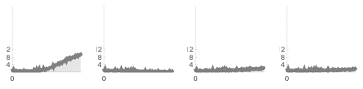
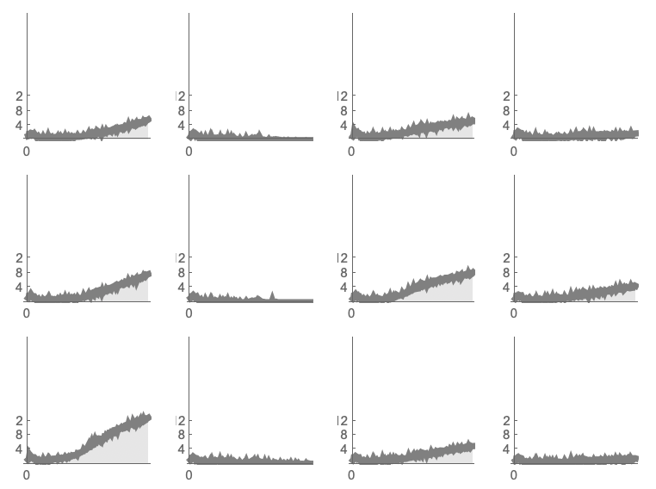
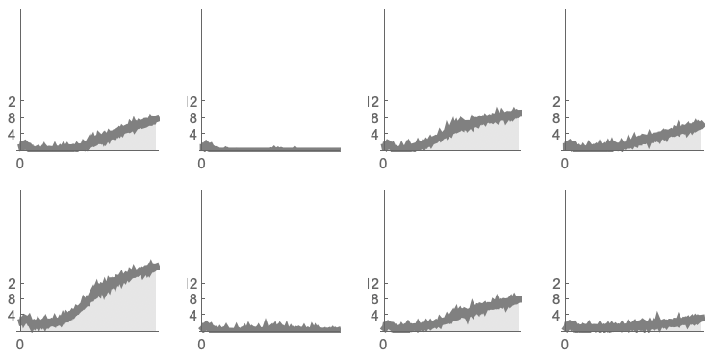
400 nm
16 h
BTO + Al₂O₃ +SrCl₂ in Al crucible
methanol
pH 2
pH 7
pH 12
methanol
pH 2
pH 7
pH 12
0% Al
1% Al
2% Al
3% Al
4% Al
5% Al

Slide 5
BTO-sA-0%Al
BTO-sA-1%Al
BTO-sA-2%Al
BTO-sA-3%Al
BTO-sA-4%Al
BTO-sA-5%Al

Slide 6
BTO+Al+SrCl₂ in Al crucible
Al addition | Lattice parameter | Volume
0%Al | 3.9048(2) | 59.54
1%Al | 3.9059(9) | 59.59
2%AL | 3.9067(6) | 59.62
3%Al | 3.9063(1) | 59.61
4%Al | 3.9049(3) | 59.54
6%Al | 3.9041(5) | 59.51

Slide 7
Comparing the results in different types of crucibles
BTO + SrCl₂ + Al₂O₃
In Al crucible
In Pt crucible

Slide 8
BTO-sP-0%Al
BTO-sP-1%Al
BTO-sP-2%Al
BTO-sP-3%Al
BTO-sP-4%Al
BTO-sP-5%Al

Slide 9
BTO+Al+SrCl₂ in Pt crucible
Al addition | Lattice parameter | Volume
0%Al | 3.9056(1) | 59.57
1%Al | 3.9056(1) | 59.57
2%AL | 3.9070(3) | 59.64
3%Al | 3.9069(2) | 59.63
4%Al | 3.906(1) | 59.6
6%Al | 3.9066(8) | 59.62

Slide 10
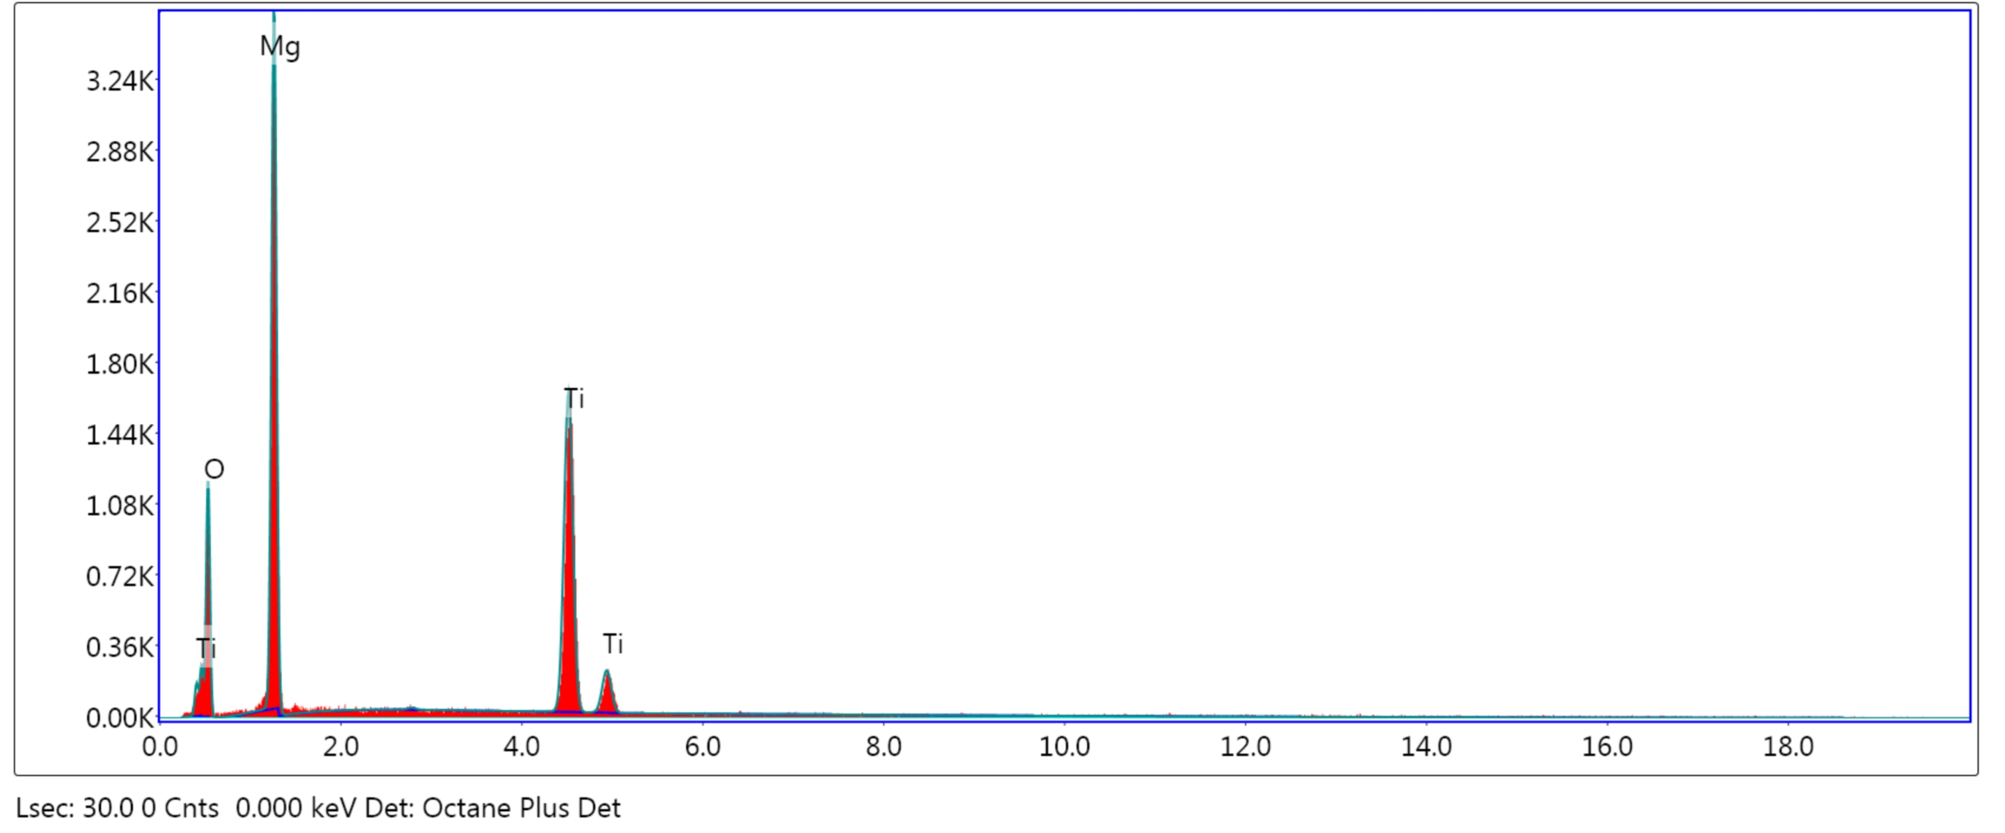
Element | Weight % | Atomic % | Net Int. | Error %
O K | 44.05 | 58.77 | 203.94 | 10.21
MgK | 37.71 | 33.11 | 810.58 | 7.78
TiK | 18.24 | 8.13 | 642.63 | 1.81
Why it restructures to spinel?

Slide 11
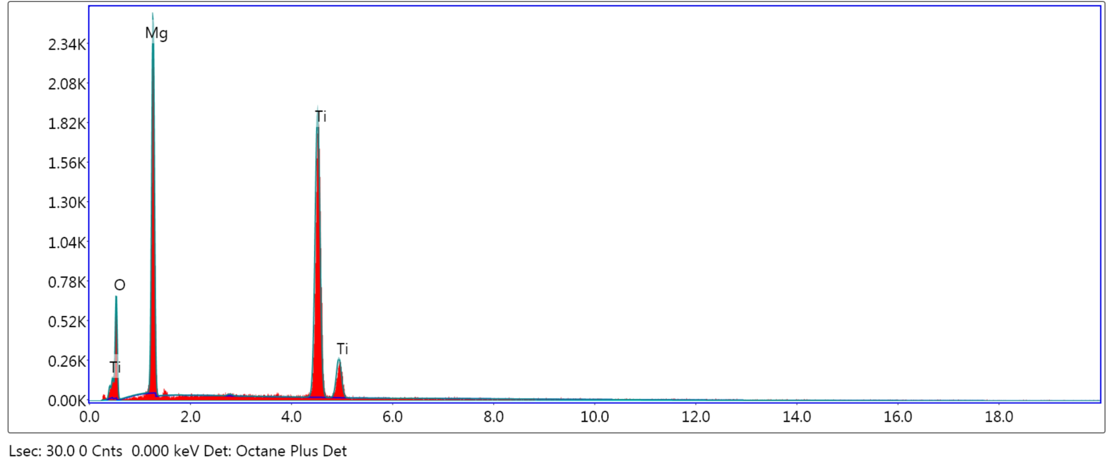
Element | Weight % | Atomic % | Net Int. | Error %
O K | 39.21 | 55.44 | 114.25 | 11.08
MgK | 34.59 | 32.18 | 560.34 | 8.22
TiK | 26.20 | 12.37 | 740.02 | 1.72

Slide 12
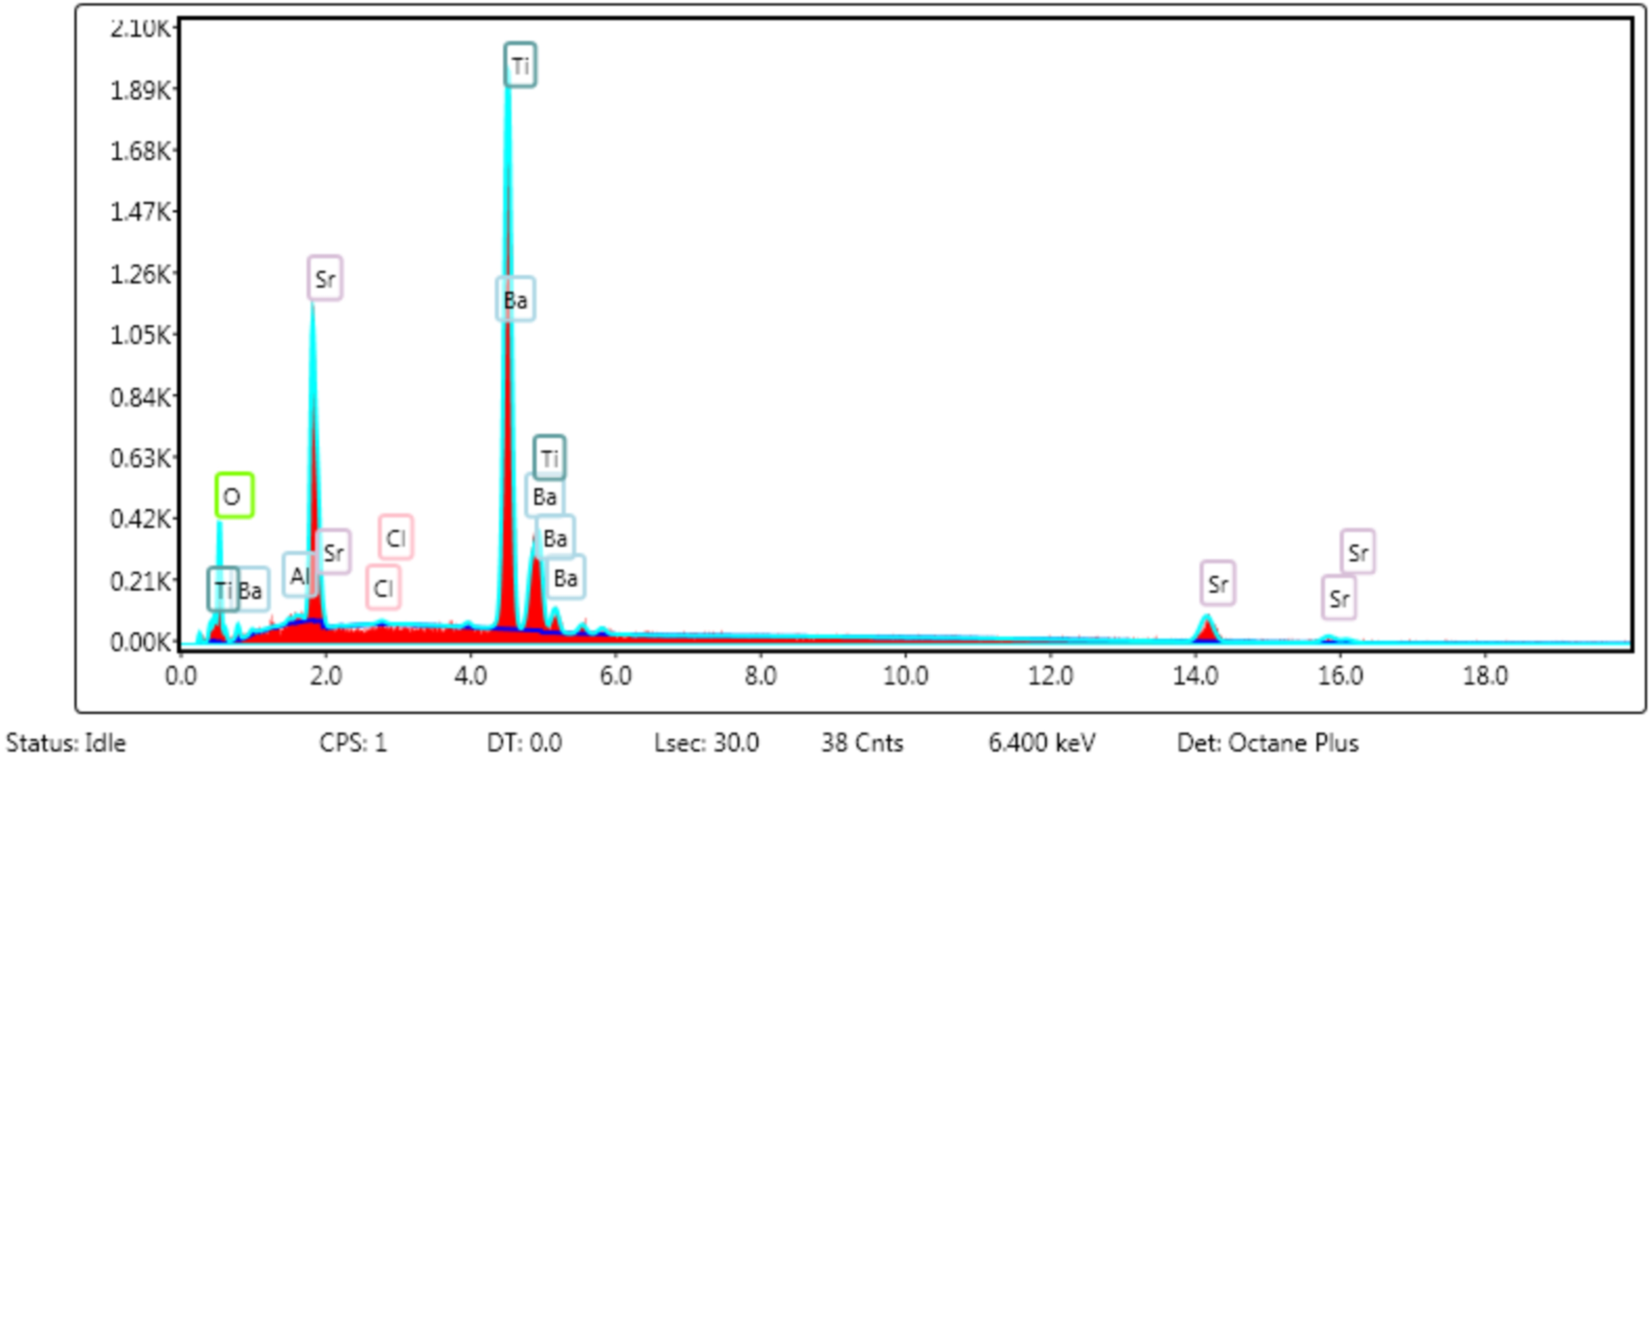
I think this SBTO solid solution.
Only a small amount of Sr was replaced by Ba.

Slide 13
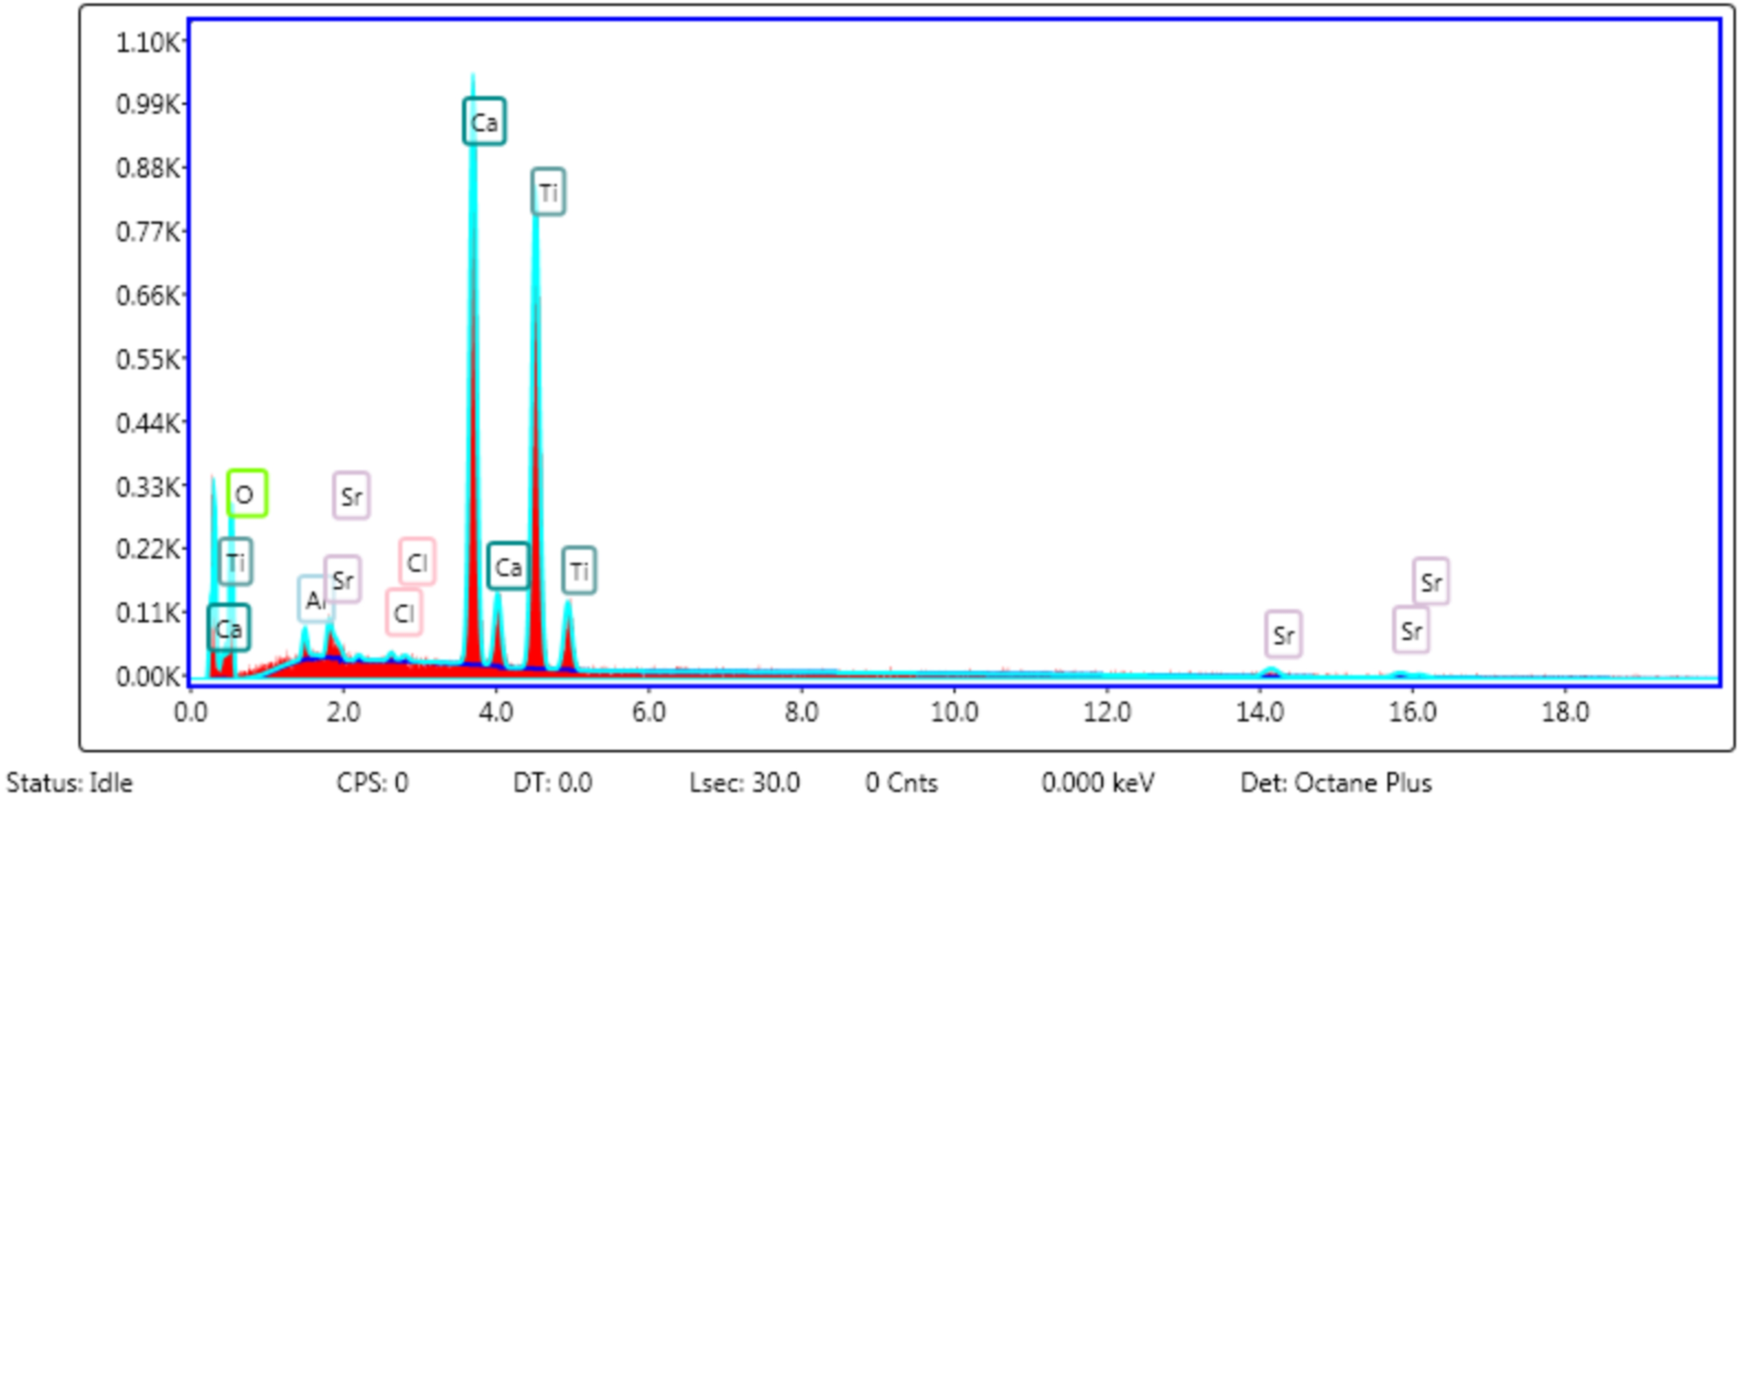
It will form CTO.
But CaCl₂ also reacts with Al₂O₃ and calcium aluminate
is insoluble.

