Slide 1
Molten salt reactions

Slide 2
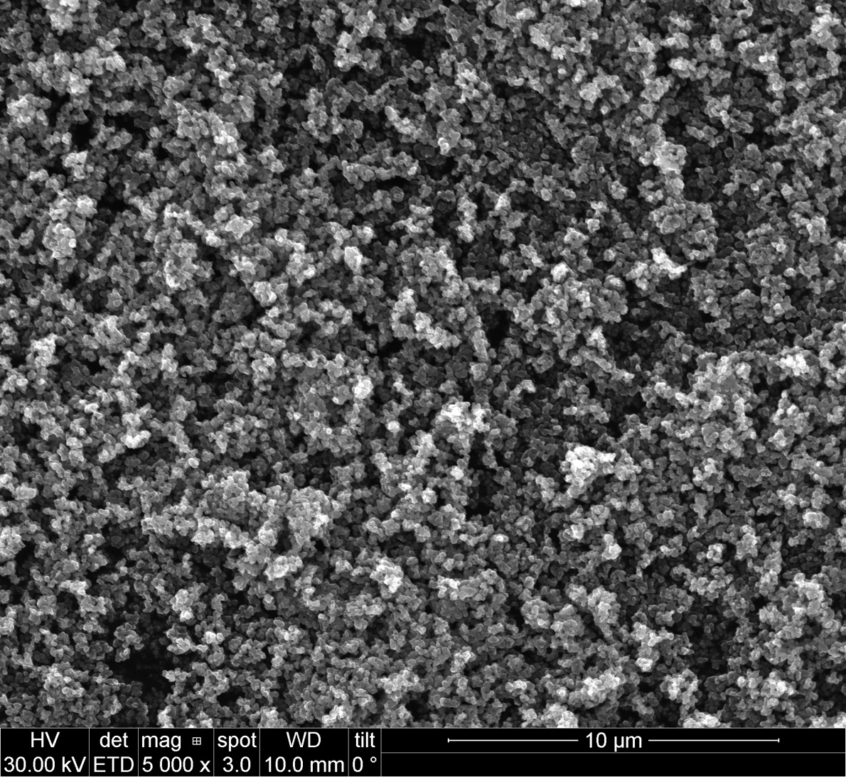
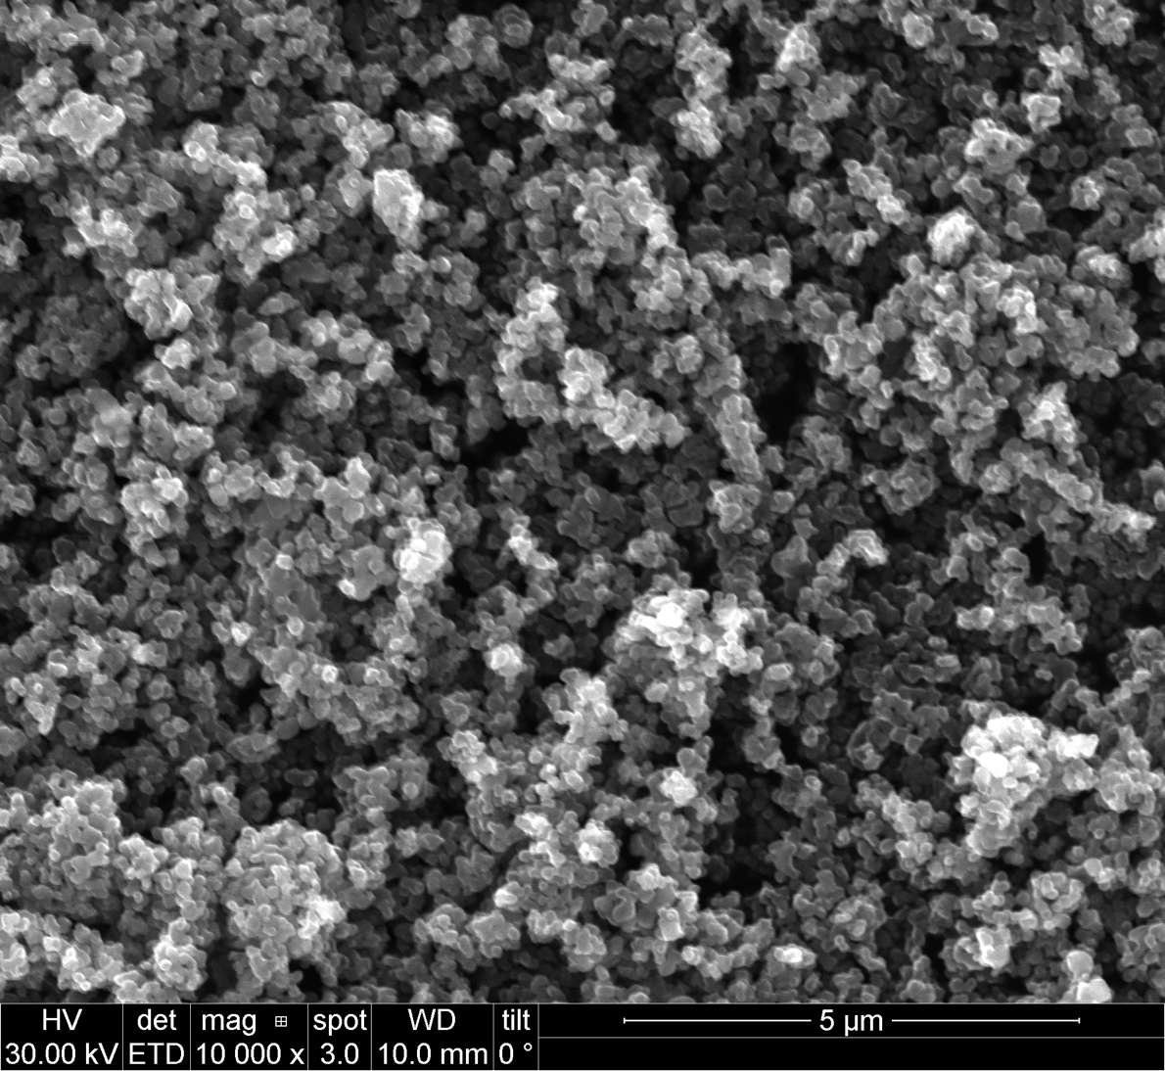
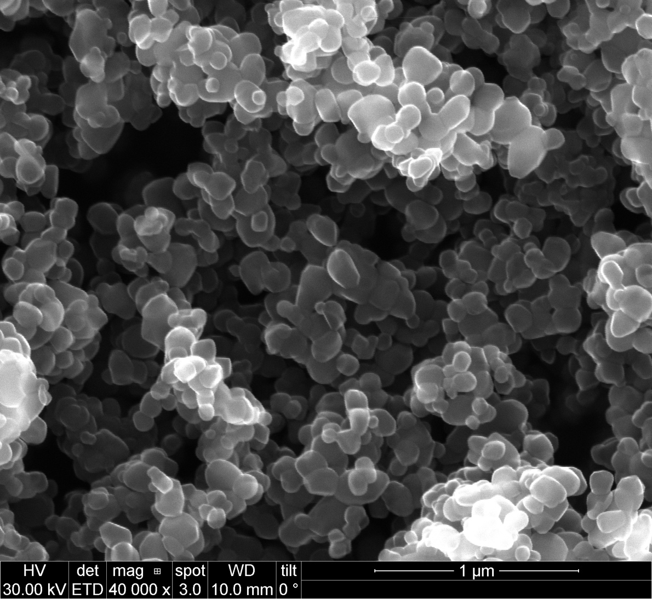
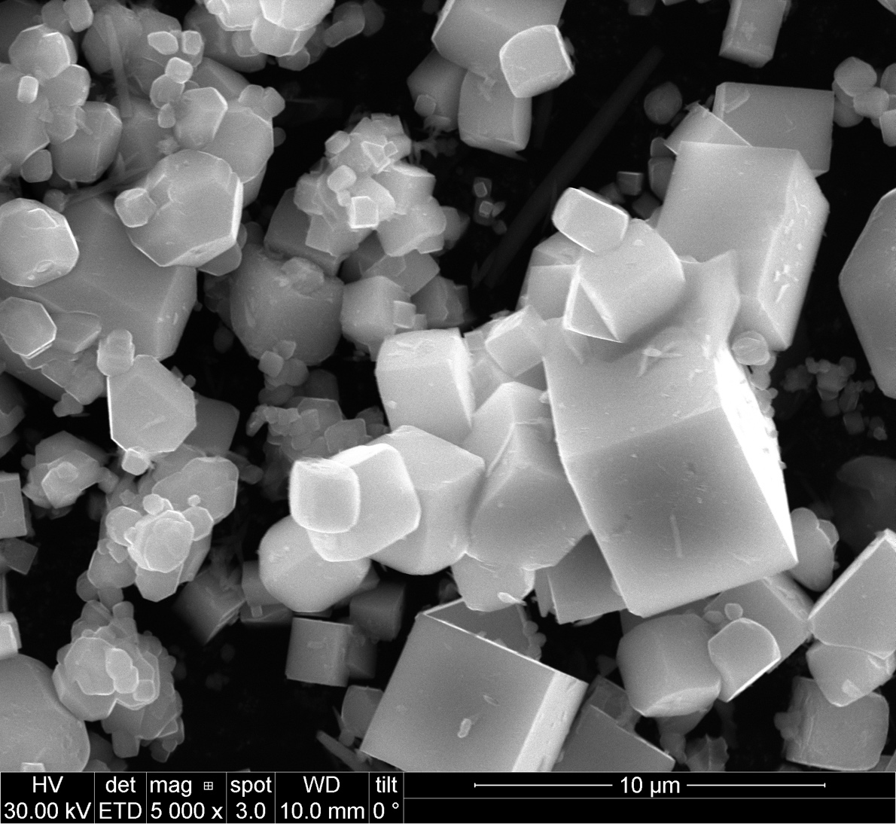
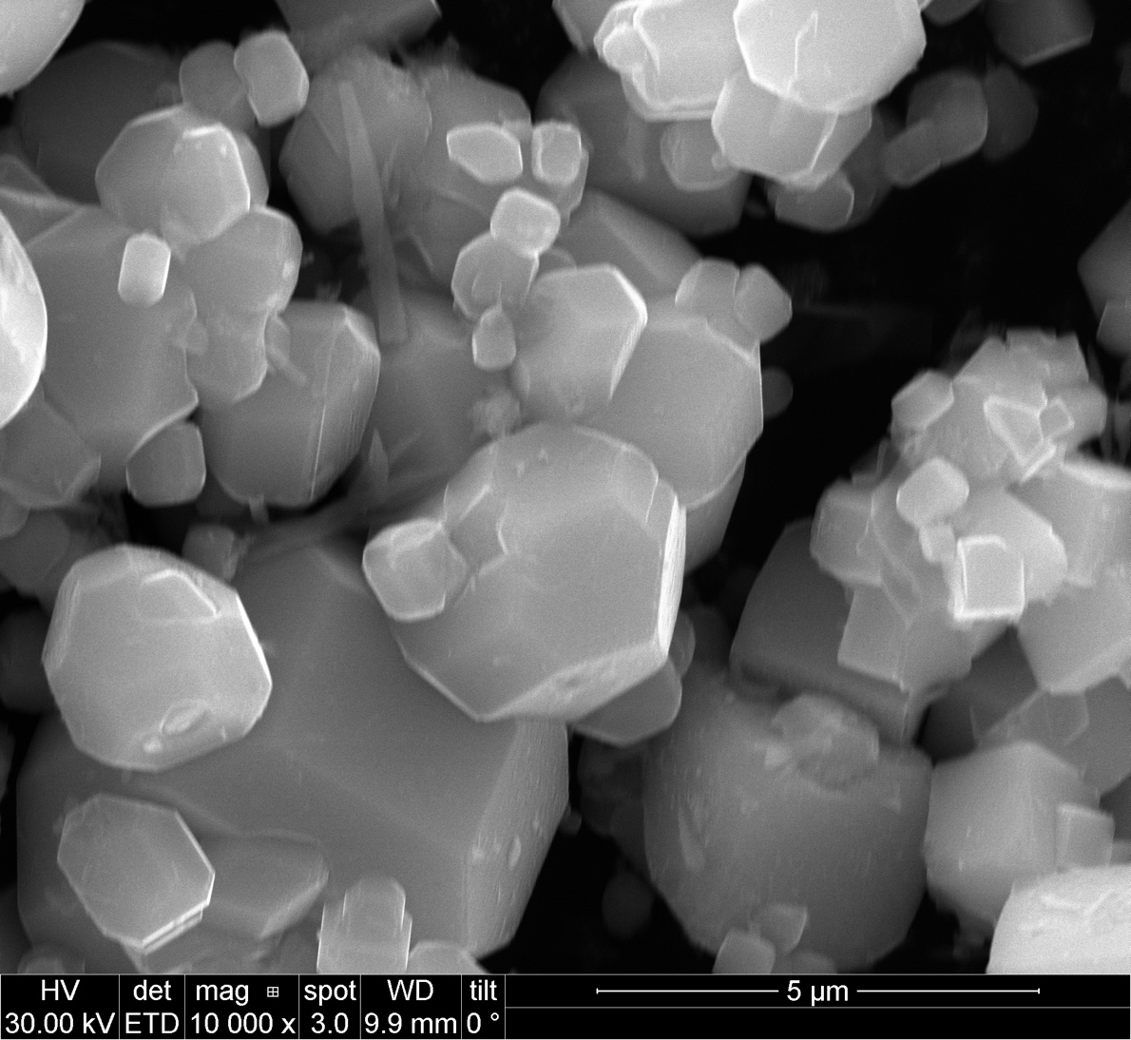
Anatase + SrCl₂
Top: before reaction
Bottom: after reaction

Slide 3
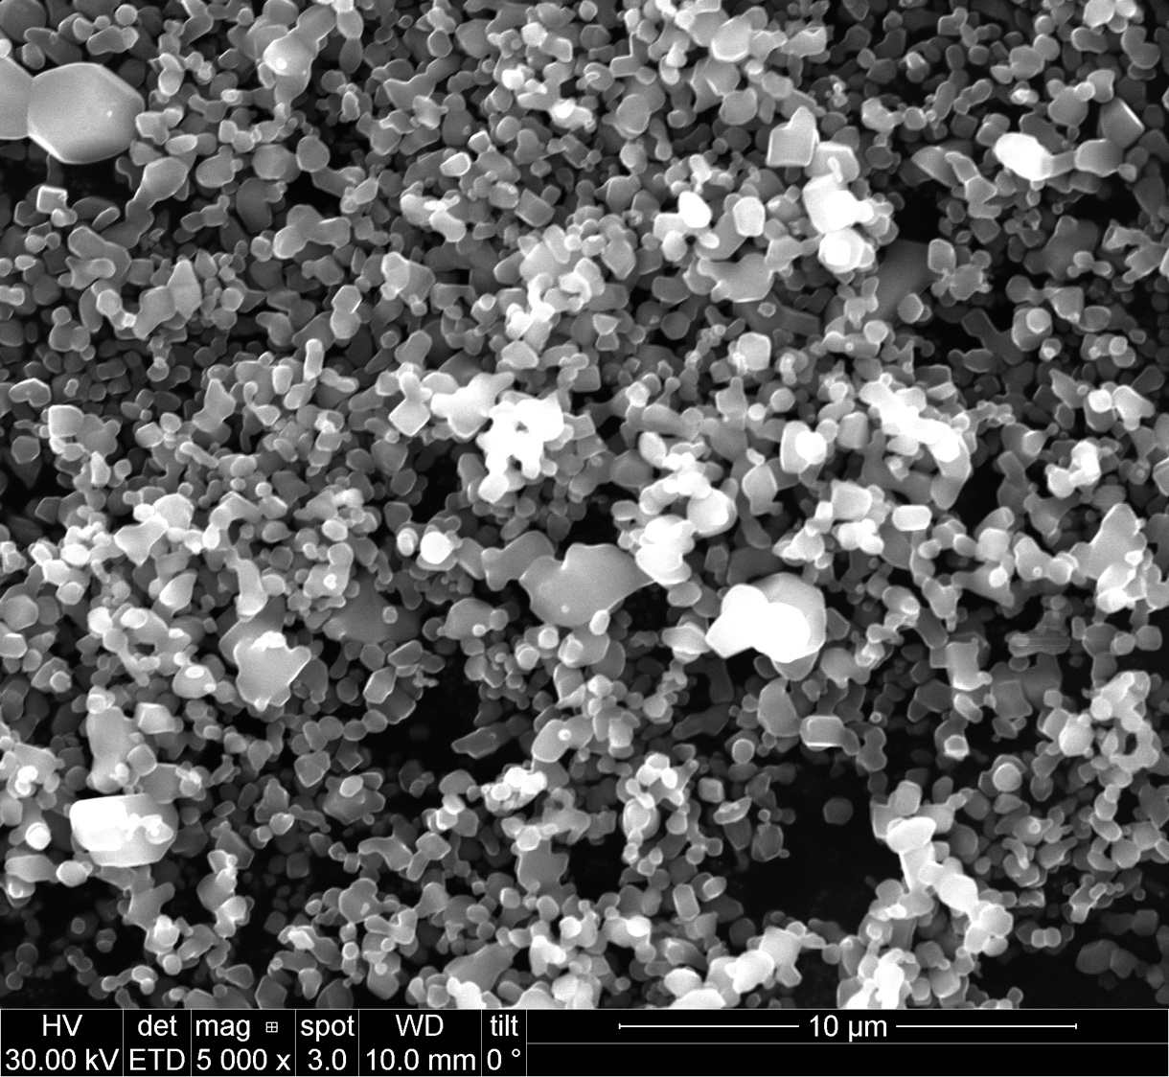
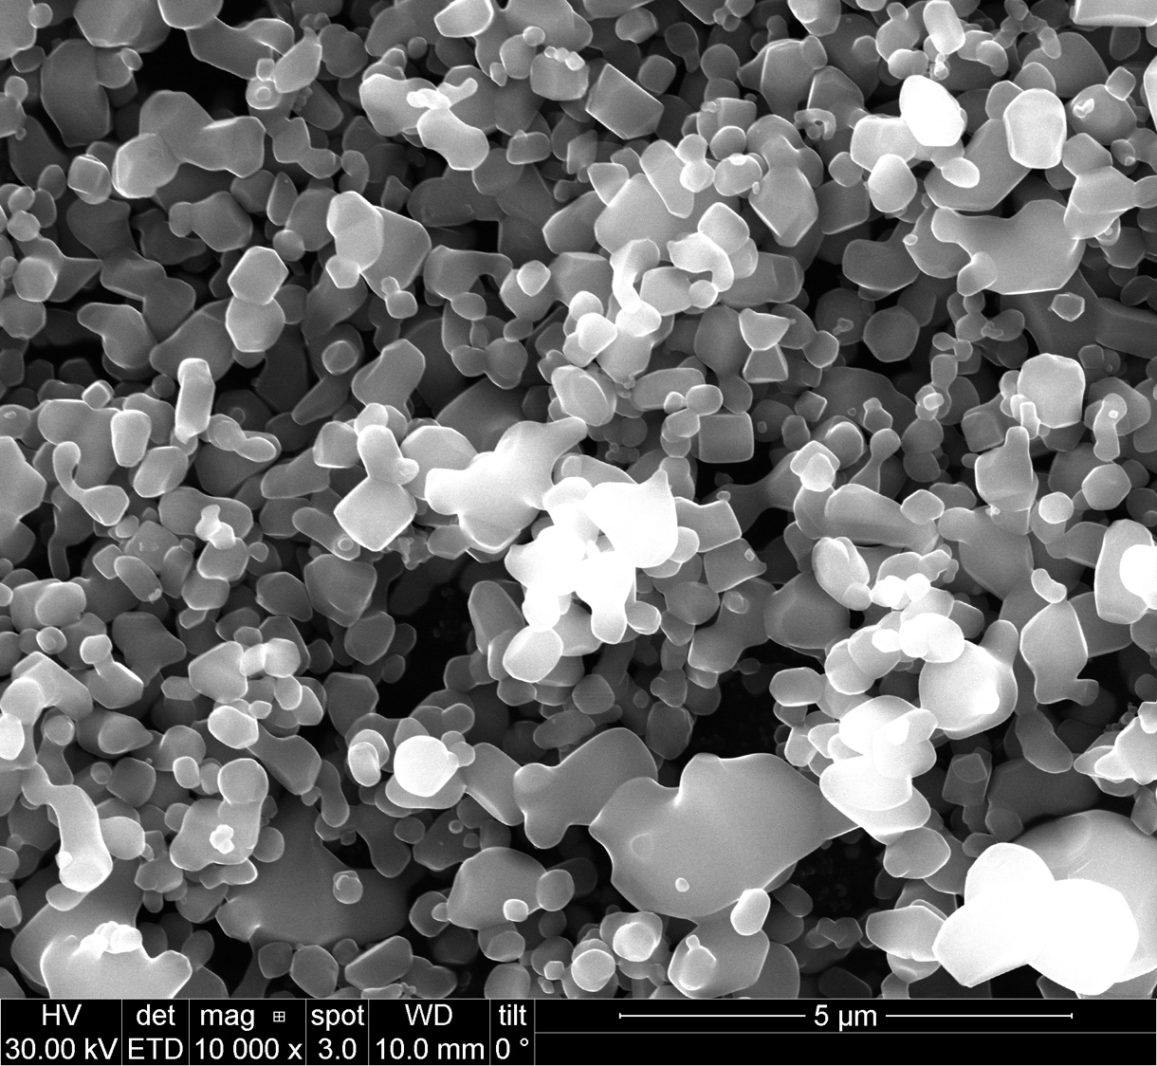
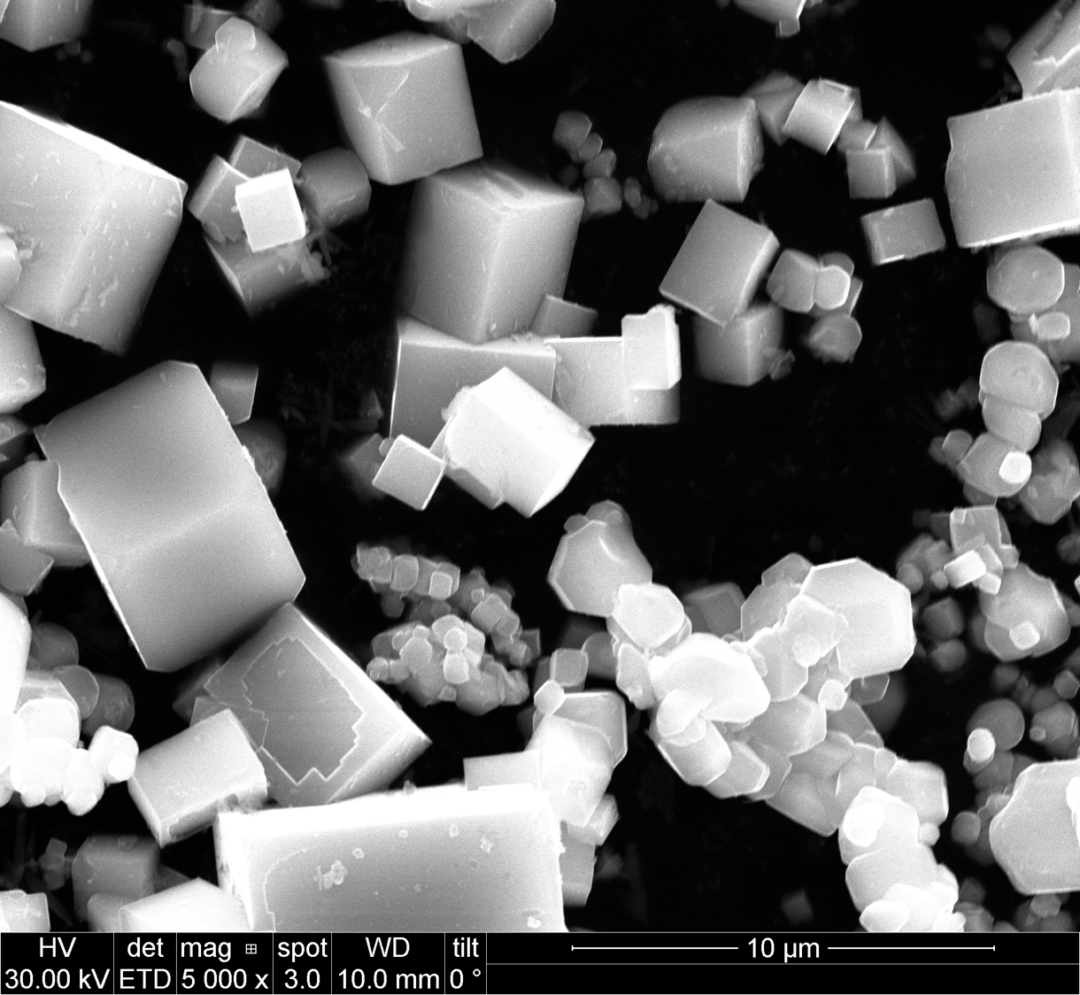
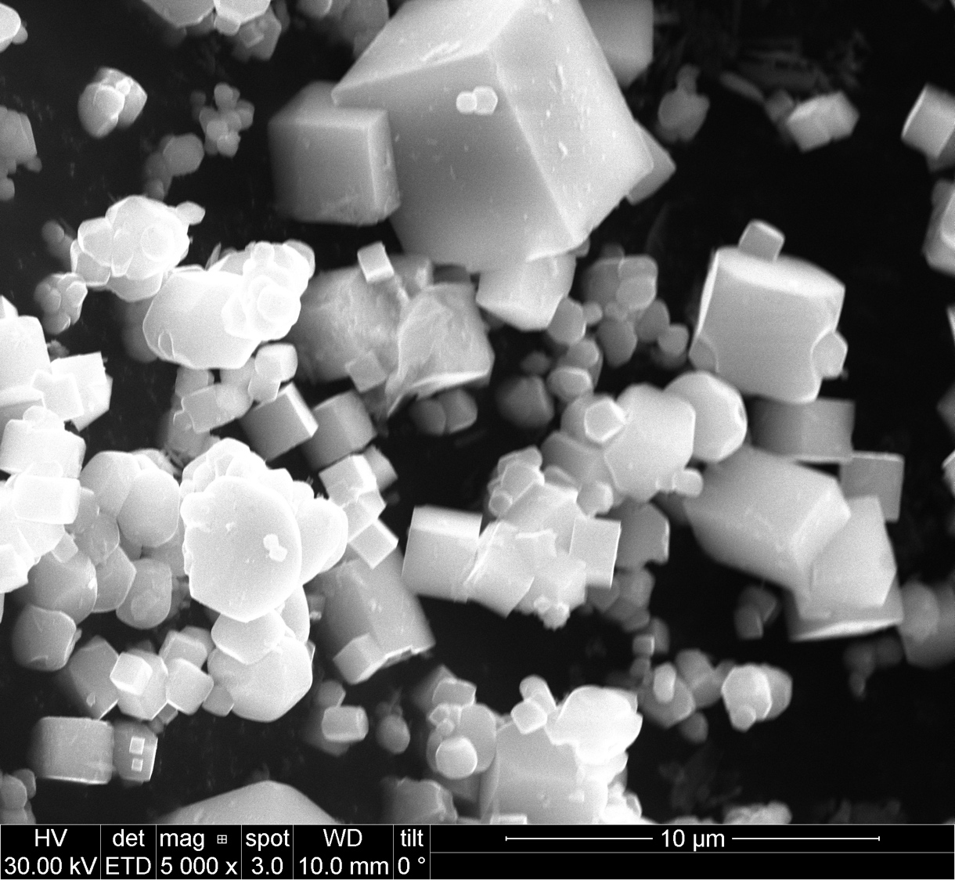
Rutile + SrCl₂
Top: before reaction
Bottom: after reaction

Slide 5
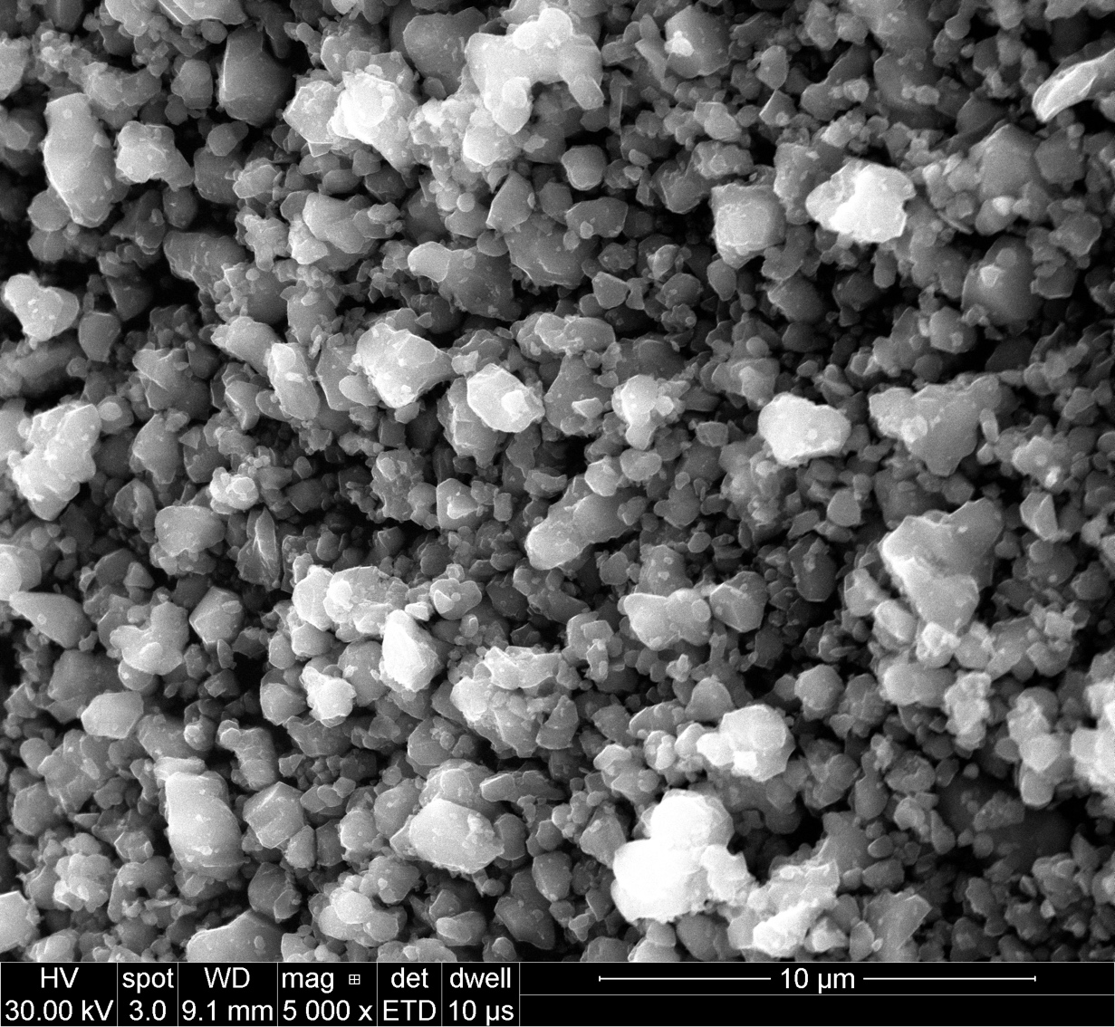
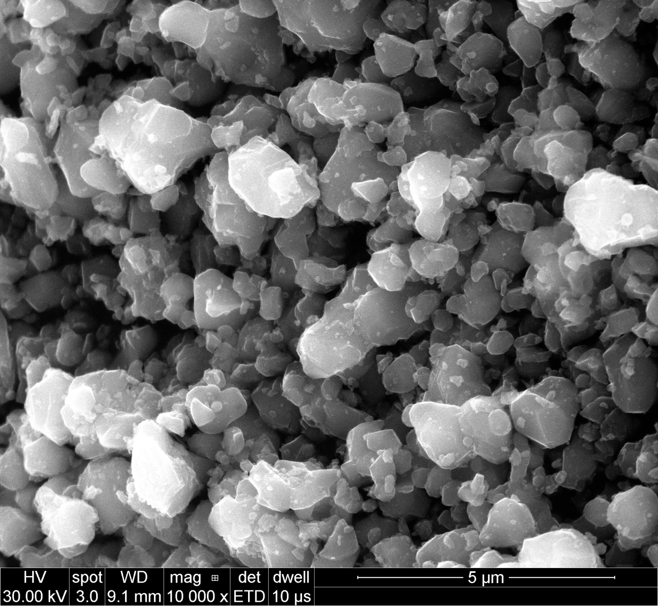
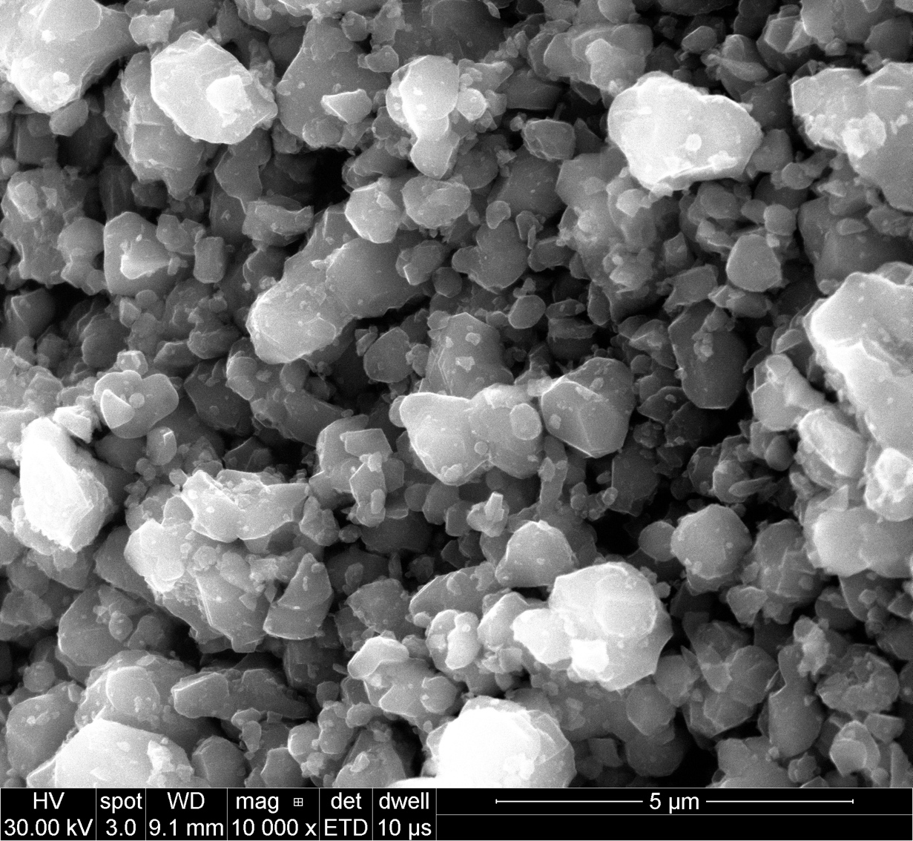
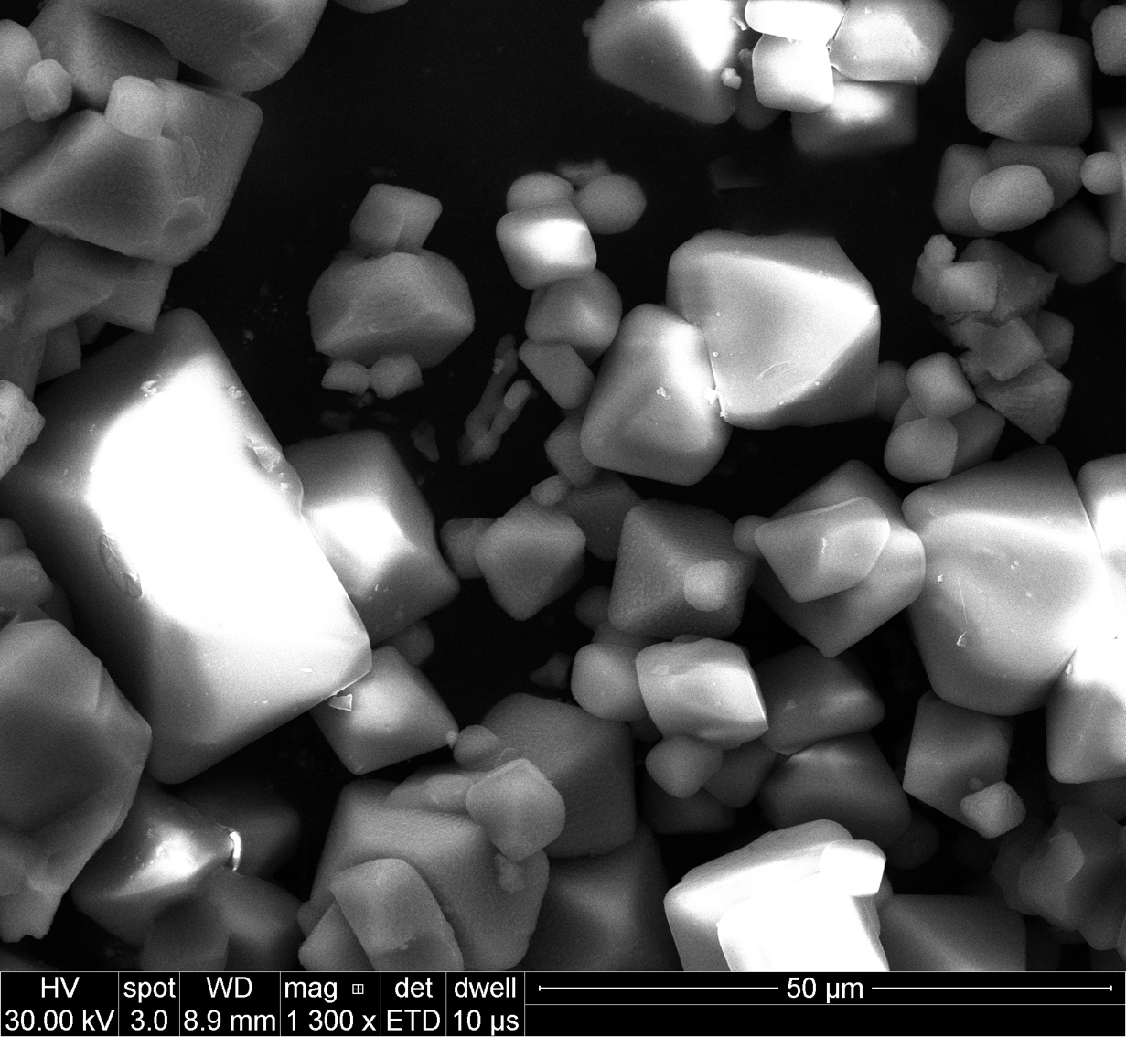
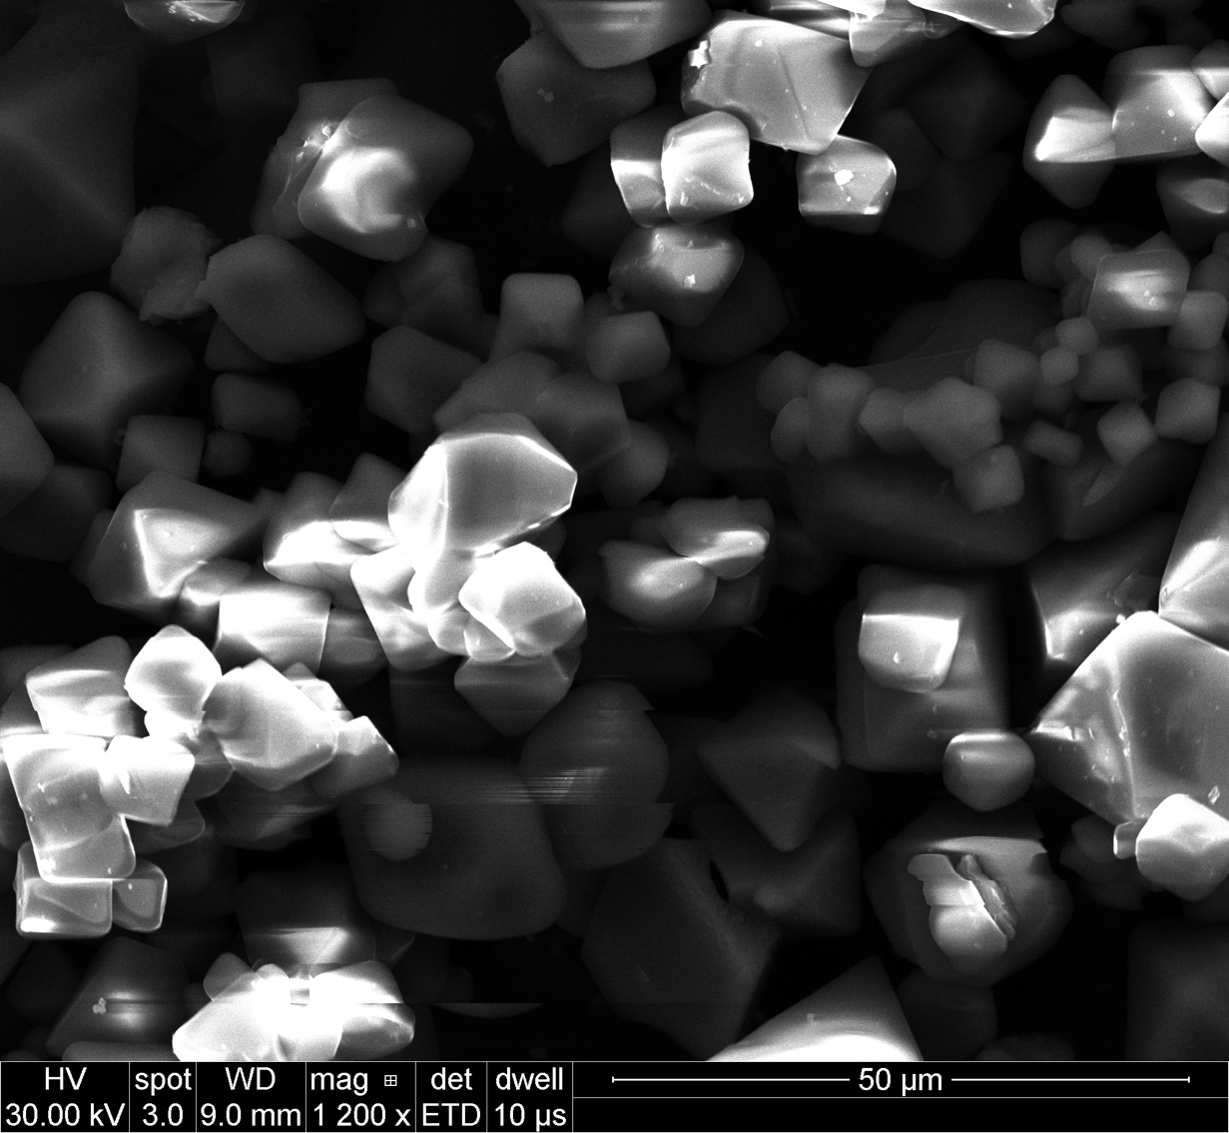
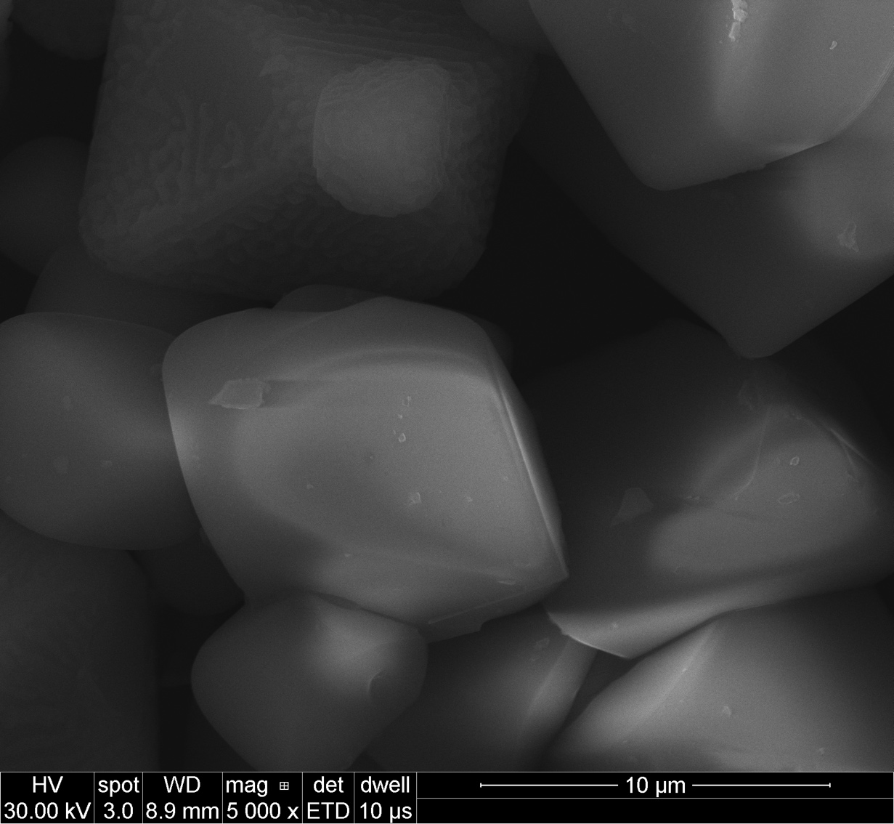
CTO + MgCl₂
CTO
CTO
CTO
CTO-Mg
CTO-Mg
CTO-Mg

Slide 6
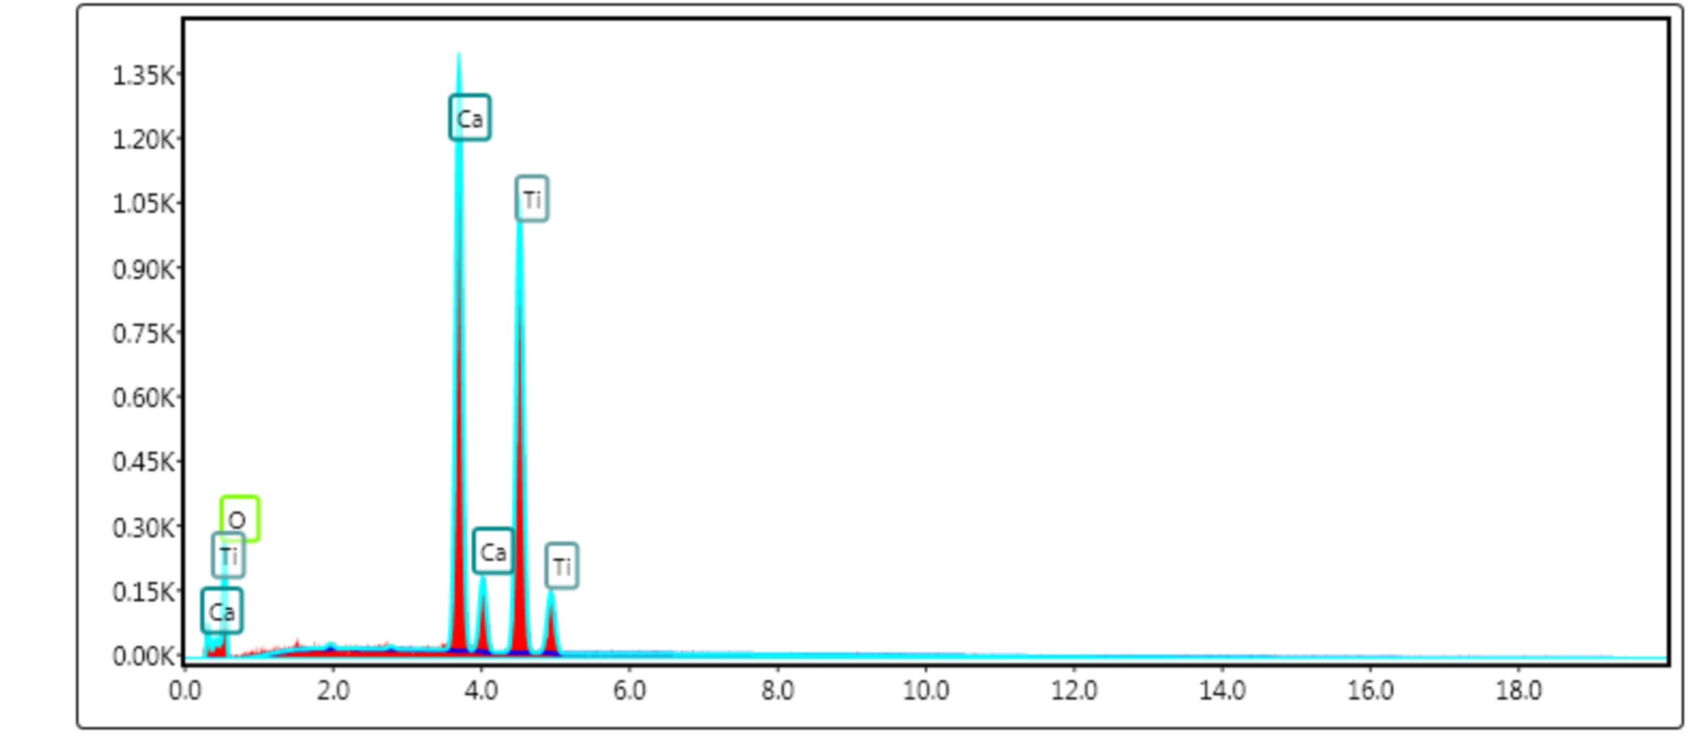
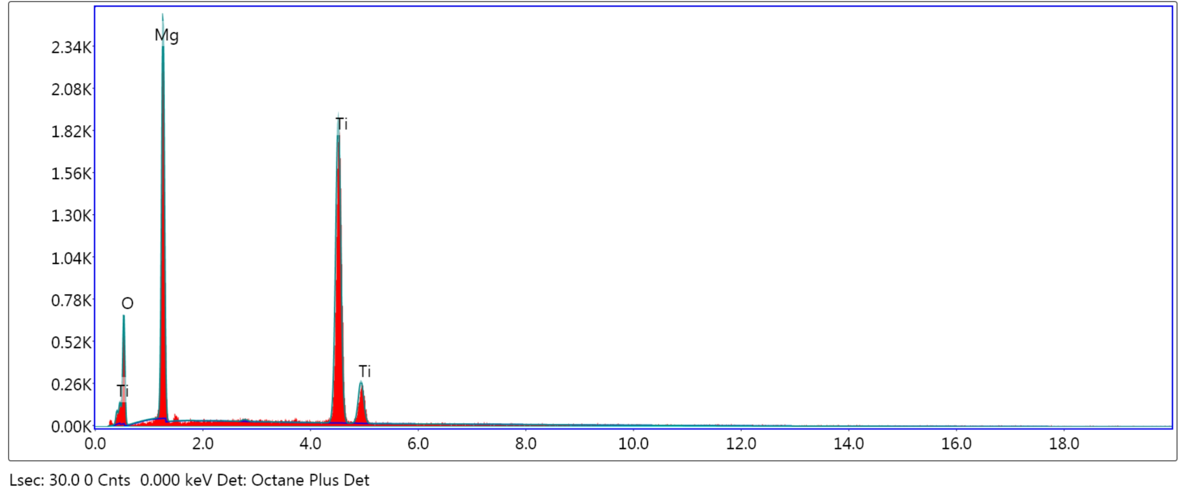
CaTiO₃
Ca peaks disappear
CaTiO₃ + 10 MgCl₂ = MgTiO₃ + MgO
MgO will form as a side product

Slide 7

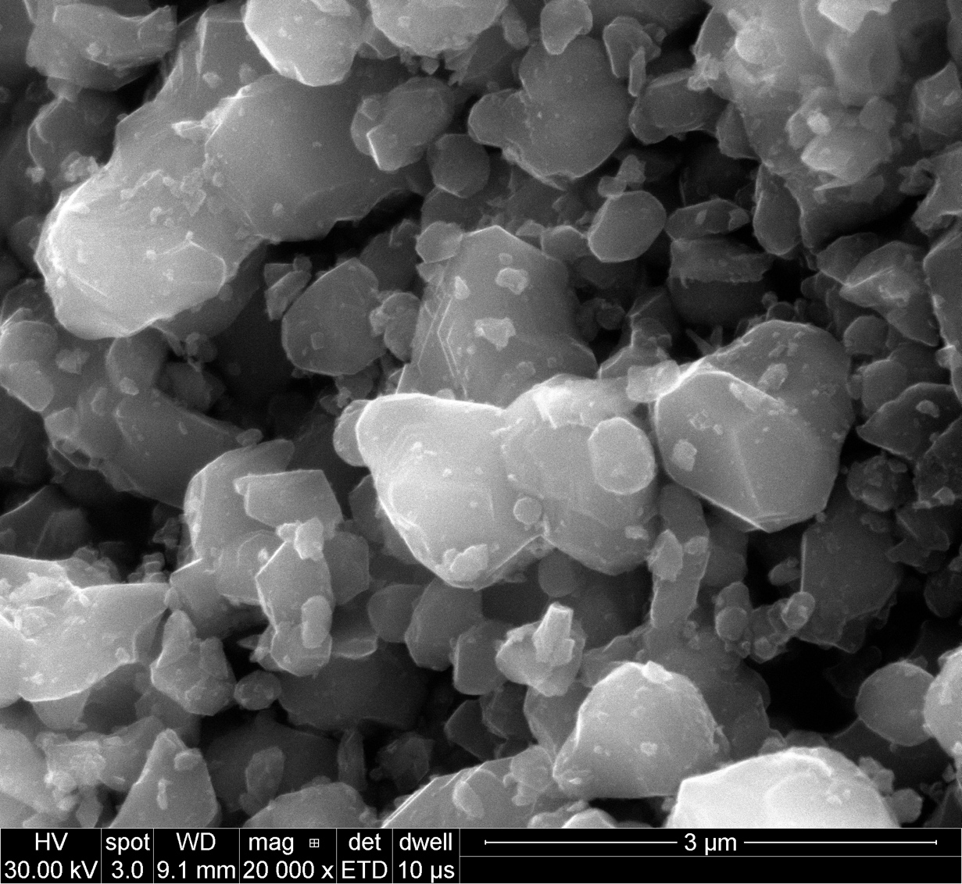
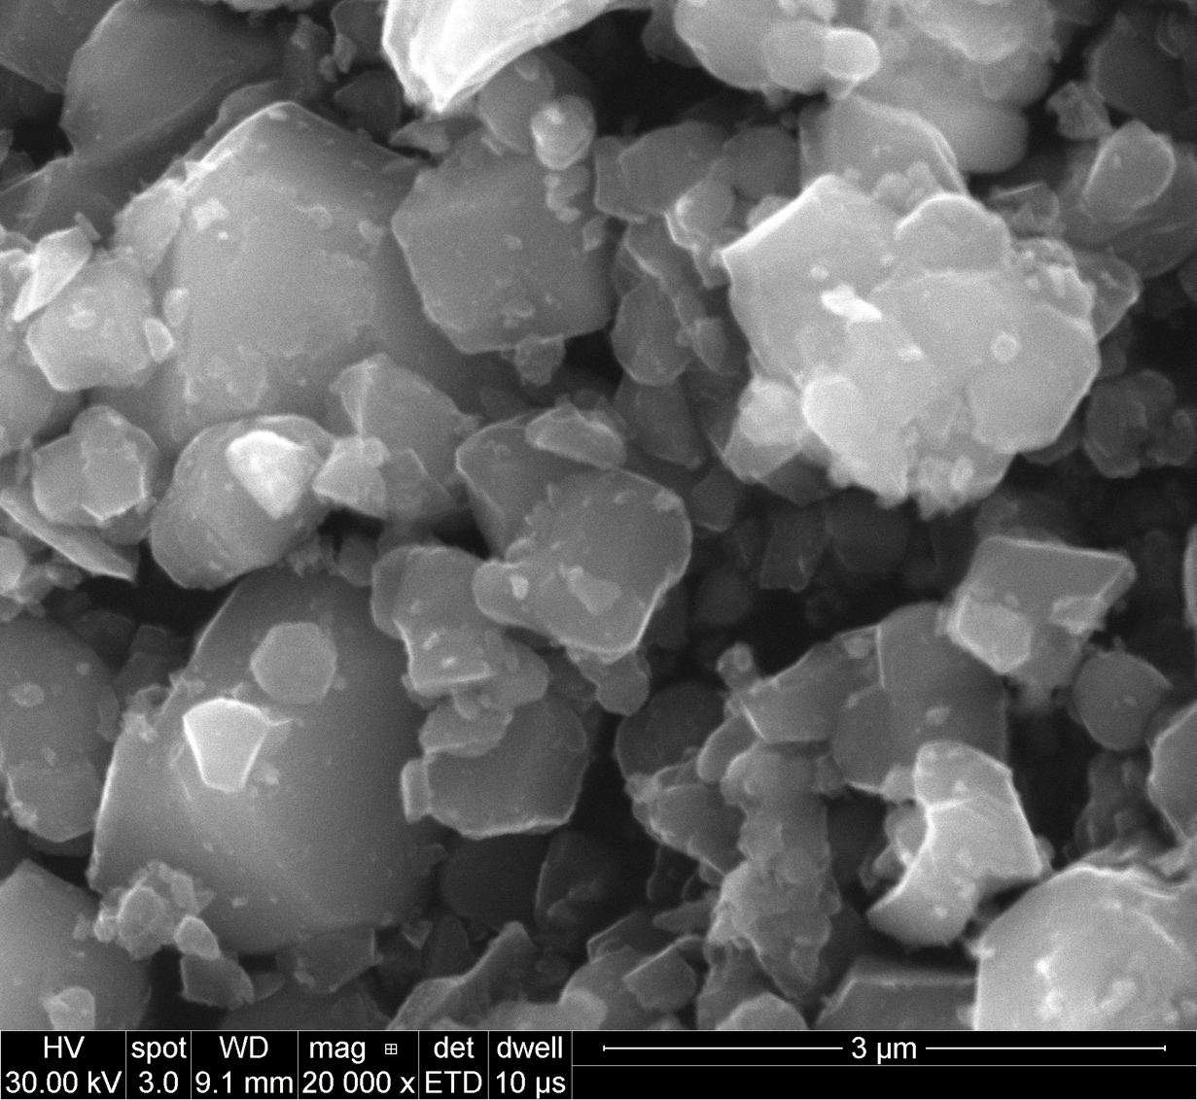
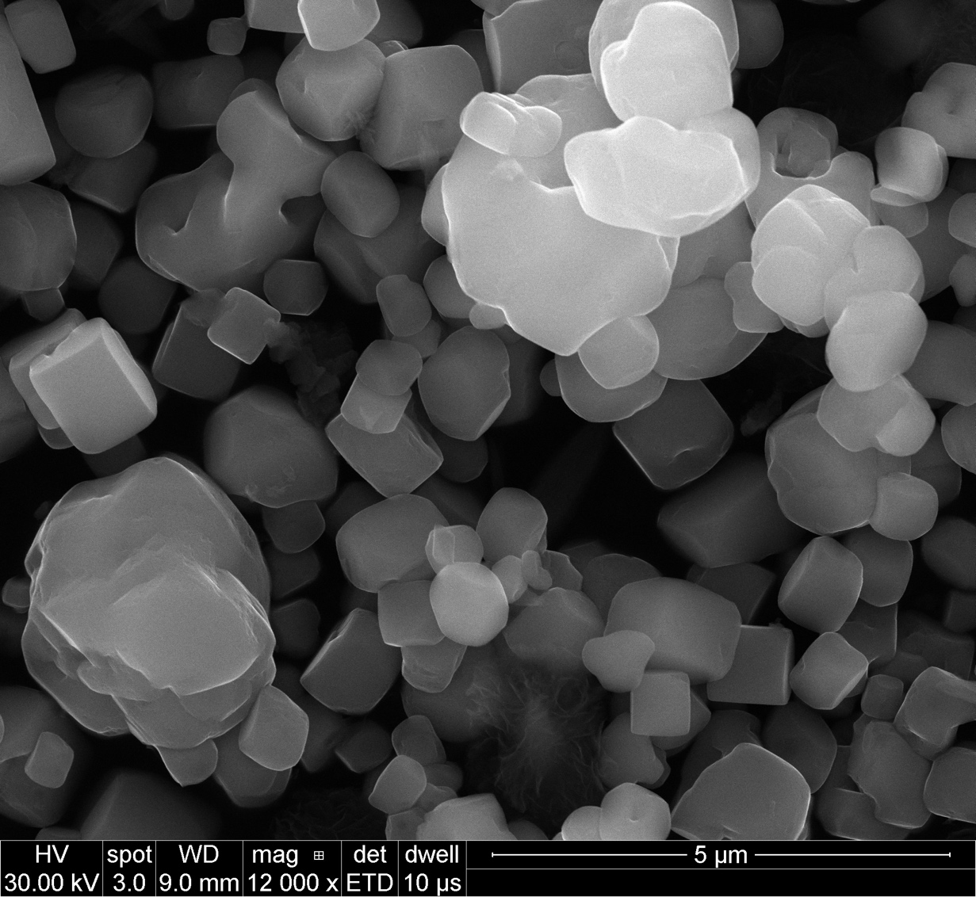
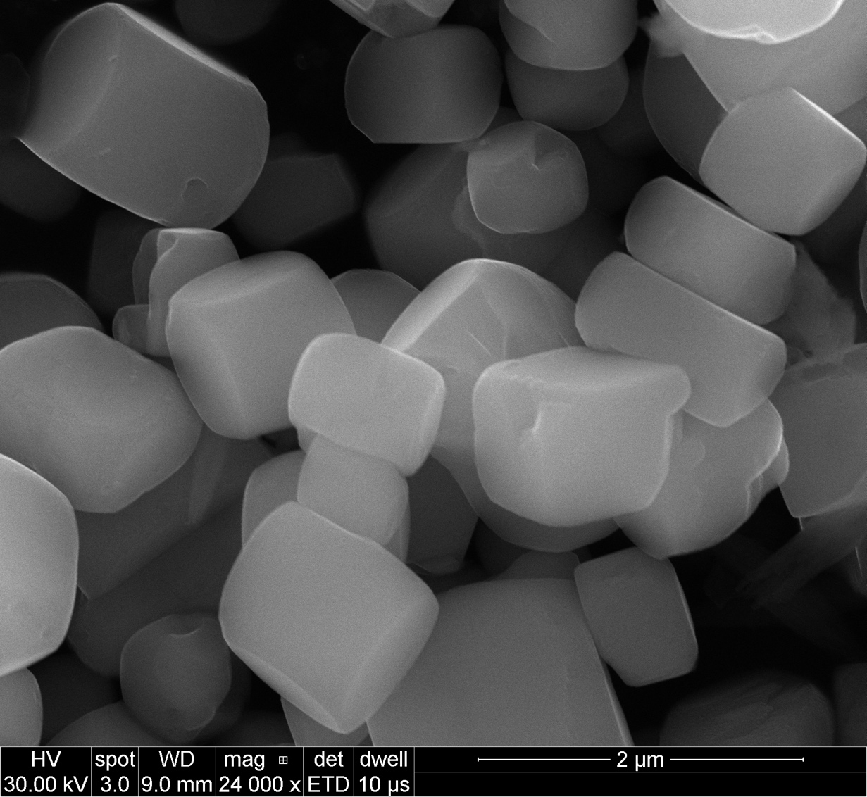
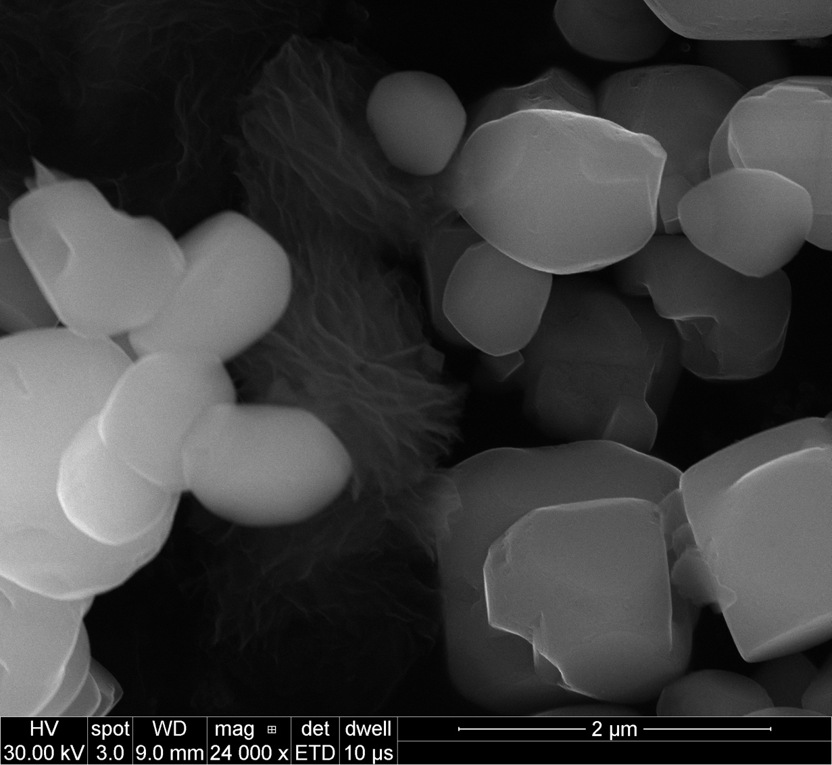
CTO + SrCl₂
CTO
CTO
CTO
CTO-Sr
CTO-Sr
CTO-Sr

Slide 8
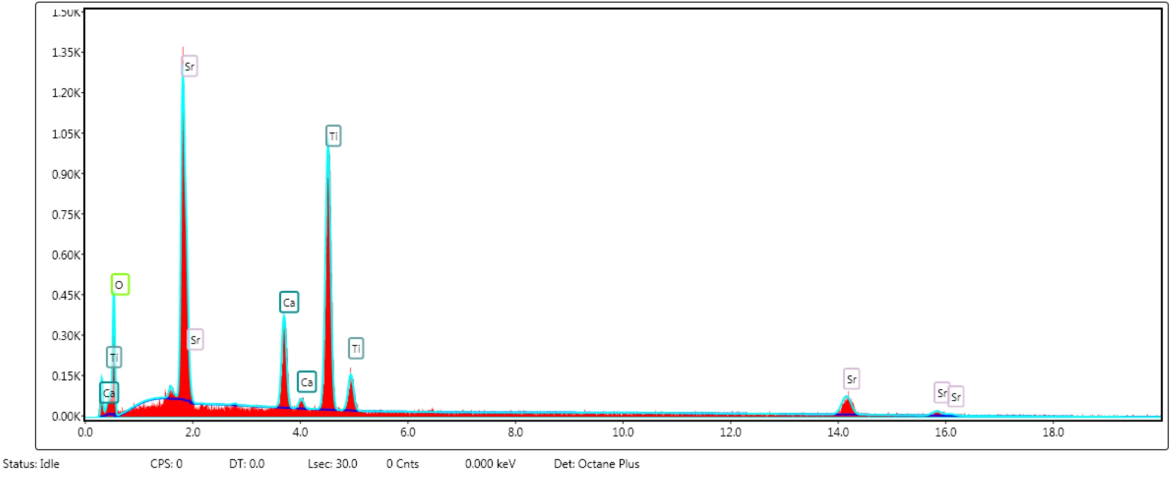
CaTiO₃
CaTiO₃ + SrCl₂

Slide 9
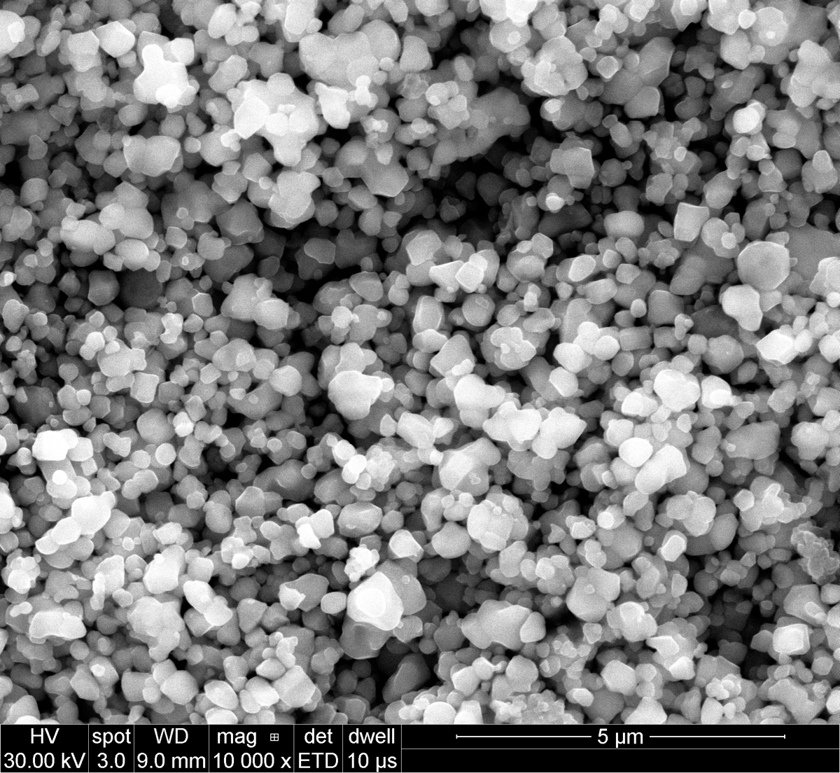
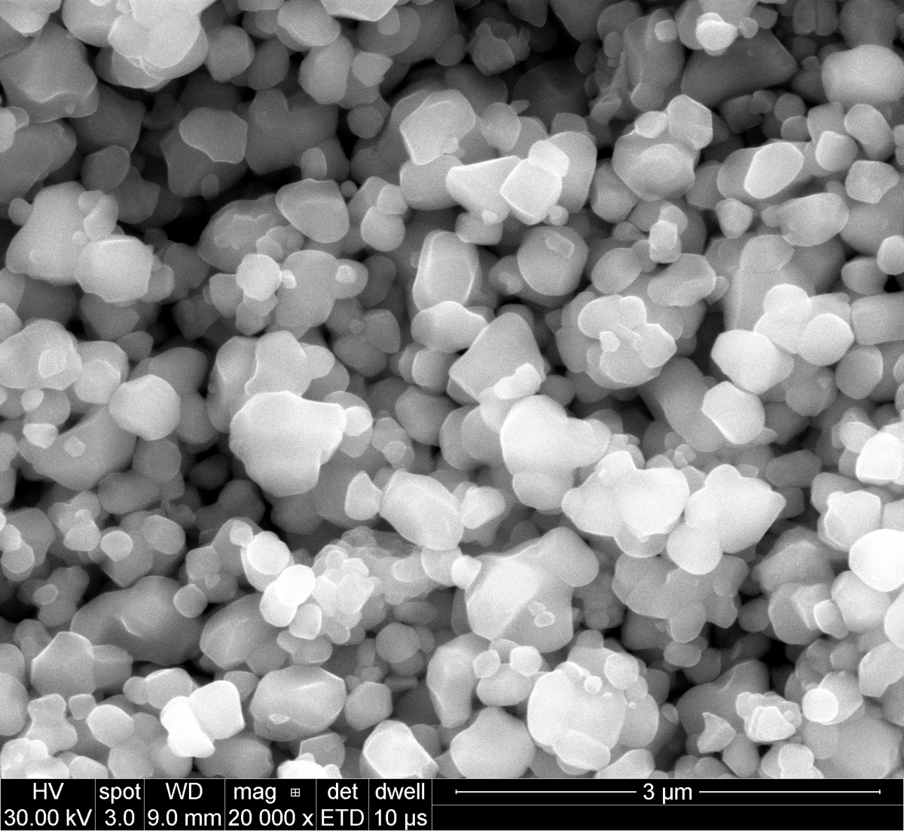
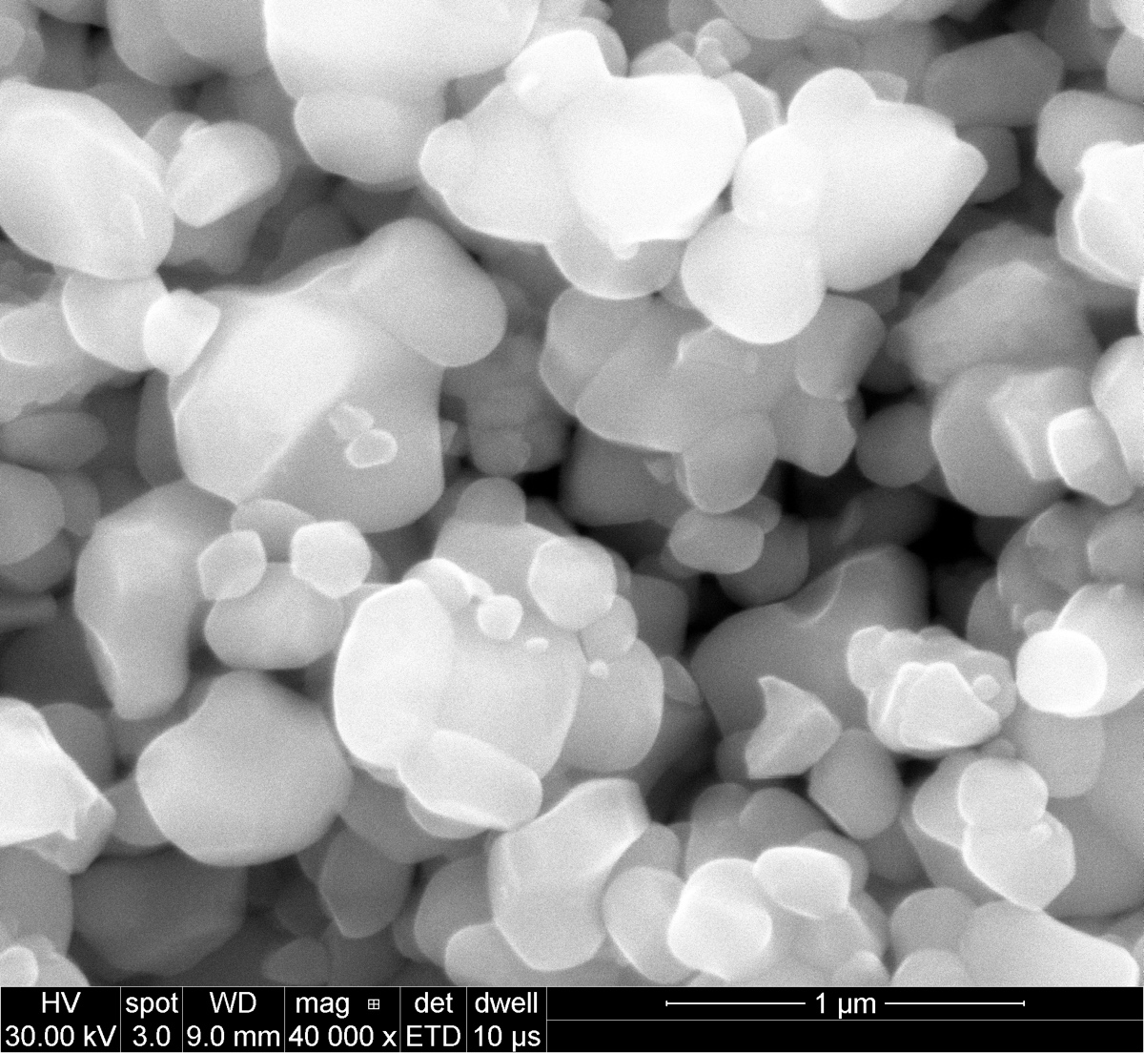
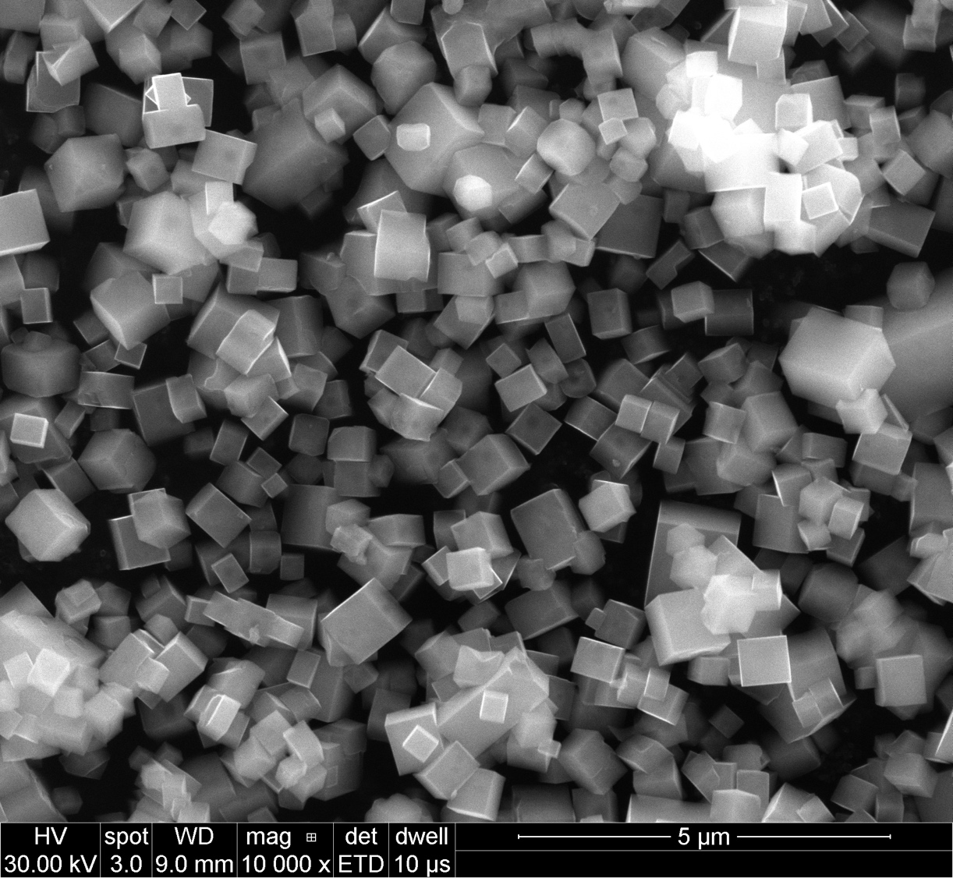
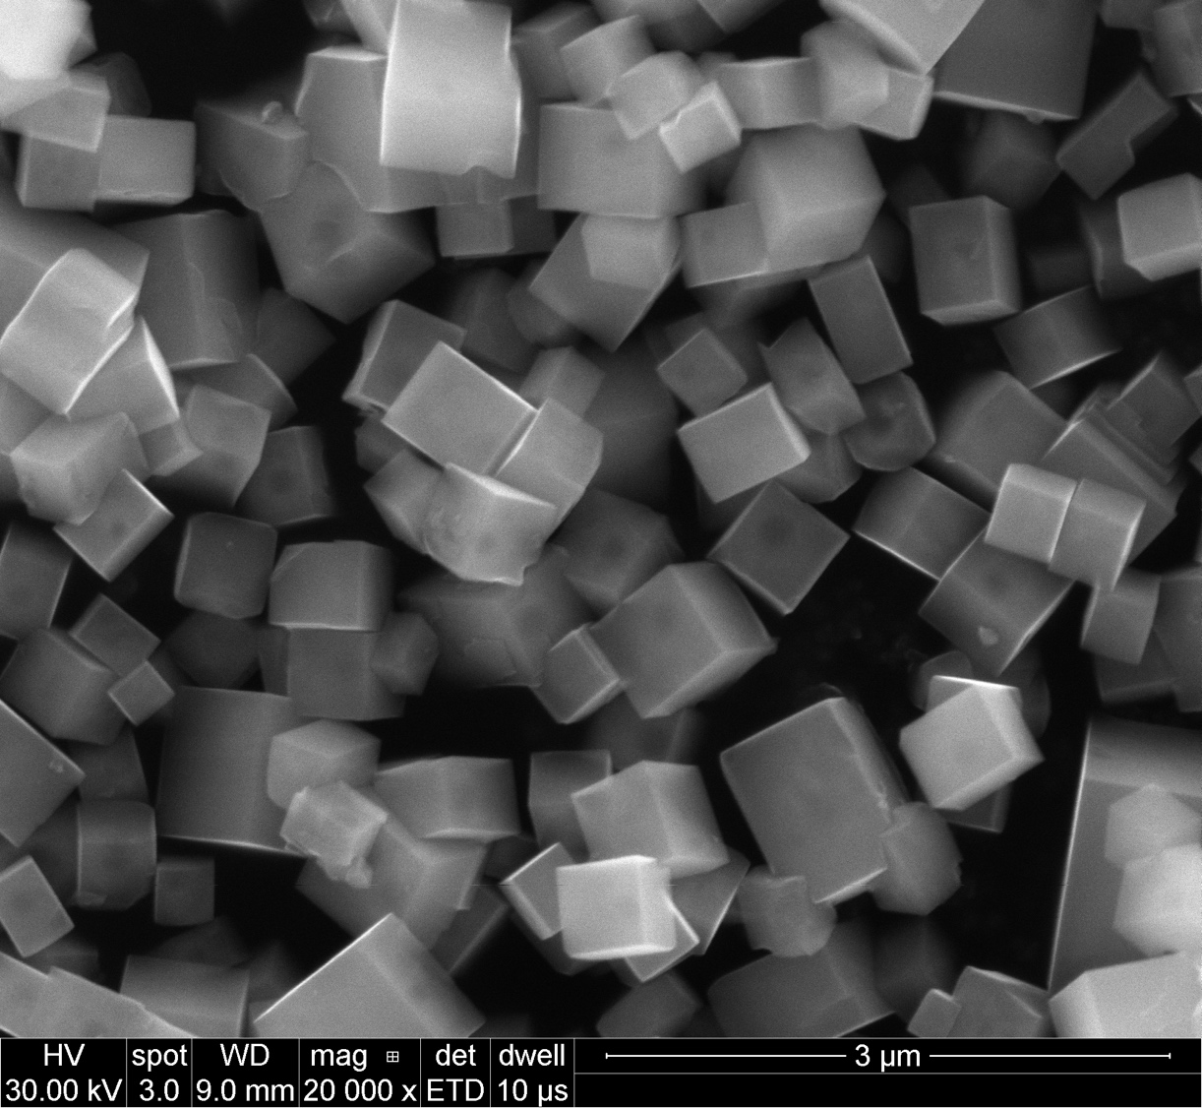
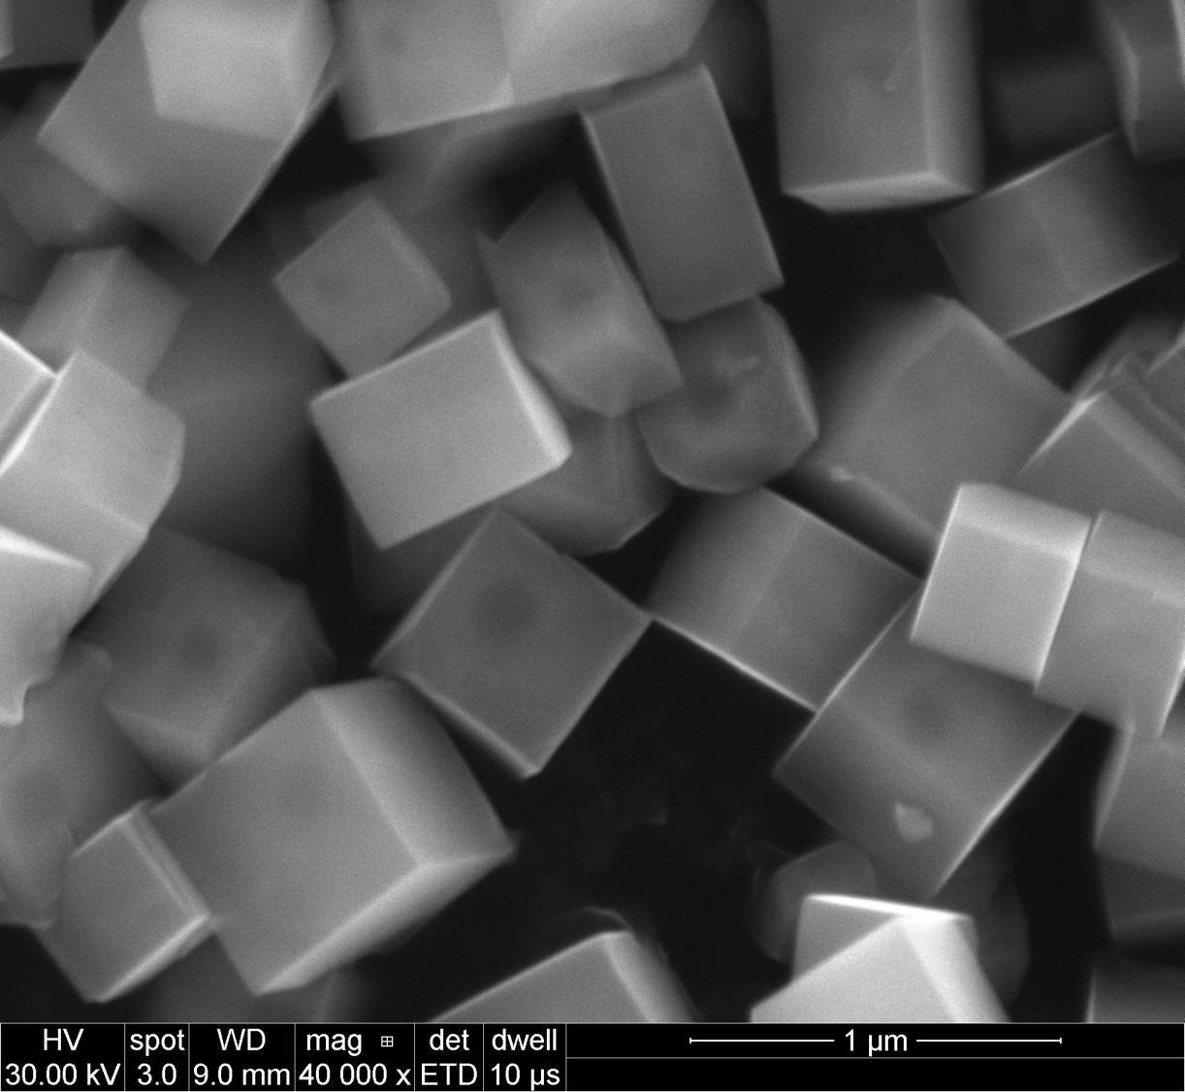
PTO + SrCl₂
PTO
PTO
PTO
PTO-Sr
PTO-Sr
PTO-Sr

Slide 10
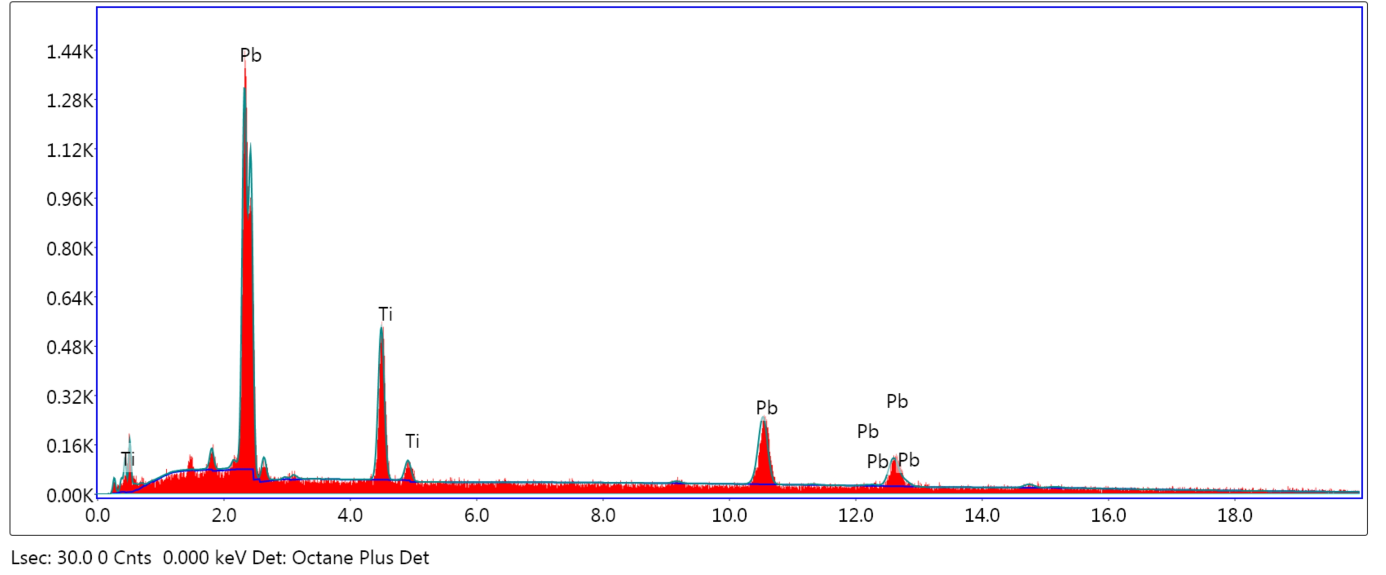
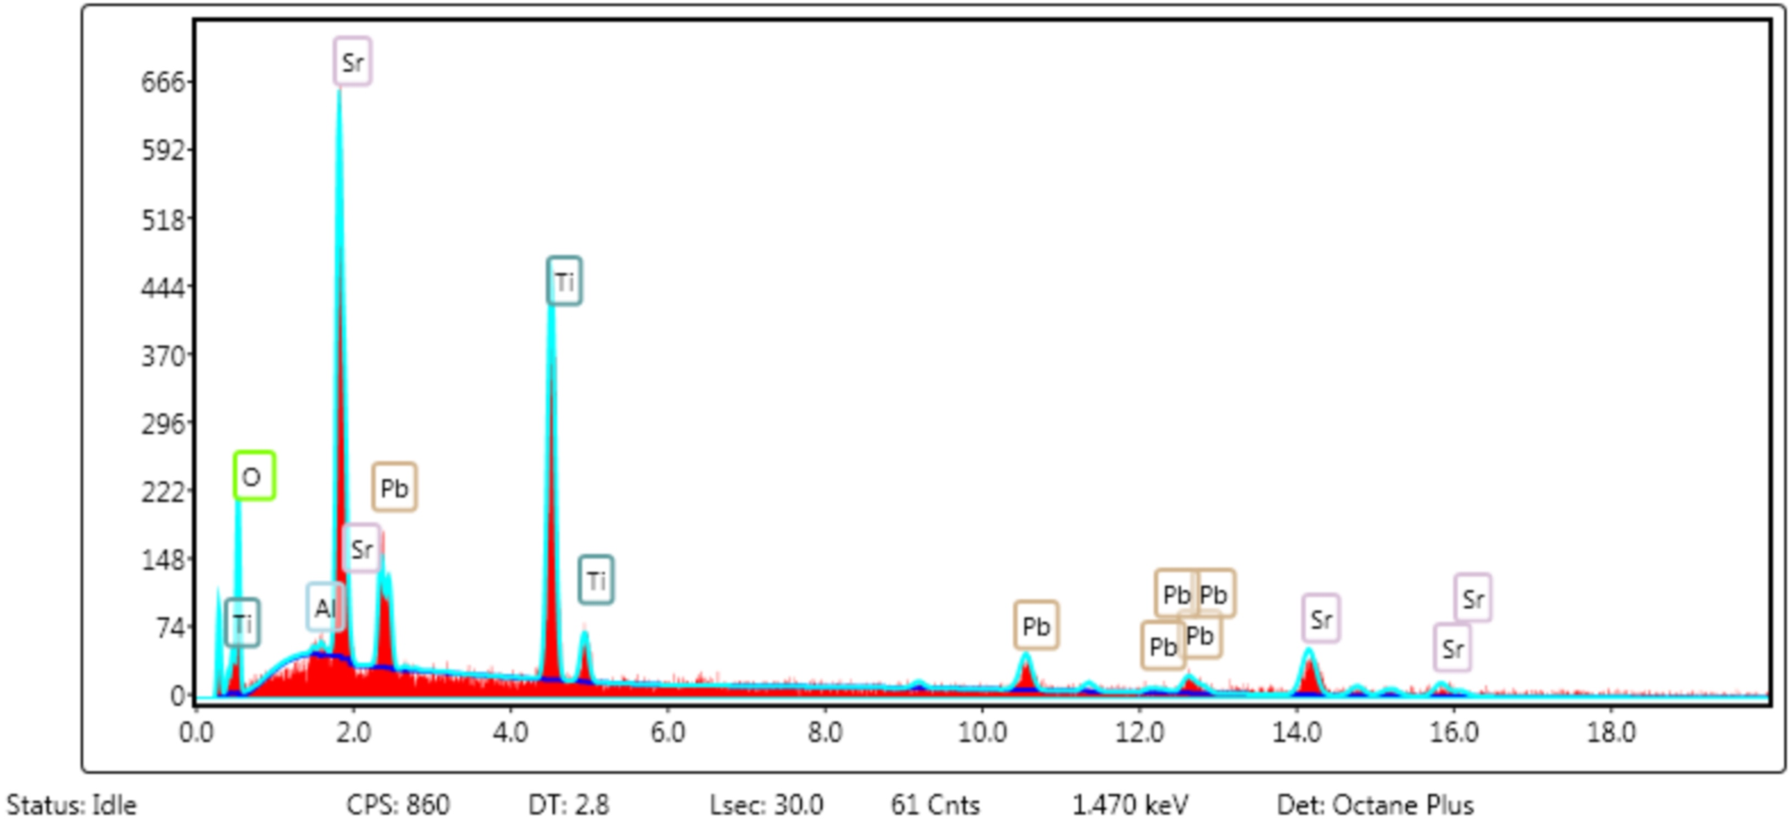
PbTiO₃
PbTiO₃ + SrCl₂

Slide 11
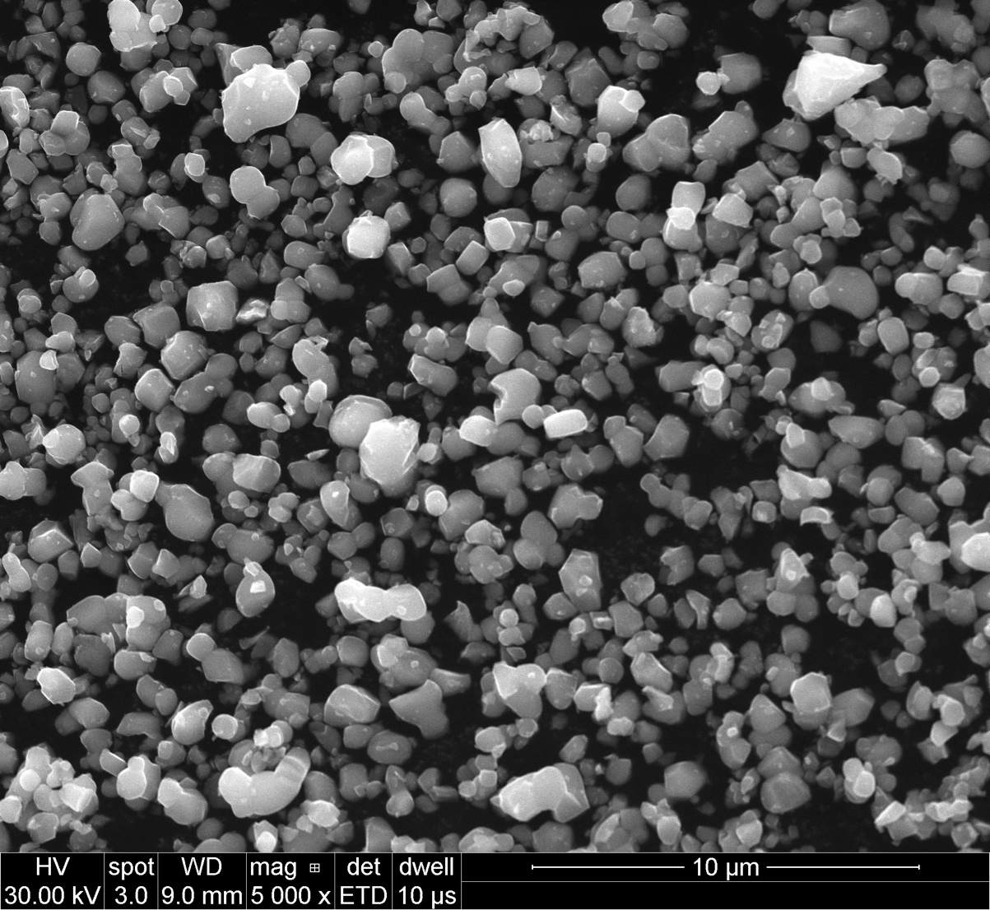
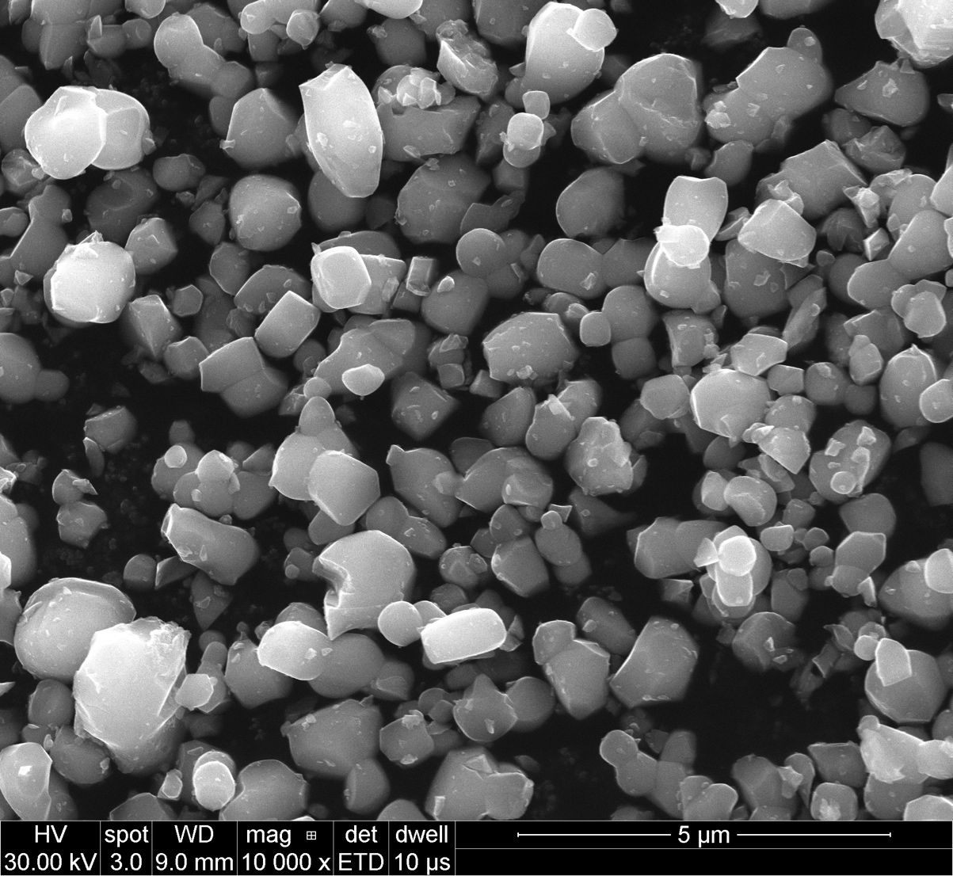
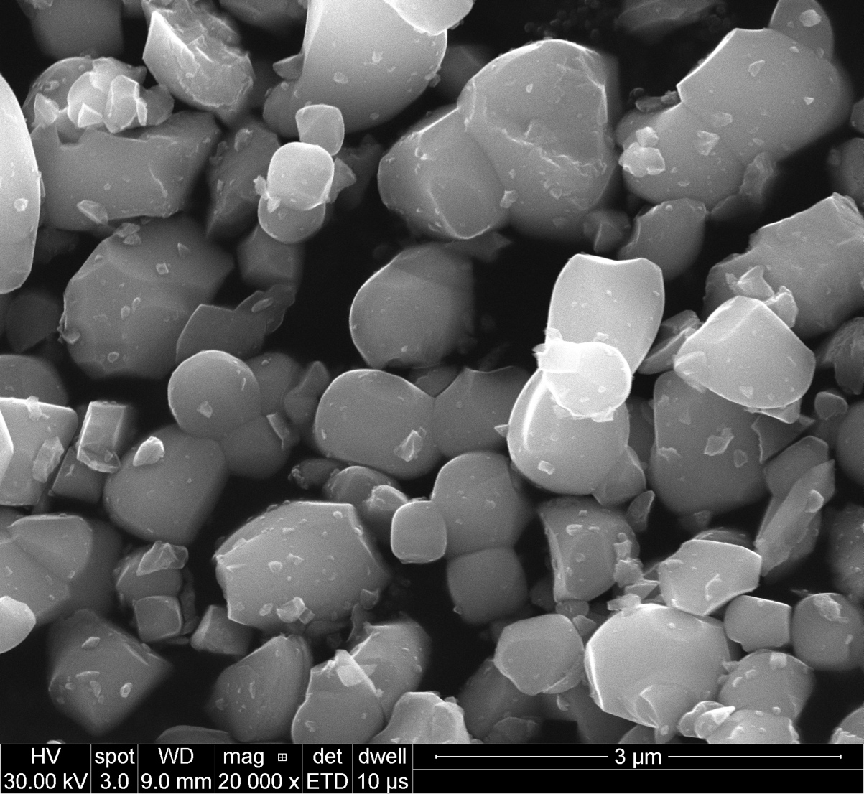
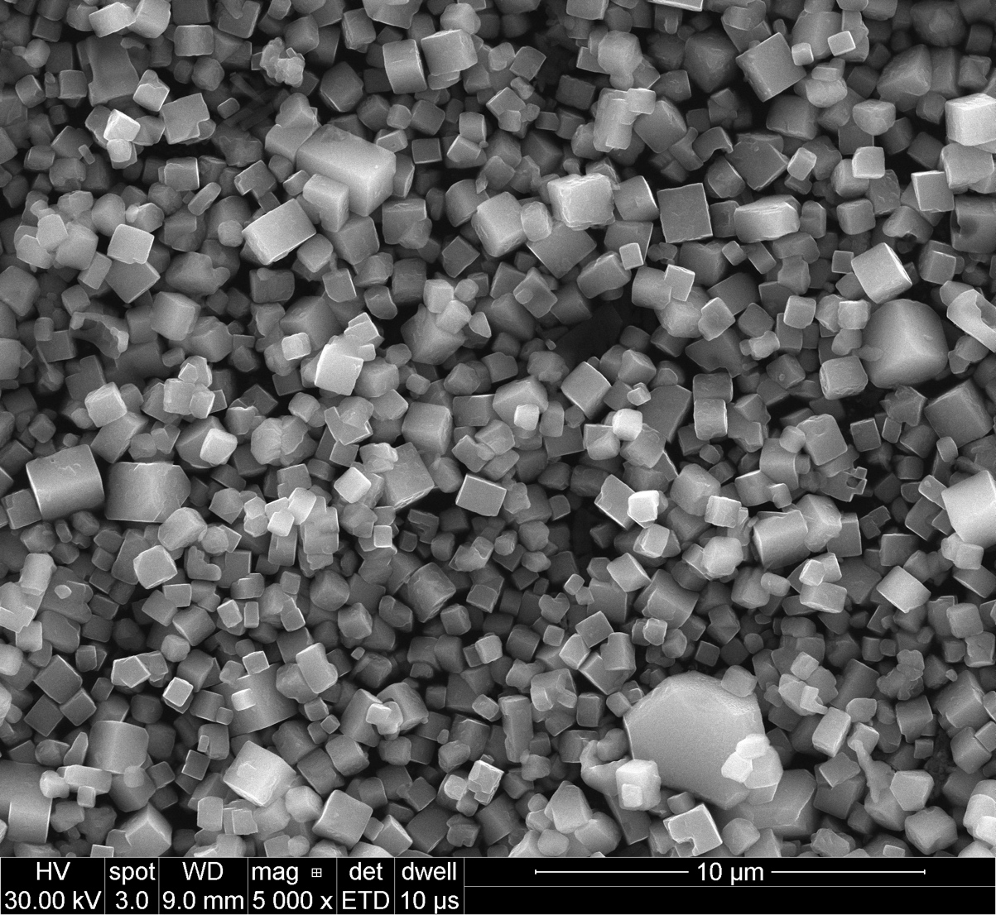
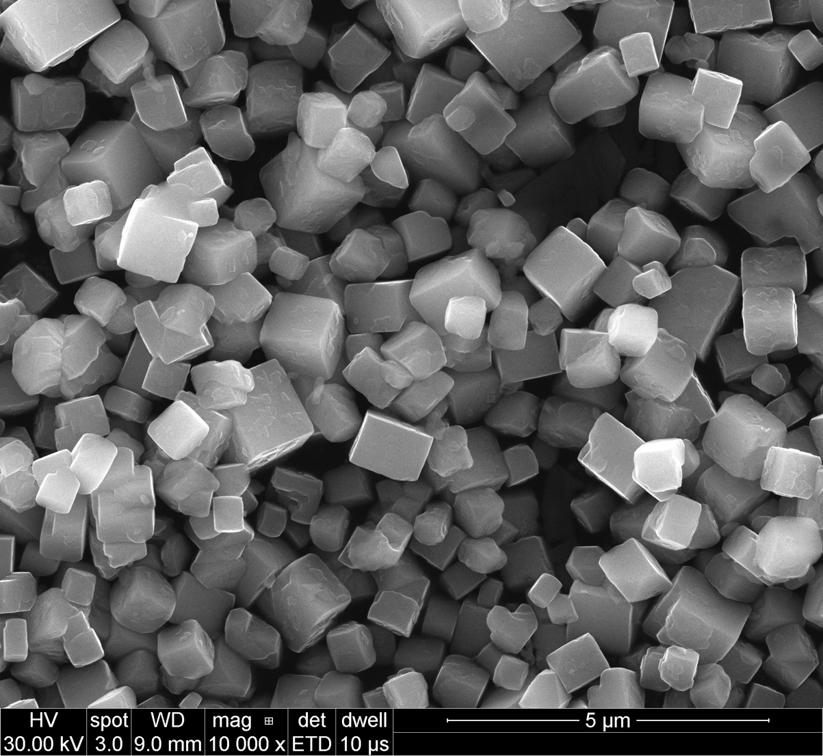
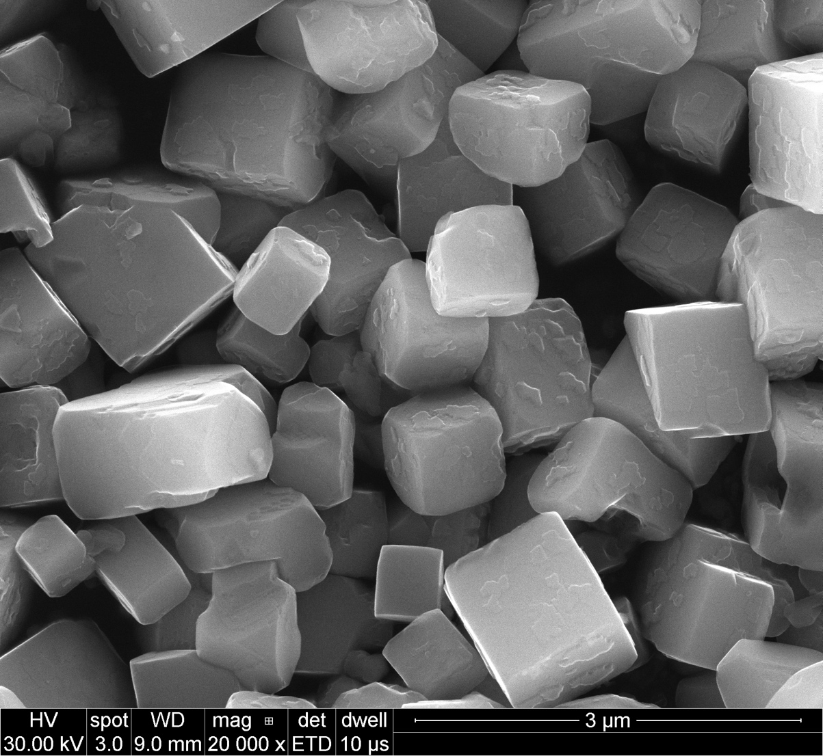
BTO + SrCl₂
BTO
BTO
BTO
BTO-Sr
BTO-Sr
BTO-Sr

Slide 12
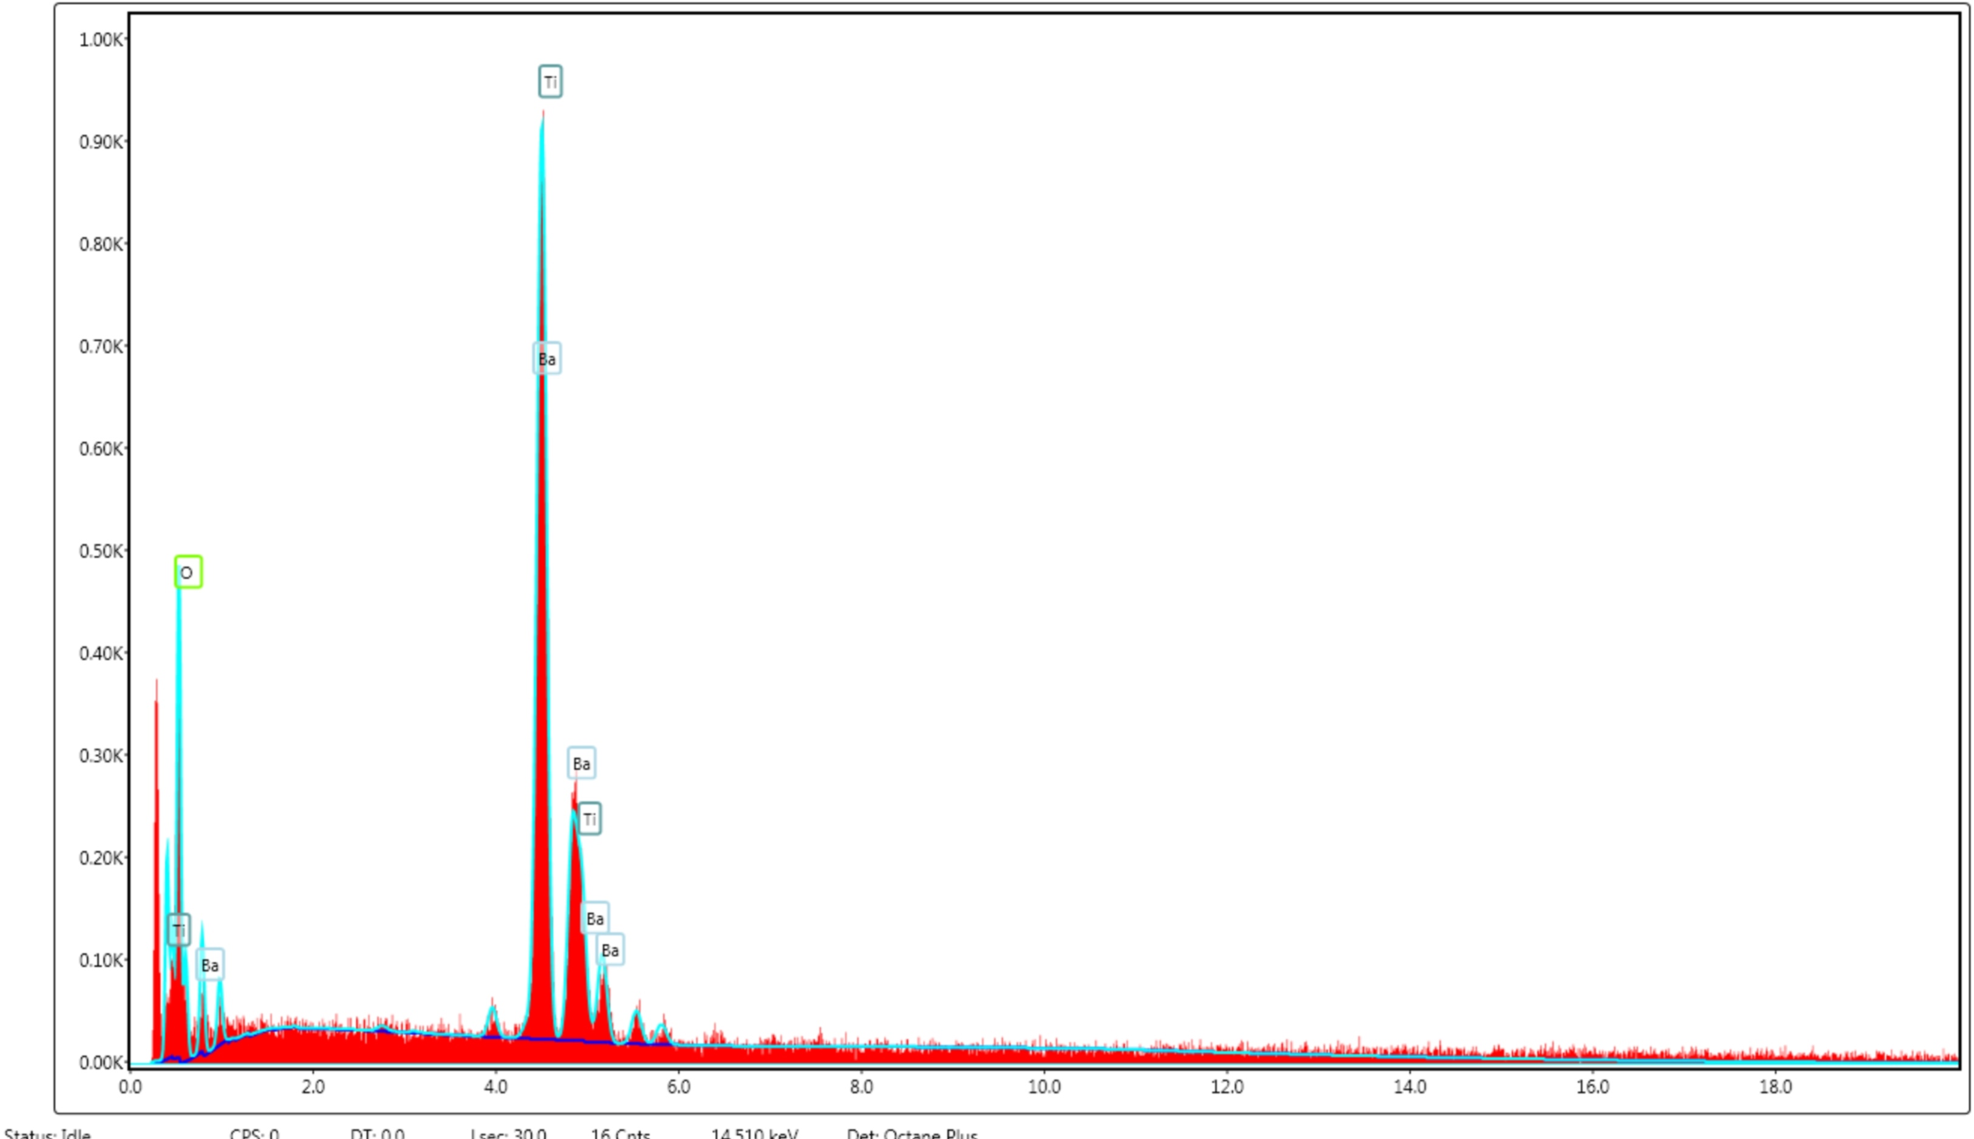
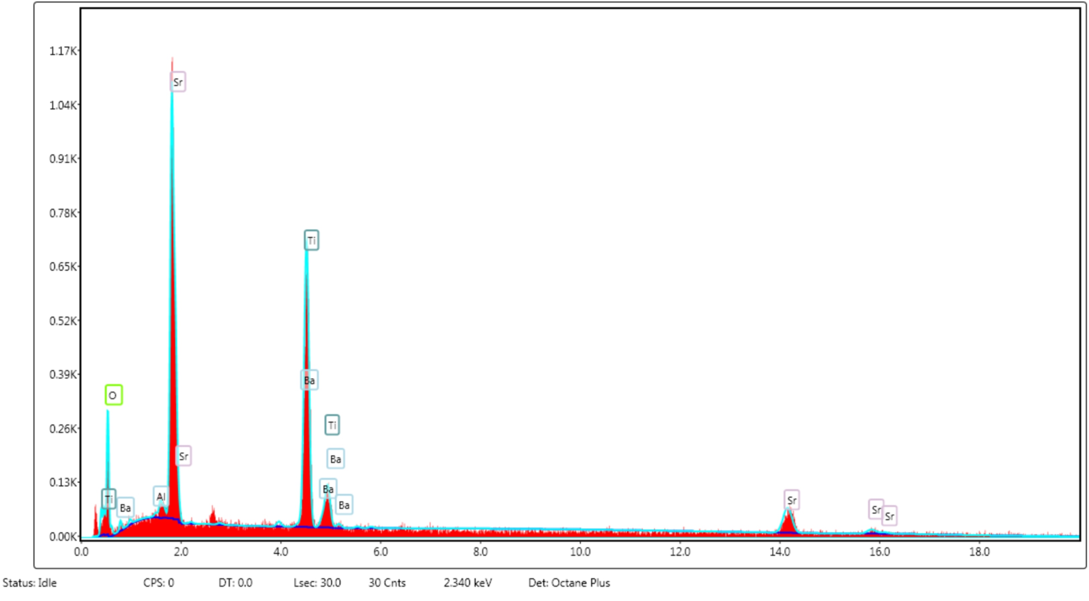
BTO
Element | Weight % | Atomic % | Error %
O K | 42.67 | 78.48 | 12.71
Ba L | 34.26 | 7.34 | 7.36
Ti K | 23.07 | 14.18 | 3.5
BTO-sA
This is closer to STO
Element | Weight % | Atomic % | Error %
O K | 41.13 | 75.17 | 12.84
Al K | 0.22 | 0.24 | 74.81
Sr L | 35.56 | 11.87 | 3.61
Ba L | 3.44 | 0.73 | 29.32
Ti K | 19.66 | 12 | 3.62
Ba peaks almost disappear
Cl

Slide 15
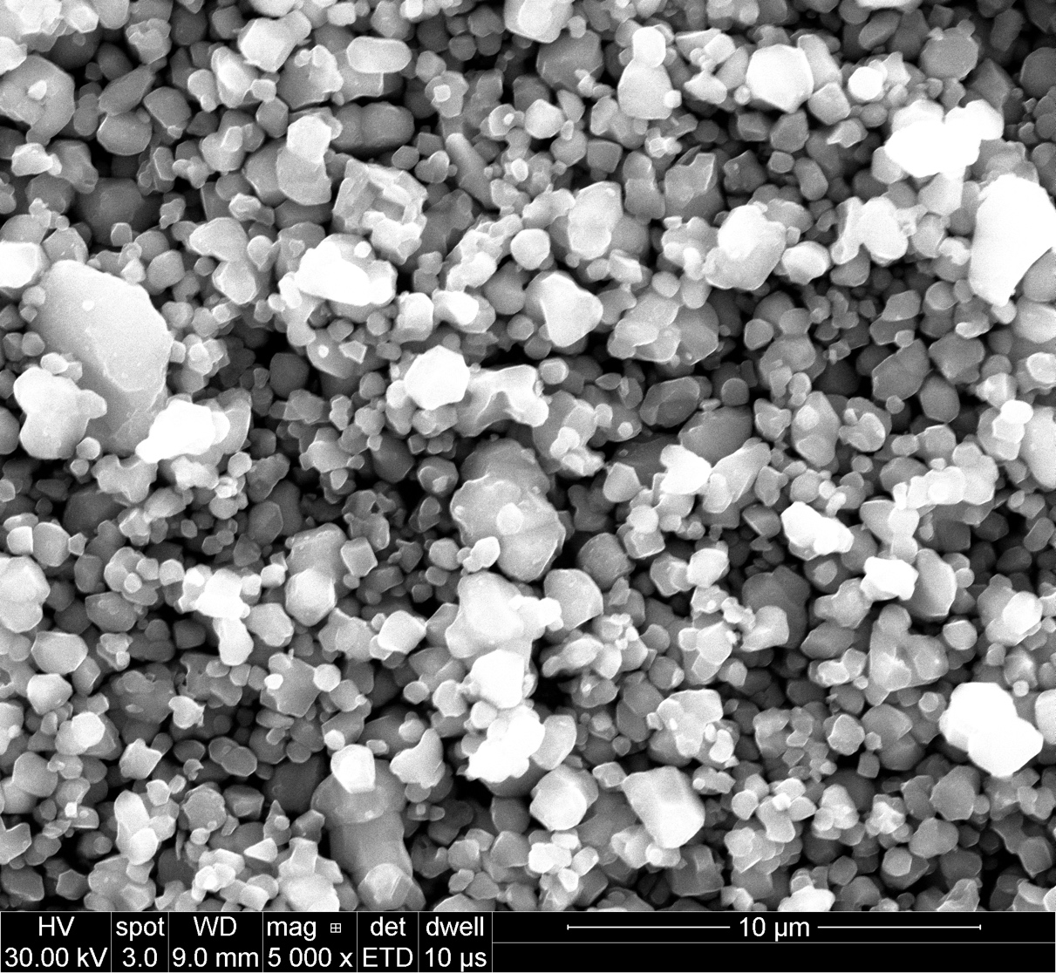
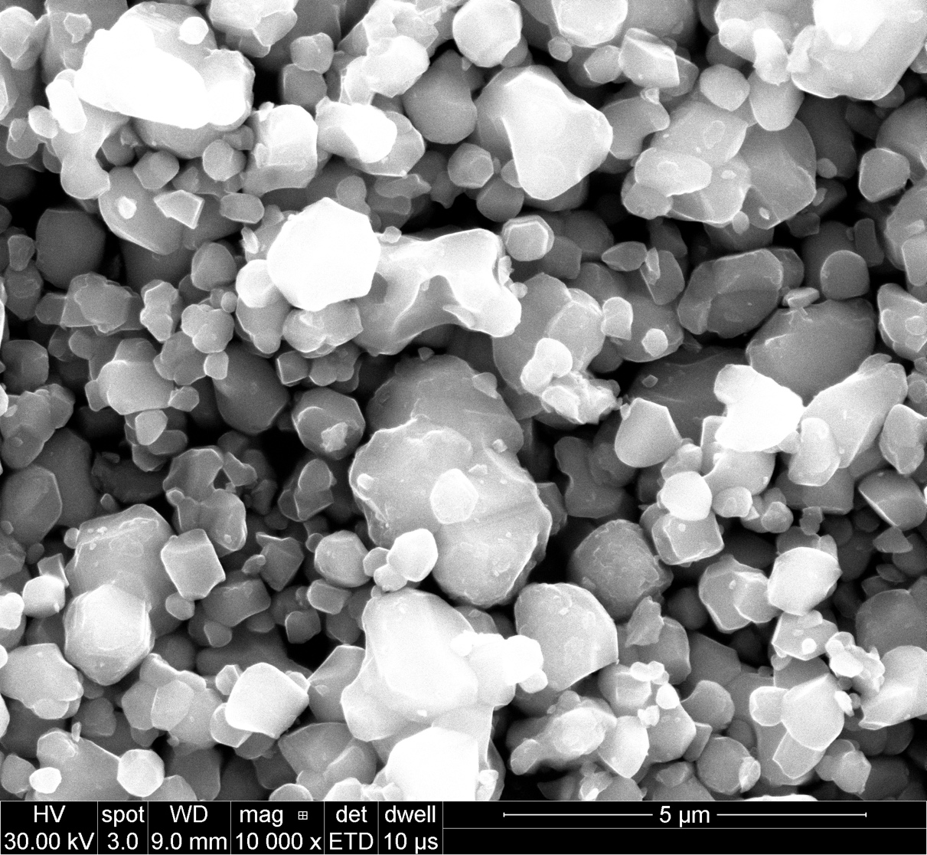
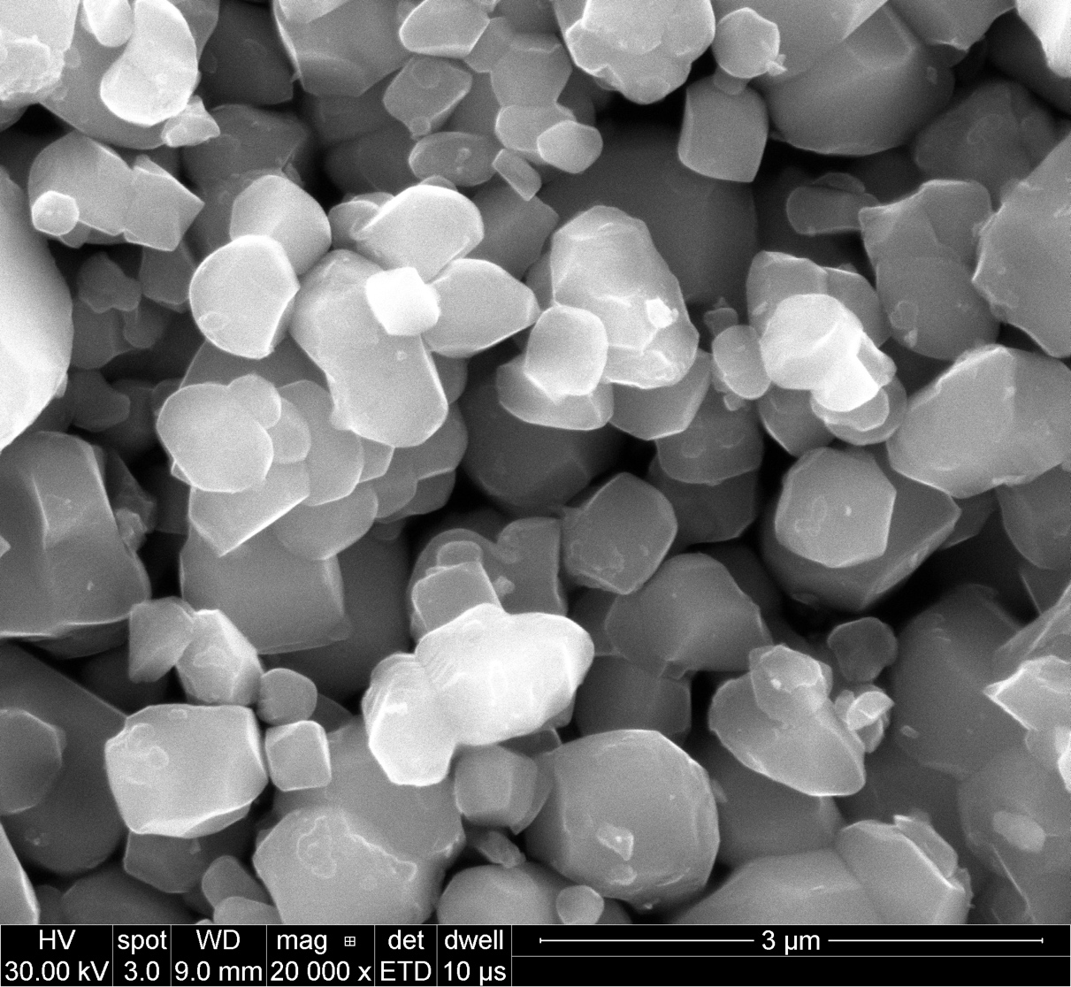
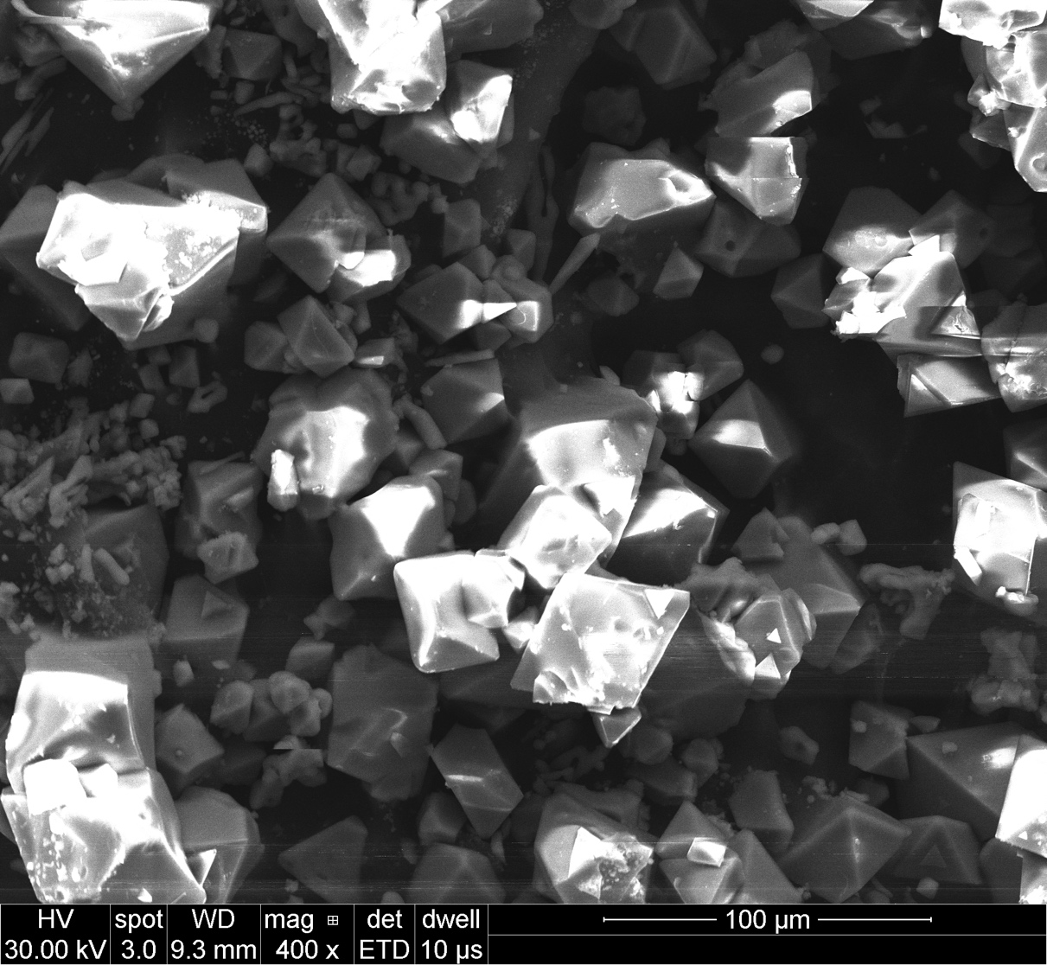
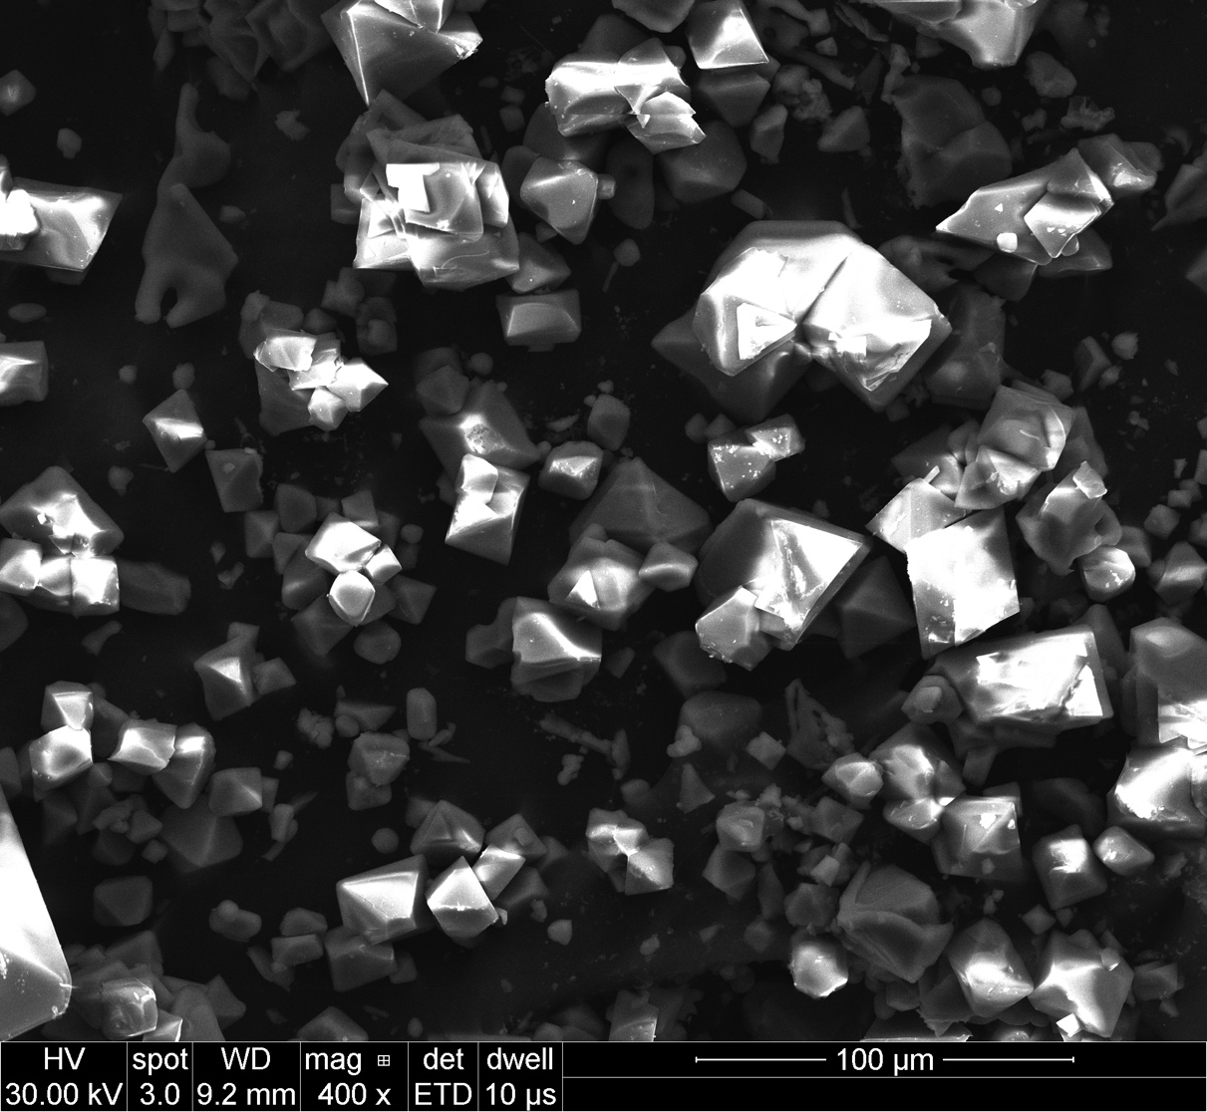
STO + MgCl₂
STO
STO
STO
STO-Mg
STO-Mg
STO-Mg

Slide 16
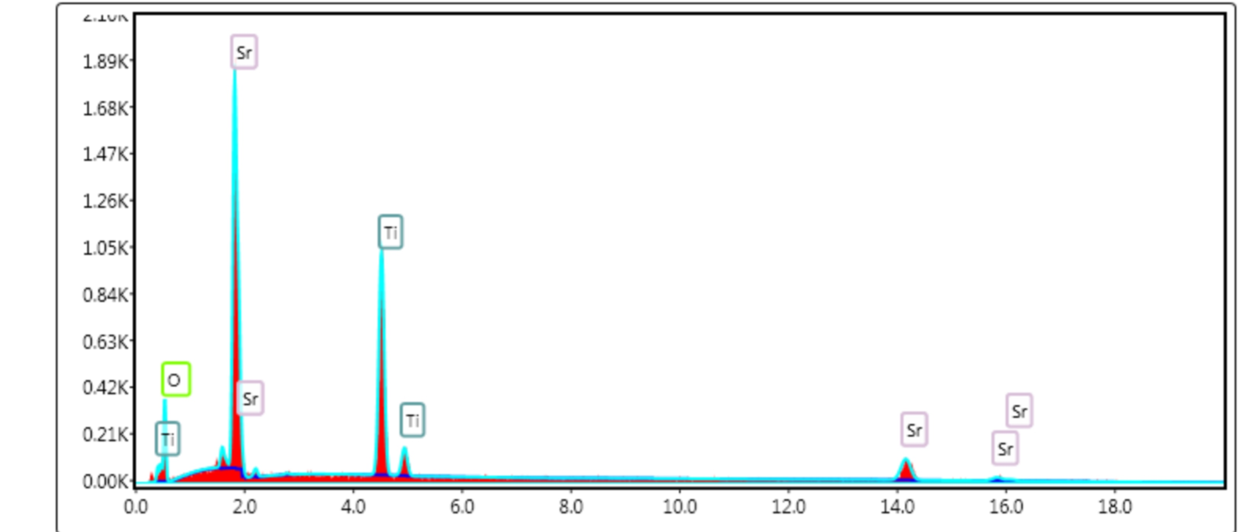
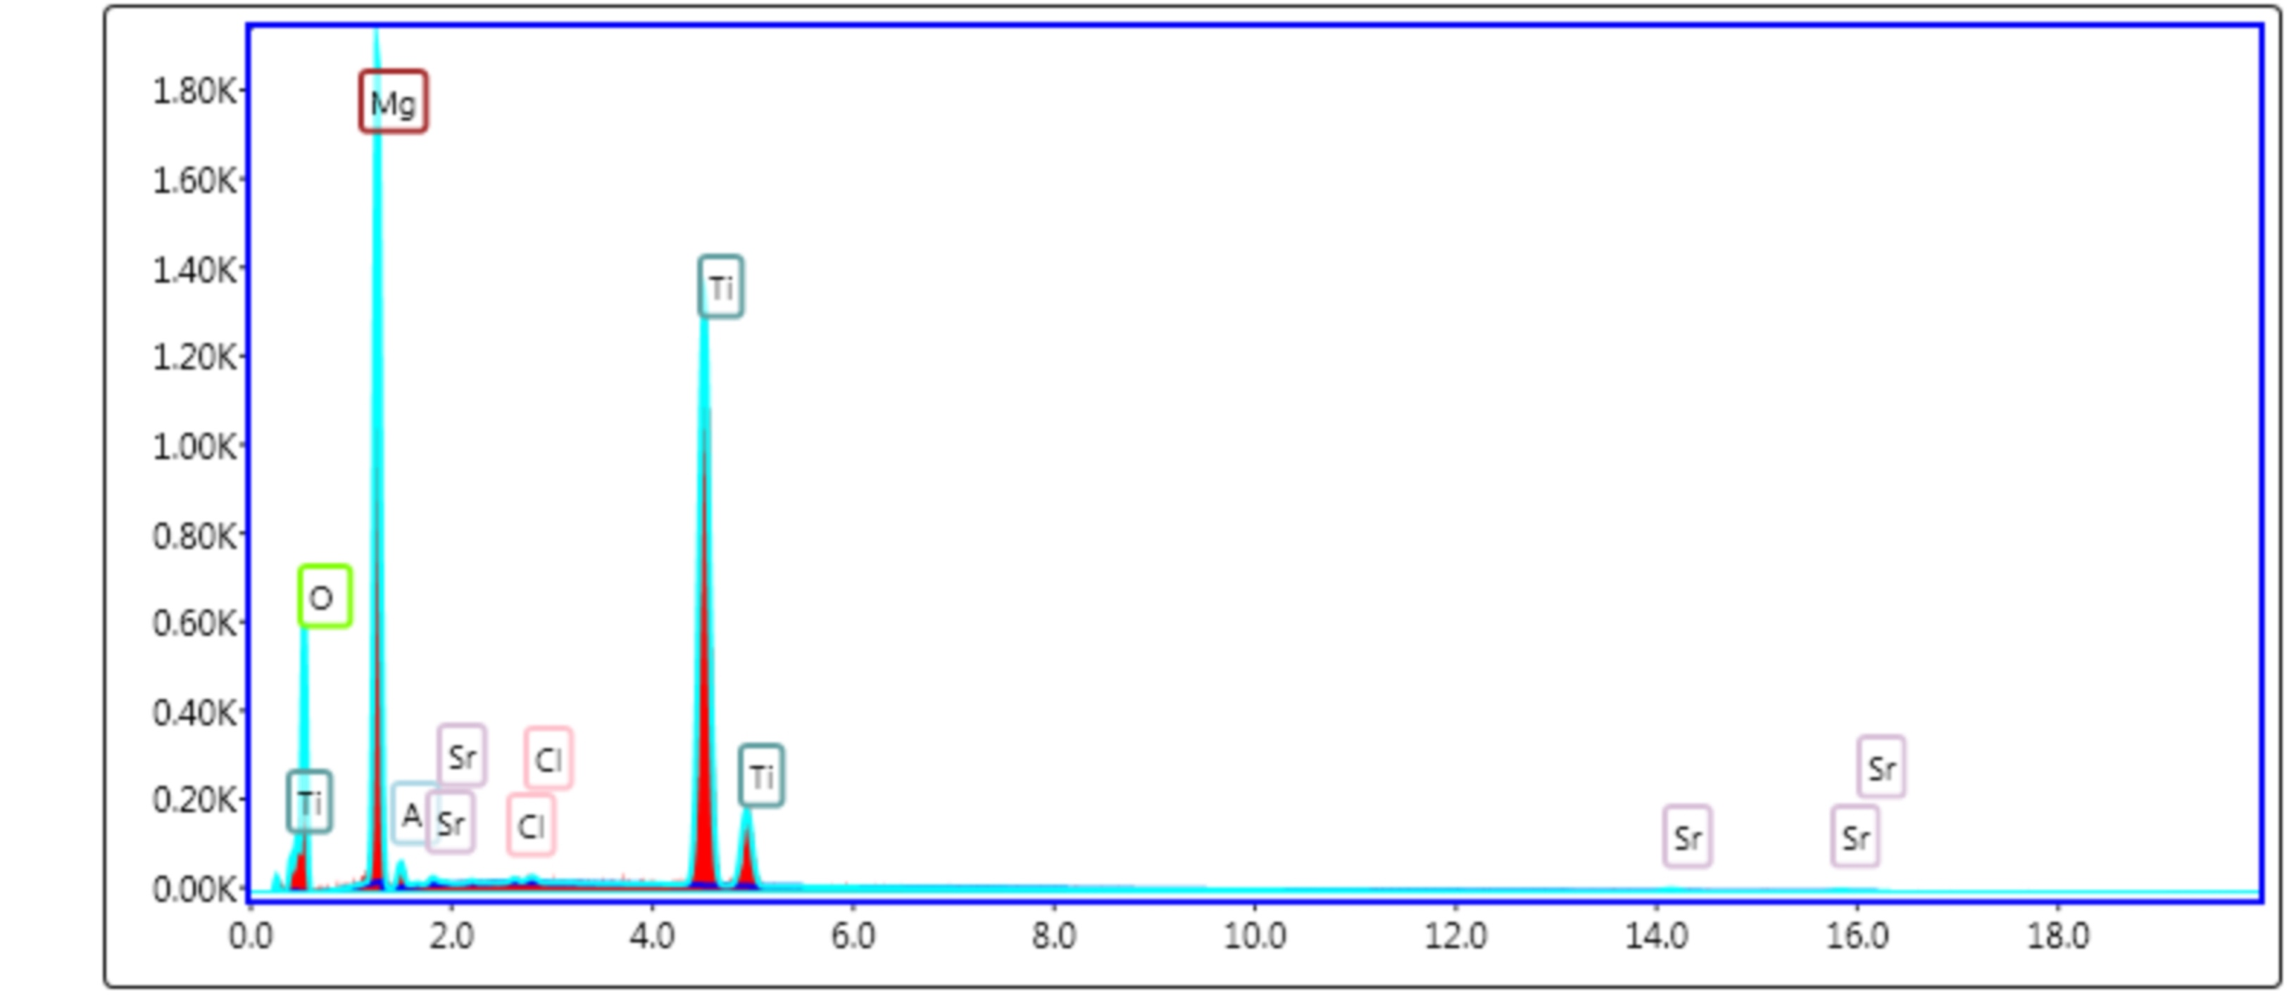
STO
STO + MgCl2
MgO will also form as a side product

Slide 17


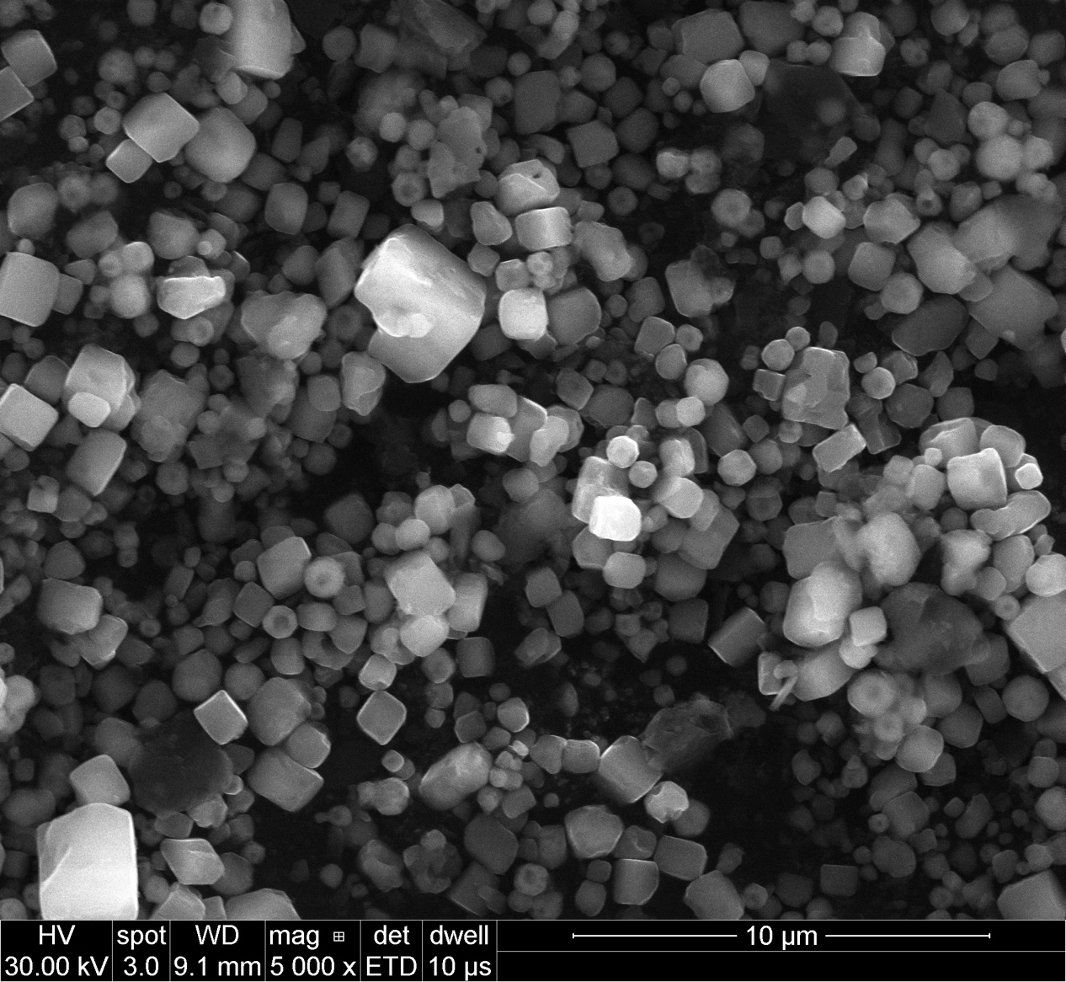
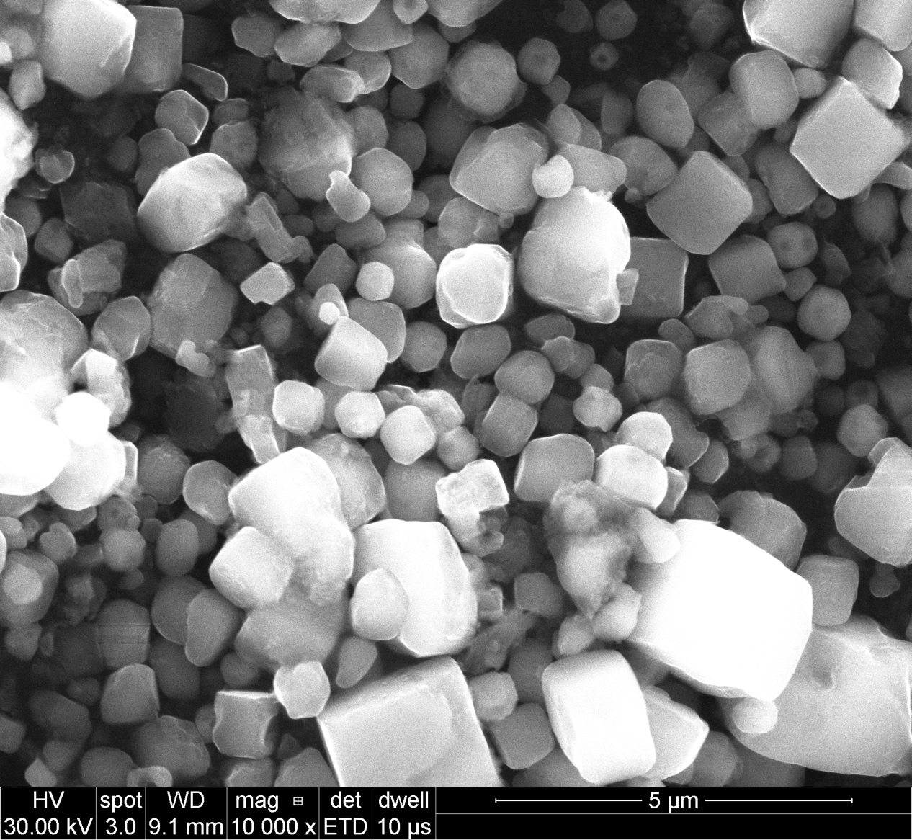
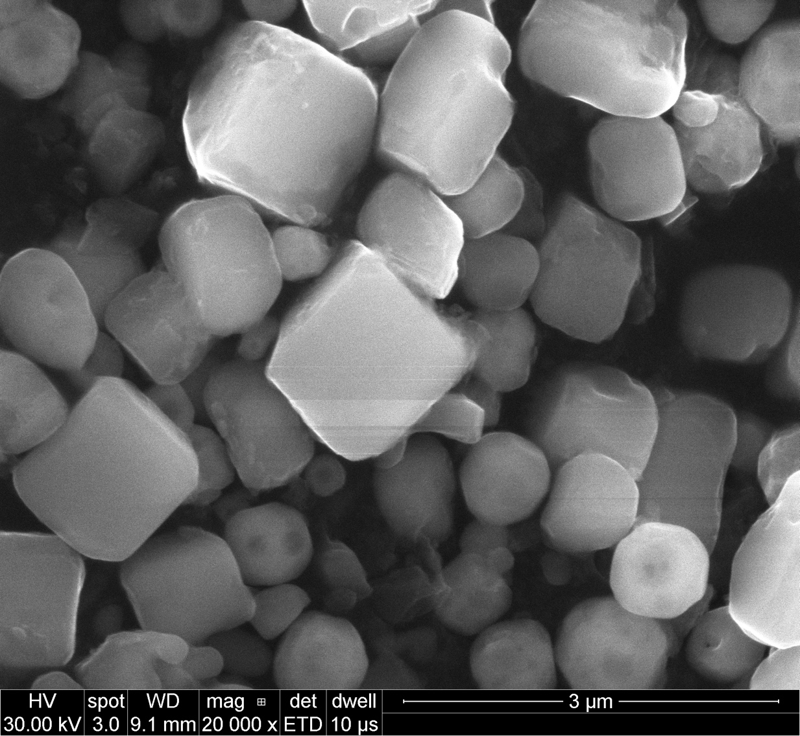
STO + CaCl₂
STO
STO
STO
STO-Ca
STO-Ca
STO-Ca

Slide 18
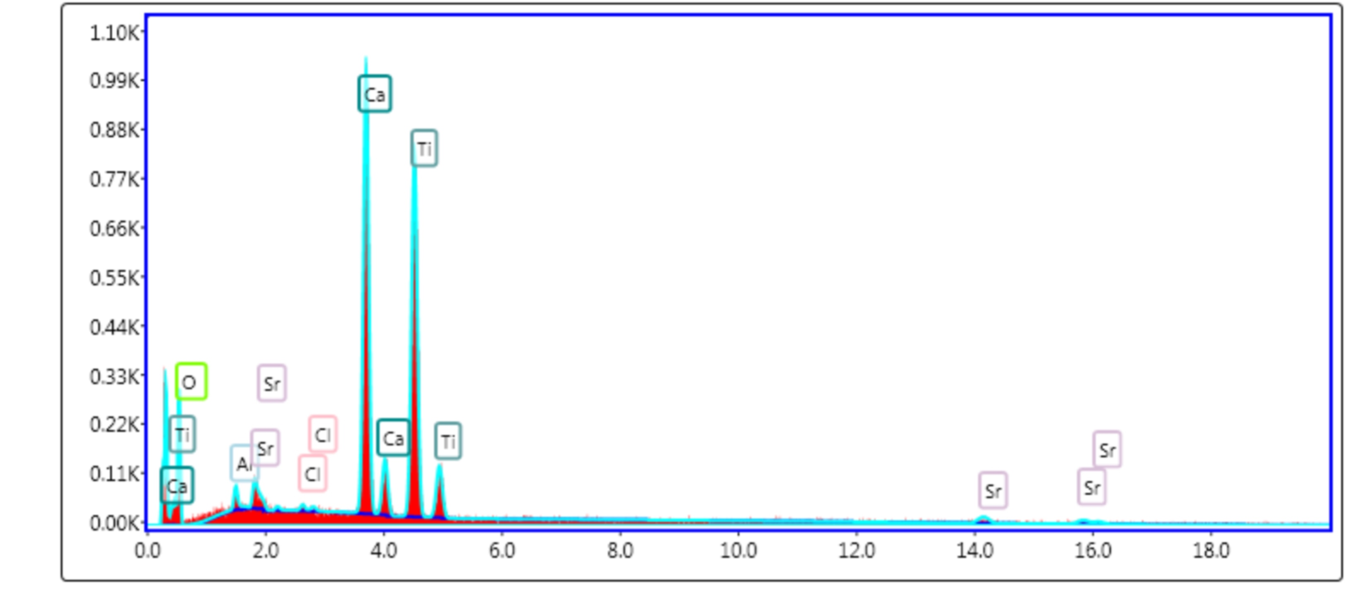
SrTiO3
SrTiO3 + CaCl2

Slide 19



BTO + CaCl₂
BTO
BTO
BTO
BTO-Ca
BTO-Ca
BTO-Ca

Slide 20

BaTiO3
BaTiO3 + CaCl2
CaCl2 react with crucible a lot

Slide 21



Slide 22






STO + BaCl₂
STO
STO
STO
STO-Ba
STO-Ba
STO-Ba

Slide 23

SrTiO3
SrTiO3 + BaCl2

